Slide 1
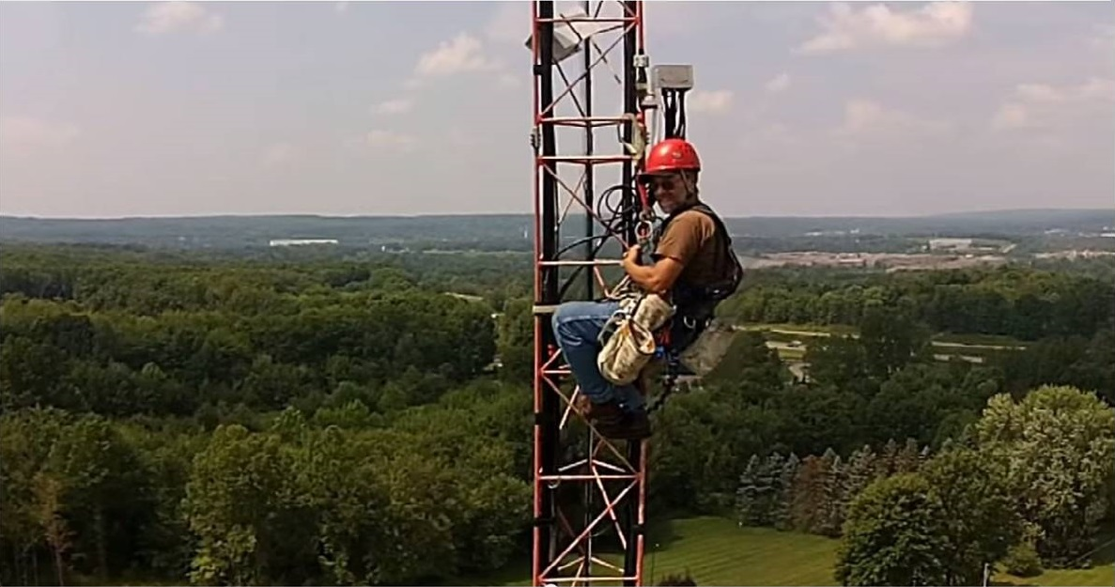
Antenna/Tower Reliability Tim Jellison W3YQ/KL7WV

Slide 2
Use quality materials (don’t be a cheap ham!)
Do it right the first time
Perform regular inspections
Be safe when working on antennas and towers
Is it K3LR approved?

Slide 4
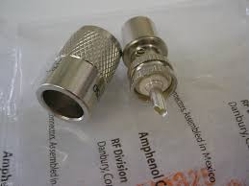
Use only good quality materials
Name-brand connectors only

Slide 5
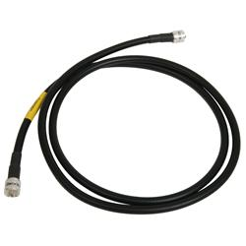
Use only good quality materials
Consider pre-made cables

Slide 6
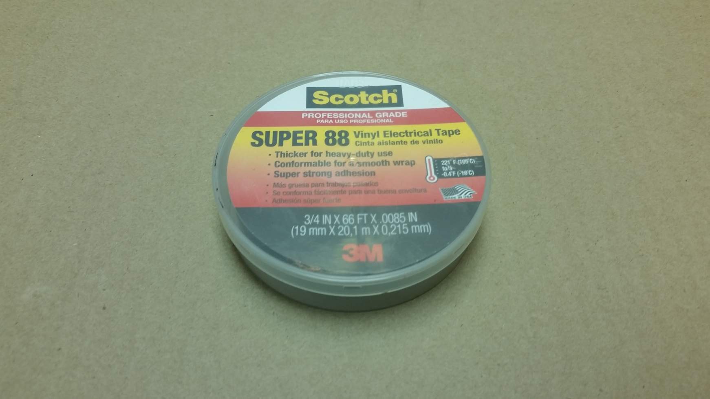
Use only good quality materials
Only use good quality tape

Slide 7
Moisture is coax’s worst enemy. All outdoor connections must be properly sealed. Here’s a proven method to keep connections dry.

Slide 8
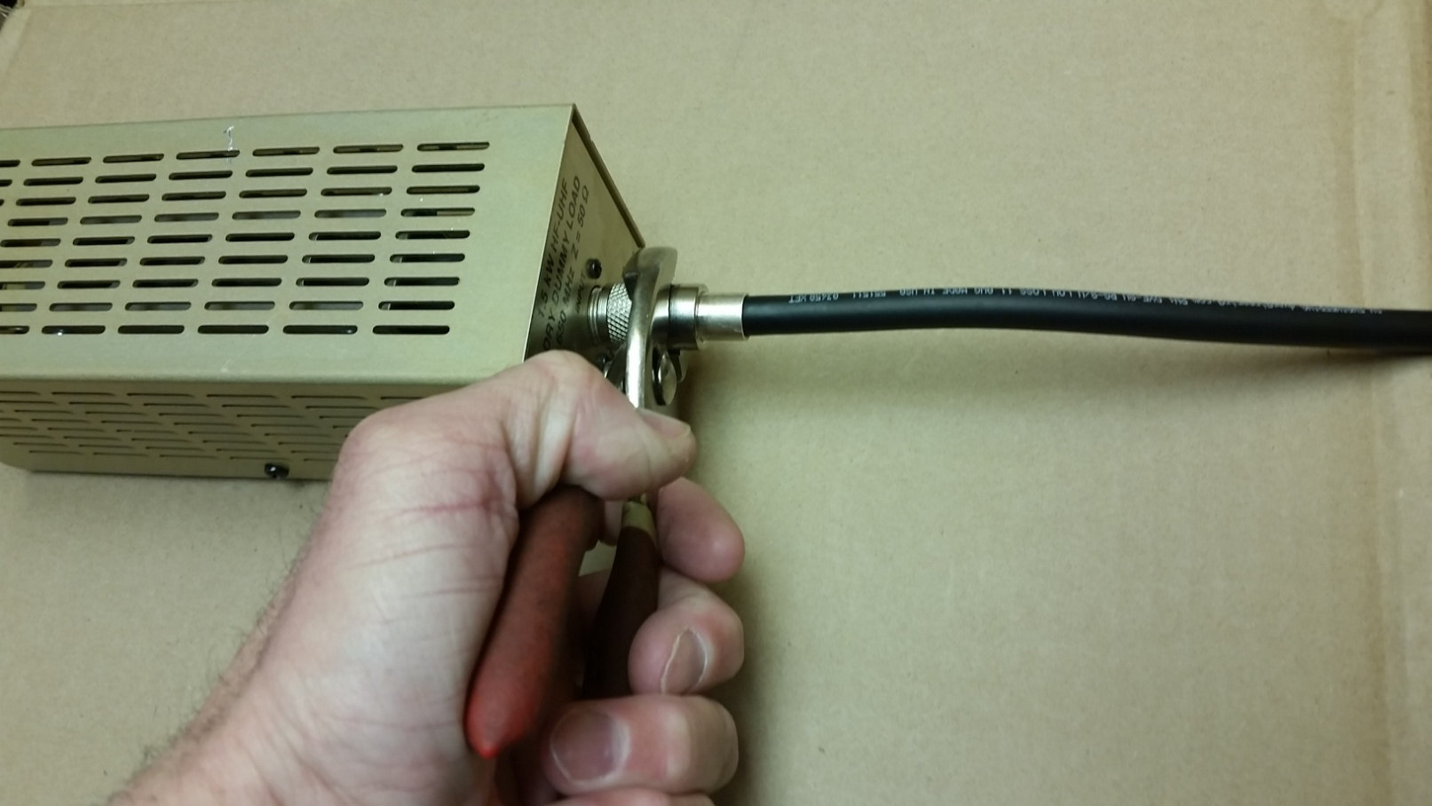
Weatherproofing connections
First, tighten with pliers. Finger-tight is not good enough.

Slide 9
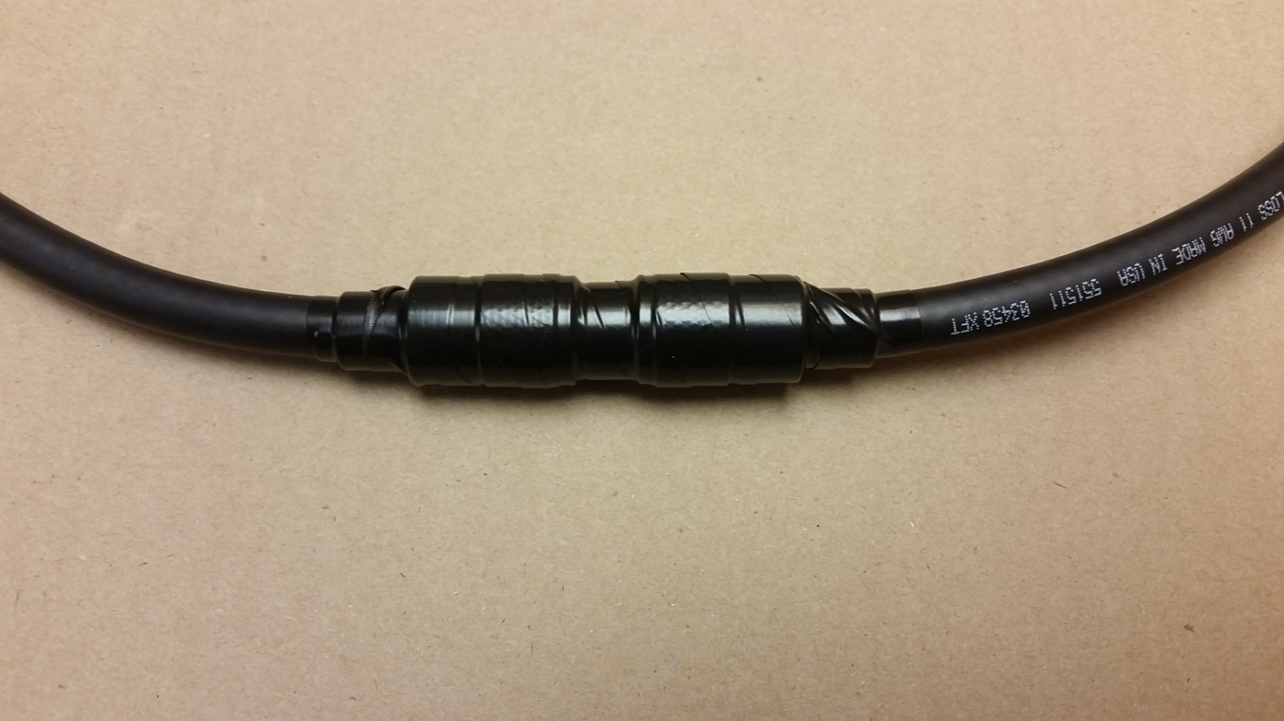
Weatherproofing connections
One wrap of 88 tape. And always cut the end when taping. Never pull/tear the end or you’ll end up with a tail.

Slide 10
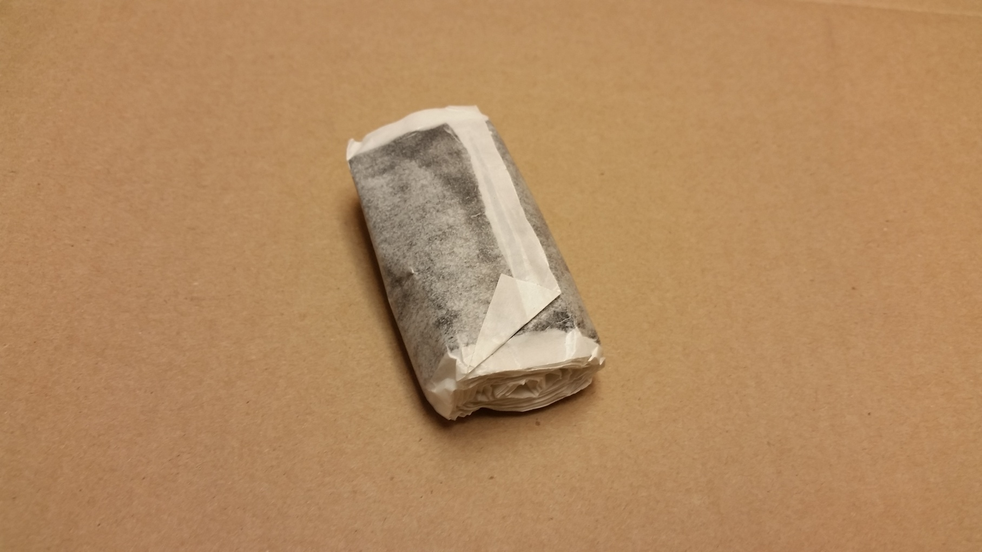
Weatherproofing connections
Add a layer of mastic.

Slide 11
Weatherproofing connections

Slide 12
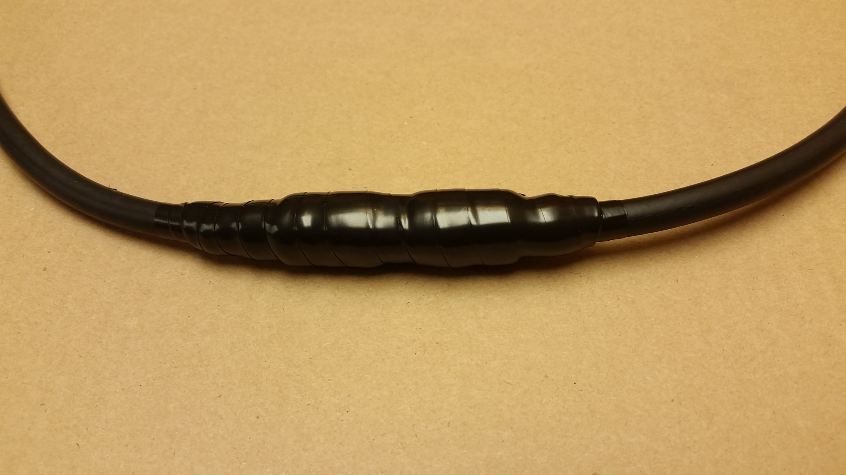
Weatherproofing connections
Two wraps of 88 tape. Overlap each layer by ½ the width of the tape.

Slide 13
There are two tips in the next photo.
First, tape your cables with 88 tape – no tiewraps. Tiewraps can smash the coax and they will eventually fail due to weathering.
Second, always put a barrel at the top of your tower if the feedpoint is out of reach. Makes antenna removal much easier.

Slide 15
Use a piece of split loom if there’s a concern about cables rubbing.

Slide 16
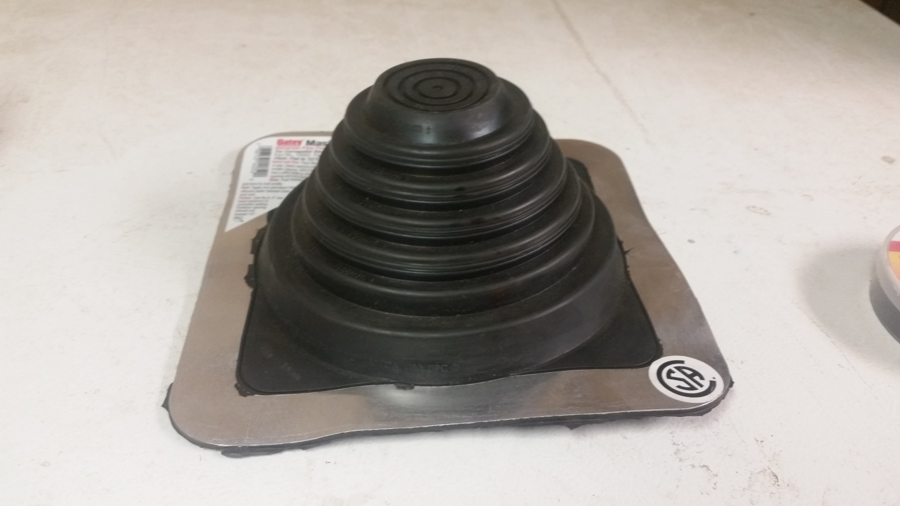
Waterproofing a bearing
Does your antenna sometimes not turn in the cold weather? It might be ice in your thrust bearing. Make a boot out of one of these.

Slide 17
Waterproofing a bearing

Slide 18
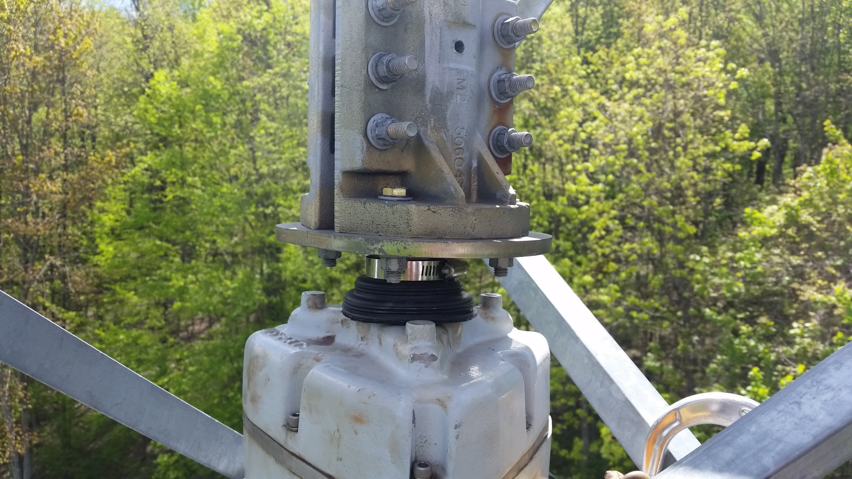
It can also keep the water out of an Orion 2800’s top bearing.

Slide 19
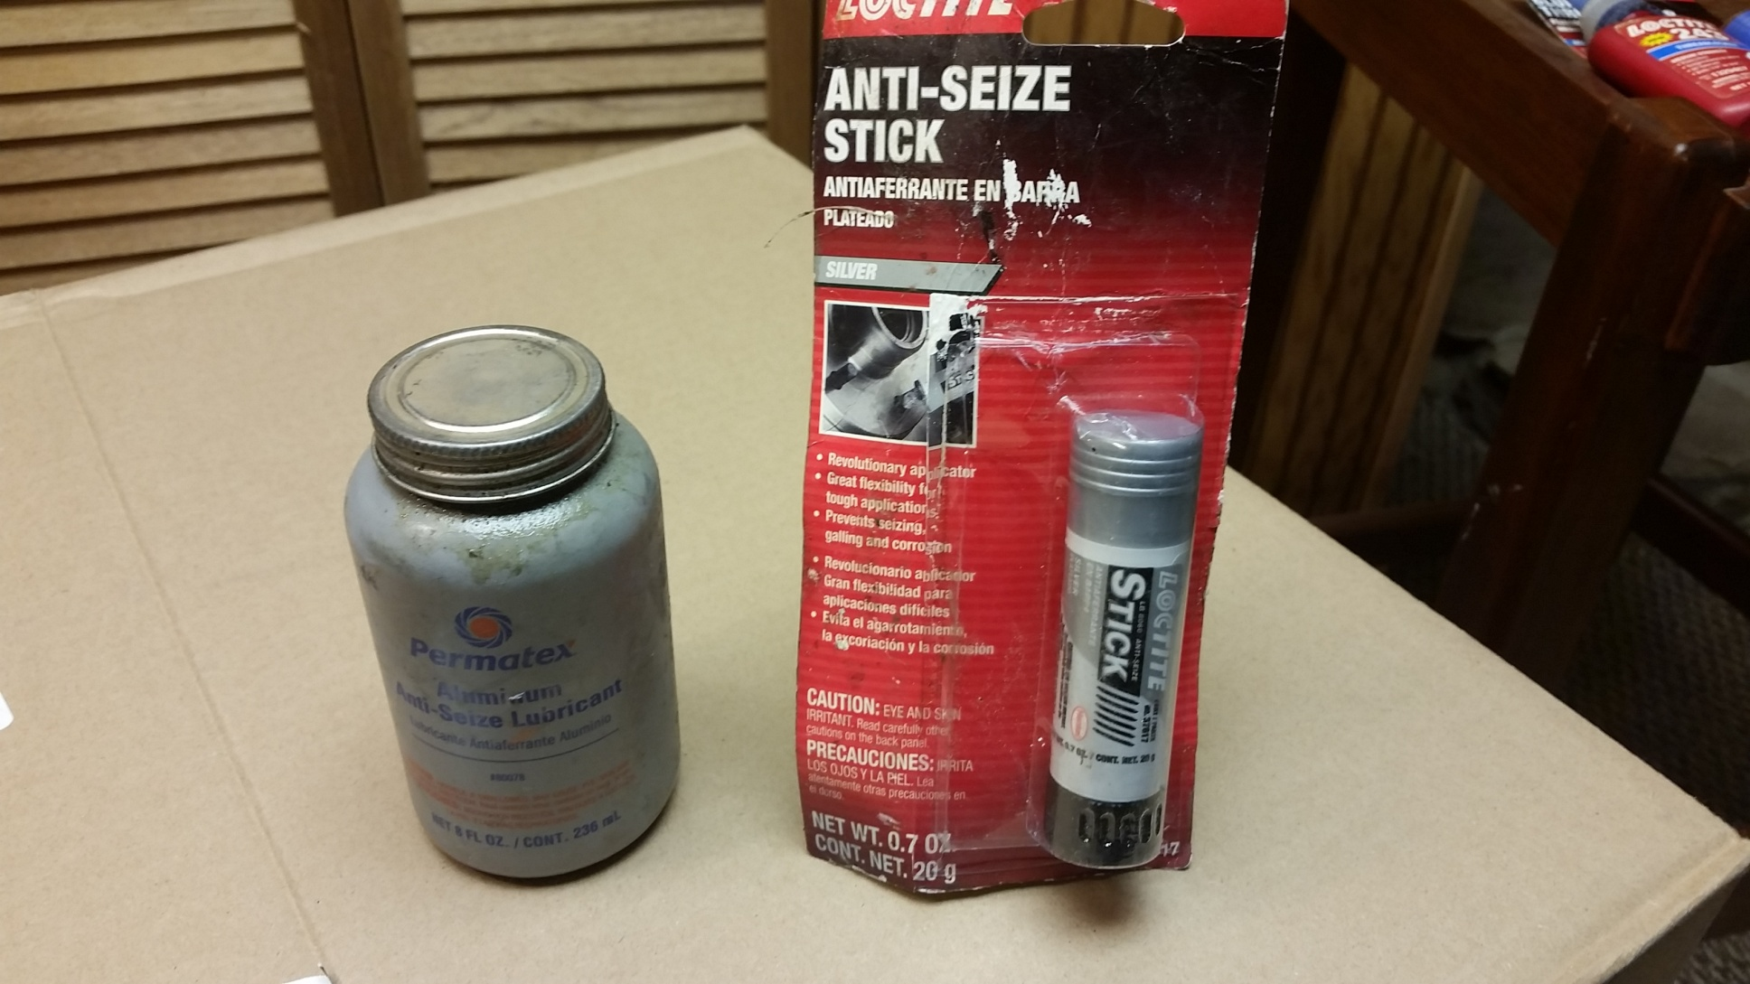
The bolts in a TB3 can seize up. Apply anti-seize before installation or swap out the bolts with stainless (and maybe still use anti-seize?)

Slide 21
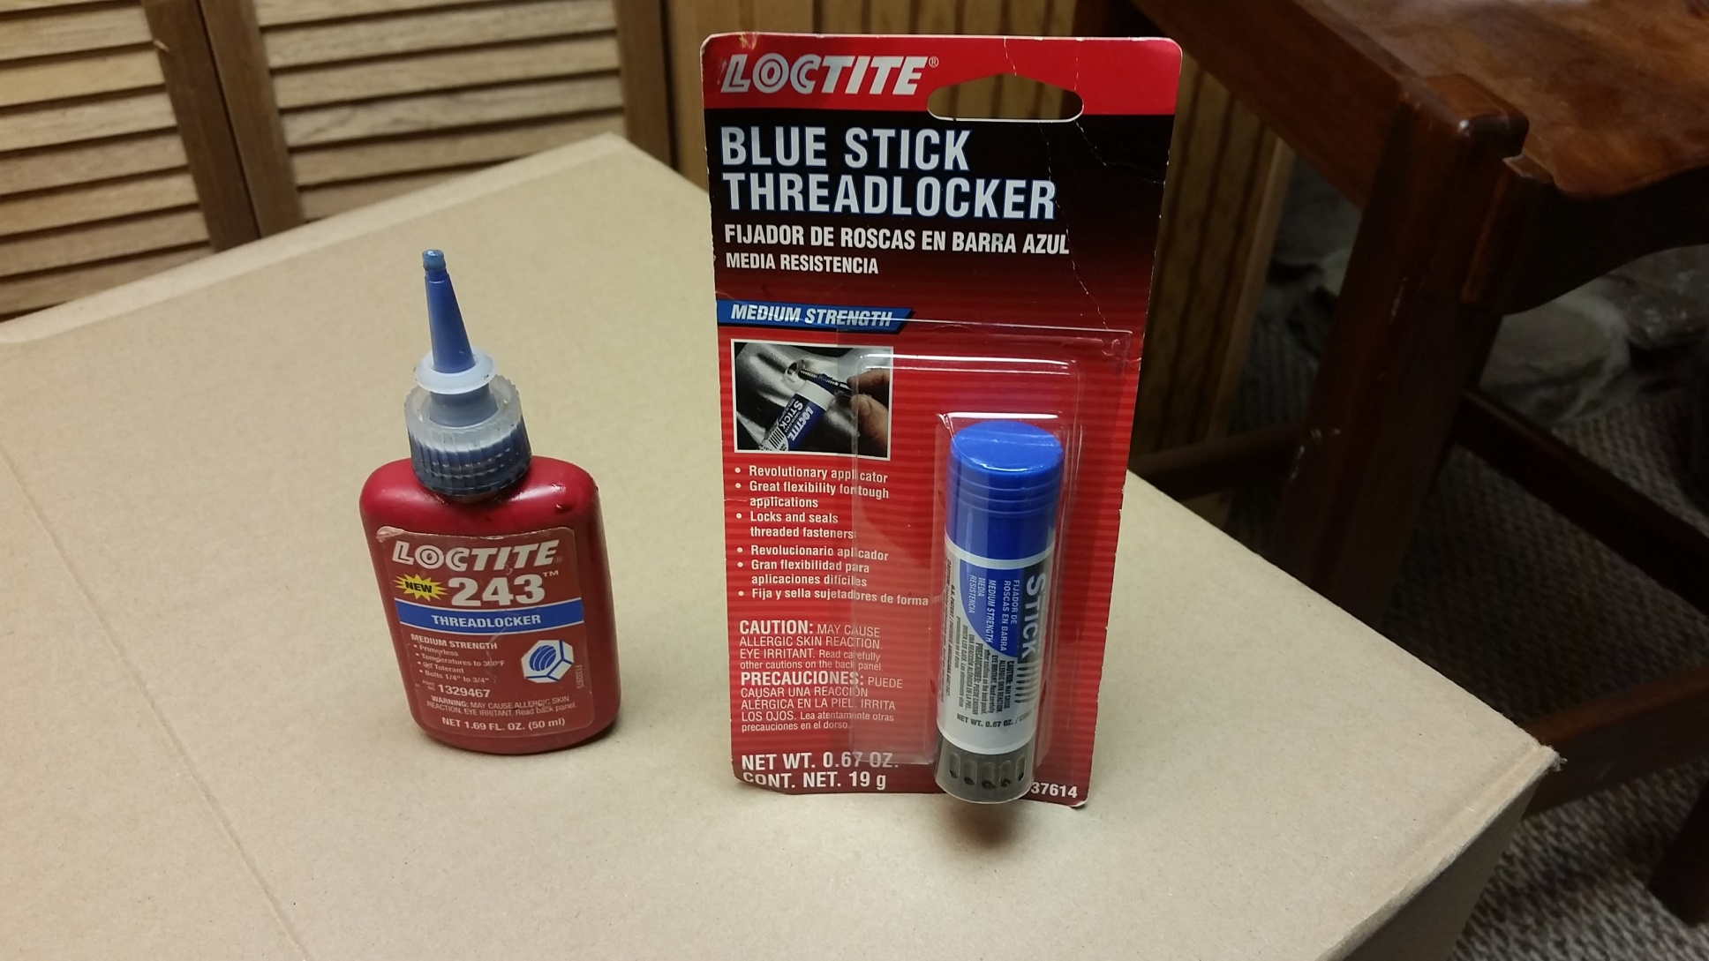
Notice all the blue stuff? You should also use a lubricant on all stainless hardware. Blue Locktite is a good choice. It lubricates, locks, yet can still be removed later.

Slide 22
Also, when installing a Rohn tower, use anti-seize on the leg joints. It’s conductive and makes the inevitable disassembly much easier.

Slide 23
Tidbits

Slide 24
Does your rotor or antenna slip on the mast? You can add a secondary clamp which will help out your U-bolts.

Slide 25
Here we give a Yaesu rotor some help

Slide 26
Here is a secondary clamp below the mast clamp of a 40M Yagi

Slide 27
If the top section of your tower is above the top set of guys, the leg bolts MUST be tight and should be regularly checked. This is a point of great lateral stress and if the bolts loosen, the holes in the legs will elongate.

Slide 29
Do not over tighten anything on a Rohn tower leg. You could smash the leg (it can even split) and the tower will be compromised.

Slide 31
When soldering PL259’s, don’t be afraid to use a big iron and get the connector hot – the solder must flow. Just keep everything straight in-line and be sure to let it cool down completely before you move it. That way the center dielectric will harden back up. I let mine sit about 10 minutes after soldering before doing anything with it.

Slide 33
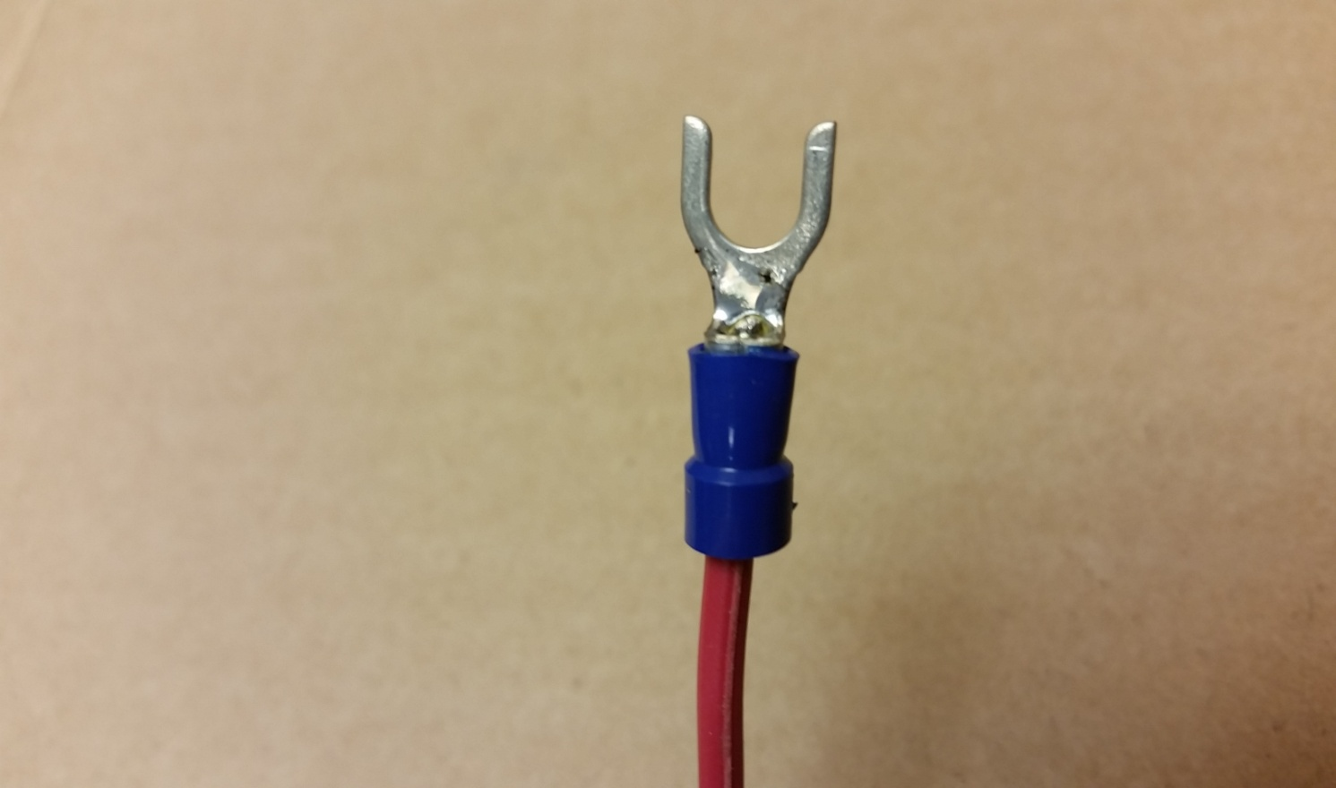
Solder all your crimps, otherwise the wire could pull out. If you’re using insulated lugs, don’t worry about melting the plastic.

Slide 34
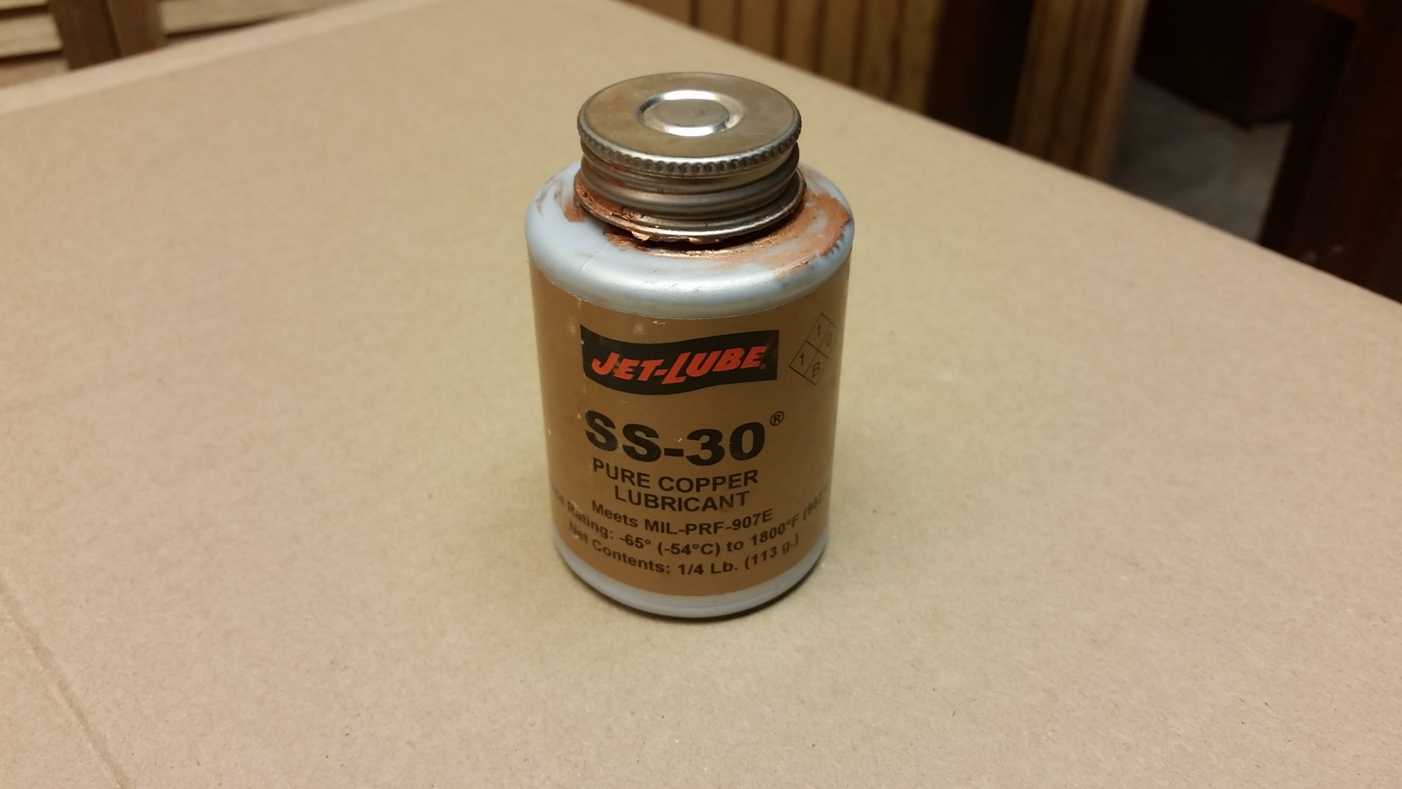
Conductive paste
Usable on all metal to metal joints, especially aluminum antenna joints.

Slide 35
And above all, when climbing follow all safety rules!
NO SK’s

