Slide 1
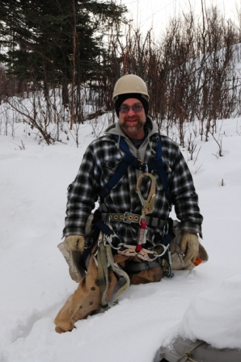
Towers and Antennas Tim Jellison W3YQ/KL7WV www.KL7WV.com

Slide 2
Do it right, or don’t do it!
Follow the manufacturers’ design rules
Do your homework prior to starting your project (budget)
Take a safety training course
Use the proper equipment

Slide 3
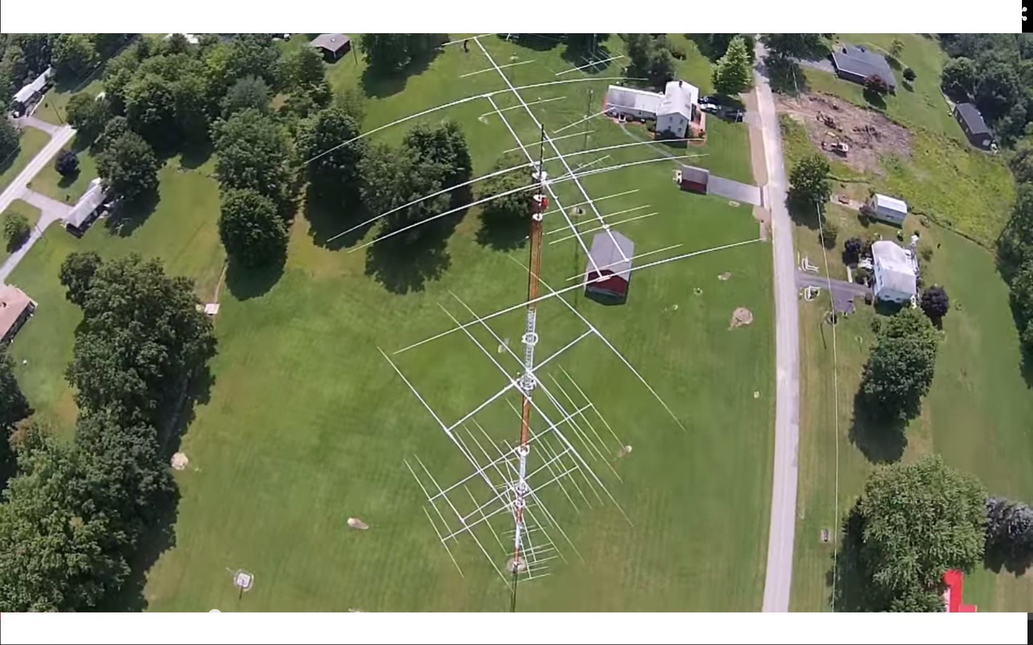

Slide 4
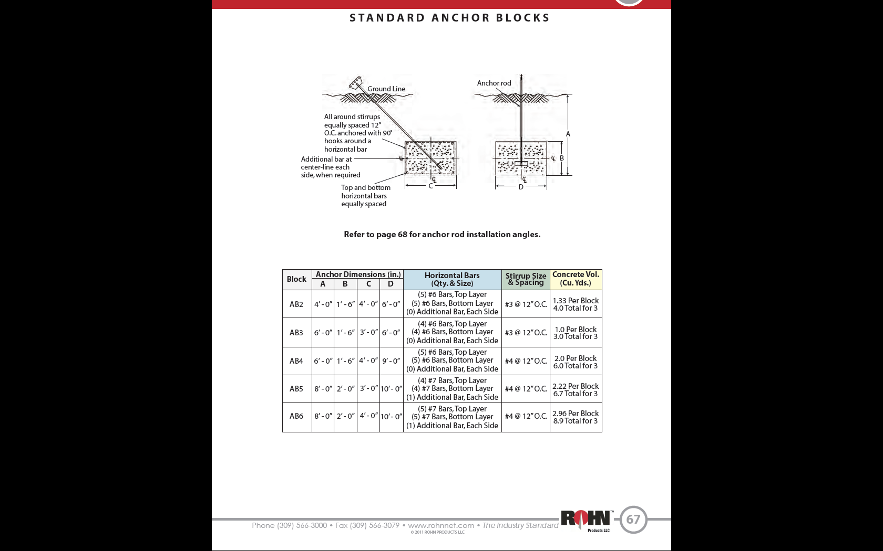

Slide 5
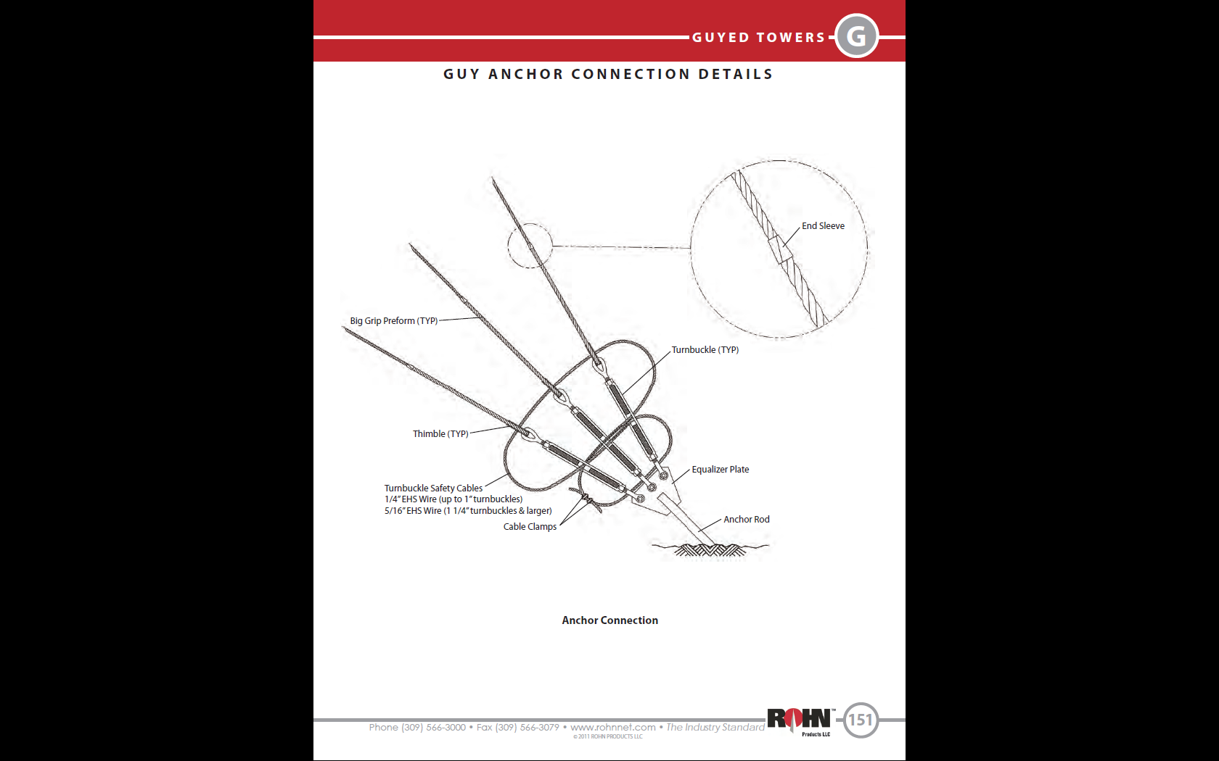

Slide 6
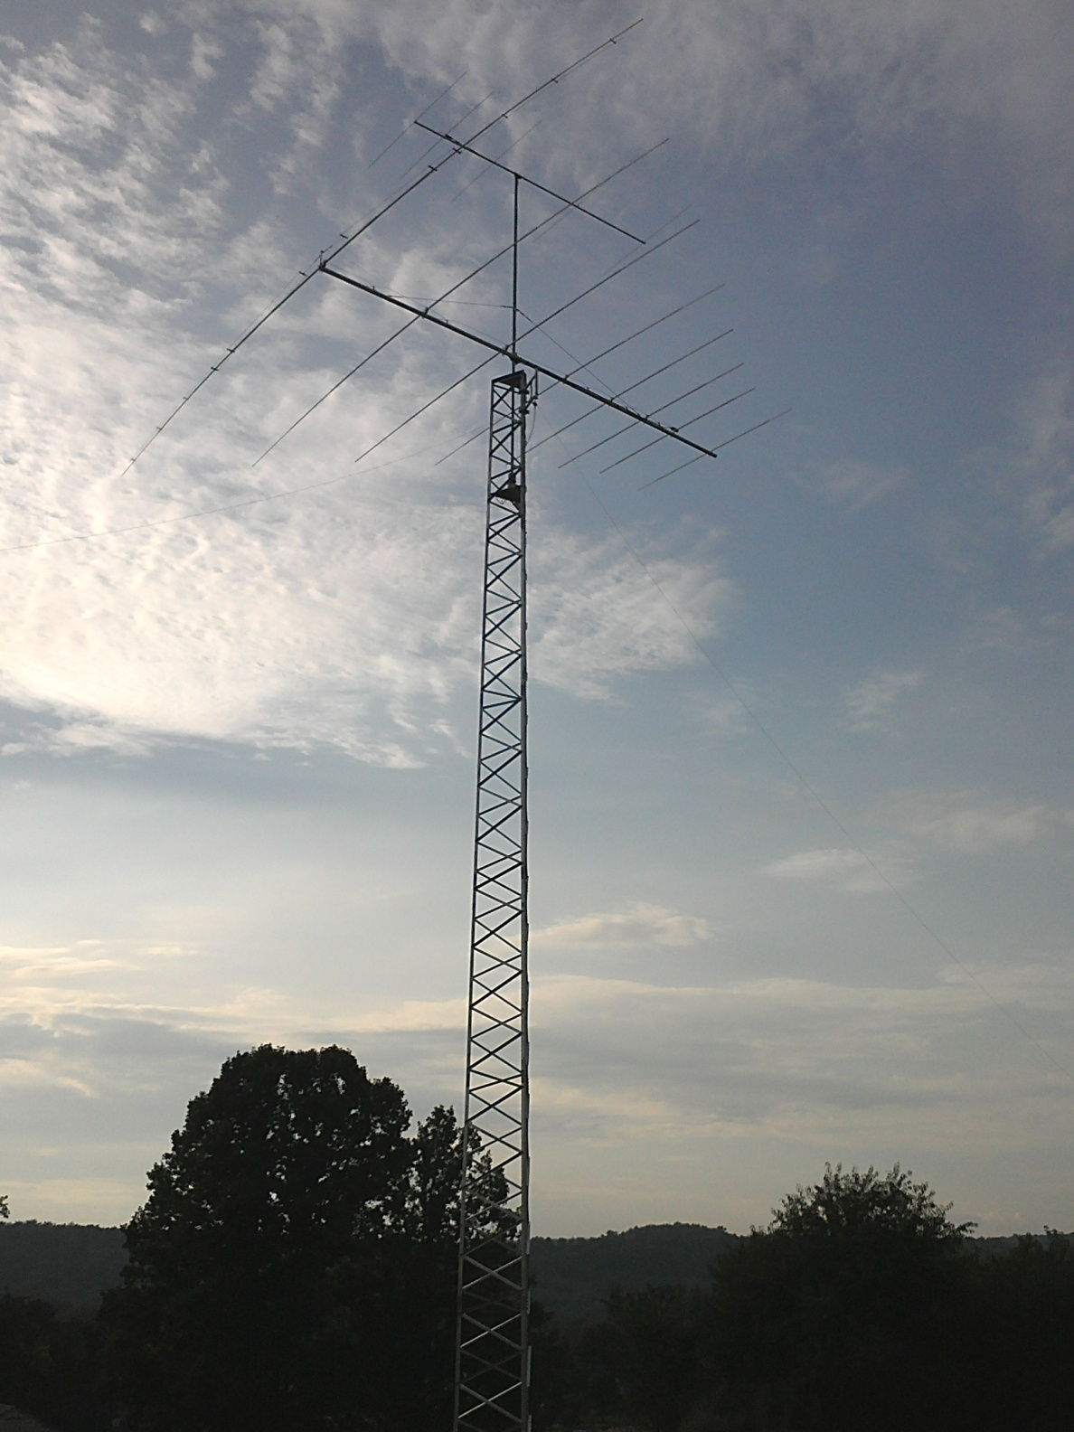

Slide 8
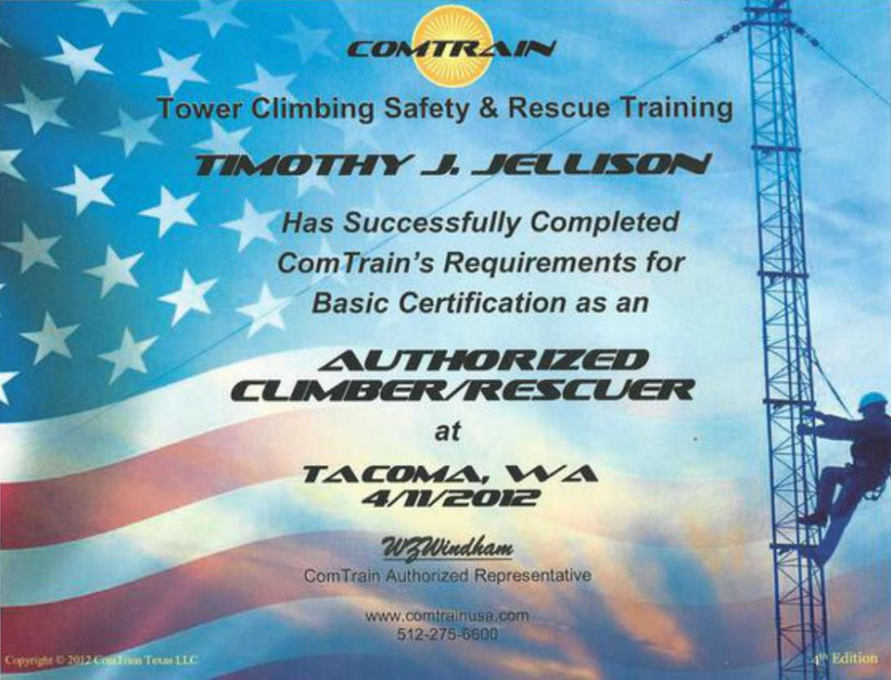

Slide 9
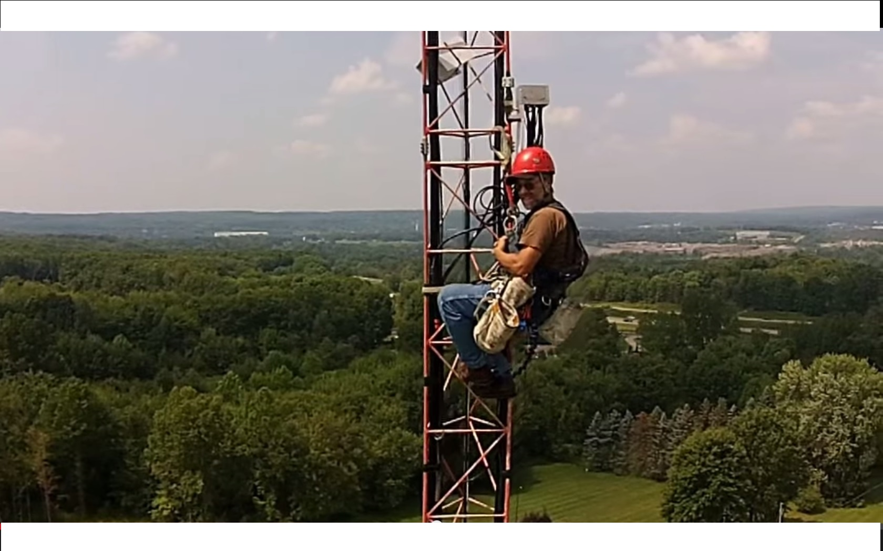
Finally a nice day!

