Slide 1
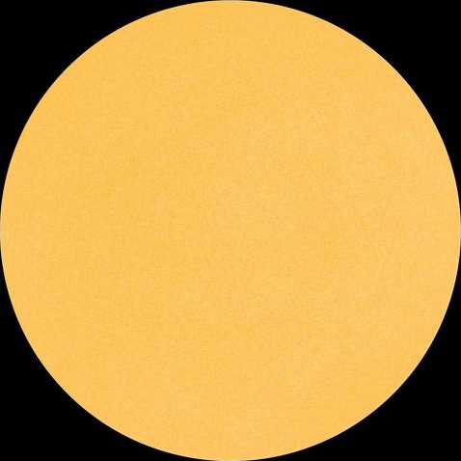
How to Adapt Your DX Contest Strategies for Low Solar Activity
How to Adapt Your DX Contest Strategies for Low Solar Activity
Frank Donovan
W3LPL

Slide 2
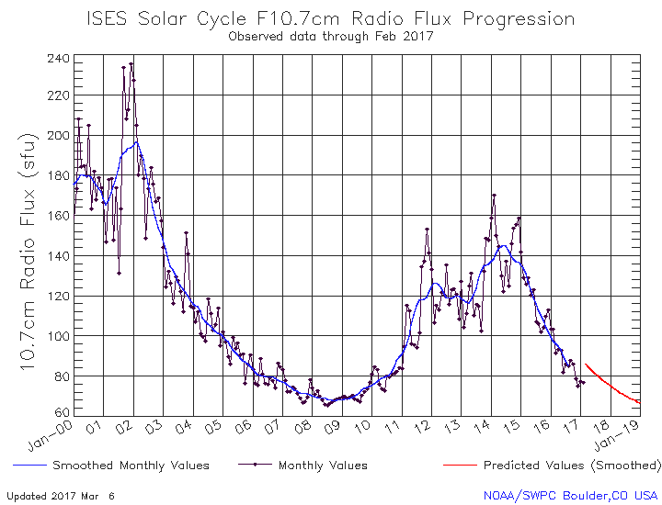
Five Years of Very Low Solar Activity Solar activity should start to increase by 2020
http://services.swpc.noaa.gov/images/solar-cycle-10-cm-radio-flux.gif

Slide 3
What About Solar Cycle 25 ?? Solar Cycle 25 is likely to be another weak cycle, slightly weaker than Cycle 24
Solar polar magnetic field strength continues very weak during Cycle 24
slightly weaker than the very weak Cycle 23 field strength
an early indicator that Cycle 25 may be slightly weaker than Cycle 24
Spotless days have recently become much more frequent
there were 817 spotless days over five years during the last solar minimum
weak cycles are preceded by at least 600 spotless days over five years
probably more than 100 this year, many more for the next three years
Geomagnetically quiet days are much more frequent after solar minimum
very few solar flares and coronal mass ejections have occurred since 2016
there will be less frequent, less intense coronal holes after solar minimum
Cycle 25 sunspots will be more frequent as solar minimum approaches
but solar flux will continue at low levels -- in the 70s – for five more years
Sunspot Number
High accuracy Cycle 25 forecasting isn’t possible until about three years after solar minimum

Slide 4
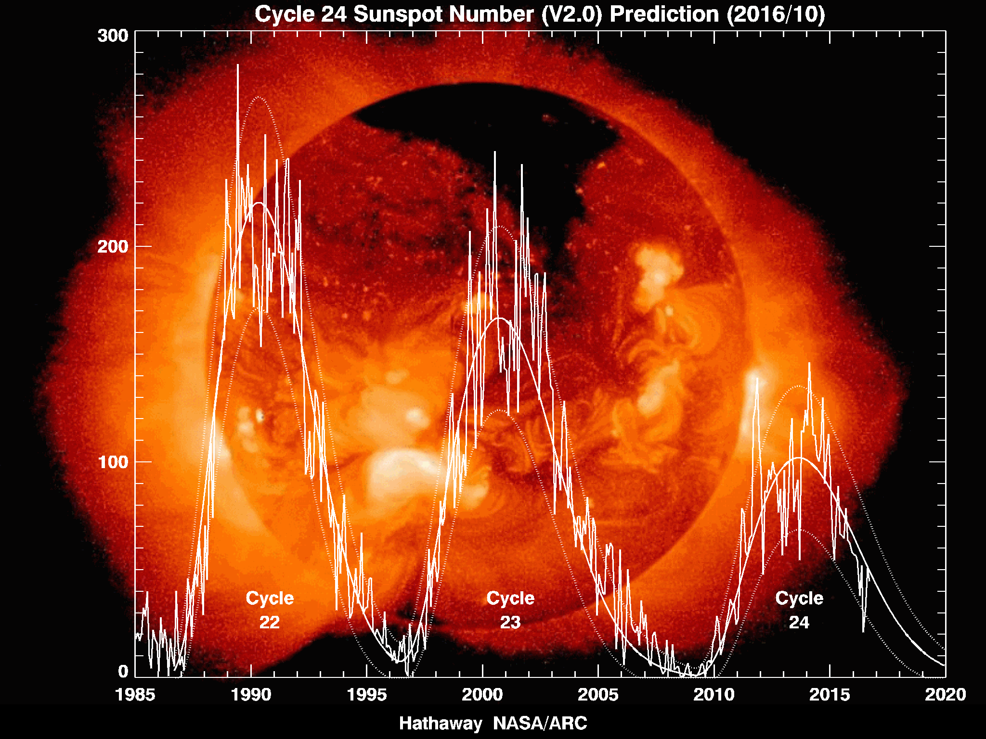
Declining Solar Activity Since Cycle 22 Suggests a weaker Solar Cycle 25
Cycle 25?

Slide 5
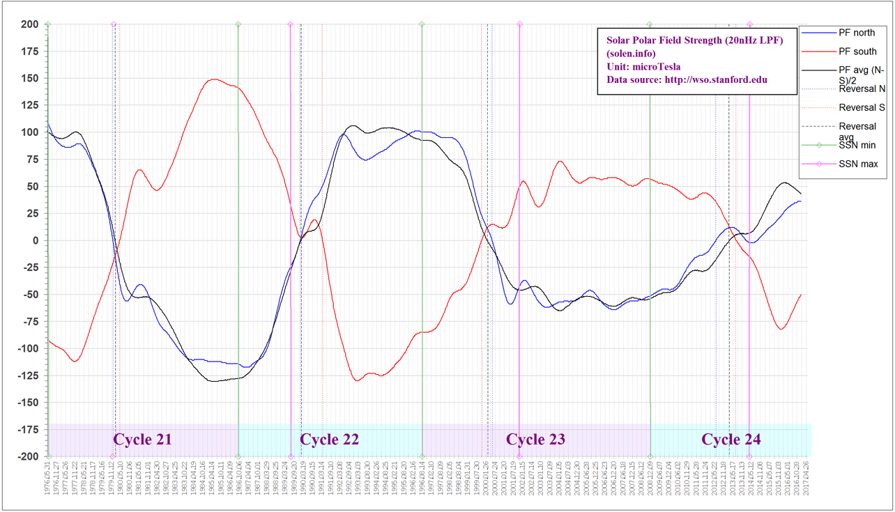
The Solar Polar Field Precursor Method A proven early solar cycle prediction method
Solar Cycle 21/22 minimum
Solar Cycle 22/23 minimum
Solar Cycle 23/24 minimum
Solar Cycle 24/25 minimum
-200 uT Polar Field Strength +200 uT
Cycle 25
www.solen.info/solar/polarfields/polar.html

Slide 6
160 Meter Propagation During five years of very low solar activity
Significantly improved DX propagation
stronger signals
more reliable openings especially to Europe and Japan
consistently low absorption caused by less frequent coronal holes
especially after solar minimum in about 2020 until 2022
less intense daytime D layer absorption before sunset and just after sunrise
less intense night time E layer absorption
More crowded band conditions
especially when there is no strong 40 meter propagation to Europe
Longer, more regular and stronger worldwide DX openings
continuous openings to Europe, Mid-east and north Africa 2200-0830Z
frequent strong JA openings at sunrise mid-Nov to mid-Feb 1200-1230Z
direct short path polar opening to central Asia will be more frequent

Slide 7
80 Meter Propagation During five years of very low solar activity
Significantly improved DX propagation
stronger signals
more reliable openings especially to Europe and Japan
consistently low absorption caused by less intense geomagnetic activity
especially for about two years after solar minimum from 2020-2022
less daytime D layer absorption before sunset and just after sunrise
More crowded band conditions
especially when there is no strong 40 meter propagation to Europe
Longer, more regular and stronger worldwide DX openings
continuous openings to Europe, Mid-East & north Africa 2130-0830Z
regular openings to JA starting before our sunrise ~1130-1300Z
direct short path polar opening to central Asia will be more frequent

Slide 8
40 Meter Propagation During five years of very low solar activity
Nearly 24 hour DX openings during CQWW CW
Europe, Mid-East and north Africa propagation
activity QSYs to 40 meters before mid-afternoon ~1930Z
don’t miss the strong mid-afternoon/evening openings 2000-0200Z
propagation often fades/fails a few hours after sunset 0200-0600Z
strong openings usually resume at sunrise in Europe ~0600-0900Z
Japan, Far East and Central Asia propagation
brief direct short path opening at JA sunset 0800-0900Z
weak skew path opening at about 240º ~0900-1130Z
strongest short path JA opening from the east coast ~1130-1300Z
strong long path Asia signals at 150º 2130-2215Z
VK/ZL and southeast Asia long path 90-150º 2100-2300Z
Southeast and central Asia long path ~240º ~1130-1300Z

Slide 9
20 Meter Propagation During five years of very low solar activity
Usually closes well before midnight ~0300Z
Sporadic, weak night time Africa & south Pacific openings 0500-0700Z
Europe, Mid-East and north Africa propagation
from before our sunrise until mid-afternoon ~1000-1900Z
the opening is sometimes delayed until after sunrise
the opening ends earlier in the afternoon than in recent years
Japan, Far East and central Asia propagation
short evening short path opening 2100-0100Z
morning short path opening 1300-1500Z
both openings are much shorter than in recent years
South Asia and Mid-East morning long path 1300-1500Z
VK, ZL and south Pacific mid-afternoon long path 1900-2200Z

Slide 10
15 Meter Propagation During five years of very low solar activity
Europe, Mid-East and north Africa propagation
from just after our sunrise until early afternoon 1200-1800Z
shorter openings than we’ve enjoyed in recent years
Japan and Far East propagation
weak late afternoon short path opening 2130-2300Z
sometimes only via the weak signal skew path to the southwest
much shorter openings than we’ve enjoyed in recent years
15M usually closes a few hours after our sunset ~0100Z
always stays closed all night

Slide 11
10 Meter Propagation During five years of very low solar activity
South America, Caribbean and Central America
PY and LU activity has increased significantly in recent years
usually opens about an hour after our sunrise ~1300Z
opening can fade for an hour or two, then return much stronger
usually closes about an hour before our sunset ~2100Z
always stays closed all night
Southern Europe and north Africa
very weak signals on the SE skew path at 110-150º ~1400-1700Z
VK/ZL and south Pacific
A fairly reliable weak signal opening ~1900-2100Z
Japan, North Pacific and Far East
rare morning weak signal long path opening at 150º ~1300-1400Z
rare evening very weak signal skew path 200-240º 2100-2200Z

Slide 12
DX Contest Strategies for five years of very low solar activity
High antennas are much more important during solar minimum
Improve your low band transmitting and receiving antennas!
Start every DX contest on 40 meters
the strong European opening often ends a few hours after sunset
Capitalize on improved 160 and 80M propagation 2200-0830Z
especially important when 40 meters is not strongly open to Europe
Strong 40 meter opening after sunrise in Europe 0600-0900Z
160, 80 and 40 meter openings to VK, ZL and JA 0900-1230Z
20M European opening starts before sunrise 1000-1900Z
15M European opening starts just after sunrise 1200-1800Z
10 meters opens primarily to the south 1300-2100Z
Strong 40M afternoon/evening openings to Europe 2000-0300Z
20 meter evening openings to Japan 2100-0100Z

