Slide 1
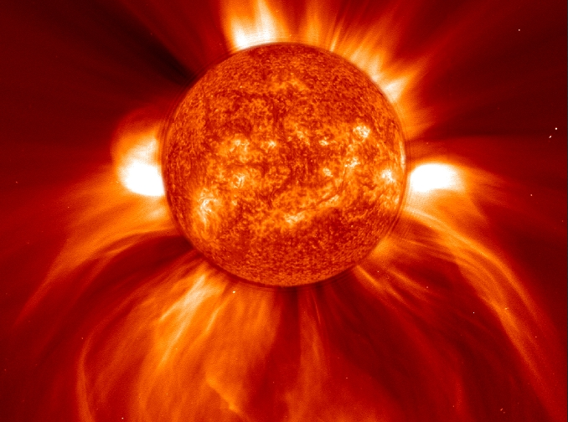
Propagation Trends 2015-2016
The Decline to Solar Minimum
2014 through about 2020

Slide 2
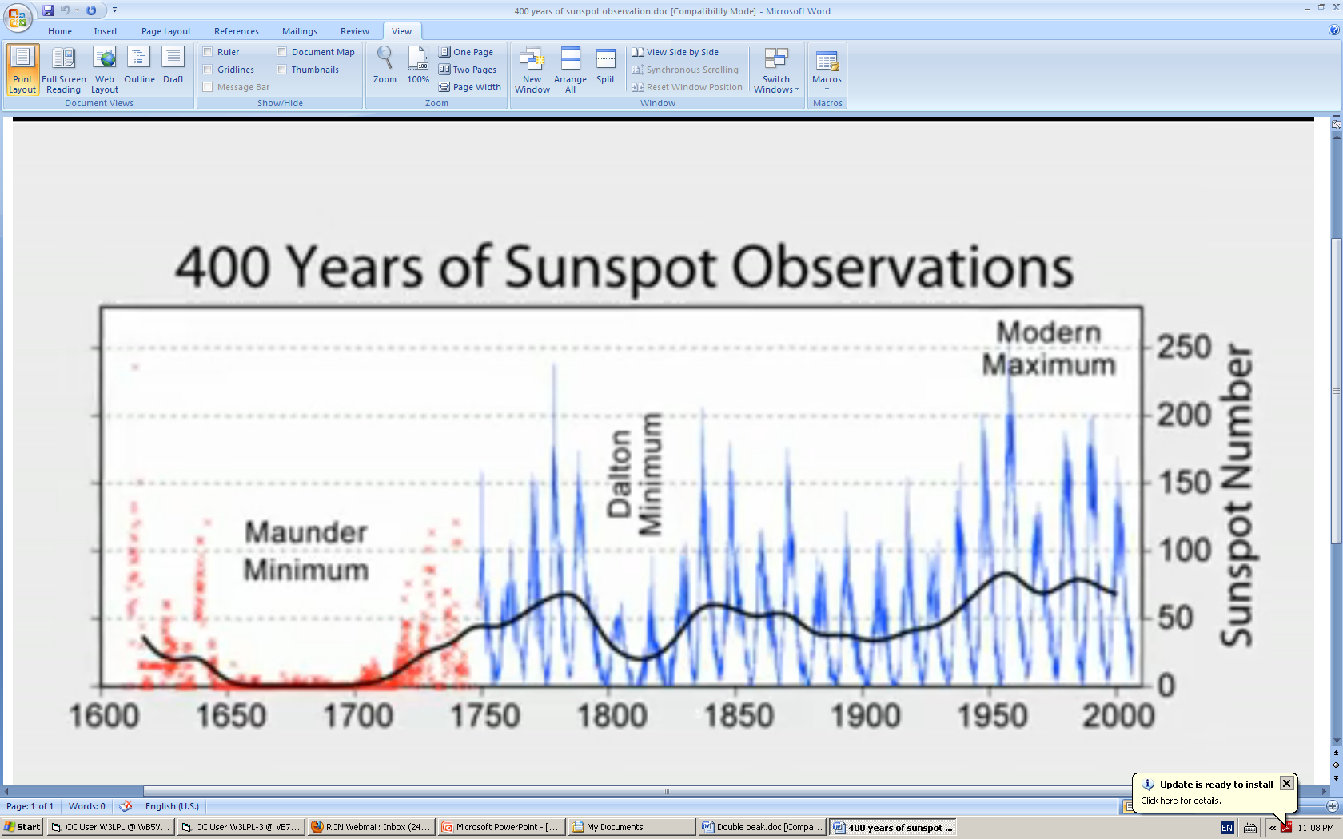
400 Years of Sunspot Observations
55 years of unusually high sunspot activity
(1947 - 2002) ended with the decline of Solar Cycle 23
Dalton Minimum
30 years
1790-1820
Early 20th century minimum
20 years
1896-1916
Modern Maximum
1947-2002
Maunder Minimum
70 years
1645-1715
The 100 year Gleissberg Cycle is clearly visible in this data

Slide 3
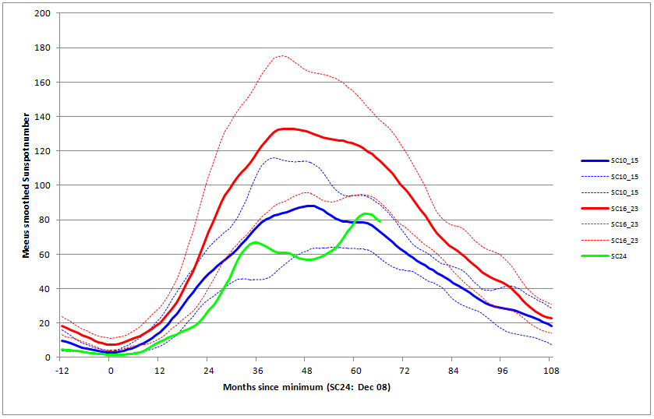
Progress of Solar Cycle 24 compared to Solar Cycles 10 through 23
Solar Cycle 24 Weak Solar Max
April 2014
The deepest solar minimum in 100 years 2007-2009
second weakest solar maximum in 100 years - 2014

Slide 4
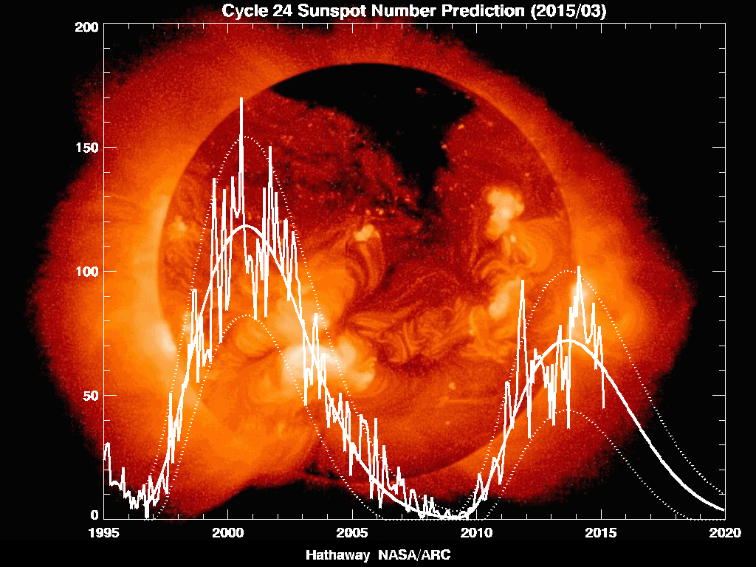
Solar Cycle Progress
Since Solar Cycle 23 Maximum
end of the Modern Maximum
2002
1st peak
Nov 2011
2nd peak
Feb 2014
solar
minimum
about 2020
Sunspot Number
266 spotless
days during
2008

Slide 5
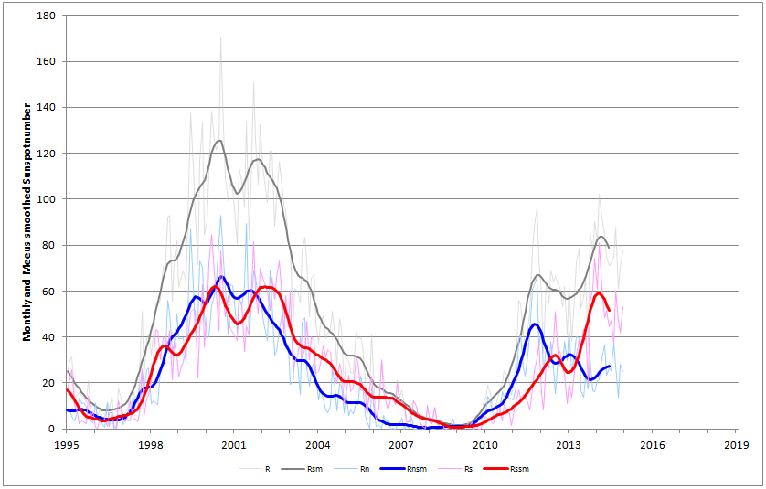
Double Peaked Solar Cycle 24
88 Freeman Street
Quincy, Massachusetts
88 Freeman Street
Quincy, Massachusetts
88 Freeman Street
Quincy, Massachusetts
Cycle 23 smoothed sunspot
peak
Mar 2000
Northern solar
hemisphere peak
Nov 2011
Cycle 24 smoothed sunspot
peak
Apr 2014
Southern solar
hemisphere peak
Feb 2014
14 years between solar cycle 23 and cycle 24 peaks

Slide 6
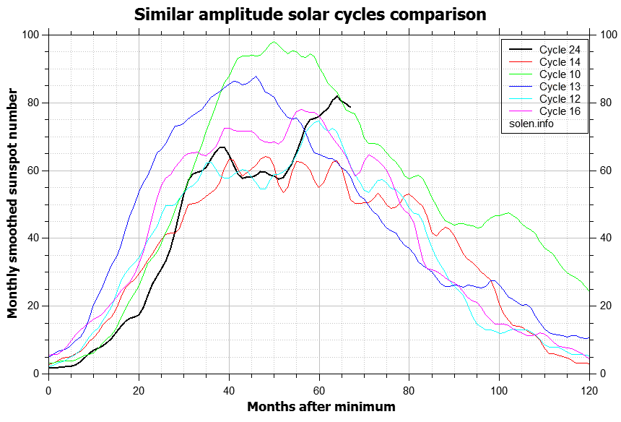
Estimated Five Year Decline to Solar Minimum in about 2020
two years between
Solar Cycle 14 peaks
Cycle 24 smoothed sunspot
peak
Apr 2014

Slide 7
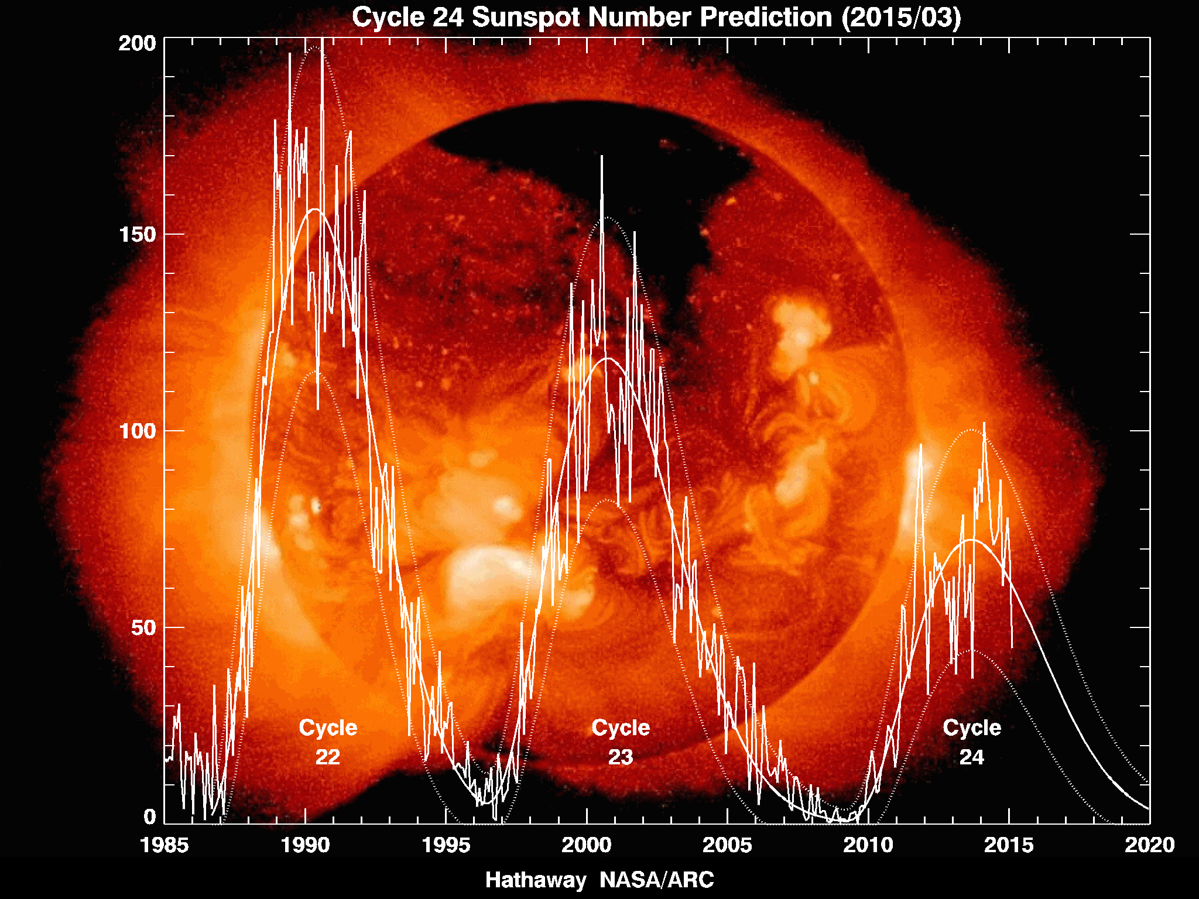
Weakening Sunspot Activity
Since Solar Cycle 22

Slide 8
SWPC Forecasts the Next 12 Months to be Similar to
2011 and 2012 (except for the brief Nov 2011 peak)
SWPC
forecast for
2015-2016
Solar Cycle 25 precursors
appear as solar minimum approaches
Sunspot Number
spotless days will become common by 2018

Slide 9
Forecasting Solar Cycle 25 future indicators of a possible weak Solar Cycle 25
Weaker than normal solar polar magnetic fields as they near peak intensity from 2018 through 2020
  as reported by the Wilcox Solar Observatory
Unusually large numbers of spotless days
Quieter than normal geomagnetic field from 2018 through 2020
  reported by the A-index
Failure of the first Solar Cycle 25 sunspots to appear by 2020
Solar minimum extending beyond 2020
Sunspot Number
An accurate forecast is not possible
until two or three years after solar minimum

Slide 10
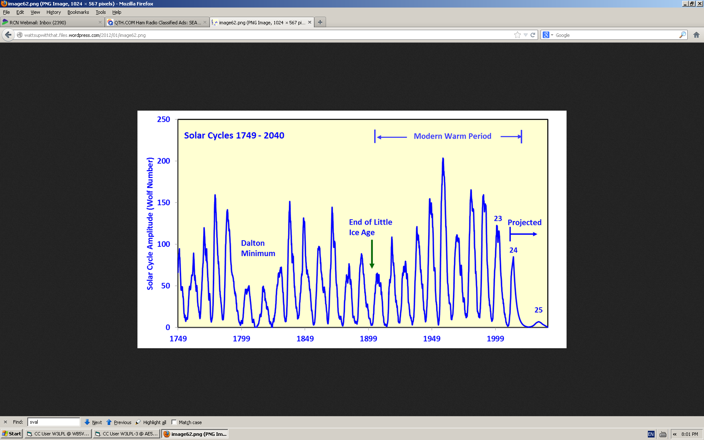
A Long Range Estimate of Solar Cycle 25 could sunspots nearly disappear by 2025?
Modern Maximum
1947 - 2002
19
3
n MM
18
21
22
8
11
4
n MM
9
2
1790 - 1835
17
20
15
1
10
13
7
12
16
14
5
6
?
some solar scientists expect Cycle 25 to be the
weakest solar cycle (SSN=7) in more than 300 years
http://www.landscheidt.info/?q=node/280

