Slide 1

Disruptive Technologies How they change our hobby
Rob Sherwood
NCØB
Something new can be a game changer
Sherwood Engineering

Slide 2
Disruptive technology can do the following:
Create a new market that didn’t exist
Disrupt an existing market
Drastically affect market share of existing companies
Significantly improve performance
Reduce costs

Slide 3
Three Examples disruptive technology
Tubes replaced by the transistor. Even microwave ovens are switching from magnetrons to LDMOS!
Digital Cameras vs. Kodak film
The sad thing is Kodak invented the digital camera and then lost the market to others.
Apple & the iPhone changed the cell phone industry forever.

Slide 4
What are some amateur examples in our lifetime?
Disruptive Technology
When I received my General class license in 1961, the Drake 1A had been out for 4 years and the KWM-2 for 2 years.
Of the two other hams in my village, one owned the KWM-2 and the other a 75A-4 and HT-32.
A lot of amateurs didn’t like “slop bucket”, but SSB was clearly winning out over AM by the late 1960s.

Slide 5
Computer Contest Logging – Major Change
My first contest was a multi-2 160-meter contest.
Logging was on serialized file cards.
Calls also recorded on a wall size piece of paper in hopes of minimizing dupes.
Computer logging has phenomenally improved our contest productivity.

Slide 6
Is there a Hardware Change Occurring?
Superheterodyne architecture is what most of us have known since we were licensed. It was invented by Edwin Armstrong in 1918.
Two interesting products went through the Sherwood lab in early 2008:
Elecraft K3 and an obscure direct sampling receiver Perseus
ARRL reviewed Perseus December 2008
Perseus was completely different, a direct sampling receiver with a “clock” but no “local oscillators”.
Perseus is only a receiver, but it foreshadowed what was coming.

Slide 7
Direct-Sampling Transceiver
Flex announces 6000 series May 2012
I first used a 6700 CQWW 160 CW January 2014.
ARRL 160 CW contest December 2014
ARRL 10 meter contest December 2014
Software proprietary (Not open source)
(Latency 163ms to 51ms, filter shape factor dependent)

Slide 8
Apache ANAN 100D & 200D
Direct Sampling SDR Transceiver
Used 200D December 2014 & January 2016 CW contests on 160 meters.
OEMed out of India
Software open source by US hams
New features and bug fixes generally can come within days.
Latency now under 20ms

Slide 9
In early 2016 two parallel tracks
The Elecraft (down-conversion) K3S and Flex Radio direct sampling 6700 or Apache ANAN-200D are top performers.
Both architectures have their advantages.
Quibbling over a few dB of dynamic range is pointless at this 100 dB level of performance.
(85 dB dynamic range is usually good enough.)

Slide 10
An alternate testing method: IFSS
IFSS = Interference free signal strength
Third-order distortion products can be measured over a range of test signal levels, not just the one point where IMD level = noise floor.
If data is taken starting with distortion = noise floor, and then beyond that into significant overload, we can produce a graph of the overload characteristics.
Unlike legacy (superhet) radios, direct sampling radios produce distortion products at much lower signal levels.
The concept of IFSS is to ignore distortion below BAND NOISE.
Of course band noise varies all over the map from “band to band” and for each location. It also varies from “day to day” to some extent.

Slide 11
How does band noise vary by band?
Band noise in 500-Hz bandwidth
If we take the ITU rural data as a starting point, what is typical?
160 meters: -87 dBm *
80 meters: -93 dBm *
40 meters: -101 dBm *
20 meters: -109 dBm #
15 meters: -114 dBm #
10 meters: -119 dBm #
That’s a 30+ dB difference in band noise
* = nighttime # = daytime

Slide 12
An Interesting Comparison of IFSS *
Noise floors equal for both radios
I decided to compare the K3S and the 6700 by leveling the playing field.
The noise floors were set to be almost identical on 10 meters.
Normalized for -135 dBm noise floor K3S had an IFSS value 4 dB > than 6700
Normalized for -117 dBm noise floor 6700 had an IFSS value 4 dB > than K3S
* IFSS = Interference free signal strength

Slide 13
IFSS comparisons of well behaved radios
The K3S is an example of an excellent superheterodyne radio.
It has excellent phase noise and dynamic range.
The Flex 6700 is an example of an excellent direct sampling radio.
It also has excellent phase noise and dynamic range.
The following two slides show that two-tone input level vs. distortion products produce smooth graphs.
This indicates that these radios should not exhibit unexpected overload characteristics.

Slide 14
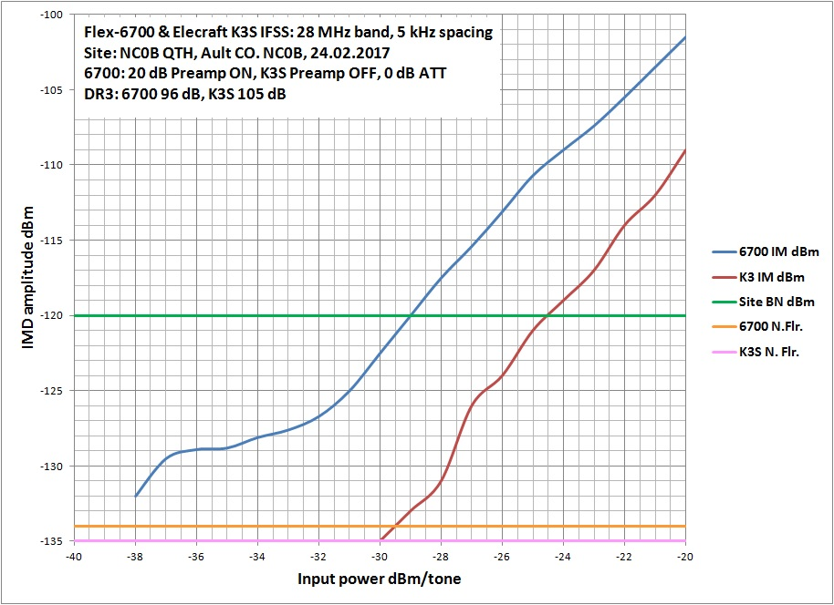
IFSS Chart: Elecraft K3S vs. Flex 6700 10 meters
Data by NC0B Graph by VA7OJ
K3S edges out 6700
10m rural band noise
4.5 dB
10m quiet rural
Equal -135 dBm noise floors

Slide 15
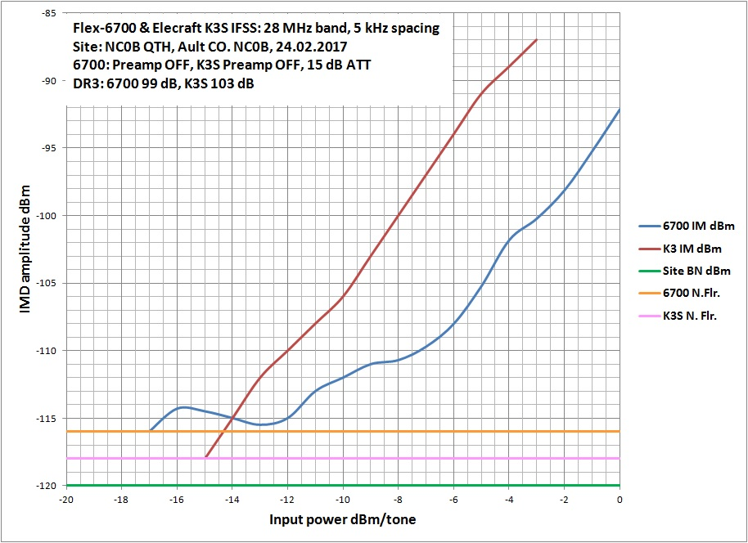
IFSS Chart: Flex 6700 vs. Elecraft K3S
Data by NC0B Graph by VA7OJ
6700 edges out K3S
80m band noise
40m band noise
4.5 dB
20m band noise
Equal -117 dBm noise floors

Slide 16
Not all direct-sampling radios are this well behaved
The following two graphs demonstrate direct-sampling IFSS distortion curves that are not as well behaved as the Flex 6700.
“Well behaved” means it should have a monotonic curve, i.e. smooth and does not reverse directions.
Note: The IFSS curve of a legacy (superhet) radio is virtually guaranteed to be monotonic and not reverse directions.

Slide 17
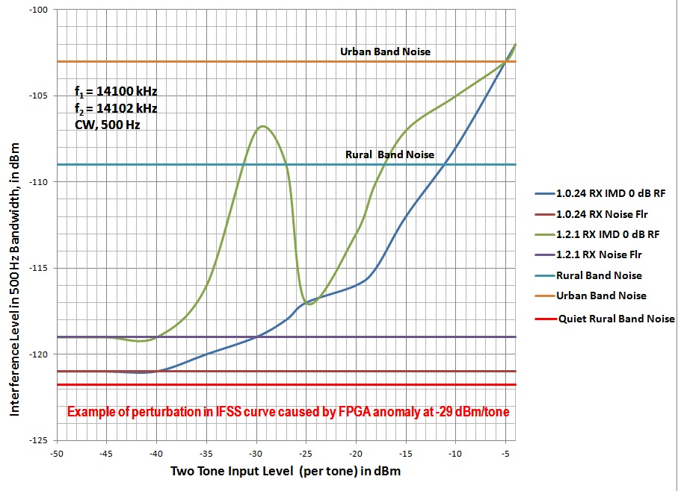
IFSS curve with non-monotonic distortion pattern
Data by VA7OJ Graph by VA7OJ
Urban noise
Anomalies
Rural noise
Quiet rural band noise

Slide 18
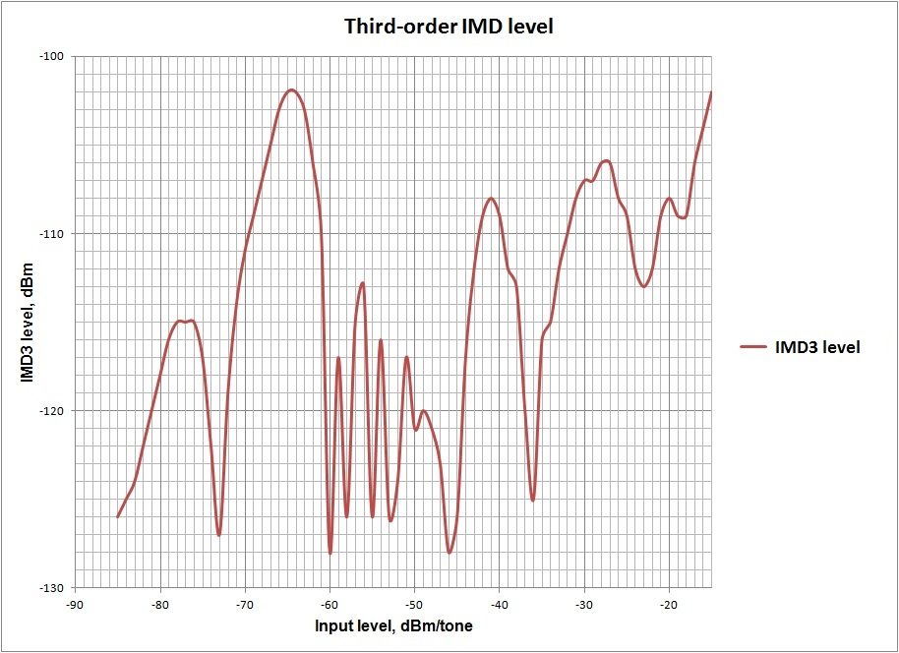
Worst case IFSS data I have measured
Data by NC0B Graph by VA7OJ
Band noise references
20m rural
15m rural
15m quiet rural
Notes:
This direct-sampling SDR does post- ADC processing with discrete IC’s (DDC, NCO) rather than an FPGA. The gross irregularity of the IFSS curve may be due to processing anomalies in this signal chain at specific input levels.

Slide 19
Disruption began in April 2016
First quarter 2016 we had about 18 very good superhet transceivers and a couple of excellent direct sampling SDR radio types that used a computer interface.
Icom dropped a grenade into the status quo.
The IC-7300 hit the market at $1495 as a direct-sampling radio with knobs.

Slide 20
Sales of the IC-7300 went through the roof
No dealer could keep the 7300 in stock in April or May.
A mini price war occurred, offering a slightly lower price with possible delivery sometime in June.
Icom delivered 1000 units to their dealers at the Dayton Hamvention, all of which sold out by the end of the show.
Two things are apparent:
Many hams still like radios with knobs.
By summer at a price point of around $1300, the decision to try the new product was easy for 1000s of hams. World-wide sales continued at a stunning pace.

Slide 21
An entry-level radio plays well
How did it perform?
Lab numbers were good, with some limitations on operating environments.
Multi-transmitter Field Day would stress the radio, particularly without bandpass filters.
Contest evaluation would have to wait until the fall of 2016.
In the mean time, my 7300 was loaned to several hams.

Slide 22
IC-7300 during 2016/2017 contest season at NC0B
CQWW SSB October 2016 (10 meters only)
ARRL 160 meters CW December 2016
ARRL 10 meters CW & SSB December 2016
Stew Perry W1BB 160 meter CW December 2016
CQWW 160 meter CW, 6 hours Sunday January 2017
10-10 Winter QSO Party
ARRL DX SSB March (10 meters only)

Slide 23
How did the 7300 perform in 7 major contests?
In a nut shell, I was stunned how Icom’s “Entry Level” Radio performed on both CW and SSB.
160 meter CW contest congestion is severe. For an S&P operator like myself, it can take three hours to tune in each signal and work every new station between 1800 & 1880 for each pass through the band.
At the other extreme, weak signal conditions were the norm for the December ARRL 10-meter contest. Except for a major E Skip opening to the pacific northwest on SSB, much of the time was spent working very weak signals on CW.
101 Qs CW all S&P & 176 Qs SSB
On Saturday afternoon I ran 94 SSB stations in 45 minutes before the sporadic E opening fizzled.

Slide 24
Which 7300 features worked ?
Selectivity is excellent on CW and SSB, and can be easily tweaked.
Used semi-breakin at 26 WPM. 2 relays limit QSK speeds.
All logging with N1MM+
Receive audio very clean and low fatigue
Noise reduction the best I have used to take the edge off of band noise.
¼ tuning speed perfect for CW
Latency under 10ms
Small spectrum scope and waterfall never let me down.
Drove an Alpha 89 or Acom 1000 in all 7 contests.

Slide 25
Does this define “Disruptive Technology” ?
Some sales number comparisons
From April 2016 through January 2017, Icom sold over 10,000 IC-7300 transceivers worldwide.
Over 5000 of those were in the US and Canada, and over 3000 in Europe.
To put this in perspective, Elecraft’s extremely successful K-Line took about 8 years to sell 10,000 radios.
Are we at the cusp of a major architecture change for the majority of ham transceivers?
We may not know for another year or two.
Icom expected to demo the IC-7610 tomorrow.

Slide 26
What has changed in last couple years?
RMDR* has usually been the practical limit for superhet transceivers except the IC-7851 and the K3S.
Direct Sampling SDR radios changed that.
On the other hand, direct sampling radios are a challenge to test since they don’t behave like legacy radios.
DS SDR front-end selectivity is all over the map
How do we compare totally different architecture?
* RMDR=reciprocal mixing dynamic range

Slide 27
What might be coming down the pike?
IC-7610 announced to have a tracking preselector & identical dual receivers for easy split operation in contests and all DXpeditions.
Solid-state T/R switching expected for QSK operation at high speeds.
ANAN 8000DLE promises improved phase noise, 200 watts LDMOS with internal DC to DC converter. (13.8 to 50 volts for PA)
(No expensive custom 50-volt power supply like in TS-990S)
Third-order IMD nominally -70 dB on 20 meters
Integrated Pure Signal for transmit IMD nearly as good as Class A
Dual 16-bit ADCs for up to 7 receivers

Slide 28
Transceivers we have now:
What happens long run?
Superhets that perform quite well
(At least a 18 good choices)
DS SDR radios with Windows or iOS UI
Flex and Apache 6 models total
Apache 8000DLE plans to ship by April 1st
Flex Maestro is a Windows tablet in a box with knobs. Can replace Windows PC
IC-7300 DS SDR standalone radio with knobs and a small but very sharp LCD display
IC-7610 ships to the US in July

Slide 29
How will this shake out in the long run?
Major changes take time.
Up-conversion-only radios are mostly gone.
Most everyone wants a bandscope/waterfall.
TS-590SG has a bandscope port for a dongle with lots of interest in that feature.
In the long run preselectors went away because up-conversion was cheaper.
In the long run up-conversion generally failed to keep up with performance demand.

Slide 30
Will DS SDR Prevail?
There isn’t anything inherently wrong with the superhet that has worked for 80+ years.
K3S & IC-7851 are top performers.
Cost may dictate DS SDR if it dominates over the next few years.
Will remote operation due to antenna covenant restrictions and urban noise favor the computer-run DS SDR?
Will the majority of operators choose a DS SDR with knobs, like the 7300?

Slide 31
The next year will be very interesting
Has the IC-7300 this past year been a one-time anomaly or just the beginning of a tectonic shift?
You can get amazing performance for a modest price today.
There certainly has been disruption in the market price of used equipment.
Time to contest with something new or simply new to you. Enjoy.

Slide 32

http://www.NC0B.com
Sherwood Engineering
Videos from past CTU presentations: 2013 - 2016
https://www.contestuniversity.com/videos/
CTU 2011, NC0B only, download wmv file
http://www.pvrc.org/webinar/radioperformance.wmv

