Slide 1

2014 / 2015 Rig Contest Results + Which Specs Really Matter?
Rob Sherwood
NCØB
Is my rig good enough?
Sherwood Engineering
Notes:
Changed font of Ø to 36pt Arial Black.

Slide 2
What is important in a contest or DX pile-up environment remains constant.
We need Good Dynamic Range to hear weak signals in the presence of near-by strong signals.
You need a better receiver for CW than for SSB.
2014 / 2015 Contest performance observations
How does published test data relate to reception of weak signals?

Slide 3
Rigs used at NC0B this past season
Contests October 2014 – February 2015
Flex 6700 series @ $7,500
Kenwood TS-990S @ $7,400
Apache ANAN 200D @ $4,250
Elecraft KX3 with KXPA100 amp @ $2,260
Kenwood TS-590SG @ $1,710

Slide 4
Rig experience in 2014 / 2015
Kenwood TS-990: CQWW SSB October 2014
Flex 6700: ARRL 160 CW & ARRL 10 meter contests December 2014
ANAN-200D: Stew Perry W1BB 160 CW end of December 2014
Elecraft KX3 + KXPA100: CQWW 160 CW contest January 2015
Kenwood TS-590SG: CQWW 160 SSB contest February 2015
(All rigs drove an Alpha 89 PIN Diode QSK legal limit amplifier)

Slide 5
Details – Kenwood TS-990S
Main receiver down conversion all bands
Third-order transmit IMD excellent at -40 dB
Has a cleaner 50 volt PA
Band scope very effective
Excellent low-fatigue receive audio
RMDR is its weakest point, but should rarely be an issue in most environments.
Needs NB and NR firmware improvements

Slide 6
Details – Flex 6700
Fantastic band scope with amazing resolution
Clean audio, very low fatigue, minimal ringing
Tuned receiver with FlexControl
V1.38 software was a significant improvement.
I used two separate computers, one for N1MM and SmartCAT for band data, plus second computer to actually run SmartSDR.
With V. 1.40 software, three logging programs support focus recovery after user adjustable time. (2 seconds default)
Notes:
“Are two computers…” is better grammatically.
Even better: “Will the need for two computers be a problem?”

Slide 7
Apache ANAN-200D
Initially CW selectivity was terrible
Consultation with NR0V resolved the issue
Tuning was done with a FlexControl
Bandscope was good, though not as good as a Flex 6700 with the default settings.
Could not view signals too weak to copy
I could have fixed this if I had known how.
Focus was a major shortcoming
Many contacts were lost due to loss of focus
Planned fix for N1MM+ by May 15th.

Slide 8
ANAN-200D continued
CW selectivity fixed with buffer & filter change
Initial shape factor @ 200 Hz was 4:1 !
Buffer & filter change shape factor = 1.6:1
Dual 19-inch monitors, N1MM + PowerSDR
Loss of focus was a rate killer.
Improper keystrokes = shifts to BC band, 3 MHz, Shortwave bands, etc.
APF excellent once selectivity corrected
Software is open source, written in C & C#
New NR code shipped in March

Slide 9
A Note on CW Selectivity
Shape factor at 500 or 250 Hz = 2:1 minimum with any modern rig
Most DSP rigs will have a shape factor 1.5:1
If you are tuned 1 filter bandwidth away from a strong CW signal, you should only hear key clicks, not a CW signal.
That was the tip-off that something was wrong with the 200D until the buffer setting and filter type was set properly.

Slide 10
Details – Elecraft KX3
Operated as CE0Y/NC0B Easter Island
Performed well in 2015 CQWW 160 CW
QSK improved, but still had keying artifacts
DSP provides excellent bandwidth control
KXPA100 drove Alpha 89 to 1.5 kW
Opposite sideband rejection is its performance limit, being around 60 dB.
Would be my first choice for QRP operation compared to IC-703+ or Argonaut VI
Notes:
When I ran a few tests on the KX3, I found that calibration at fairly frequent intervals was required to maintain acceptable opposite-sideband rejection. - Adam

Slide 11
KX3 continued
The only problem operationally I had was large QSYs on 160 with a narrow-band antenna.
Had to drop power to 10 watts to disable 100 watt PA
Then retune L-network to low SWR
Otherwise if I put Alpha 89 in standby, the KXPA100 would lockup on a high SWR.
10 dB preamp used during daylight hours 160, which should be considered normal.
(Battery and charger details available on request)

Slide 12
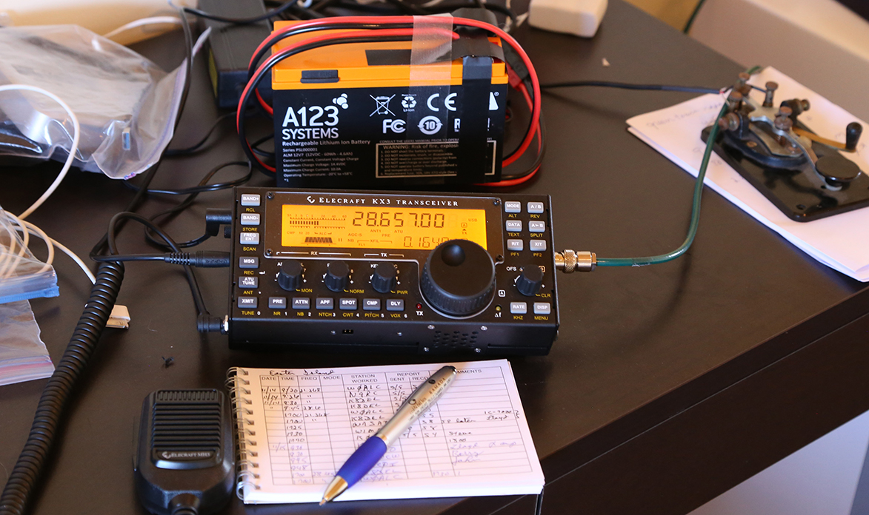
Shack on Easter Island - Great Fun !
Operated SSB and CW on 10 & 15 meters

Slide 13
Kenwood TS-590SG
The 590S was improved as the 590SG
The radio is now in the top 10 on my chart
N2IC, a top contester, has a pair of the older TS-590S models.
I don’t know a better bang for the buck than this Kenwood transceiver.
DSP selectivity is excellent and easy to use with Hi / Low adjustments on SSB or width on CW.
Ergonomics are user friendly

Slide 14
What is the least understood Spec ?
When is the spec for noise floor significant?
Why does it rarely matter on most bands?
What is often not understood ?
Noise Floor is usually significantly lower than Band Noise.
An ITU graph published in the ARRL Handbook gives us a starting point to relate band noise to noise floor.
This ITU data is in a 500-Hz bandwidth, just like typical noise floor data.
(Note: Noise floor is bandwidth dependent, unlike Noise Figure)

Slide 15
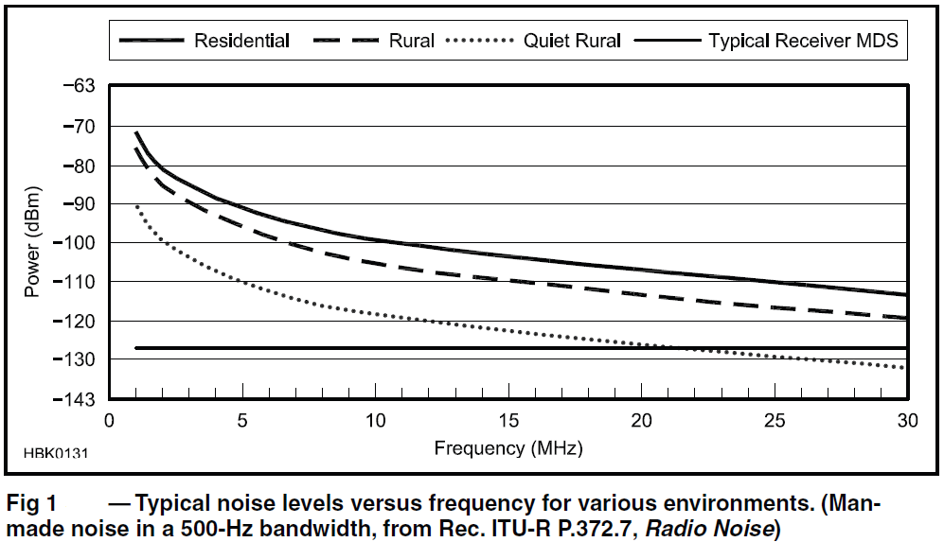
Band Noise vs. Frequency from ARRL Handbook

Slide 16
Most Radios are designed for 10 meters
It is easy to assume that a -140 dBm noise floor is better than a -130 dBm noise floor.
If band noise on 20 meters is typically -110 dBm, of what value is a receiver noise floor that is 20 to 30 dB lower than band noise?
Use your 6 or 10 dB attenuator on the lower bands
Band noise easily changes 10 dB depending on beam heading.
Optimally receiver noise should be 8 to 10 dB lower than band noise to have minimal effect on receiving weak signals.
Notes:
“The short answer is that it isn’t useful…” reads better.

Slide 17
How does band noise vary by band?
If we take the ITU rural data as a starting point, what is typical?
160 meters: -87 dBm
80 meters: -93 dBm
40 meters: -101 dBm
20 meters: -109 dBm
15 meters: -114 dBm
10 meters: -119 dBm
That’s a 30+ dB difference in band noise

Slide 18
Measured band noise at NC0B
160 meters 8:00 AM MST: -105 dBm January 2014
160 meters 4:00 PM MST: -101 dBm 160 meter CQ
160 meters 6:30 PM MST: -91 dBm CW Contest
ITU rural nominal value: -87 dBm
Beam Heading, October 2013 15 meters 10 meters
0 degrees beam heading: -124 dBm -129 dBm
30 degrees: -124 dBm -123 dBm
60 degrees: -118 dBm -120 dBm
90 degrees: -114 dBm -120 dBm
120 degrees: -113 dBm -122 dBm
150 degrees: -114 dBm -122 dBm
ITU rural nominal value: -114 dBm -119 dBm

Slide 19
ITU / ARRL Data is generally correct
Those numbers = starting point for a rural QTH
On a give day can be +/- 10 dB differences
CQWW SSB 2014 my 10 meter noise floor was 10 dB lower than the ITU value, pointed West between 3 and 5 PM local time while working ZL, VK & JAs.
(5 element monoband yagi @ 65 feet)
80 M mid-day band noise measured -120 dBm
Urban QTH with RFI noise, all bets are off.
How’s your neighbor’s Plasma TV ?

Slide 20
Typical receiver noise floor values
Rig Preamp OFF Preamp ON
Pro III -132 dBm -140 dBm
TS-990 -127 dBm -138 dBm
K3 -130 dBm -138 dBm
ITU night-time band noise on 40 meters is around -100 dBm, while typical receiver noise floor is -130 dBm, or 30 dB lower with the preamp OFF !
Notes:
“ITU band noise on 40m is around -100 dBm…” flows better.

Slide 21
What does all this imply?
For most radios: Up-conversion / down-conversion
On the lower bands at night, attenuation is often appropriate.
There is no point in band noise reading upscale on your S meter.
A preamp is usually NOT needed on 20 meters.
A preamp would never be needed on 40 meters and below, assuming the transmit antenna is used on receive.
Notes:
upscale: should be one word

Slide 22
Preamp on 160 or 80 meters OK?
Many rigs today have an RX input for a receive only antenna.
A Beverage or a small loop would usually have a head amp, at least for impedance matching. (Maybe just a transformer)
A preamp for a receive-only antenna may well be appropriate on the low bands.
Use common sense for special cases.

Slide 23
Where do these examples not apply?
Direct sampling radios are very different
Examples of direct sampling radios:
Perseus receiver (CW Skimmer)
Apache ANAN-100D & ANAN-200D
Flex 6300, 6500 or 6700
The overload point of the Flex is much higher, and the noise floor is also much higher, with the preamp OFF.
Apache is different in that it has a preamp in the circuit all the time, plus a variable attenuator.
Notes:
Should be: ANAN-100D

Slide 24
Some comparison data
Rig Noise Floor Preamp Off / On Noise Figure Preamp Off / On
Icom Pro III -132 dBm / -140 dBm 12 dB / 4 dB
Elecraft K3 -130 dBm / -138 dBm 14 dB / 6 dB
Kenwood 990S -127 dBm / -138 dBm 17 dB / 6 dB
Flex 6700 -118 dBm / -132 dBm 26 dB / 12 dB
For classic radios with normal mixers (up-conversion or down-conversion) attenuation is often helpful in potential overload conditions (contests / DX pile-ups) on 40 meters and below. Possibly even on 20 meters.
For direct sampling radios, particularly the Flex 6000 series, attenuation would rarely be needed, but a preamp would be useful on 15 meters and up.

Slide 25
How do we chose a new transceiver?
On most bands receivers are too sensitive.
Make the most of the radio’s dynamic range by properly using the attenuator and using the preamp only when necessary.
Published dynamic range can be misleading, depending on how it is measured. Read the fine print, as I discussed in past years.
Look at RMDR, as this typically dominates.
(RMDR* = Reciprocal Mixing Dynamic Range)
[*QST April 2012 for sidebar – Bob Allison]
It is a numbers game today!
Evaluation in contest conditions is critical.
A lab setup can never approximate CQ WW !

Slide 26
Speaking of RMDR - It means what ?
Most of the time phase noise (reciprocal mixing dynamic range) isn’t a problem.
Poor RMDR likely implies bad transmitted broadband noise, too.
When does it likely really matter?
Field Day
Multi-Multi contest stations
You have a nearby neighboring ham within a few miles of you.

Slide 27
Example of transmitted phase noise hell
There are two hams in Boulder, CO that are 5 miles apart.
Ham A never bothered Ham B with his Yaesu FT-1000 MP
New FTdx-3000, Ham A wipes out the whole 15 meter band with S9 broadband noise at Ham B’s QTH
We need to be a good neighbor, be it from a wide SSB signal, terrible key clicks on CW or poor transmitted phase noise.

Slide 28
RMDR can be the limit instead of DR3
My web site’s the top 4 radios are outstanding from an RMDR standpoint.
Flex 6700, Elecraft K3 & KX3, PT-8000A
The new Elecraft K3 synthesizer board can upgrade any K3 to outstanding phase noise / RMDR performance
For under $200 you can be state-of-the-art
(Part # KSYN3A)

Slide 29
Passive IMD in Roofing Filters
While testing the K3’s new synthesizer, six roofing filters were tested for their effect on dynamic range.
Some variation is expected, but there was significant variation with the 5-pole filters.
This warrants further investigation.
Roofing filter passive IMD has been observed with all “Down Conversion Radios”.
This has become the limit in the numbers race.

Slide 30
How to cope on noisy bands
Set the RF GAIN so punching in 6 dB attenuation definitely drops the band noise.
If the band noise between words is as loud as a weak but Q5 signal, this adds to fatigue.
If your receiver has hiss or hum in your phones, consider plugging your phones into a speaker that has high-pass and low-pass filters.
Examples: Icom SP-20, SP-23 or SP-34
Yaesu SP-2000 or Kenwood SP-990
Notes:
Should be SP-2000, SP-990.

Slide 31
Transmit IMD Needs to be improved
Receivers have improved dramatically over the past 10 years, but rarely so transmitters.
AI0L had complaints of being broad.
Comparing rig A & amp A to rig B and amp B
Desired sideband was S9 +15 dB
Opposite sideband with “A” combo = S8
Opposite sideband with “B” combo = S2
“A” combo is current rig & solid-state amp
“B” combo is 30 year old rig & 2x3CX800A7s

Slide 32
Transmit Intermodulation IC-7410
White noise fed into mic jack to approximate speech using IC-7410.
(This is a typical example, not just this rig.)
Look at the “shoulders” of IMD close-in to the transmit passband.
If this station is 3 kHz away and is strong, hearing a weak signal will be difficult.

Slide 33
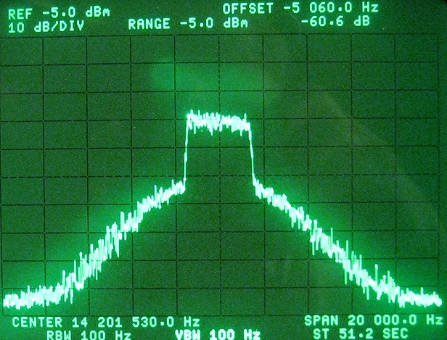
Icom IC-7410 Class AB, White Noise
Noise source = GR 1381, 5-kHz -3 dB BW
3 kHz from edge
40 dB down @ 3 kHz
Notes:
Actually, IC-7410 PA operates in Class AB (180° < conduction angle < 360°)
33

Slide 34
Reception limits on SSB may be the other guy
On SSB, adjacent-channel splatter is usually worse than the dynamic range of the receiver.
Today’s 13.8 volt PAs are significantly worse from a transmitted IMD standpoint than tube PA circa 1962 (Collins 32S-3).
Why are rigs today, that will never be used mobile, still running on 13.8 volts?
With today’s LDMOS FETs, 50 volt PA s should be the norm.

Slide 35
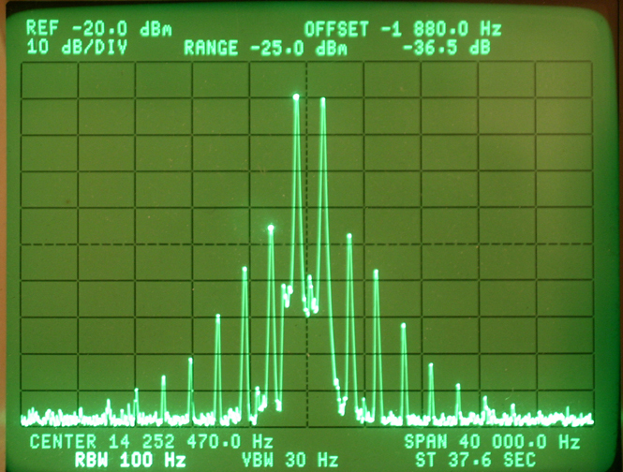
My cleanest transmitter
-36 dB 3rd Order, -60 dB 7th Order
Collins 32S-3 on 20 meters @ 100 W

Slide 36
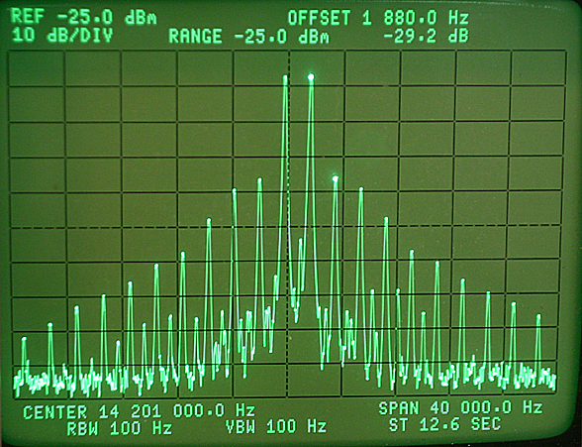
Flex 5000A on 20 meters @ 70 Watts
-29 dB 3rd order, -41 dB 7th order

Slide 37
Will you pay more for a cleaner signal ?
We need help from our OEMs to clean up the bands
Will you spend $100 to $200 more for a cleaner SSB signal?
Pre-distortion could help even a 13.8 volt PA
Apache offers that now, though setup is complex
A cleaner rig is only useful if the operator doesn’t over drive his linear into clipping. Who me splatter?
Every ham should have a scope or a real peak reading wattmeter if you run a linear amplifier.

Slide 38
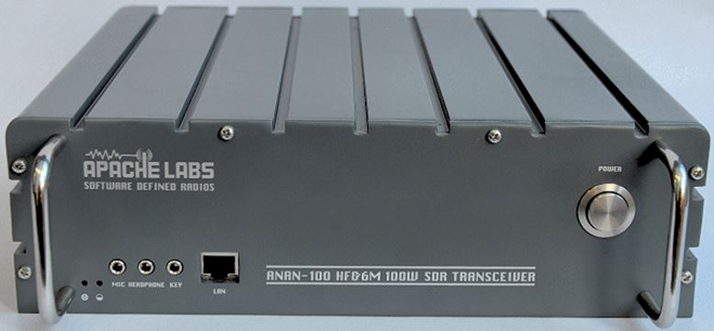
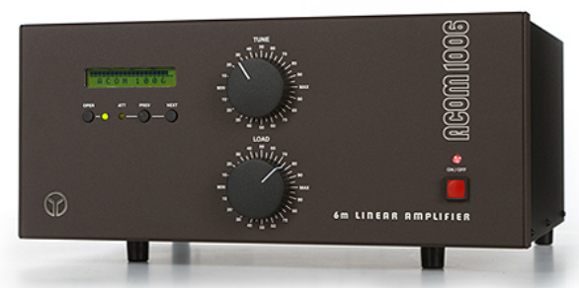
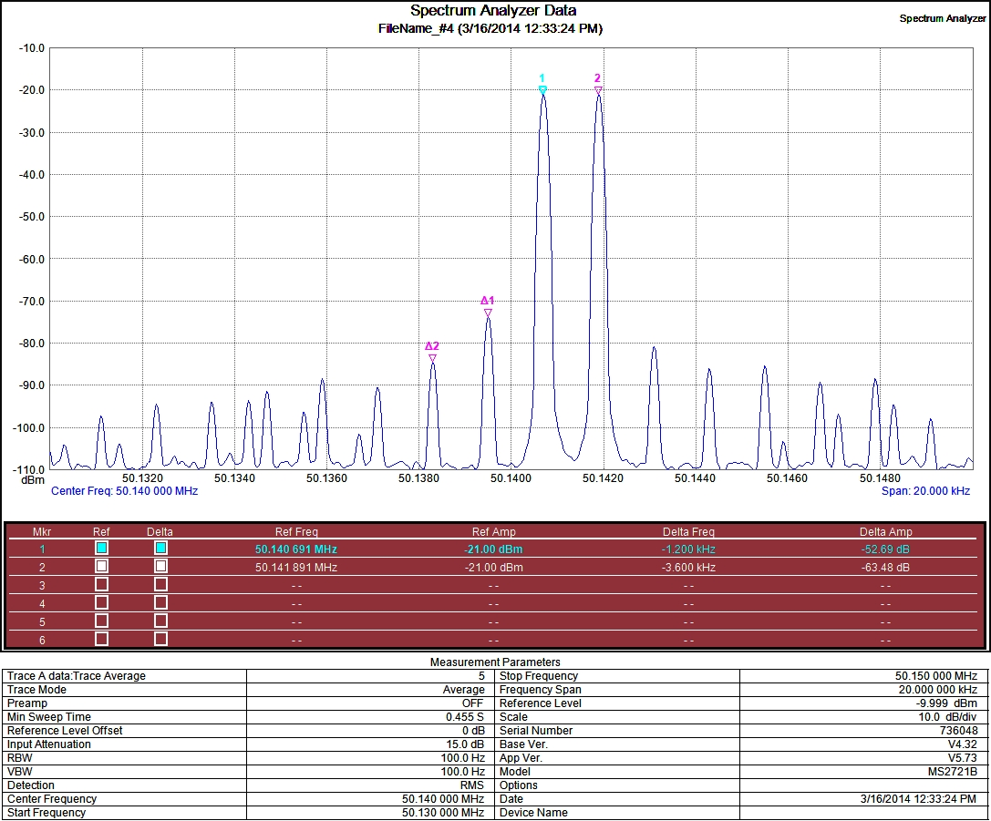
PURESIGNAL RESULTS
Mike, N1JEZ
Pre-Distortion results with RF sampler at output of Acom linear amp
ANAN-100
ACOM-1006
3rd order -52 dBc
5th order -63 dBc
IMD3 -52.69 dBc
IMD5 -63.48 dBc

Slide 39
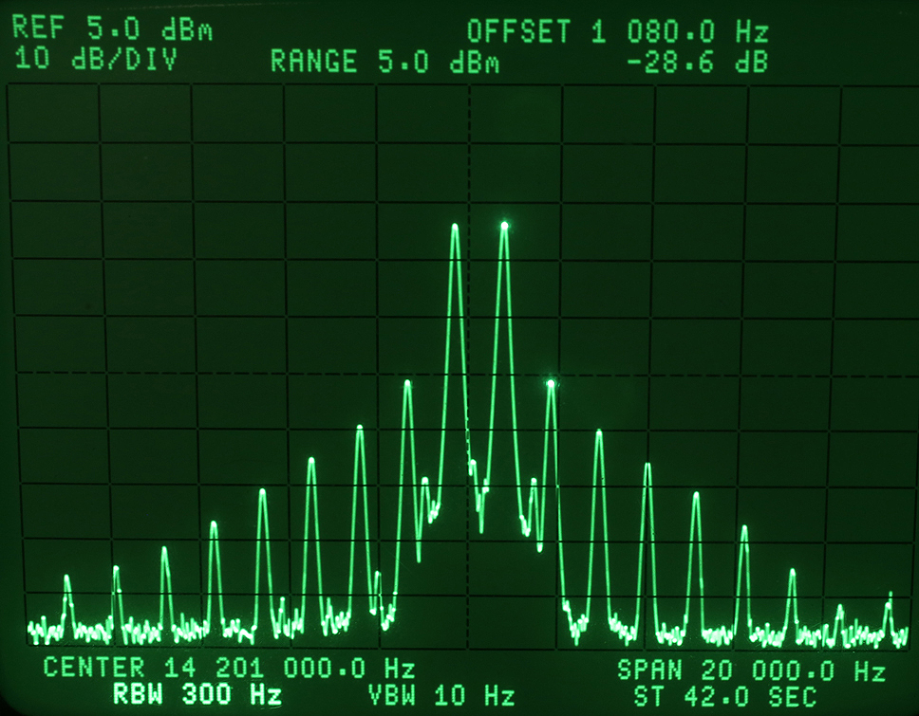
Tones are 700 Hz and 1800 Hz
Icom IC-781 Classic 2-Tone Test 3rd order -28 dB
-34 dB below PEP

Slide 40
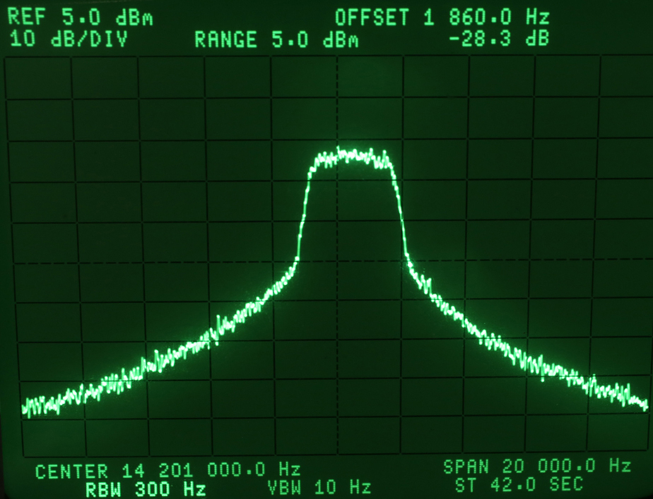
GR 1381 BW = 5 kHz @ -3 dB
IC-781 White Noise Intermodulation Occupied Bandwidth
28 dB

Slide 41
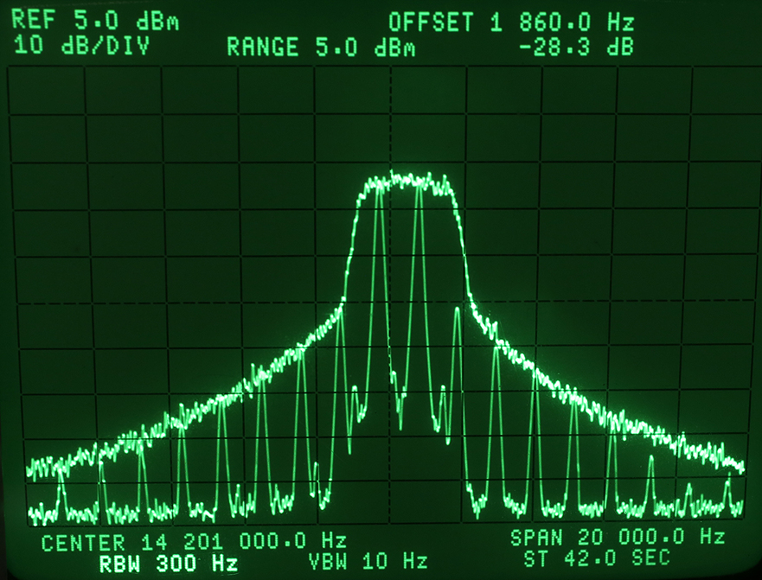
How Wide Is Your Signal ?
Comparison 2-Tone vs. Noise Intermodulation Bandwidth
3 kHz
-37 dB
Notes:
Remark: The overlay of the white noise IMD spectrum over the 2-tone IMD spectrum is pretty conclusive. They match very closely. I do not see how the “pink noise advocate” can rebut this. It may be interesting to add a similar image for the 7410.
In general, I always point out to my audience that as long as the ITU-R guideline remains at -25 dBc (ref. one of 2 equal tones) for single-channel J3E, we can expect nothing better from the ham equipment OEM’s. (Rec. SM.326-7, Sec. 1.2.3)

Slide 42
Broad signals Also Exist on CW
The following slide shows the difference between a rise time of 3 milliseconds vs. 10 milliseconds.
There is a 20 dB difference in the strength of the key clicks 700 Hz removed from the transmitting station.
(Transmitter was a Ten-Tec Omni-VII that has a menu to adjust the rise time.)

Slide 43
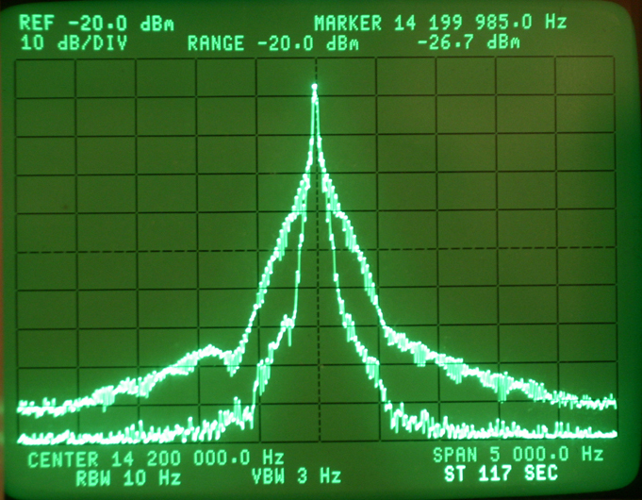
Spectrum of CW Signal on HP 3585A Analyzer
Many rigs are much faster than 3 msec
Comparison of 3 msec vs 10 msec rise time
20 dB difference

Slide 44
Bad choices in the menus of many rigs
Many rigs today offer user adjustable rise times for CW operation.
The choices are often way too fast.
Typical choices: 1, 2, 4 & 6 milliseconds
I tested a $7000+ rig with a 1.5 millisecond rise time that was 4.8 kHz wide at -60 dB.
Anything faster than 4 milliseconds will to too broad.
Again: Be A Good Neighbor !

Slide 45
Choices today on rig selection
We have rigs from $1000 to $14,500 for sale.
Many do well in contest conditions.
It is hard to evaluate on-air performance from some of the published data.
Many aspects of a radio affect contest scores
In the end, hopefully you enjoy using your rig on the air !
Notes:
It is hard to evaluate…

Slide 46

http://www.NC0B.com
Sherwood Engineering
Videos from past CTU presentations
CTU 2013 & 2014 (Select desired year)
http://www.contestuniversity.com/main/page_videos.html
CTU 2011
http://www.pvrc.org/webinar/radioperformance.wmv

