Slide 1
Improving Domestic Contest Scores
Larry “Tree” Tyree, N6TR

Slide 2
Domestic Contests (USA / VE)
ARRL Sweepstakes
The biggest domestic contest.
Big emphasis on receiving accuracy.
Fast rates first day – walking in mud the second (unless you are in KP4/KP2/VY1).
NAQP
Great two radio event.
Uses all six bands – multipliers by band.
Fast rates!!
NA Sprint
QSY rule makes this a great challenge for the operator.
Lots of competition in low power and QRP categories.
Other QSO Parties
Typically very sparse competition.
Good rates can be made just running guys who tune across you.
Should not be “advertised” as a contest.

Slide 3
Why are domestic contests different?
Easier propagation.
Often lower antennas work better.
Only one or two directions typically needed for good results.
In some cases – more reliance on working the non-contester (primarily on SSB).
Exchange “quality” enables almost complete log checking.

Slide 4
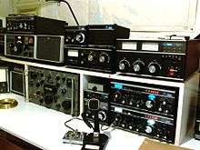
Basic Strategies for Score Improvement
Get Louder
Hear Better
Antenna Flexibility
Logging Accuracy
Maximizing Rate
Touchy Feely Stuff

Slide 5
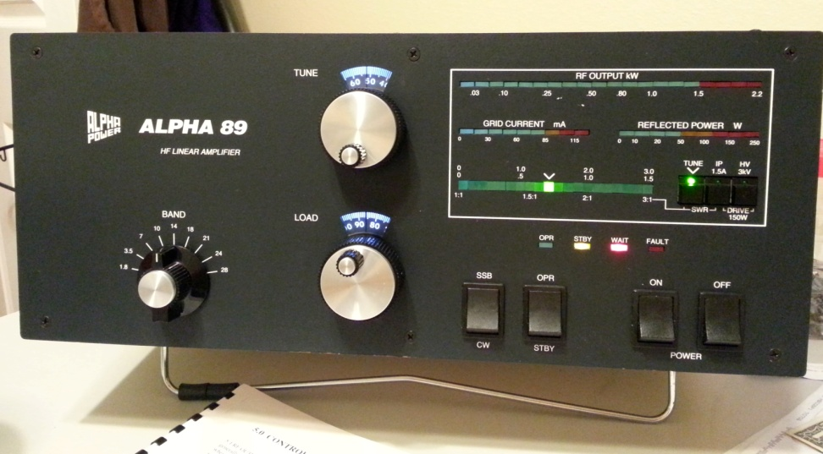
Get Louder
Understand how your location interacts with your antenna
Domestic contests are not typically low angle
Sharper beam patterns not always needed
Do you need to point east and west at the same time?

Slide 6
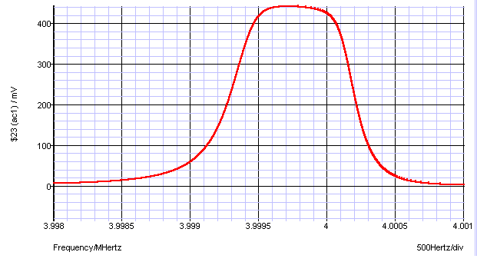
Hear Better
New receivers are really good at reducing QRM and QRN.
Is your code speed holding you back?
Are you listening to too narrow of a bandwidth?
Do you hear people calling you off frequency?

Slide 7
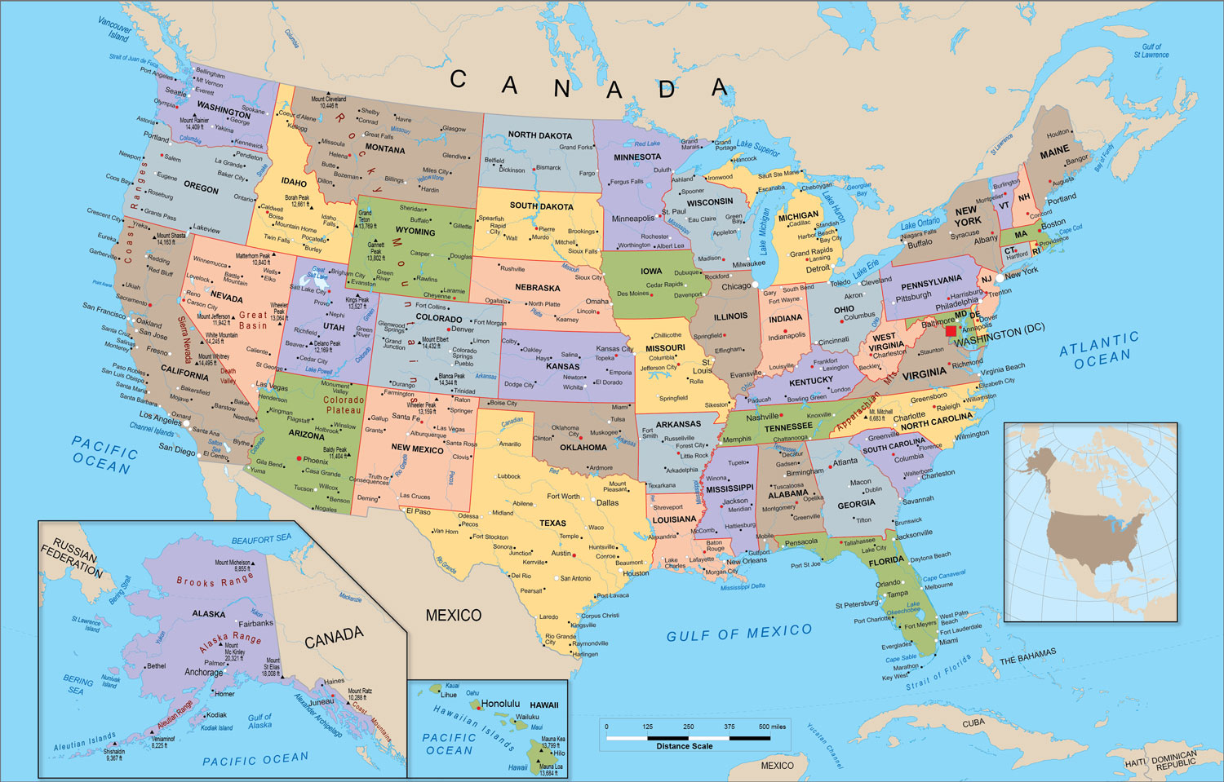
Antenna Flexibility
Can you quickly locate a signal and select the best receiving antenna for it quickly?
Can you optimize your transmitted signal for busting through pileups.
Can you change your antennas pattern based upon conditions (time of day or propagation).

Slide 8
Logging Accuracy
If your error rate is over 1 percent – you can improve your score simply by making fewer mistakes.
Get copies of your log check reports – look for areas of focus to improve accuracy.
Compare your reports against audio recordings.
Stay in the moment – most people have found that using a database of exchanges actually hurts their accuracy. Copy what was sent instead.
However, don’t over-do it – you do not want to be asking for un-necessary repeats. You should build confidence in your ability to get it right the first time.
Operating a lot between contests helps your ear stay in shape. Spend time on “weak signal” bands.

Slide 9
Maximizing Rate
On SSB
You are giving a performance that is trying to suck in non-contesters
Make sure your audio is pleasant to listen to.
Don’t be that guy with a CQ that sounds totally different than the live operator.
Imagine an SWL working on his Heathkit and you need to entice him to put in the effort to find a footswitch and call you.
Avoid repeating received exchanges and other un-necessary words.
On CW
Make sure your CW is pleasant to listen to.
Code speed should change based upon your rate.
Minimize the “pregnant pause” – the time between when you get an answer and when you come back.
QSK can improve efficiency – but also might make you more tired.
Diversity reception can eliminate one letter drop-outs from QSB.
It can also help you identify location of a signal quickly.

Slide 10
The ARRL Sweepstakes
Logging accuracy is a big factor
On CW – a second radio has a big impact.
An SB-101 & trap vertical can work most CQers.
Many stations work > 100 QSOs on their 2nd rig.
Clean sweep is nice – but don’t sacrifice rate.
Off time strategy is important
Focus on your best two bands

Slide 11
Sprint (mostly CW)
Strategy depends on your ability to win “jump balls”.
If you own the band – find guys to work and get “doublets” on each frequency.
If you are weak – calling CQ a lot might be more effective.
Code speed is important
Many stations sending 35+ WPM
Need to be effective on three bands
Advanced two radio techniques are used by most top-ten, high-power entrants.
Call CQ while tuning on another band
Call CQ while receiving exchange from a CQ solicited QSO on another band.
SSB Sprint is a contest in flux.

Slide 12
NAQP
If you are in a rare state – you can have a decent score just running guys.
Two radio techniques really work well on CW.
Move multipliers!!
When the rate gets slow – changes bands.
Be careful not to miss a 10 meter opening.

Slide 13
Other points
Are you having fun?
Are you setting firm goals?
Do you over-plan?
Do you have a good off time strategy?
Can it adapt to the unexpected?
Are you able to “see” band openings
Do you operate too many contests (AA3B does not need to answer this question).

Slide 14
Summary
Domestic contests offer opportunities to have pretty competitive scores with modest stations and fixed directional antennas.
NAQP with low power further enables two radio operation that would be challenging at high power levels for most city lots.
Get on and have fun!!

Slide 15
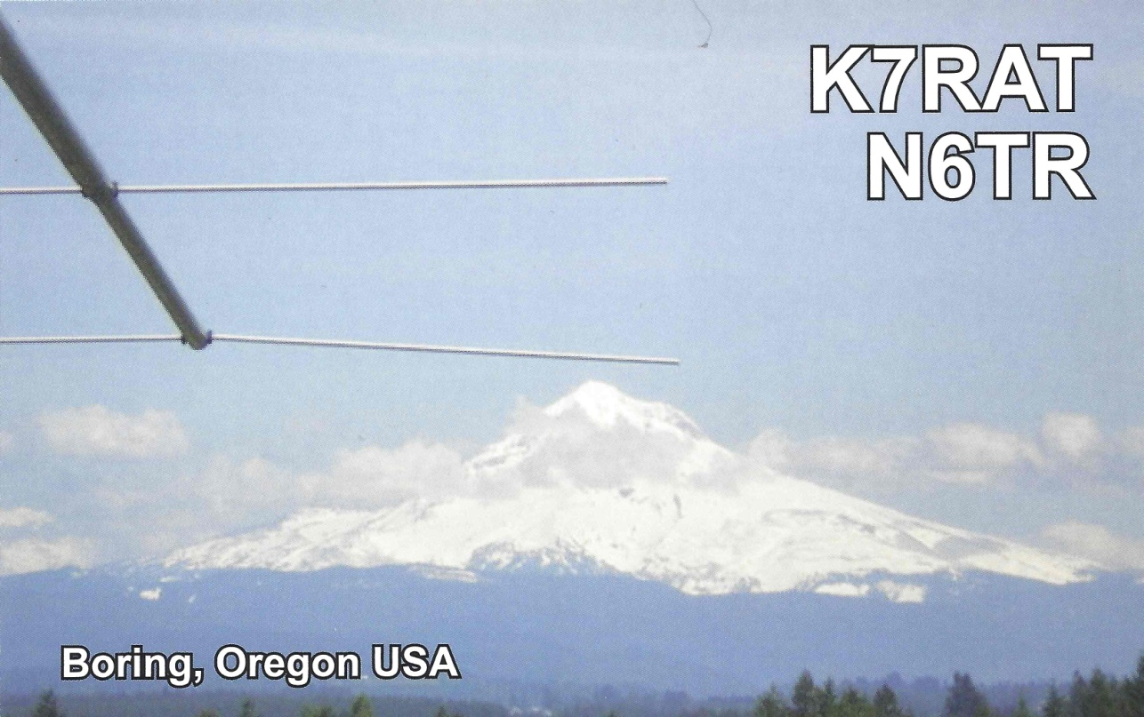
Thanks for your time
See you in the next contest!!

