Slide 1
CTU Presents
Play by the Rules – Your Most Important Operating Skill
Ward Silver, NØAX

Slide 2
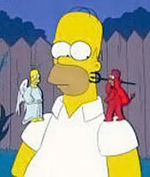
Purpose of this Session
Discussion of what ethical behavior is in radio contesting
Understand the impact of unethical behavior
Encourage participants to take ownership of their own behavior and encourage others to do the same

Slide 3
Why do we play games?
What is a game?
A contest with rules to determine a winner
An amusement or pastime
Games provide players with
A means of exploring one's own capabilities
An opportunity to look at, understand, and experience things
Lessons about themselves and possibly the world.

Slide 4
An unusual game
Entrants keep their own score
Complex rules govern scoring
Individuals and “team” entries permitted
Some events include off-times
Winners of the top-level event often invest $50k or more and travel to favorable locations
An on-line network helps participants increase their scores
Spectators don’t find it particularly interesting

Slide 5
Is this Radio Contesting?

Slide 6
Is this Radio Contesting?
No! Its Birdwatching!
Birders keep track of “life lists” of bird species seen (“DXCC”)
Audubon started the “Christmas Day Bird Count” in 1900.
Competition got serious after an innocent comment in the book Wild America, when Roger Tory Peterson wrote: “My year’s list at the end of 1953 was 573 species”

Slide 7
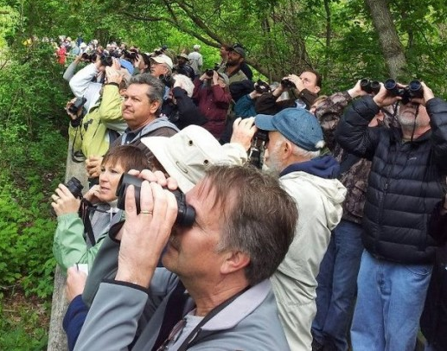
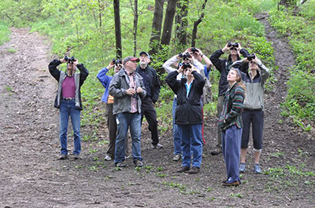
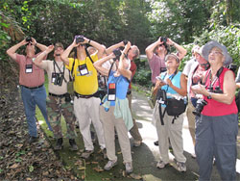
They have pileups, too!

Slide 8
Radiosport vs Birding
 | Contesting | Birding
Premier Event | CQWW, WRTC | Big Year
Smaller event | Sprint | Big Day
Spotting | DX Cluster | Birdingonthe.net
Travel | Zone 9, 10, 33… | Migratory paths
Book/Movie | “To Win the World” | “The Big Year”
Conventions | Dayton, Visalia | Annual, moves around

Slide 9
Why do we do games?
FUN and EXCITEMENT!!!
Self Improvement
Personal Satisfaction
Financial Rewards
Peer Recognition
Internal
External

Slide 10
Why do we do radio contests?
FUN and EXCITEMENT!!
Self Improvement
Personal Satisfaction
Financial Rewards
Peer Recognition
Internal
External

Slide 11
What is this peer recognition?
You are recognized by your achievements and how you went about achieving those results
Your recognition is strongly influenced by what other people say about you

Slide 12
Negative Peer Recognition Examples
That station was too loud in the NAQP.
That guy uses a pair of 8877s and has remote receivers in Europe.
Joe uses spots but enters as unassisted.
Ken had a second operator help him.
Larry operated with a broad signal to push away nearby stations and keep his channel clear.
While most of these examples can not be proven – they are often based upon something not being quite right about an entry.

Slide 13
Ethics and Respect
Ethics comes from respect…
Respect for others
Respect for the game
Respect for yourself

Slide 14
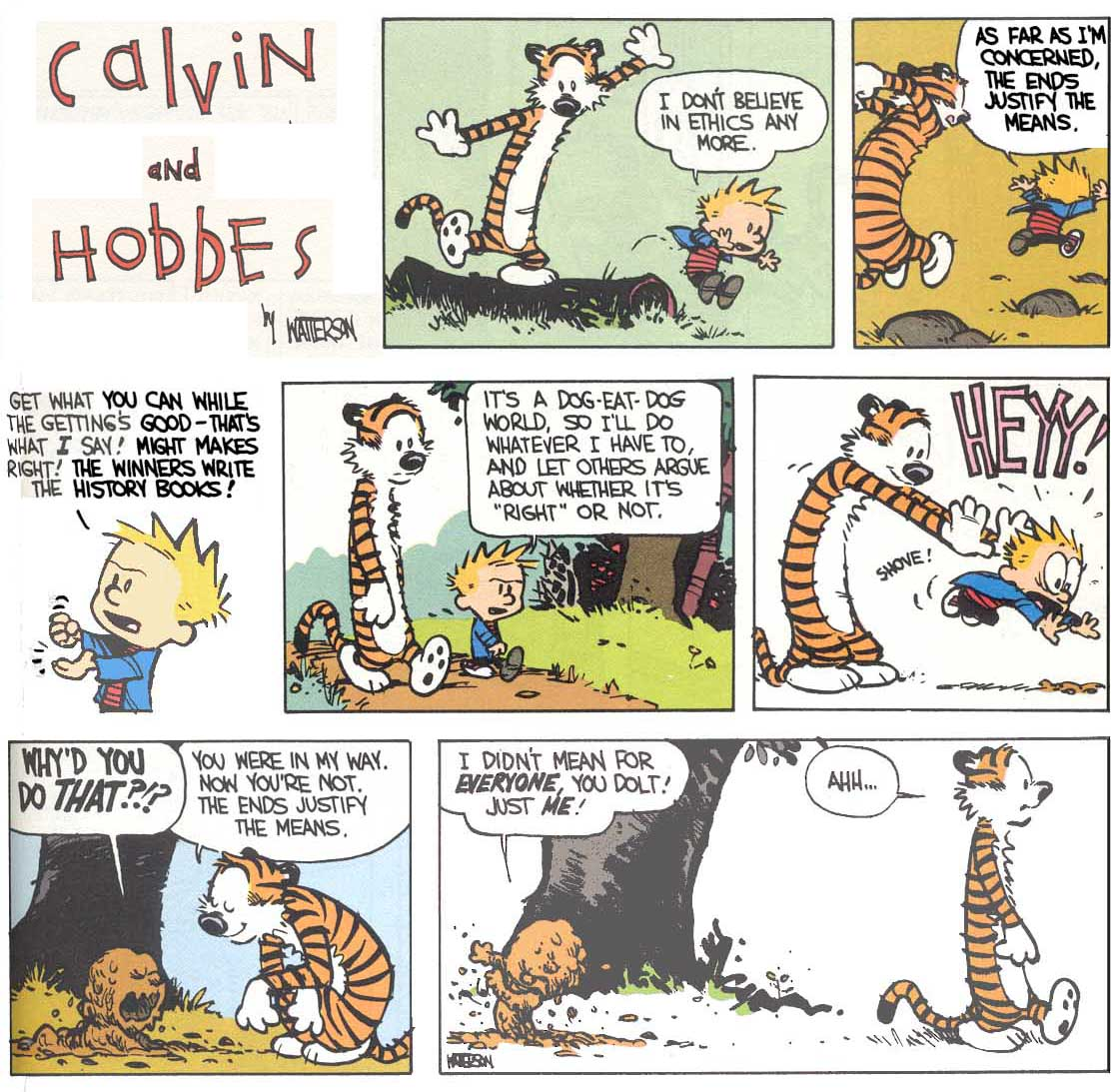

Slide 15
Ethics and Respect
Ethics comes from respect
Respect for others
Respect for the game
Respect for yourself
To get respect, you have to give respect

Slide 16
What do we mean … Ethics?
Observe
Judge
Act

Slide 17
What do we mean … Ethics?
Observe
Repent
Judge
Act

Slide 18
What do we mean … Ethics?
Ethics denote the theory of right and wrong actions
Written and unwritten codes of principles and values that govern decisions and actions
Morals indicate their practice within guidelines
Standards for determining the difference between good and bad decision making and behavior
Ethics are…knowing the difference between right and wrong and choosing to do what is right.

Slide 19
Ethics in Contesting
Choosing to do the right thing even when no one is looking
With SDR technology, people *are* looking at what happens on the air
Unobservable rules require participants to apply ethics

Slide 20
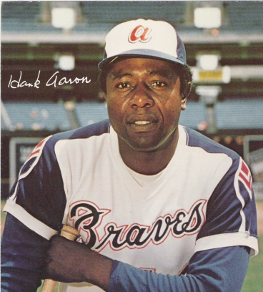
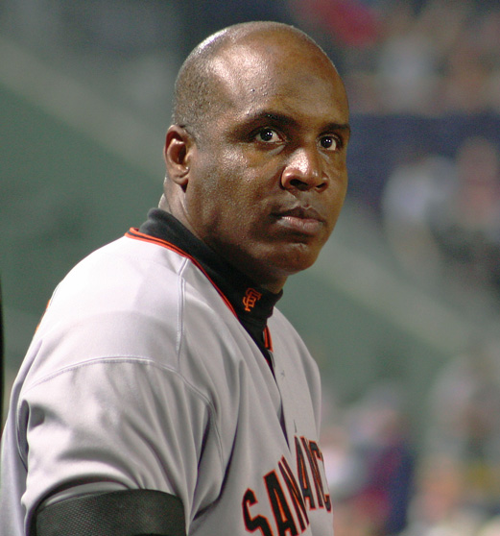
Why do ethics matter?
Hank Aaron
755 Home Runs
Barry Bonds
762 Home Runs

Slide 21
Why do ethics matter?
Without ethics and respect – we have NOTHING

Slide 22
Explaining Radio Contesting to a non-ham (or non-contester)
“We operate for 4/24/48 hours, log all the stations we contact, and see who can make the most contacts in the most states, countries”
“How do you know who won?”
“We send our logs to the sponsor, and they check them”
“How do you prevent cheating?”

Slide 23
How do we know what to do?
Written Rules
Specified by the contest sponsor in writing
Black and white
May, can, should, must…
Unwritten Rules
Expectations about behavior
Interpreted norms
Gray areas

Slide 24
Some written rules are very clear (some people break these anyway)
“A. Single Operator categories: For all single operator categories, only one person (the operator) can contribute to the final score during the official contest period.”
“Total output power per band must not exceed 1500 watts or the output power regulations of the country in which the entrant is operating, whichever is less.”

Slide 25
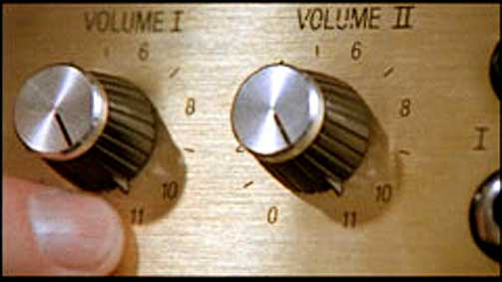
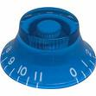
Play Fair
Do not exceed power limits for your category
Just because the knobs go to 11…
See also: “headroom,” “smoke,” “gas,” “soup,” “smash,” “Eimac antenna tuner”. . .

Slide 26
More Examples of Written Rules
Off times must be a minimum of 60 minutes in length.
The log MUST show the correct serial number sent and received for each contact.
The exchange consists of signal report and serial number. Serial numbers sent must be progressive, starting with 001.
Self-spotting or asking other stations to spot you is not allowed.

Slide 27
Essence of Unwritten Rules
“Can” is not the same as “Should”
Just because it’s not specifically prohibited by written rules doesn’t mean you should do it!
Keep the contest on the radio and within the contest period
Don’t give or take unfair advantage of others
Learn and follow the spirit of the rules

Slide 28
Examples of Unwritten “Rules”
Do not make pre-arranged schedules
Do identify frequently
Do not ask friends to work you … only
Do encourage club members - work everyone
Do not work friends with multiple calls
Do work and spot stations equally

Slide 29
Examples of Unwritten “Rules”
Do not call or text message multipliers
Do make an effort to help casual callers enjoy the contest and make a contact
Do not let others “help” your single-op effort
See the ARRL’s “HF Contesting - Good Practices, Interpretations & Suggestions”

Slide 30
No “Log Washing”
Using QRZ.com, spot history, 3830 reports, LoTW, club databases
Using utilities to analyze and correct the log
Replaying the contest to change the log
Asking others who they worked or if a call sign is correct
“Fixing” off times or band changes
It’s over when the 2359 rolls over to 0000

Slide 31
How do people justify cheating?
Everybody does it
I like being an outlaw
It was exciting to push the limits
Nobody was getting hurt
Nobody was watching
Rules don’t mean much to me, I’m bigger than that
It doesn’t make a difference anyway
Little to lose and much to gain by it
It helped me overcome my unfair disadvantage
I had to do it to win!
The rules weren’t clear but it seemed to me it might be OK
The rule I broke was unfair anyway
Hat tip: AB7E
Notes:
Here’s a list that has most all of what you just called out in one form or another.

Slide 32
“All the guys at the top are cheating”
No, they are not
There are a few bad apples – this is true in any sport
They don’t last long
This belief the primary reason for cheating - in virtually every sport studied!
This mindset is a contagious malady – don’t let it get a foothold with your peers

Slide 33
“I’m not a big gun…it doesn’t matter if I cut corners a bit”
Yes it does!
Bad habits early on become seriously bad habits later
Your reputation is established early
Dealing with temptation is hard…“It’s easy to just give in! And it keeps getting easier.”

Slide 34
Technology - A Game Changer
More options
More rules
More decisions
More bad decisions
More bad outcomes
Etc
Ethics is more important than ever
Respect is more important than ever
Figure out where your “good arrow” points and let it be your guide when making decisions

Slide 35
Honor Code
You are responsible for your own reputation
Follow the rules!
Don’t participate with people who cheat – you will be known by the company you keep
Lead by example
You never know who is listening or watching
Don’t do anything you would not want to be made public
Be vocal
Confront cheating when you see it
Every incident is an opportunity to teach proper behavior

Slide 36
Peer Pressure
Social pressure by members of one's peer group to take a certain action, adopt certain values, or otherwise conform in order to be accepted.
Good
Encourage others to follow the rules
People respect those who are true to their beliefs
Bad
Letting others influence you into not doing the right thing
“everyone else is doing it."

Slide 37
From “The Code of Birding Ethics”
If you witness unethical birding behavior, assess the situation, and intervene if you think it prudent. When interceding, inform the person(s) of the inappropriate action, and attempt, within reason, to have it stopped. If the behavior continues, document it, and notify appropriate individuals or organizations.

Slide 38
Applying Positive Peer Pressure
Be aware of your motives
Is it personal?
If necessary, enlist others to help deliver the message
Give the benefit of the doubt
They may not realize what they are doing is against the rules
Take the opportunity to encourage taking the right path
Choose the right time and place
Can they listen without feeling attacked?
Don’t be angry or accusatory
Treat the issue as a mistake, not a crime
Focus on actions, not character
Be there
People cheat because they see others get away with it
Not confronting the problem hurts everyone

Slide 39
Communication Success is Defined by the Receiver

Slide 40
Scenario 1
You discover a local contester uses cluster spotting and enters an unassisted category. What do you do?
She doesn’t win anything so assume it doesn’t matter
Avoid speaking to her ever again
Publicly call her a cheater at the next club meeting
Send a letter to the contest sponsor
Call her up and ask if she is aware of the rules about using spotting information

Slide 41
Scenario 2
You are invited to a multi-op and upon arrival, you discover they are running 2.5 kW. What do you do?
You are there, loud is good, operate anyway
Turn the power down to 1500 W when you’re operating
Loudly encourage the other ops to follow your example
Quietly ask the owner if he always runs excess power
Leave
Send a note to the contest sponsor and FCC

Slide 42
Scenario 3
A local contester has key clicks that wipe out large chunks of the band. What do you do?
Sharpen up YOUR keying and give him a dose of his own medicine!
Send “KLIX” on his frequency anonymously
Call him, tell him he has key clicks, and sign your call
Contact him after the contest, explain the problem, and ask to help fix the problem
Notify the contest sponsor and his rig’s manufacturer

Slide 43
The Contest Code of Ethics www.wwrof.org
I will learn and obey the rules of any contest I enter, including the rules of my entry category.
I will obey the rules for amateur radio in my country.
I will not modify my log after the contest by using additional data sources to correct call sign/exchange errors.
I will accept the judging and scoring decisions of the contest sponsor as final.
I will adhere to the DX Code of Conduct in my operating style (see dx-code.org).
I will yield my frequency to any emergency communications activity.
I will operate my transmitter with sufficient signal quality to minimize interference to others.

Slide 44
WWROF Contest Code of Ethics
1. I will learn and obey the rules of any contest I enter, including the rules of my entry category.
No spotting if not permitted, no second op or skimmer for single ops, off-times per rules, correct output power
2. I will obey the rules for amateur radio in my country.
Power, frequencies, licensing – wherever you transmit
3. I will not modify my log after the contest by using additional data sources to correct call sign/exchange errors.
When it’s over, it’s over

Slide 45
Contest Code of Ethics, expanded
4. I will accept the judging and scoring decisions of the contest sponsor as final.
No whining, no lawsuits, no threats or defamation of any sort
5. I will adhere to the DX Code of Conduct in my operating style (see dx-code.org).
Listen, listen, listen; only call when you can hear the station; never trust the cluster (copy the call!)…

Slide 46
Contest Code of Ethics, expanded
6. I will yield my frequency to any emergency communications activity.
Contesting is a game. Emergencies are real life.
7. I will operate my transmitter with sufficient signal quality to minimize interference to others.
Mic gain set properly; amp not overdriven; no splatter!
www.wwrof.org

Slide 47
The RIGHT Way
Play fair
Obey the rules, remember this presentation
Try to do better next time
Improve your skills, station
Make your enjoyment of contesting be about the journey, not the destination

Slide 48
Who are you?
What does winning the contest mean to you?
How important is your radio identity to you?
Notes:
What does winning the contest mean to you? What does it mean if you cheated to do it?
What will your past results mean to others when they find out?
How important is your reputation?
But is my radio identity my whole identity? How many ways do we characterize ourselves?

Slide 49
Who is the final judge ?
The person in the mirror
Your peers
“Yeah, I know that guy. He cheats.”
- Anonymous Contester

Slide 50
Final Thought
Do unto others as you would have them do unto you – nothing else matters.

Slide 51
Acknowledgments
This presentation draws on material developed by Ken Adams, K5KA (SK), Randy Thompson, K5ZD, Doug Grant K1DG, Larry Tyree N6TR, and Dave McCarty K5GN
Analogies with birding originally developed by Dick Norton, N6AA

