Slide 1
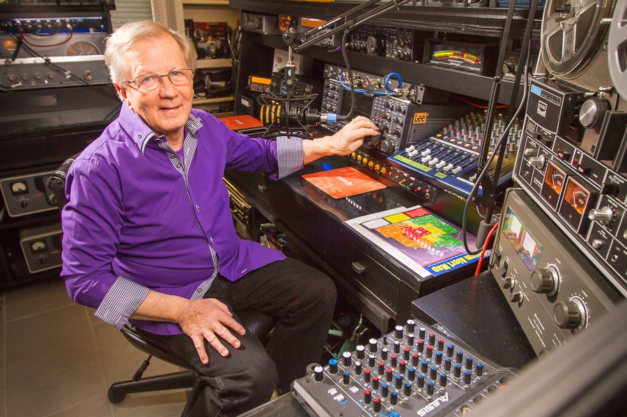
SCIENCE of AUDIO Bob Heil, K9EID

Slide 2
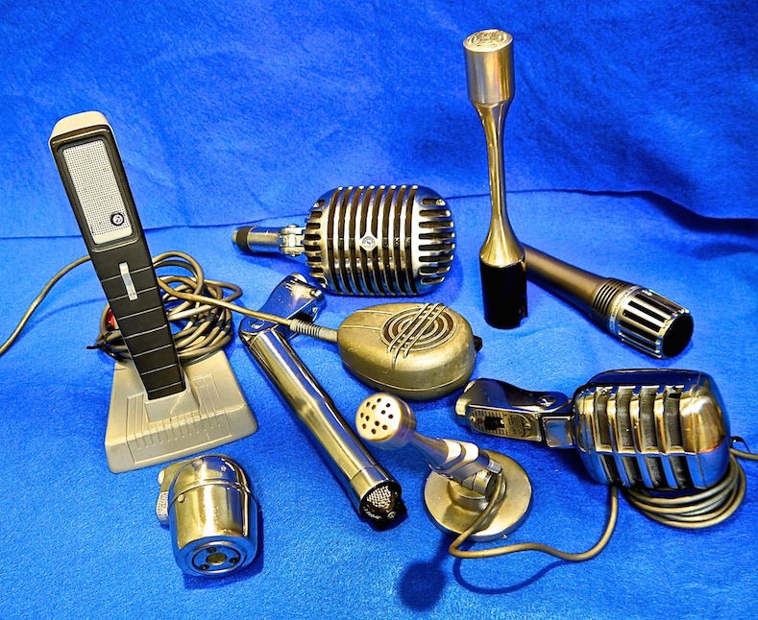
AMATEUR RADIO HAD NO DEDICATED MICROPHONE
We only had microphones designed for public address or home recording.
We were trying to cut pileups and noise with flat response, mushy sounding microphones

Slide 3
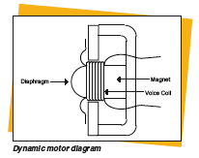
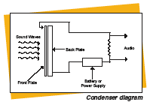
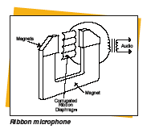
TYPES of MICROPHONES
Dynamic
Electret
Condenser
Ribbon
Dynamic
Condenser
Ribbon

Slide 4
MICROPHONE CHARACTERISTICS
Frequency Response - Most Important
Proximity Effect - A blessing or a curse
Pattern - Pick up pattern is important
Rear Rejection - Most important but seldom
discussed

Slide 5
Microphone Pick Patterns
All microphones pick up audio
But not all the same
Some pick up from all angles
Others favor sound from one angle
Omni, Cardioid, Supercardioid patterns

Slide 6
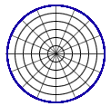
OMNIDIRECTIONAL pick up pattern

Slide 7
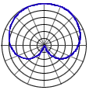
CARDIOID pick up pattern

Slide 8
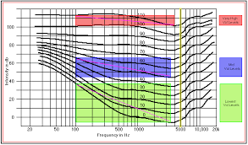
FLETCHER MUNSON CURVE
Humans do not hear all frequencies at the same sound level. Our ears are more sensitive to some frequencies than others.
In the 1930’s Dr. Fletcher and Dr. Munson of Bell Labs made this important discovery

Slide 9
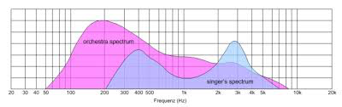
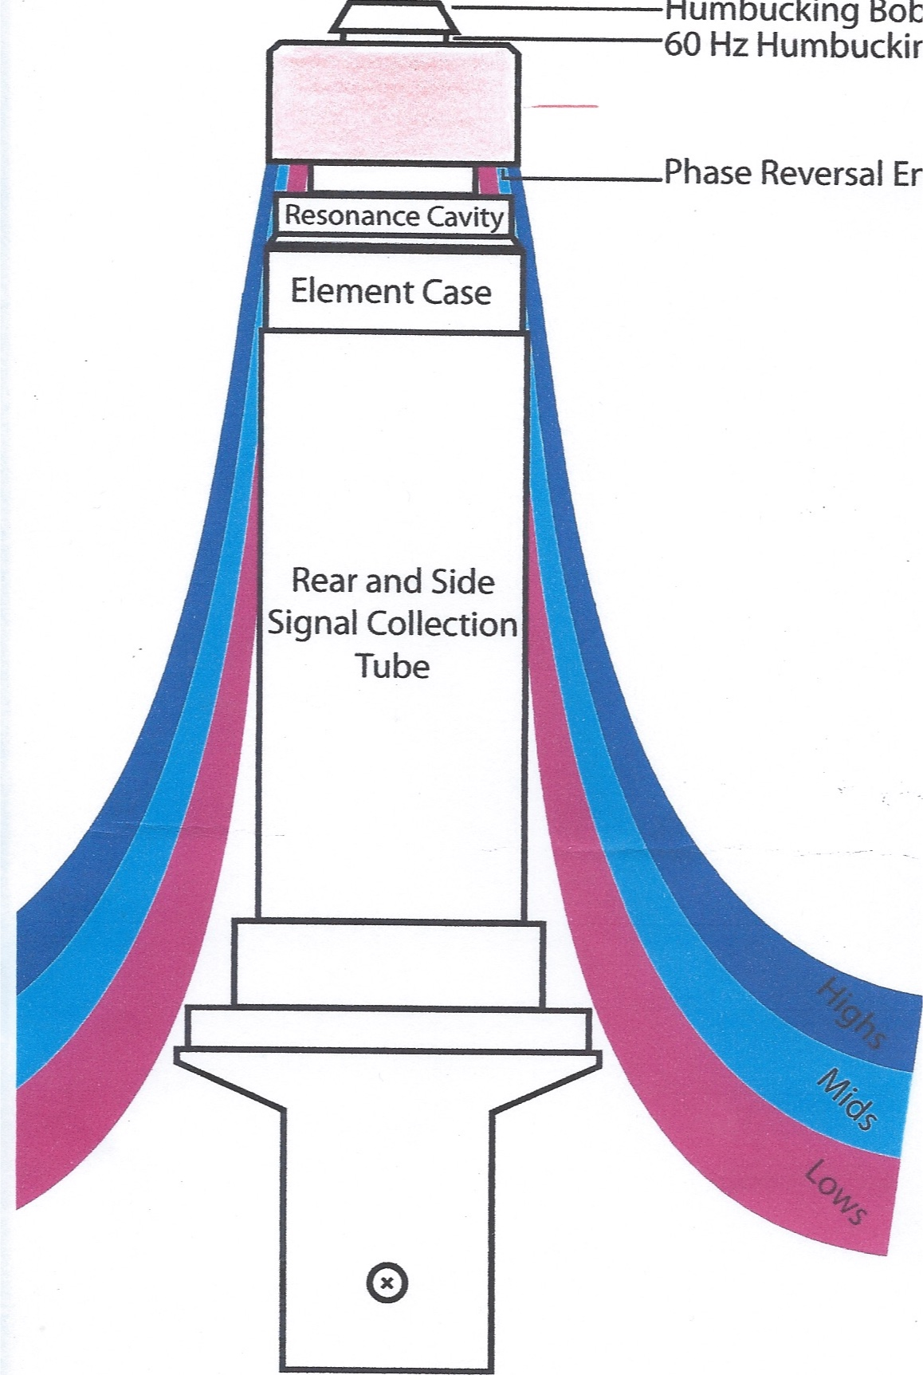
Tailored Response Audio WHY ?
In studying the Fletcher Munson curves and their many papers written at the early Bell Labs about what voice frequencies are most important, it was evident a tailored response audio was needed for Amateur Radio

Slide 10
Choose your frequency response requirement
Flat is NOT always (if ever) the ‘preferred’
Your ears certainly are not flat
A ‘shaped response’ with a boost in the correct place is the best for speech. Most microphones do NOT have this shaping
Heil Sound figured it out and did it

Slide 11
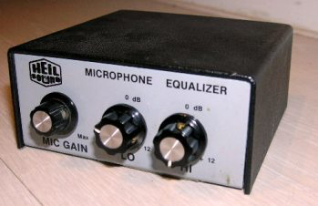
HEIL EQ 200 forever changed Amateur Radio audio
In 1982, Heil Sound changed the Amateur Radio industry with the introduction of the very first equalization system, the EQ 200.
It appeared in a DIY feature article in the July 1982 QST and received the cover award for that issue
It brought awareness to the importance of speech articulation
It was apparent that it should become a feature product for Heil Sound. Thousands were built and sold during the 80s

Slide 12
Amateur Radio Needed a Dedicated Microphone
Following the scientific studies of Dr. Fletcher and Dr. Munson
After two years of experimenting and using the EQ 200 equalizer it was easy to determine the exact response we needed to cut through the pileups and noisy conditions
Heil tailored response elements were born

Slide 13
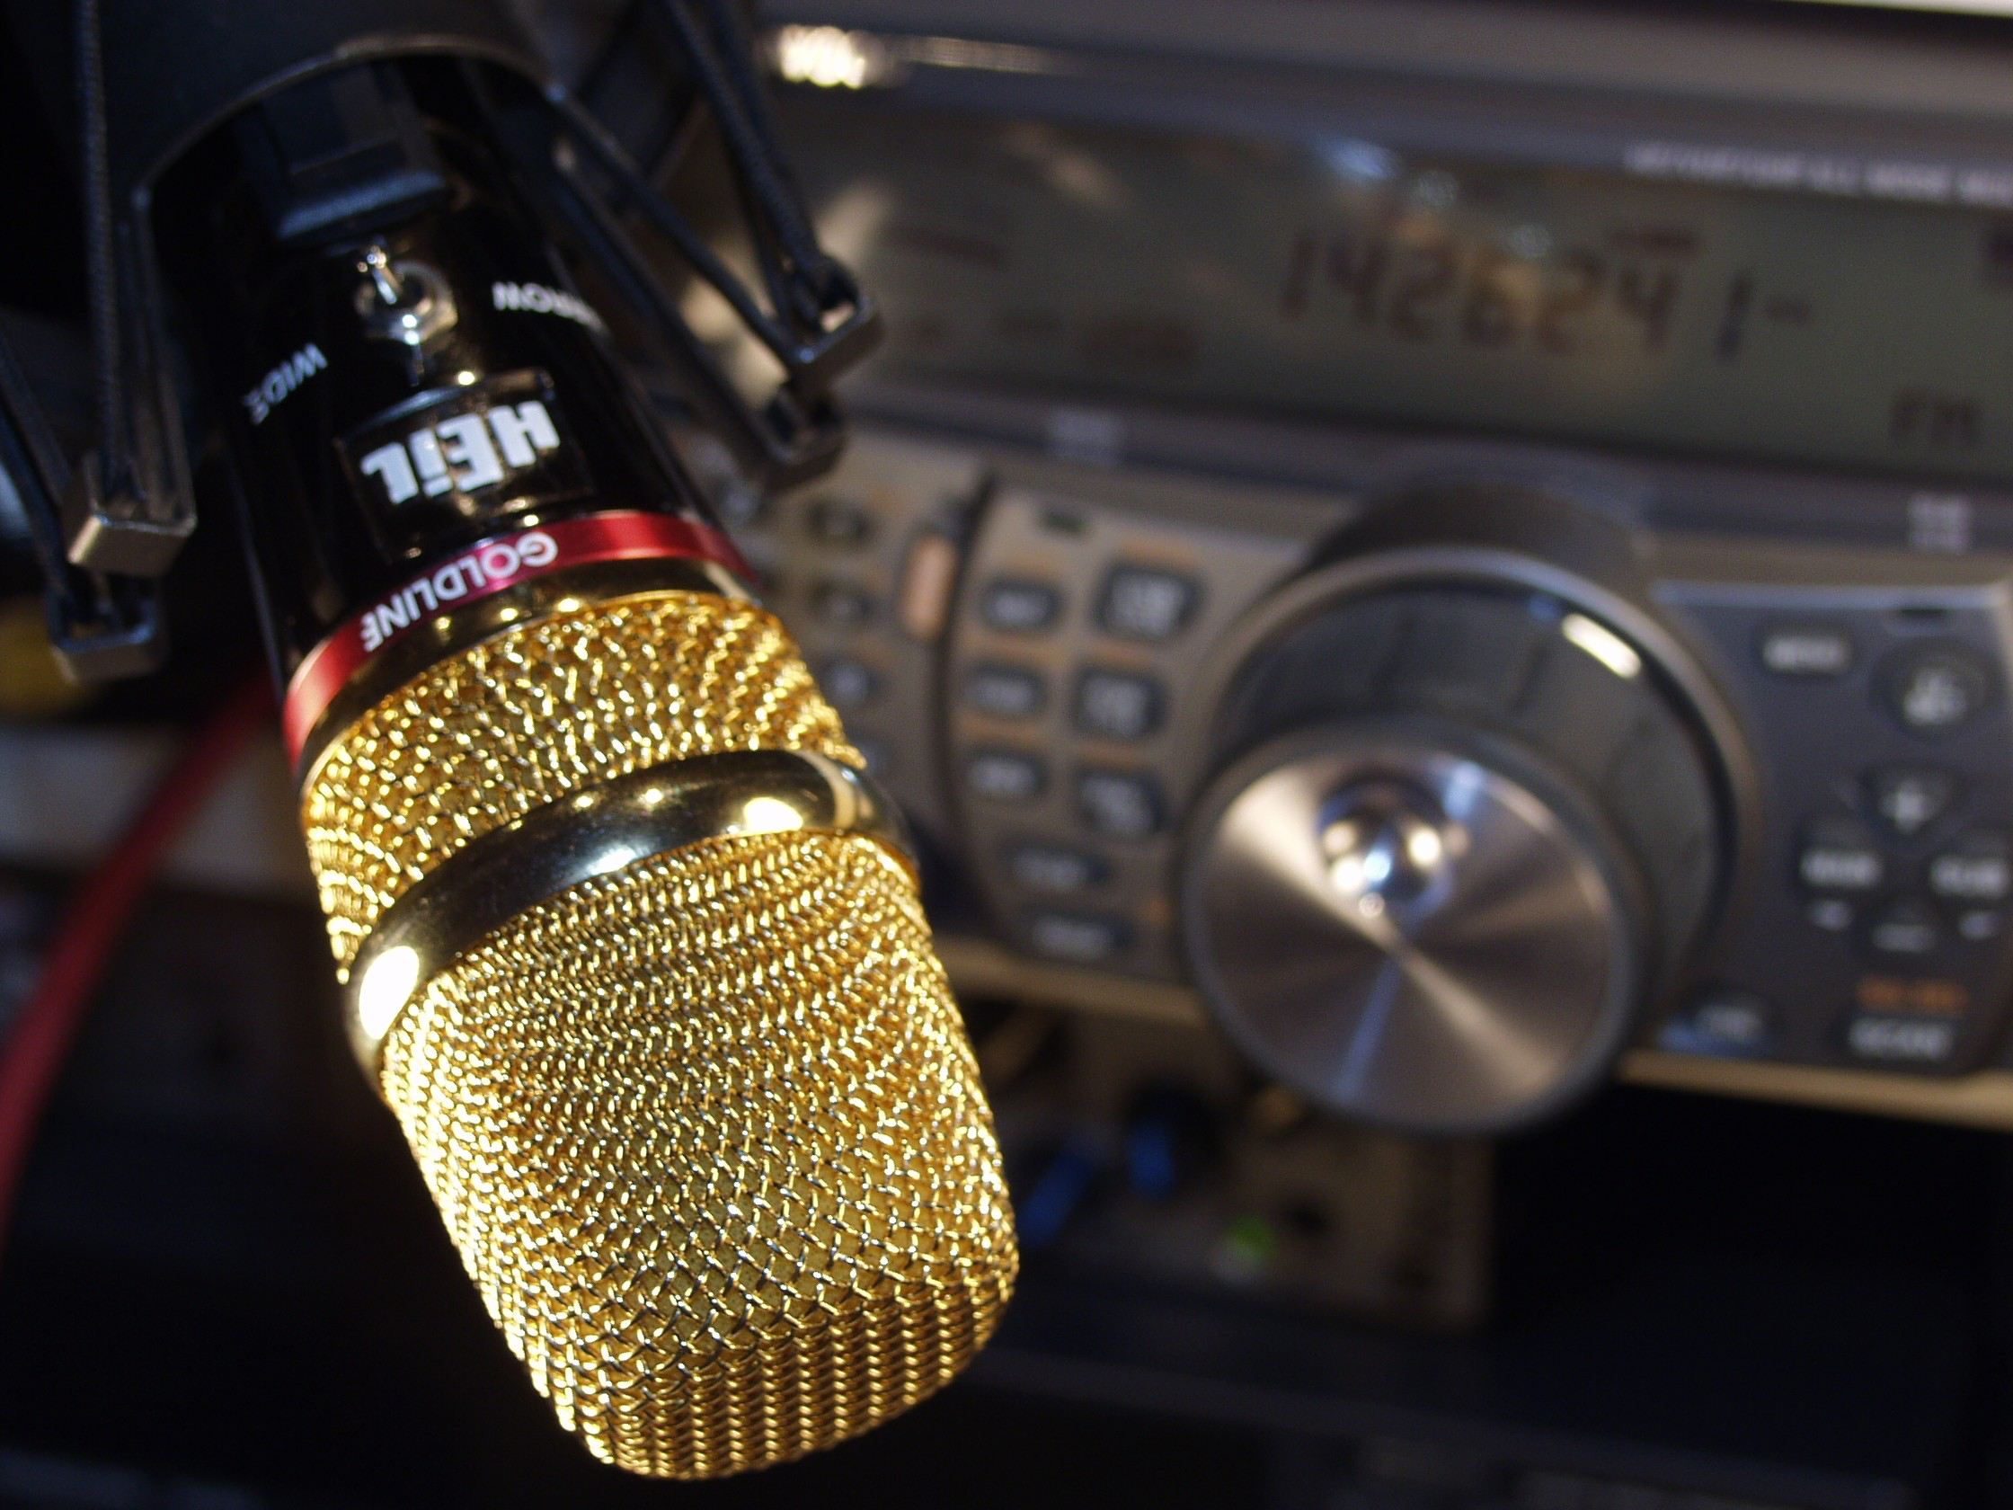
It Changed the audio world

Slide 14
The Heil GOLDLINE
The dual element Goldline has brought great audio performance to ham radio – worldwide
The first microphone designed for Amateur Radio
Each element addresses the importance of speech articulation with a rise at 2K to 3K
The full range element 50 Hz – 16 kHz with a 4 dB rise in the 2K – 3K region.
The Narrow (dx) element has a response of 200Hz to 8k with a 10 dB rise at 2 to 3K
……with great rear rejection to reduce room and blower noise

Slide 15
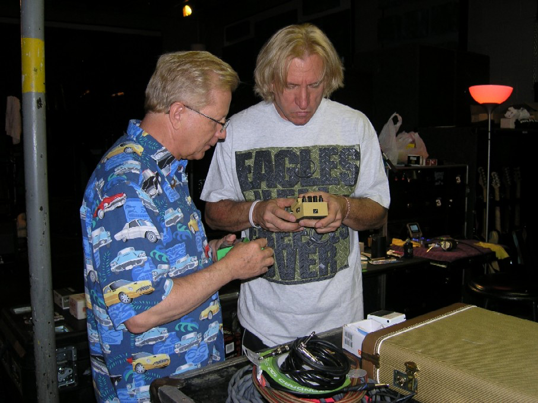
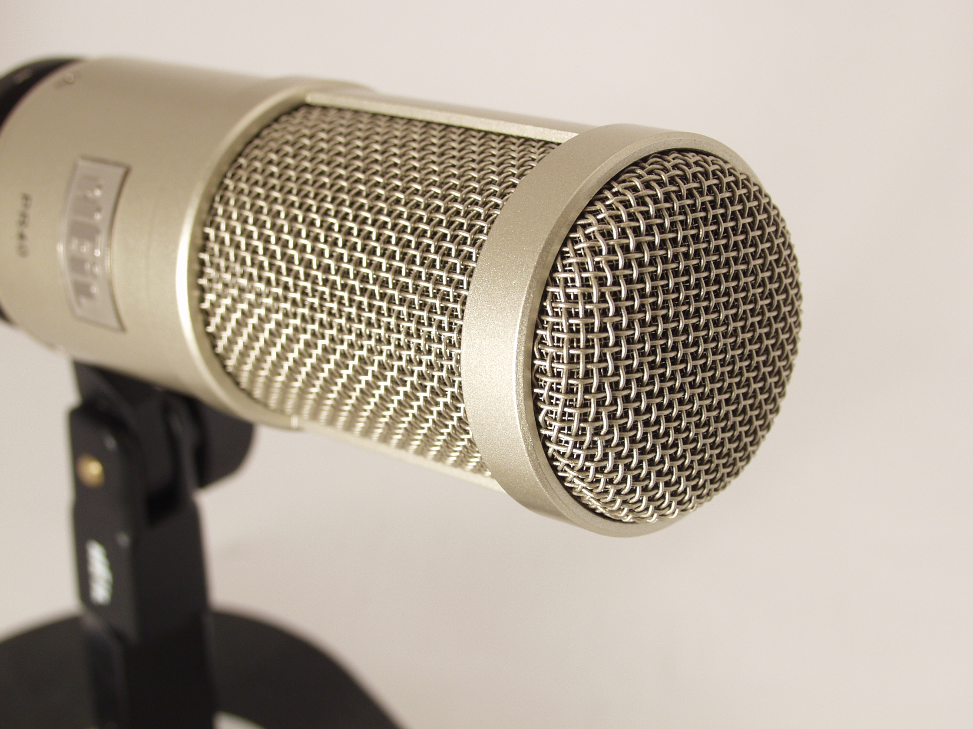
Then Joe suggest something better - The PR 40 was born
Two hams with good ears and a soldering
iron figured it out

Slide 16
The specifications
Widest frequency range 28Hz. To 18kHz. with a + 4dB rise at 2.4 kHz- 5kHz producing great articulation.
trademarked Heil rear rejection of -40dB.

Slide 17
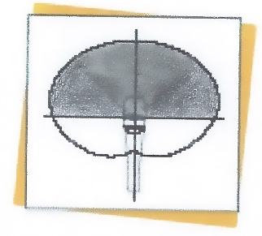
The HEIL PATTERN Omni front -40 dB rejection
OMNI front pattern allows you to move about freely
The Heil Pattern hears nothing from the back

Slide 18
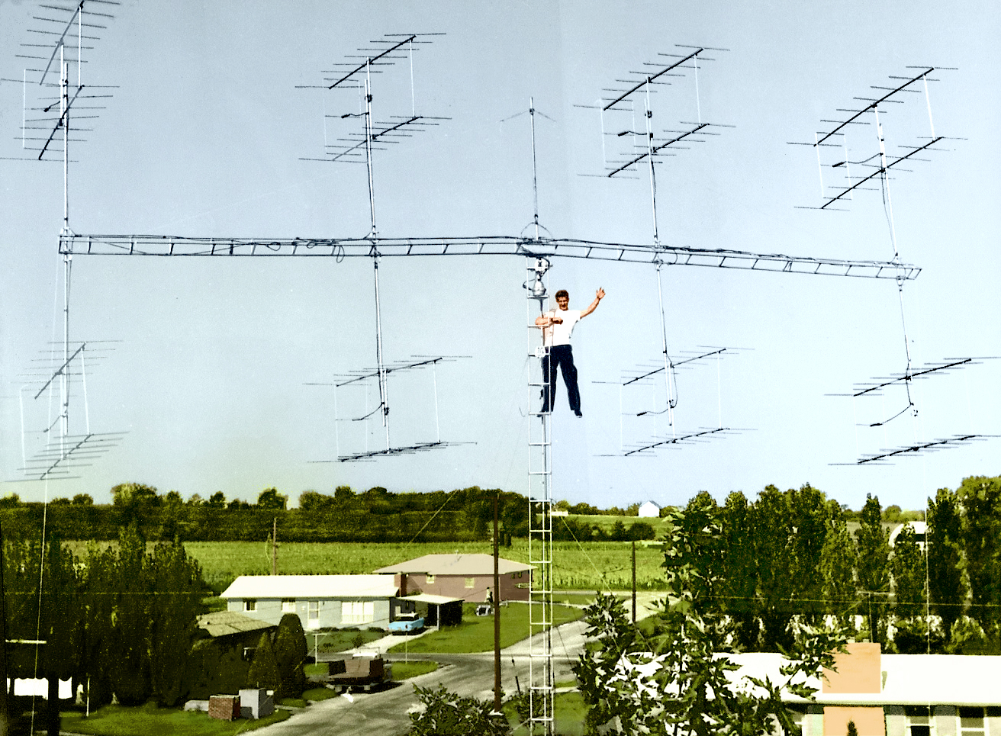
HOW DID WE DID THIS? It’s all about phasing
…….and I learned it from lots of antenna experiments during me early ham radio days

Slide 19
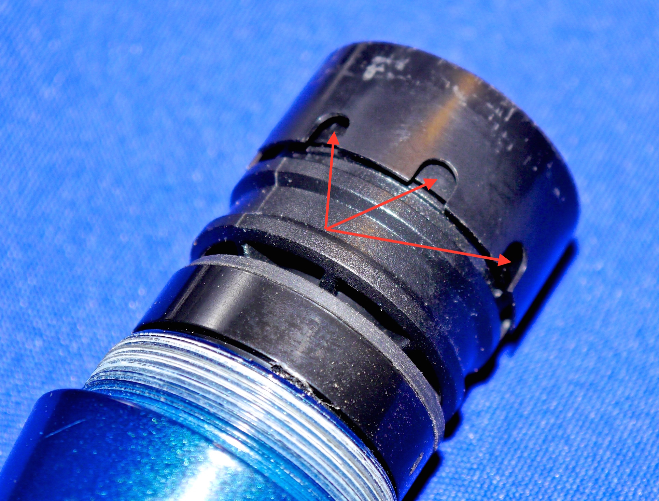
It’s All About the Heil ‘Collection Tube’
While all others have a few small holes around the side to receive unwanted rear info
That is not enough for good rear rejection

Slide 20
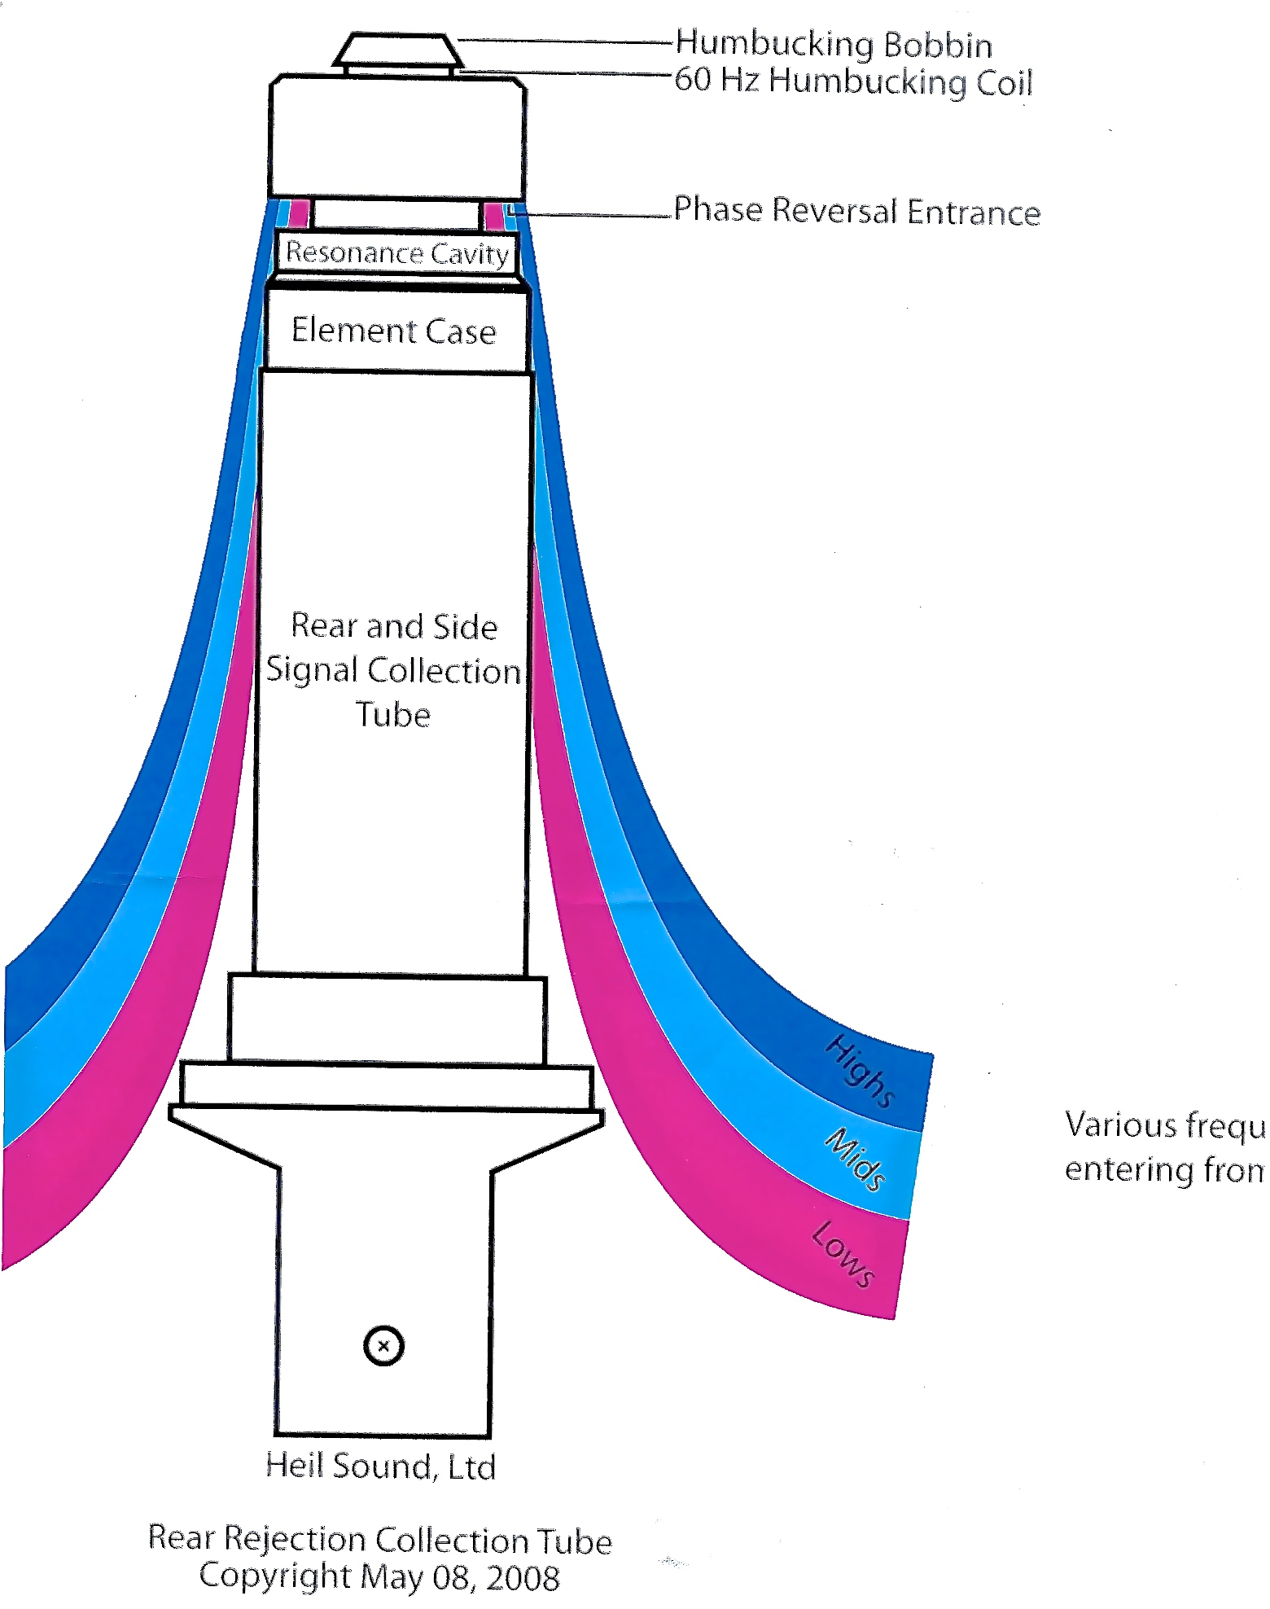
HEIL SOUND developed their ‘COLLECTION TUBE’

Slide 21
What is a ‘Humbucking coil’ ?
A coil of wire, tuned to 60Hz is wired across the voice coil – out of phase so if the microphone is passed in front a monitor screen that emits noise, it cancels.
A necessity for broadcast studios

Slide 22
DESIGN DETAILS
All Heil microphones are much more than a ‘matching’ (painted same color) microphone
Attention is paid to Transient Response – the ability to respond to rapidly changing speech levels and response.
Better dynamic range – being able to handle SPL (sound pressure) of 145 dB.
Serious -40 dB rear rejection

Slide 23
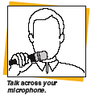
It all starts at the Microphone !
An audio chain is only as good as its weakest link.
We start with a properly designed microphone for the proper application
Apply Proper microphone technique

Slide 24
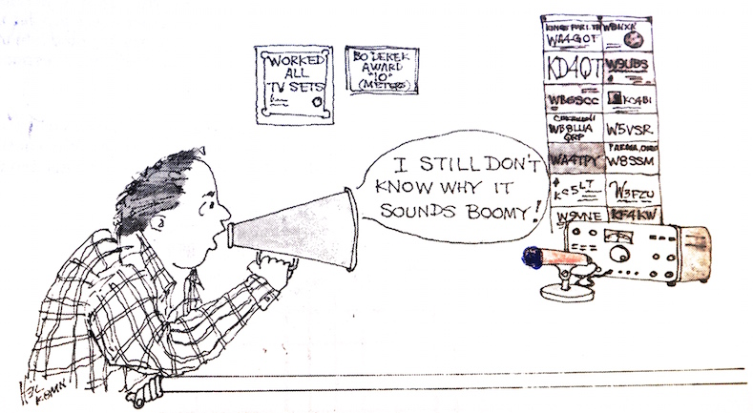
NEVER BE MORE THAN 2” FROM THE MICROPHONE

Slide 25
Place that microphone correctly
Forget the usual desk stand that you sit back three feet and address the microphone…no!
Oh, I forgot – it’s “matching”
Desk stands allow you to be too far away.
Never be more than 2”
Booms are the answer
….or desk stands WITH booms ! PR 10

Slide 26
So Many Reasons……
You loose dynamic range
You loose transient response
You loose speech articulation
Scientific fact – every time you double the distance from your microphone you loose SIX dB! Think about that.
To ‘try’ and make that up you ‘crank up’ the gain
The result ? You sound like you’re in a barrell

Slide 27
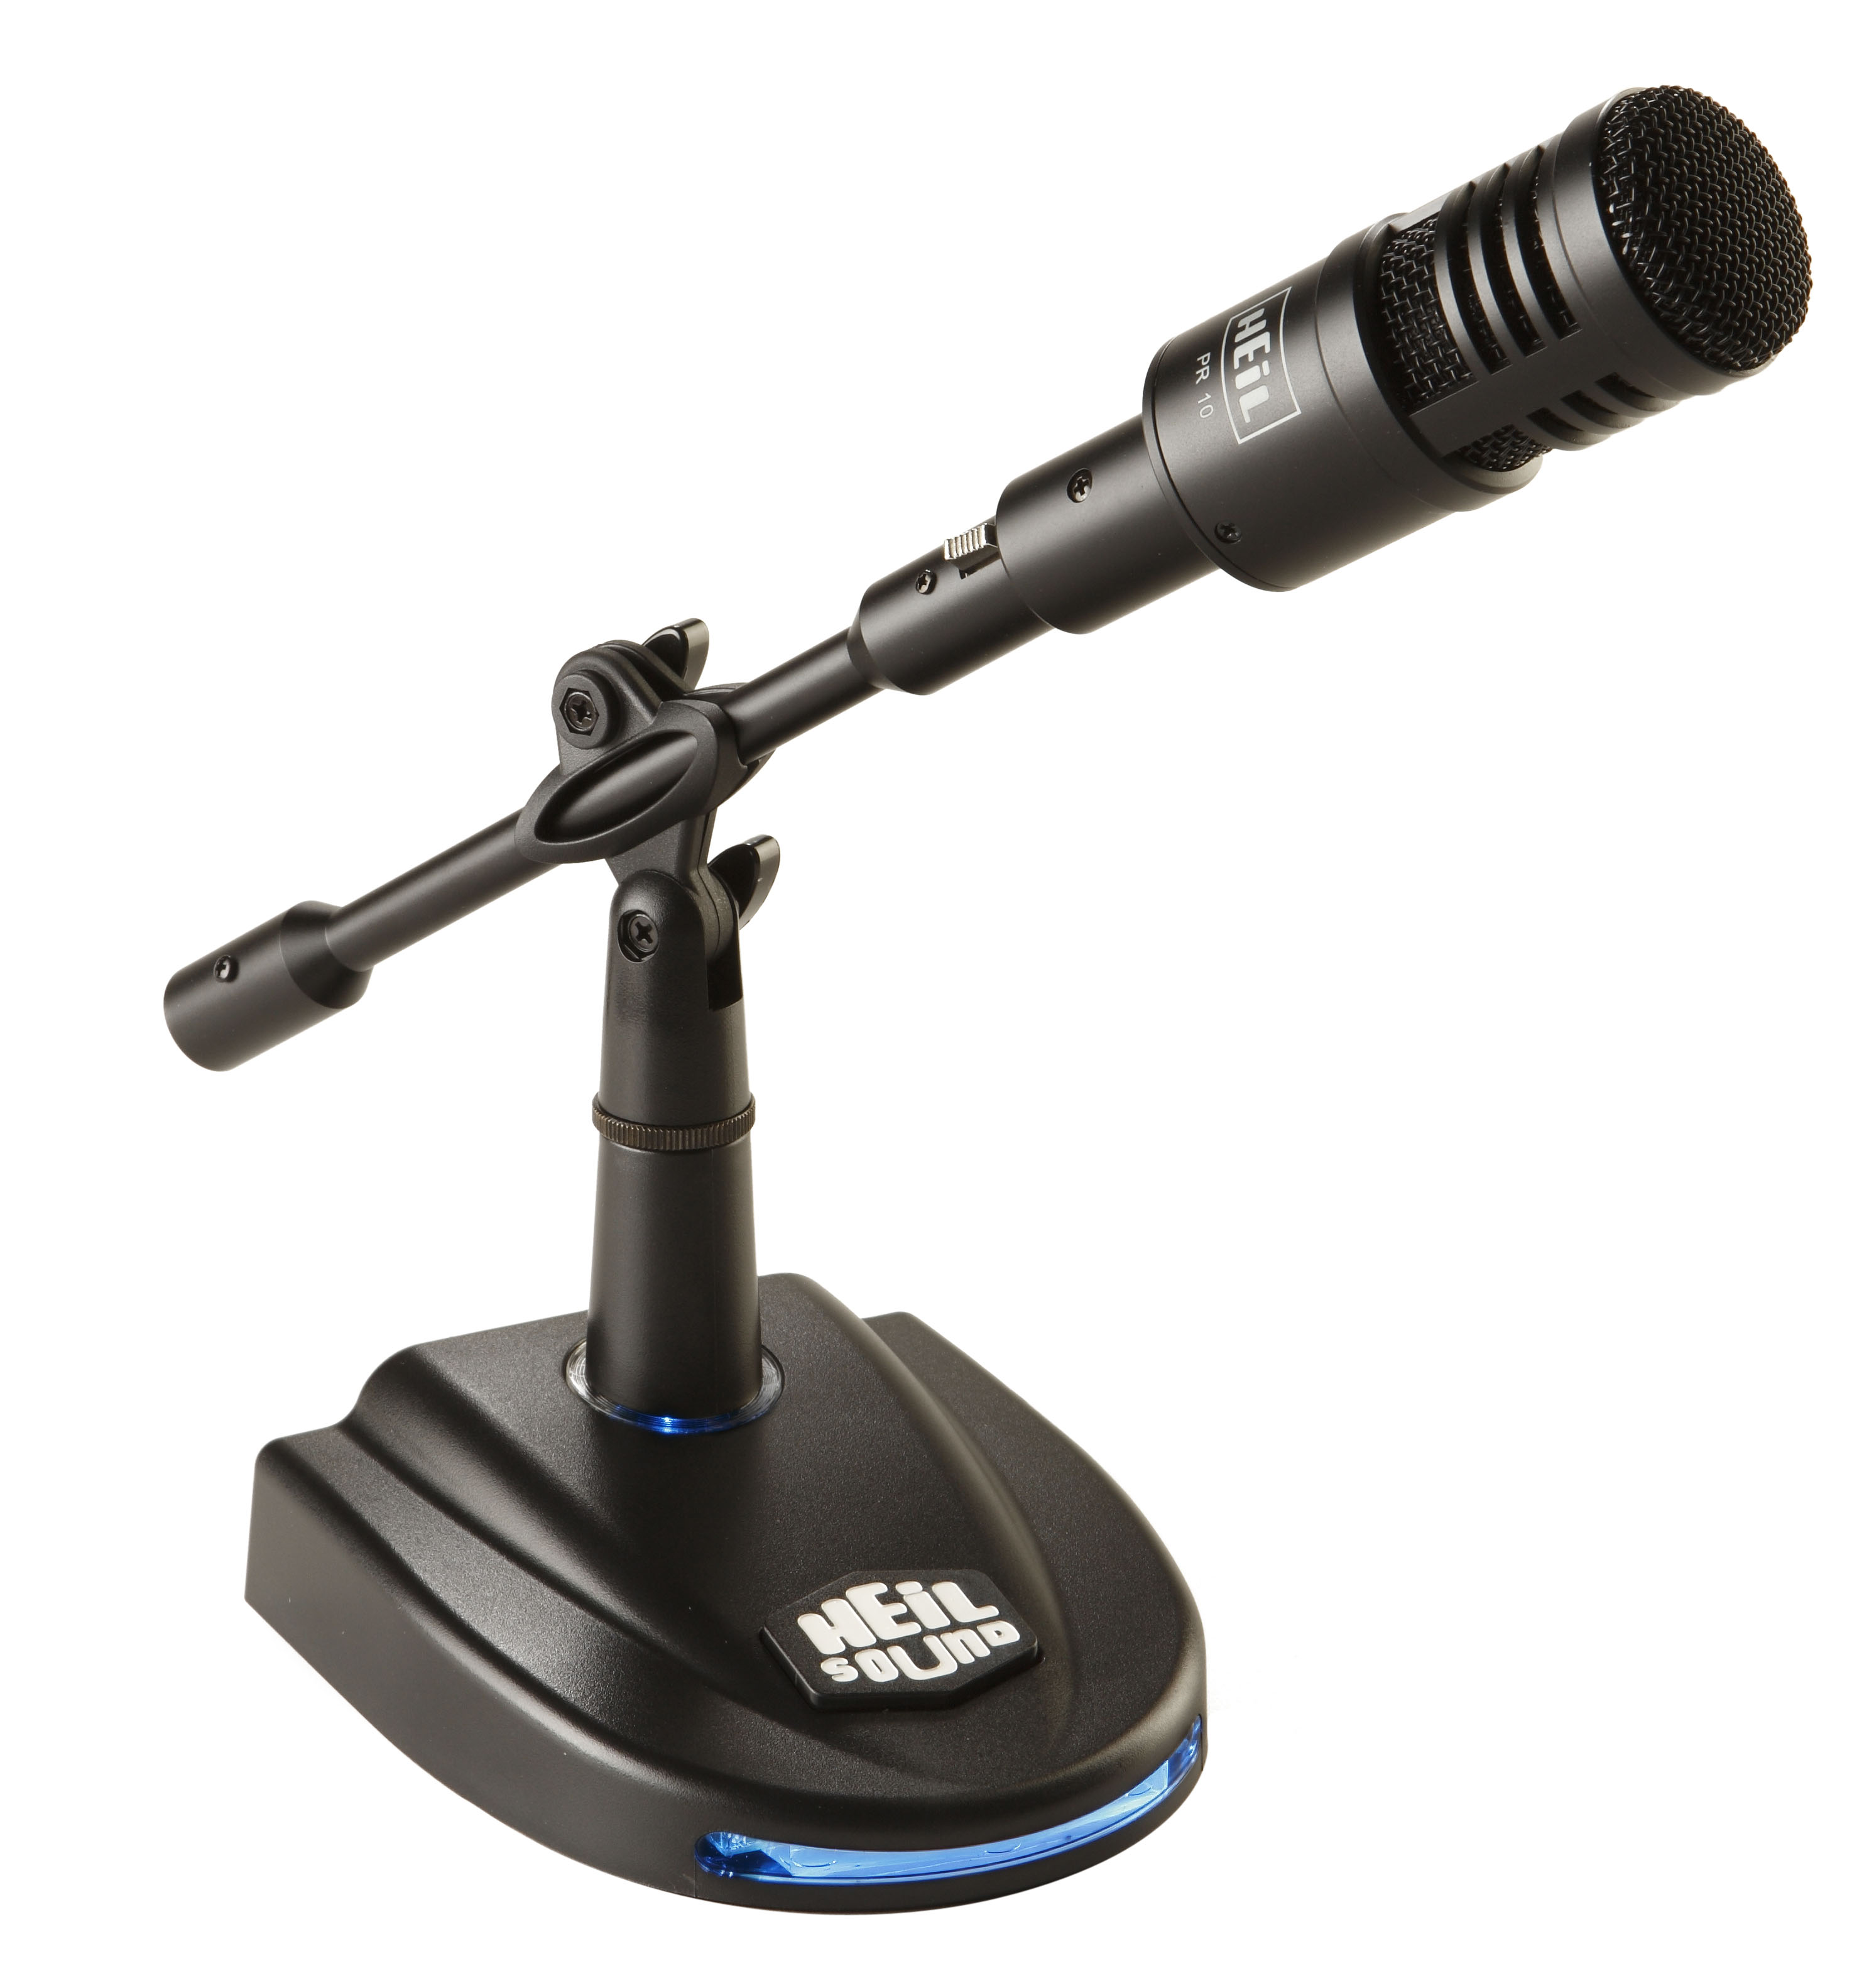
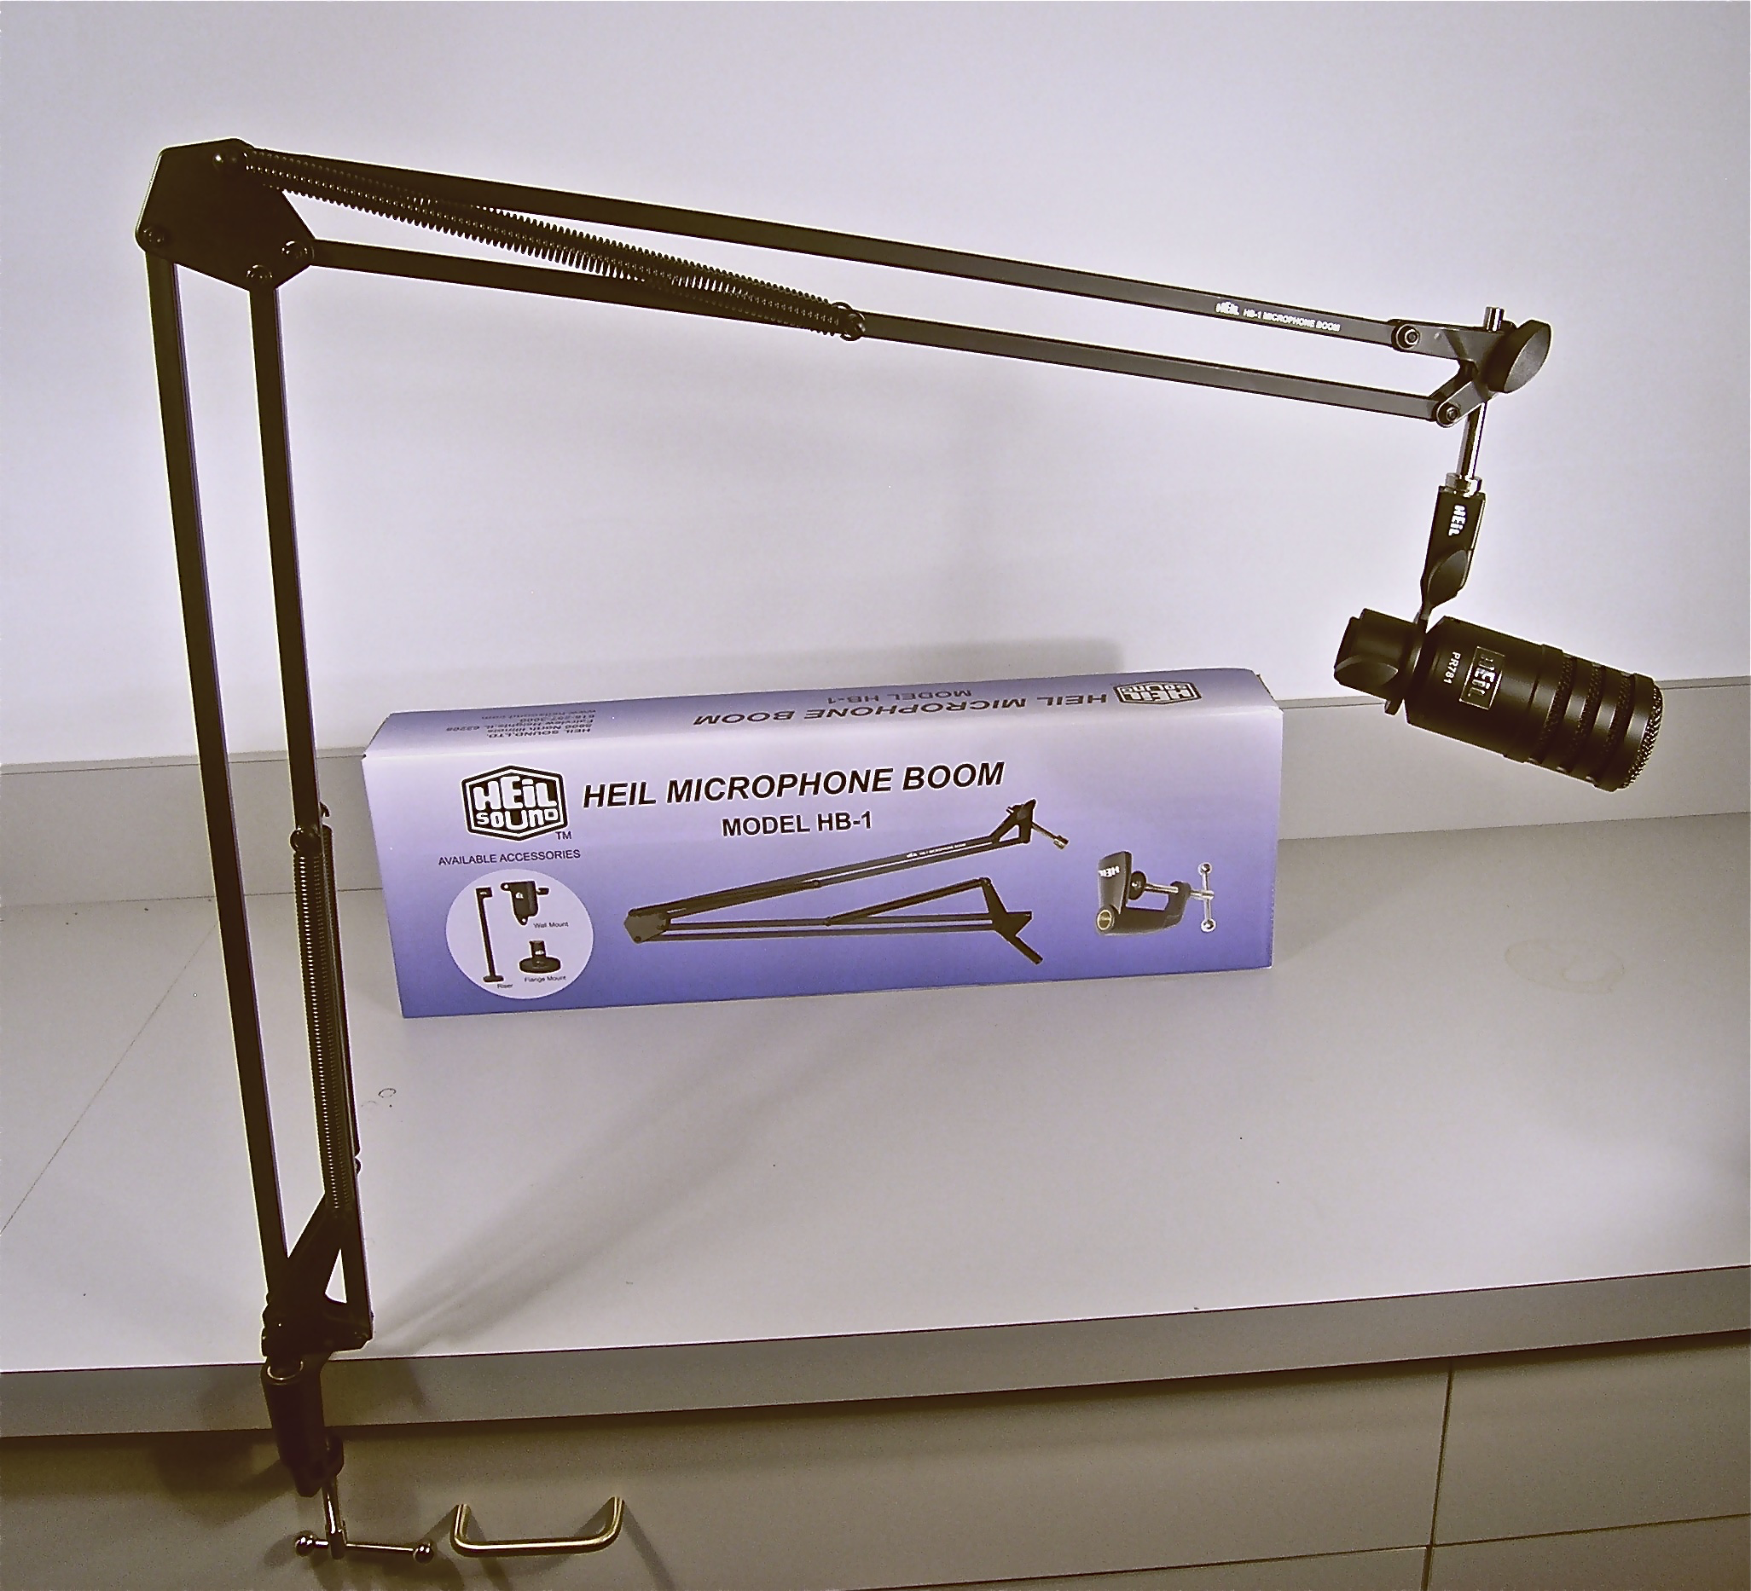
The answer -
The Heil PR 10 package HB-1 or PL2 T boom

Slide 28
PROPER ADJUSTMENTS are crucial
Each transmitter has a different mic input.
Different pre amp gains and audio response.
Different types of operation requires very different equalization. Rag Chew, DX, nets
Full Response mics don’t make it for DX
Narrow (DX) mics are not ‘ragchew’ popular
Monitor yourself through a second receiver

Slide 29
And then there is iCOM !
Dynamic mics will usually not work. Not enough gain to drive the low level inputs usually found on early models. (pre PRO)
Dynamic mics work beautifully on all of the Pro series, 7600,7700,7800
BEWARE ! All iCOM has +8 volts superimposed on mic line
iCOM has several different mic inputs.
‘Early’ iCOM (pre PRO) mic inputs are -15dB
Very early iCOM had their mic pre amp inside the microphone, not in the transmitter (720,30,40) Finally put it inside with the iC735

Slide 30
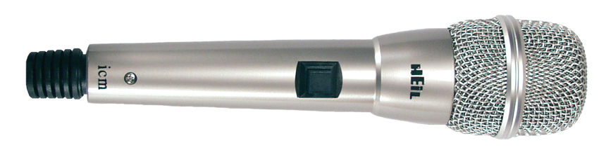
The iCOM ‘fix for low level inputs
In working with iCOM, we designed the perfect microphone for those low level inputs
The ‘iCM’

Slide 31
The HEIL ‘iC’ for iCOM only
Used in our iCM microphone and all headsets built exclusively for low level inputs.
Works great on all late model iCOM as well on Elecraft K2 and K3 (turn on the phantom power) No other transmitter furnishes phantom power. iCOM and Elecraft.
It is a full range element but accepts EQ easily to tailor for DX or contest work as well as full range casual rag chew operation

Slide 32
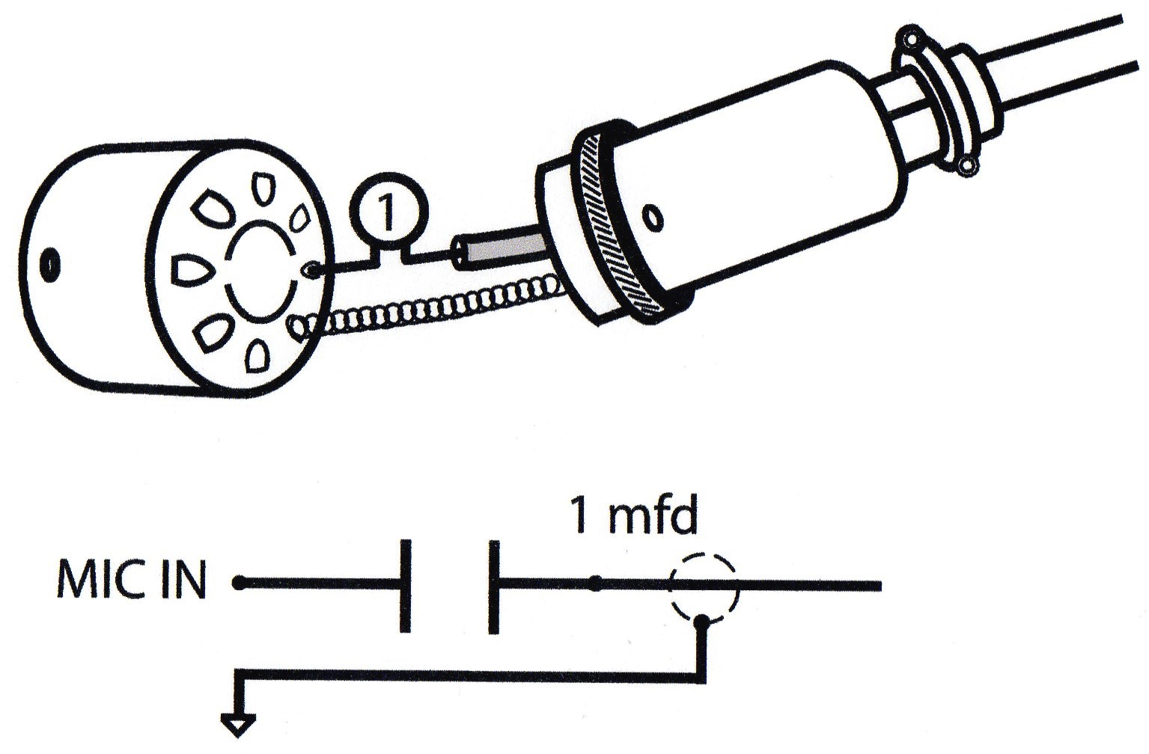
Decoupling the iCOM inputs
Always beware that every iCOM has +8 volts d.c. superimposed onto the mic line. It’s called Phantom Power
Audio is A.C. and carried down the mic line to the input.
On the same mic lead, the + 8volts is fed back up that line to power the electret element needed on some iCOM
Always be sure to decouple that lead with a one mFd capacitor

Slide 33
The microphone is only one half of the audio in your station
Now you have the microphone all set, what about receive audio?
All of the transceivers have very poor receive audio components and specifications. (yes, even the $10K ones !)
When have you ever seen ANY receive audio specifications? Nope, they don’t publish them
Why? Most are producing 1 watt @ 10% distortion !
And then you plug in the ‘matching’ (painted the same color) 50 cent speaker. True
The listening fatigue is awful – but you never think of it
A new world is in front of you

Slide 34
THE answer to a great receive system
Small mixer (many out there) driven from the line out signal in your accessory jack
The mixer drives the pair of JBL Control 2P
Most of the mixers have 2, some 3 way EQ
JBL has two 35 watt @ .5 (point 5) distortion
So many things you can do with this set up
Also is one incredible headphone amplifier

Slide 35
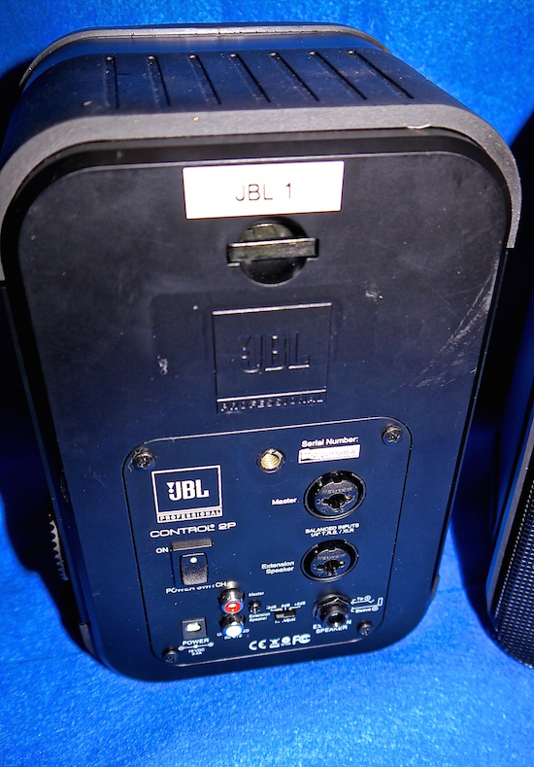
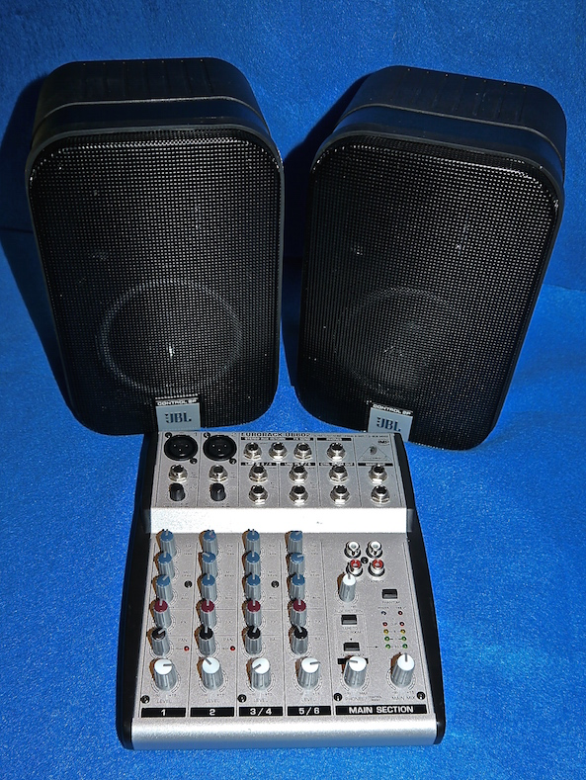
All done for under $200.00
Berhinger UB 802
JBL Control 2P

Slide 36
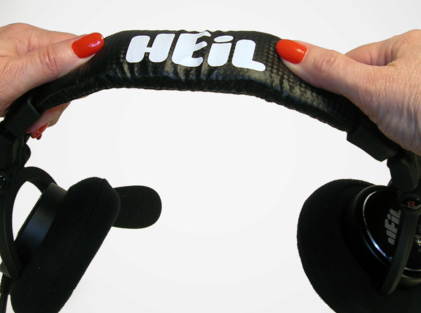
Headphones, Headphones, Headphones……….
Heil Sound continues to lead the headphone industry since 1985
Many choices for you
The PRO 7 is the ultimate for serious contest or DX work as well as casual operation
Comfort is important. The steel band inside the padded top can be adjusted for more or less pressure

Slide 37
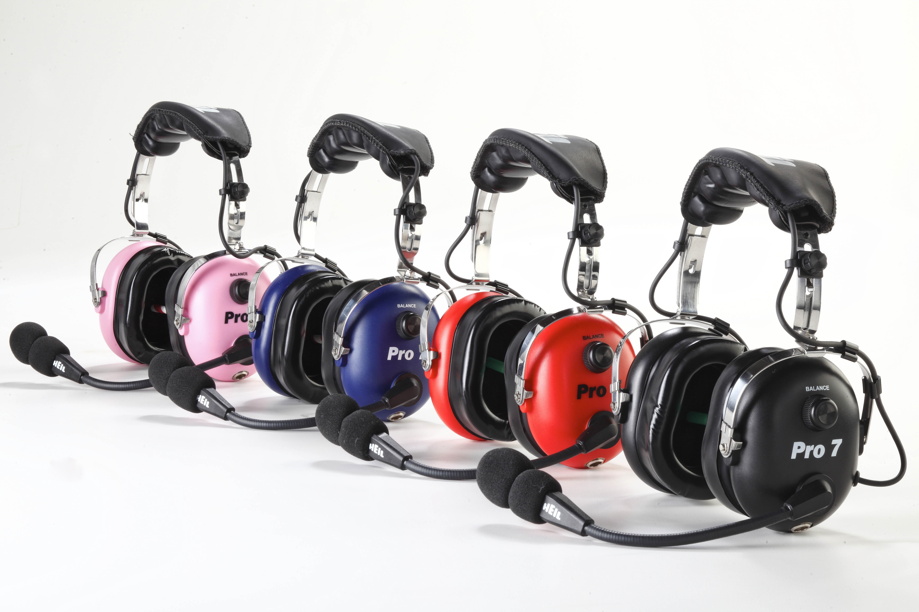
PRO 7 The Next Generation of headsets The choice of serious DX Pedition and contest ops
* Extremely Comfortable
* Specially designed 2” foam Gel ear pads
* -26 dB of outside noise cancelling
* Exclusive Heil speaker Phase reversal
* Two detachable cables…coil or straight
* Military grade fiber reinforced cables
* Interchangeable microphone elements
* Features the HC 7 articulate dynamic or
Heil ‘iC’ electret for early iCOM
* 40 mil speakers in acoustically tuned cavities*

Slide 38
The Heil PRO 7 The new Boss in Headsets

Slide 39
LISTEN, LISTEN!
Remember this important audio fact:
LISTENING is a MENTAL process
HEARING is a PHYSICAL process
Make sure you are mentally evaluating what you hear when adjusting your station audio

