Slide 1
Why Cabrillo is Important to You
Randy Thompson, K5ZD
Notes:
50 Minutes
Original title - “Getting the most out of your station – Contest operating strategies”

Slide 2
Purpose of this Session
History of the Cabrillo log specification
Cabrillo log file basics
How the log submission process works

Slide 3
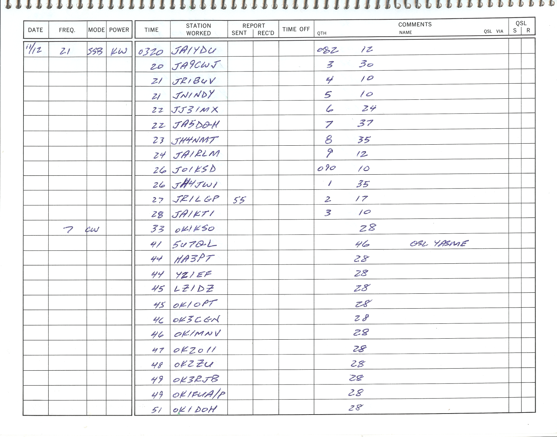
“Contest Log” – 1980

Slide 4
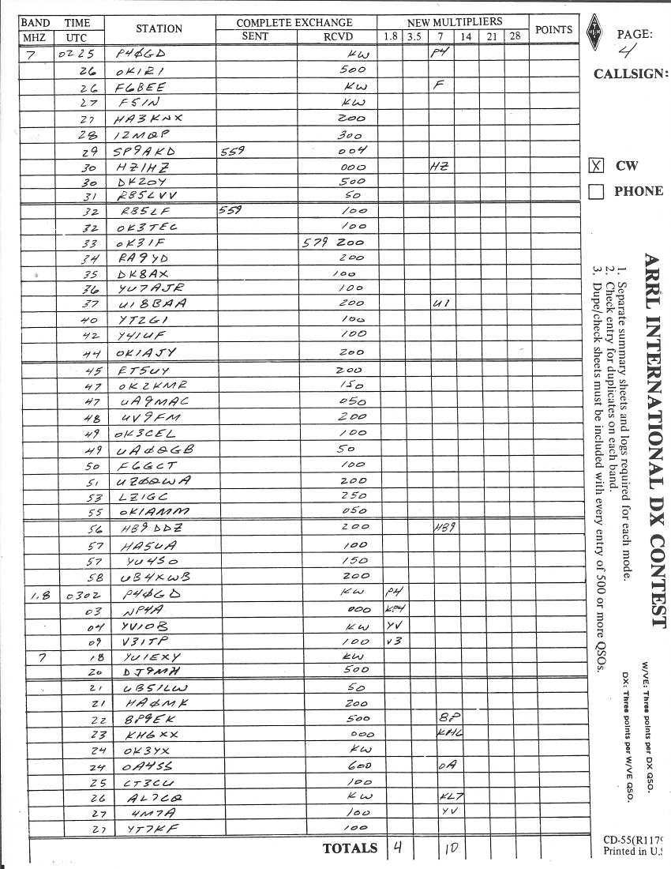
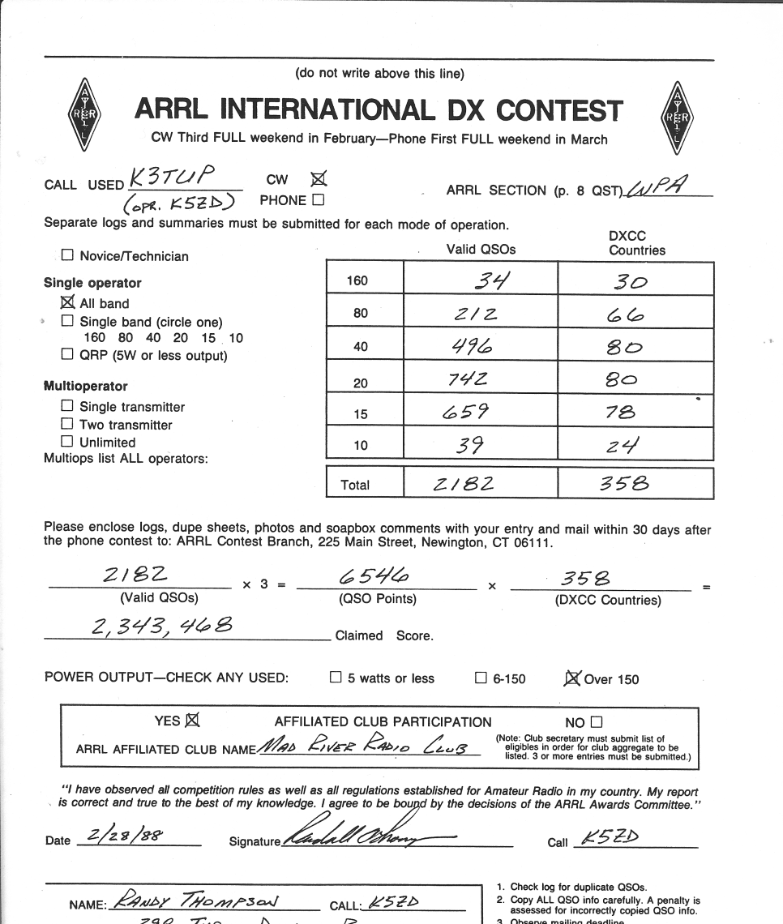

Contest Log - 1986

Slide 5
CQWW Paper Log Processing
Receive logs (4-8 weeks in mail)
Divide logs by category
Mail logs to log checker for that category
Checker reviews logs and marks scoring changes on summary sheet
Sends summary sheets back to Director
Mail Log
Mail Log
Director
Mail Summary
Checker
Director
Entrant

Slide 6
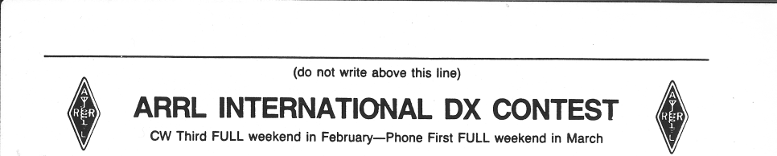
Paper Log Results
Director collects all summary sheets
Write correct line score info “above this line”
Store summary sheets in results order
When final, deliver to typesetting department (in results order)

Slide 7
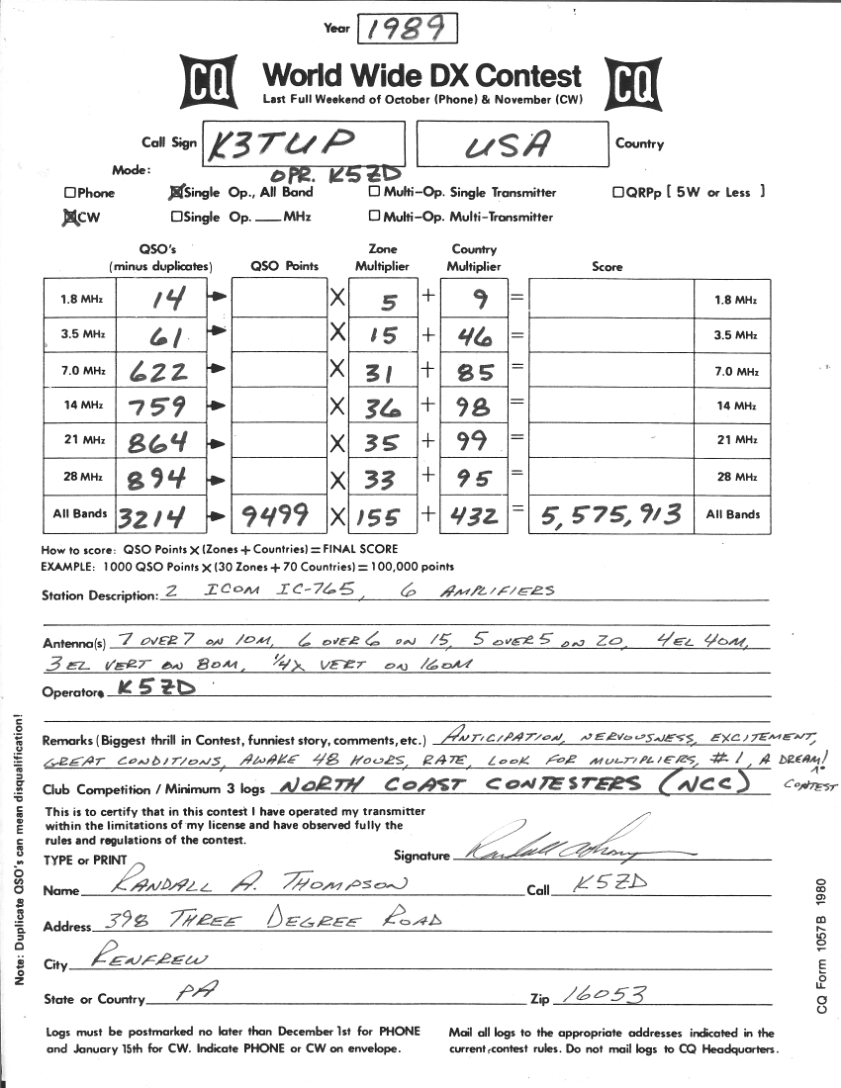

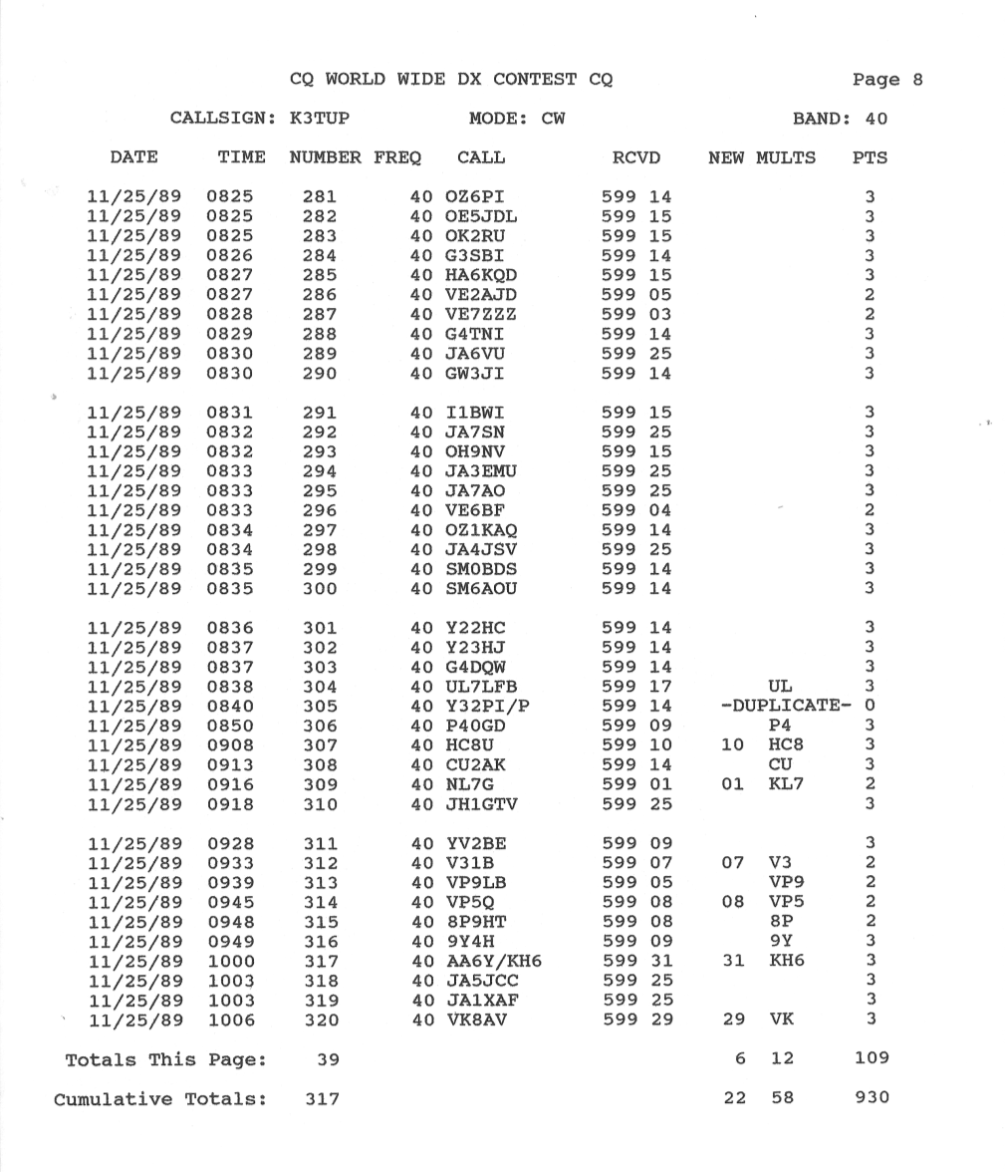
Contest Log – 1989

Slide 8

We need a better way!
Electronic Log Submission

Slide 9
Requirements
What makes up a contest log?
What data do we need for each QSO?
What data is needed from the summary sheet?
Formatting?
Human readable?

Slide 10
QSO Data
3/9 21 0050 JH3DPB 59 TX 59 KW
JA7YAA KW
VS6BG 100
55 KH6ND KW
ZL1ANJ 150
28 HC8A KW
OA4ANR 100
0100 KL7RA KW
14 VP2E KW
Easy for humans to understand, but not for computers

Slide 11
ARRL Format “V1” – 1993
ARRL Suggested Standard File Format For Submission of Contest Log Data
All files must be in standard ASCII format.
All files must be on an MS-DOS formatted disk, 3.5 inch (720-KB or 1.44-MB) or 5.25 inch (360-KB or 1.2-MB).
The diskette label should clearly indicate the call sign used, contest name, entry class, and date of the contest.
A paper summary sheet is required of all logs, either an official ARRL summary sheet or a close facsimile with a signed contest participation disclaimer.
All diskettes become the property of the ARRL and are not returnable.
All QSO data must appear in each line, aligned by columns…
SAMPLE FILE:
20 CW 15/02/92 0001 UW9WA 599 MA 599 100 * 3 20 CW 15/02/92 0001 UZ1AWJ 599 MA 599 200 * 3 20 CW 15/02/92 0002 OZ1IKW 599 MA 599 100 * 3 20 CW 15/02/92 0002 YU1GN 599 MA 599 100 * 3 20 CW 15/02/92 0003 UZ9XWT 599 MA 599 100 3 20 CW 15/02/92 0003 UZ4WWA 599 MA 599 200 3 20 CW 15/02/92 0004 OZ4UN 599 MA 599 500 3 20 CW 15/02/92 0005 OK1ALW 599 MA 599 KW * 3 20 CW 15/02/92 0005 DF5UL 599 MA 599 KW * 3 20 CW 15/02/92 0005 YU7XM 599 MA 599 100 3 20 CW 15/02/92 0006 RH0E 599 MA 599 300 * 3 20 CW 15/02/92 0006 YO7BGA 599 MA 599 006 * 3
Source: http://lists.contesting.com/_cq-contest/1993-02/msg00078.html

Slide 12
Next Steps
Logging software authors had embraced ARRL Format V1
But, floppy disks and paper summary sheets wasn’t making things better
In 1998 K5FUV at ARRL invited Trey, N5KO, to investigate electronic log submission

Slide 13
Other Possible Formats
ADIF
Late response from developers
DARC Contest Data Exchange Format "STuetzerbach Format" – STF
Discovered too late
XML
Too new and not easy to read

Slide 14
ARRL Format V2
Needed summary sheet data to put complete log submission in one file
CQ Magazine would not accept file format with ARRL in the name

Slide 15

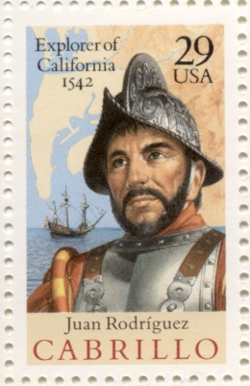

Cabrillo Log Format – 1999
Name of Portuguese explorer whose name was popular near where Trey lived!
1999-08-16 Cabrillo V2.0 recognized by ARRL and CQ

Slide 16
Cabrillo Basics
Sample Log File
START-OF-LOG: 3.0
CALLSIGN: AA1ZZZ
CONTEST: CQ-WW-SSB
CATEGORY-OPERATOR: SINGLE-OP
CATEGORY-ASSISTED: NON-ASSISTED
CATEGORY-BAND: ALL
CATEGORY-POWER: HIGH
CATEGORY-MODE: CW
CATEGORY-TRANSMITTER: ONE
CATEGORY-OVERLAY: ROOKIE
LOCATION: WMA
CREATED-BY: SuperLogger v1.0
NAME: John Smith
ADDRESS: 100 Main St
ADDRESS-CITY: Uxbridge
OPERATORS: K5ZD
SOAPBOX: Put your comments here.
QSO: 3799 PH 2000-10-26 0711 AA1ZZZ 59 05 K9QZO 59 04 0
QSO: 14256 PH 2000-10-26 0713 AA1ZZZ 59 05 P29AS 59 28 0
QSO: 21250 PH 2000-10-26 0716 AA1ZZZ 59 05 4S7TWG 59 22 0
QSO: 28530 PH 2000-10-26 0721 AA1ZZZ 59 05 JT1FAX 59 23 0
QSO: 7250 PH 2000-10-26 0751 AA1ZZZ 59 05 WA6MIC 59 03 0
END-OF-LOG:
The beginning of each line is <LABEL>: followed by a space
Header
QSO Data

Slide 17
Cabrillo Basics
Sample Log File
START-OF-LOG: 3.0
CALLSIGN: AA1ZZZ
CONTEST: CQ-WW-SSB
CATEGORY-OPERATOR: SINGLE-OP
CATEGORY-ASSISTED: NON-ASSISTED
CATEGORY-BAND: ALL
CATEGORY-POWER: HIGH
CATEGORY-MODE: CW
CATEGORY-TRANSMITTER: ONE
CATEGORY-OVERLAY: ROOKIE
LOCATION: WMA
CREATED-BY: SuperLogger v1.0
NAME: John Smith
ADDRESS: 100 Main St
ADDRESS-CITY: Uxbridge
OPERATORS: K5ZD
SOAPBOX: Put your comments here.
QSO: 3799 PH 2000-10-26 0711 AA1ZZZ 59 05 K9QZO 59 04 0
QSO: 14256 PH 2000-10-26 0713 AA1ZZZ 59 05 P29AS 59 28 0
QSO: 21250 PH 2000-10-26 0716 AA1ZZZ 59 05 4S7TWG 59 22 0
QSO: 28530 PH 2000-10-26 0721 AA1ZZZ 59 05 JT1FAX 59 23 0
QSO: 7250 PH 2000-10-26 0751 AA1ZZZ 59 05 WA6MIC 59 03 0
END-OF-LOG:
MUST have Start-of-Log:
Number is version (2.0 or 3.0)
MUST have End-of-Log:

Slide 18
Cabrillo Basics
Sample Log File
MUST have callsign used in the contest
START-OF-LOG: 3.0
CALLSIGN: AA1ZZZ
CONTEST: CQ-WW-SSB
CATEGORY-OPERATOR: SINGLE-OP
CATEGORY-ASSISTED: NON-ASSISTED
CATEGORY-BAND: ALL
CATEGORY-POWER: HIGH
CATEGORY-MODE: CW
CATEGORY-TRANSMITTER: ONE
CATEGORY-OVERLAY: ROOKIE
LOCATION: WMA
CREATED-BY: SuperLogger v1.0
NAME: John Smith
ADDRESS: 100 Main St
ADDRESS-CITY: Uxbridge
OPERATORS: K5ZD
SOAPBOX: Put your comments here.
QSO: 3799 PH 2000-10-26 0711 AA1ZZZ 59 05 K9QZO 59 04 0
QSO: 14256 PH 2000-10-26 0713 AA1ZZZ 59 05 P29AS 59 28 0
QSO: 21250 PH 2000-10-26 0716 AA1ZZZ 59 05 4S7TWG 59 22 0
QSO: 28530 PH 2000-10-26 0721 AA1ZZZ 59 05 JT1FAX 59 23 0
QSO: 7250 PH 2000-10-26 0751 AA1ZZZ 59 05 WA6MIC 59 03 0
END-OF-LOG:
MUST have contest name specified by the sponsor

Slide 19
Category Information
V3.0 (preferred)
V2.0 (old)
Each descriptor has its own line
All lines must be included
All descriptors on one line
CATEGORY-OPERATOR: SINGLE-OP
CATEGORY-ASSISTED: NON-ASSISTED
CATEGORY-BAND: ALL
CATEGORY-POWER: HIGH
CATEGORY-MODE: CW
CATEGORY-TRANSMITTER: ONE
CATEGORY-OVERLAY: ROOKIE
CATEGORY: SINGLE-OP ALL HIGH
CATEGORY-OVERLAY: ROOKIE

Slide 20
Other Header Fields
Sample Log File
START-OF-LOG: 3.0
CALLSIGN: AA1ZZZ
CONTEST: CQ-WW-SSB
CATEGORY-OPERATOR: SINGLE-OP
CATEGORY-ASSISTED: NON-ASSISTED
CATEGORY-BAND: ALL
CATEGORY-POWER: HIGH
CATEGORY-MODE: CW
CATEGORY-TRANSMITTER: ONE
CATEGORY-OVERLAY: ROOKIE
LOCATION: WMA
CREATED-BY: SuperLogger v1.0
NAME: John Smith
ADDRESS: 100 Main St
ADDRESS-CITY: Uxbridge
OPERATORS: K5ZD
SOAPBOX: Put your comments here.
QSO: 3799 PH 2000-10-26 0711 AA1ZZZ 59 05 K9QZO 59 04 0
QSO: 14256 PH 2000-10-26 0713 AA1ZZZ 59 05 P29AS 59 28 0
QSO: 21250 PH 2000-10-26 0716 AA1ZZZ 59 05 4S7TWG 59 22 0
QSO: 28530 PH 2000-10-26 0721 AA1ZZZ 59 05 JT1FAX 59 23 0
QSO: 7250 PH 2000-10-26 0751 AA1ZZZ 59 05 WA6MIC 59 03 0
END-OF-LOG:
LOCATION: used to determine section or call area where operation occurred
Address is optional, used to mail certificates

Slide 21
Other Fields
OPERATORS:
Calls of all operators, use @ to show station used
OPERATORS: K3EST @N6RO
SOAPBOX:
Limit line to 75 characters, use multiple lines
CREATED-BY:
Optional, sometimes helps us know which programs are not formatting correctly
SOAPBOX: The contest was great fun
SOAPBOX: until my amplifier blew up!

Slide 22
Other Fields
CLUB:
Single ops – only one club name
Multi-ops – may list multiple club names
CLUB: 1/3 Yankee Clipper Contest Club 2/3 North Coast Contesters
Robot will give warning if multiple clubs, but can be ignored
CLAIMED-SCORE:
Optional, not used

Slide 23
QSO Data
QSO: 3799 PH 2000-10-26 0711 AA1ZZZ 59 05 K9QZO 59 04 0
QSO: 14256 PH 2000-10-26 0713 AA1ZZZ 59 05 P29AS 59 28 0
QSO: 21250 PH 2000-10-26 0716 AA1ZZZ 59 05 4S7TWG 59 22 0
QSO: 28530 PH 2000-10-26 0721 AA1ZZZ 59 05 JT1FAX 59 23 0
QSO: 7250 PH 2000-10-26 0751 AA1ZZZ 59 05 WA6MIC 59 03 0
--------info sent------- -------info rcvd--------
QSO: freq mo date time call rst exch call rst exch t
QSO: ***** ** yyyy-mm-dd nnnn ************* nnn ****** ************* nnn ****** n
QSO: 3799 PH 2000-11-26 0711 N6TW 59 03 JT1Z 59 23 0
000000000111111111122222222223333333333444444444455555555556666666666777777777788
123456789012345678901234567890123456789012345678901234567890123456789012345678901
QSO: indicates a QSO
Each line contains all frequency, date, time, and sent/received info
Every line must include all fields
Use spaces or tabs between fields
Columns do not need to line up

Slide 24
Why no Multipliers or QSO Points?
Electronic logs enable fully computerized log checking
All logs are scored in a consistent way without “interpretation” by the entrants
Common multiplier file and scoring algorithm
What country is TO2A? TX5K? GM4WXQ?
Mult File
Logs
Log Checking
Results
(FY, FO/c, GM/s)

Slide 25
What about dupes?
Submit all QSOs that you make
Even if you are single band
The Header tells us your category for scoring
There is no penalty for logging duplicate contacts

Slide 26
Cabrillo Notes
Must be ASCII text file
You can edit with any text editor (such as Notepad or Wordpad)
Please do not use special fonts to create slashed zeroes
Use tabs or spaces between line items
Text columns do NOT need to line up
ACCURATE DATE/TIME IS IMPORTANT!

Slide 27
Submitting Your Log
A few tips

Slide 28





ARRL and CQ “Robot”
Storage
CQ WW/WPX
Web Upload
Log Checkers
Confirmation or error email
Logs
Received

Slide 29
Email Tips
Log can be an attachment or in the body of the email
Use <call>.cbr or <call>.log for file name
Subject line should have only your callsign
Subject line must have less than 4 words (spam defense mechanism)
READ THE CONFIRMATION EMAIL!
Your log may have errors or been rejected
Each new log submitted replaces any previous one

Slide 30
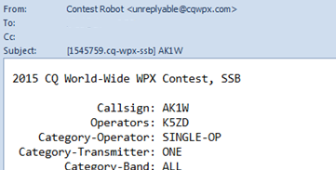
Final Confirmation
Your log is not officially received you receive an email confirmation with tracking number in subject line
Check your category!!
The robot may enter a default if something is missing or invalid

Slide 31
Note
Do not put any information about your entry in the email subject or body.
The log checkers only see the log file!

Slide 32
Log Submission Deadlines
See the contest rules for log deadline
For CQ Contests, it is 5 days
For ARRL Contests, it is ~15 days
Robot accepts late logs
If you need more time, request an extension
Why not just submit your log as soon as the contest is over?

Slide 33
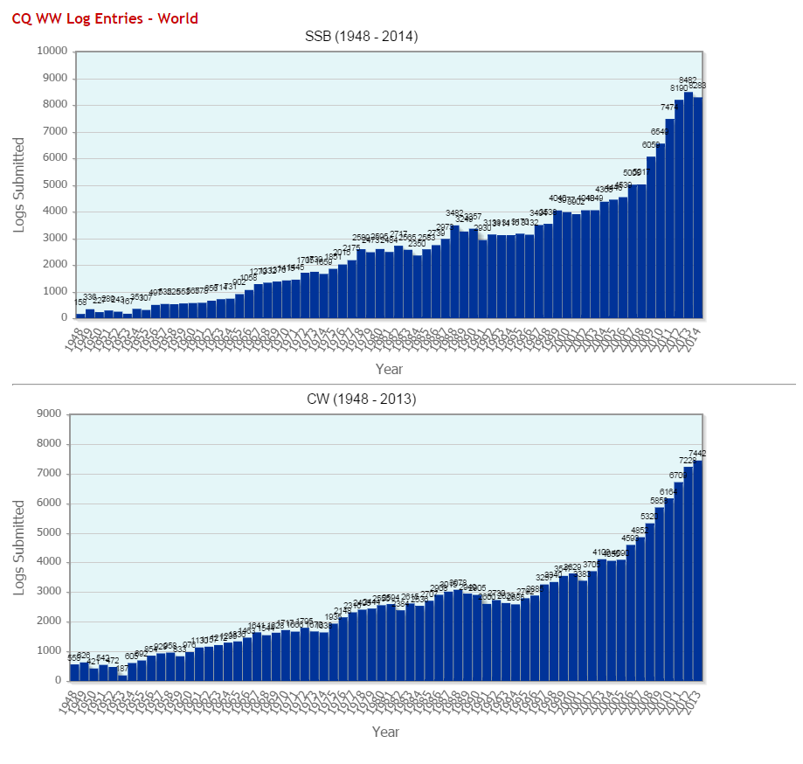
Impact of Electronic Logs
Cabrillo
introduced

Slide 34

World Wide Radio Operators Foundation
Non-profit corporation focused on support of radio contesting
WWROF funds
CQWW infrastructure including the robot, web site, log checking software/hardware
Manages Cabrillo log format standard
Webinar series
Other projects that support contesting
Learn more and donate at www.WWROF.org

Slide 35
Questions?
Cabrillo Specification: http://wwrof.org/cabrillo/
Questions or Change Requests: cabrillo@wwrof.org
ARRL Article about Cabrillo: http://bit.ly/1FzgkM9
Notes:
ARRL article: http://www.arrl.org/files/file/Contest%20-%20General/Tutorials/Submitting%20An%20Electronic%20Contest%20Log.pdf

