Slide 1
Ten Ways to Improve Your Contest Score
Doug Grant, K1DG

Slide 2
Ten ways to improve your contest score
10. New radio
9. Amplifier
8. New antennas
7. Move
6. Second radio
5. Join a club
4. Go to a multiop
3. Use the Cluster
2. Go to Dayton/CTU
1. THE BIG SECRET

Slide 3
First cluster of improvements
Tangible improvements
10. New radio
9. Amplifier
8. New/better/more antennas
7. New QTH
All of these are ways to increase your score, but maybe not the way you think

Slide 4
10. New Radio
IMHO, this is the least useful improvement
Most $1000+ radios from the past 10 years provide adequate performance and features
IMD DR >70 dB SSB, >80dB CW sufficient (NCØB)
Benefits of a new radio
It gets you more interested & on the air more
You enjoy it more & get on the air more

Slide 5
9. Amplifier 8. Antennas 7. QTH
All are ways to “add dB”
How much is 1 dB worth in score?
How much does a dB cost?
Amplifier dB
Antenna dB
QTH dB
If the goal is increasing score, where do you spend the money?

Slide 6
Score increase vs. dB
Prior to 2014, N1UR always operated LP
Good antennas, hillside W1 QTH
Switched to HP in 2014
Did it help his score?

Slide 7
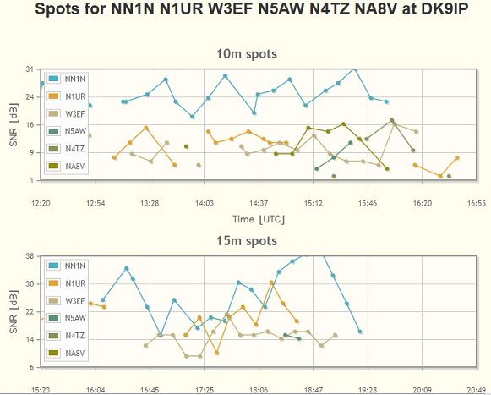
Is N1UR Really LP?
2013 CQWW CW RBN data

Slide 8
N1UR SOLP vs the Top SOHP, CW
When N1UR added an amplifier (12 dB),
he picked up 120 of those percentage points!

Slide 9
N1UR SOLP vs Top SOHP, SSB
On SSB, adding the amplifier closed about 100 points of the 120 % gap
Normalized score increase was 73% 6%/dB

Slide 10
Does it hold for other LP-HP comparisons?
Compared Top 5 QRP, LP vs top 5 HP
Calculate % score increase vs. dB
For CW, ~12% per dB (range: 10.3-15.1)
For SSB, ~15% per dB (range: 11.3-17.7)
May be closer to the 6%/dB figure, since many LP stations have lesser antennas than HP

Slide 11
From QRP to LP to HP…
No RBN data (QRP guys don’t call CQ!)
5 spots total in DL for top 5 QRPs, all bands)
HP scores typically 1000% (CW) to 1500% (SSB) higher than QRP
1500W is ~25dB above 5W
Most QRP guys do not have big antennas…another 10dB of QRPness maybe?
If linear, 30%(CW) to 40%(SSB) per dB increase

Slide 12
9. Add an amplifier (LP guys only)
Cost:
Used SB220 $500
$10k for auto-everything
Use $2500
100W to 1500W is 11.6 dB
Cost per dB: $200 (only $43 with SB220)
Score improvement should be ~80%; $31 /%
KPA500 vs. 1500W: 4.77 dB; ~30% score increase

Slide 13
For HP entrants…
More than 1500 W is against the rules
Adding 10 dB is very expensive…
Tubes >$1000
Electrical service to the shack is expensive
Coax, connectors, filters… all get complicated
Damage to reputation
Don’t do it!

Slide 14
8. Antennas
A very mixed bag of bang-for-buck
Gain is expensive after a while
¼-wave vertical: 1.77 dBi FS, 5.15 dBi over perfect ground, 0 dBi over average ground
40M dipole used on 15M: 2.8 dBi
80M dipole used on 15M: 4.7 dBi
3 element 15M beam: 7.44 dBi, $500, 2.7m boom, 12 lb
4 el: 9.01 dBi $750, 5.4 m, 20 lb
5 el: 9.1 dBi $900, 6.2m, 25 lb
5 el: long boom 10.1 dBi $1050, 8.5m, 28 lb
6 el: 10.9 dB $1500, 11.3m, 51 lb
7 el: 12 dBi $2300, 17.6m, 78 lb

Slide 15
The K1AR Story
Excellent scores with “just a dipole”
AR is one of the best operators ever
NH QTH
1500W output

Slide 16
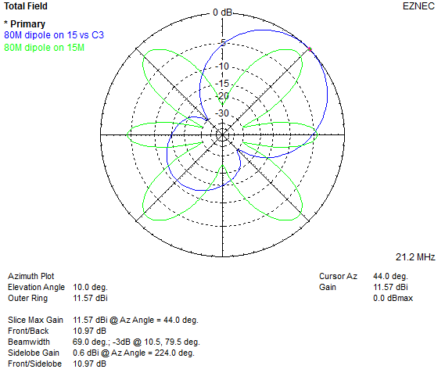
80M Dipole vs. Tribander (15M)

Slide 17
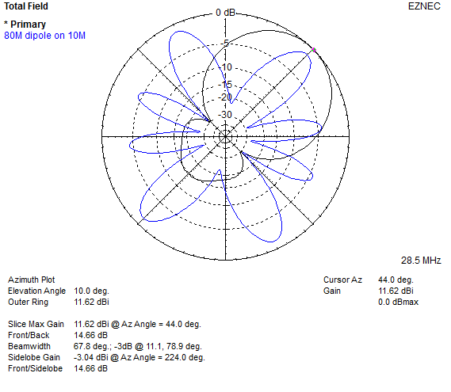
80M Dipole vs. Tribander (10M)

Slide 18
Antenna dB/$
4dB = 40% score increase, $1000 ➔ $25/%

Slide 19
If you already have a beam…
Assume starting point of 40-foot tower with 3-element tribander
Move to 80-foot tower, stack two 4-element beams
Cost, comparison of patterns, gain

Slide 20
Low band improvements are hard
40M
Start with inverted Vee at 60 feet
(1.6 dBi FS, 6 dB over real ground but very high angle)
Move to 2-el shorty beam at 60 feet
($1000 + rotator, gives 5-6 dBi gain in FS, 9-10 over real ground)
4 dB for $1000 = $250/dB; 25% increase in score
Probably much better due to lower angles
Vertical or sloper array
80M/160M
Start with inverted Vee at 60 feet
Consider half-sloper or vertical array
Verticals need lots of radials
Arrays need phasing boxes, build or buy
Adding a Beverage to receive better is <$50

Slide 21
Feedline improvement
Assume a tribander at 60 feet, 140 feet from the shack, fed with RG8X
Loss of 200’ of RG8X on 10M: 4 dB
Replace with 200’ LMR400, loss: 1.6 dB
Gain 2.4 dB for $180 = $75/dB
Equivalent to raising power by 1.7x AND helps on receive
24% score increase
Replace with surplus ¾” CATV line, loss of 0.4 dB
Gain 3.6 dB for $?
Equal to raising power by 2.2x OR…

Slide 22
Getting 3.6 dB additional gain on 10M
3-el 10M yagi: 7 ft boom, $300, 7.5 dBi
6-el 10M yagi: 28 ft boom, $1000, 11.1 dBi
Spend $180 (or scrounge) better coax or spend $700 on a bigger beam
If you already have a 6-element yagi, the next 3 dB will cost a lot more!

Slide 23
7. Move
Complicated and expensive
Can be effective
Hilltop or oceanfront vs valley
W1 vs. Black Hole
(NM/WTX/KP4 vs W1 for SS)

Slide 24
7a. “Virtual Move”
Remote station
This is now practical
RHR, others…
Roll your own

Slide 25
6. Add a Second Radio
“Don’t try SO2R until you are really good at SO1R…please!” - K5ZD
“SO2R station construction is harder than Multi-Multi” - KL7RA
Adding a second radio only adds ~10% to a DX contest QSO total, maybe 20-30% to score
It allows you to know what is happening on the other bands

Slide 26
5. Join a Club
Chose the right club…or start one!
Learn from the other guys
Exchange rate sheets
“Do for others and let others do for you”
– B. Dylan

Slide 27
4. Go to a Multiop
Most multiops are well-equipped
See what it is like to use the “Big Iron”
See how other ops play the game
Learn some best practices in station design and construction

Slide 28
3. Use the Cluster (sigh)
It will add 20-30% to your score…BUT…
You will not learn anything if the Cluster does the work for you
Don’t let the Cluster distract you
Don’t believe all the spots…it can make your score go DOWN

Slide 29
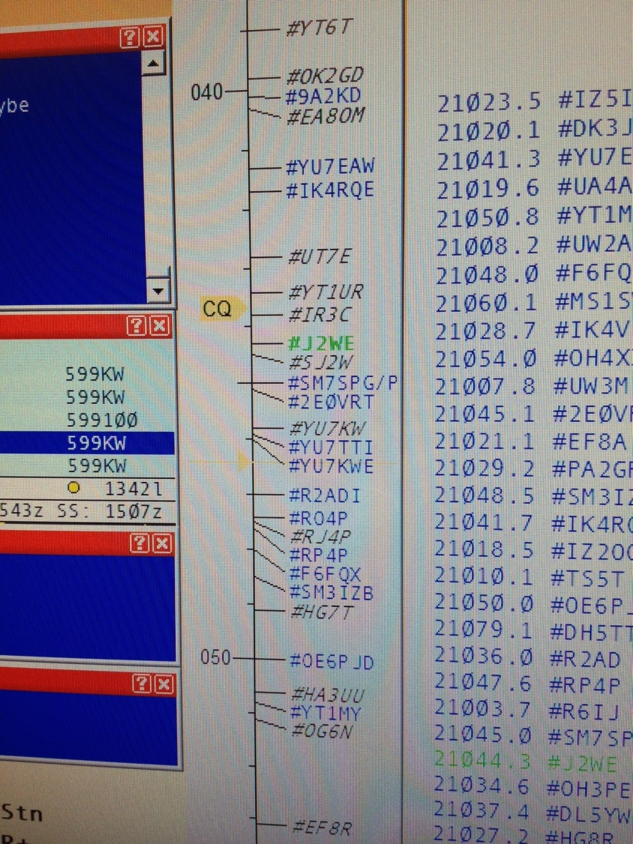
The Cluster Makes Mistakes!
If you worked all the calls on these screens
you would have a negative score!

Slide 30
2. Go to Dayton (and CTU)
Meet people
Learn from the pros
Ask questions
Pay attention

Slide 31
AND THE NUMBER ONE WAY TO IMPROVE YOUR CONTEST SCORE… >>>> THE BIG SECRET <<<<

Slide 32
1. There is no secret!
Get on the air a lot
Learn the bands and your station capability
Practice calling in pileups to hone your timing
LISTEN!
Run any time you can…get familiar with callsigns (improve your “vocabulary”)

Slide 33
The Big Myth
“I yam what I yam, and that’s all what I yam”
– Popeye the Sailor
“Can’t run, can’t jump.”
– scouting report on Larry Bird
"Can't sing. Can't act. Balding. Can dance a little.”
– RKO screen test of Fred Astaire

Slide 34
“Outliers” (Malcolm Gladwell book)
Cites Ericssons’ “10,000 hour rule”
Beatles (1200 live performances in Hamburg 1960-64),
Bill Gates (had access to a computer at age 13)
10,000 hours of “deliberate practice” required for mastery
“Deliberate practice is not always enjoyable”
The top contest operators don’t have bigger or more sensitive ears, springier fingers, …

Slide 35
How did the top operators get there?
“Giftedness researchers have long debated whether there is empirical evidence to support a distinction between giftedness and attained level of achievement. With the exception of fixed genetic factors determining body size and height, we were unable to find evidence for innate constraints to the attainment of elite achievement for healthy individuals. “
K. A. Ericsson et al, “Giftedness and evidence for reproducibly superior performance: an account based on the expert performance framework”, High Ability Studies Vol. 18, No. 1, June 2007, pp. 3–56,

Slide 36
Two more factors, from recent research
Starting young
All other factors being equal, those who started younger were higher achievers at the elite level
Probably related to development of working memory capacity, the ability to remember a set of objects while engaged in another task
“Grit”
The unique blend of IQ and EI that results in persistence
“The desire and passion to get better drives the willingness to spend so many hours practicing a skill.”

Slide 37
However…
The 10,000 hour rule applies to the World-class top performers
You can get “pretty good” in 20 hours
Josh Kaufman’s rules for learning:
1. Deconstruct the skill into smaller parts
2. Learn enough to self-correct
3. Remove barriers to practice
4. Put in the full 20 hours…overcome the initial frustration barrier

Slide 38
Contesting is a personal endeavor
Some do it to compete
Build station
Improve station
Operate a lot
Some do it just for fun
Part-time operation
Pick up new countries, etc.
Take what they can get

Slide 39
Some do it for both
Most games are more fun when you develop a high level of skill
Whatever your goal, have fun!

