Slide 1
Tower, Antenna and Feedline Maintenance and Improvements
Improving the competitive performance and long term reliability of your tower, antennas and coaxial cables
Frank Donovan
W3LPL

Slide 2
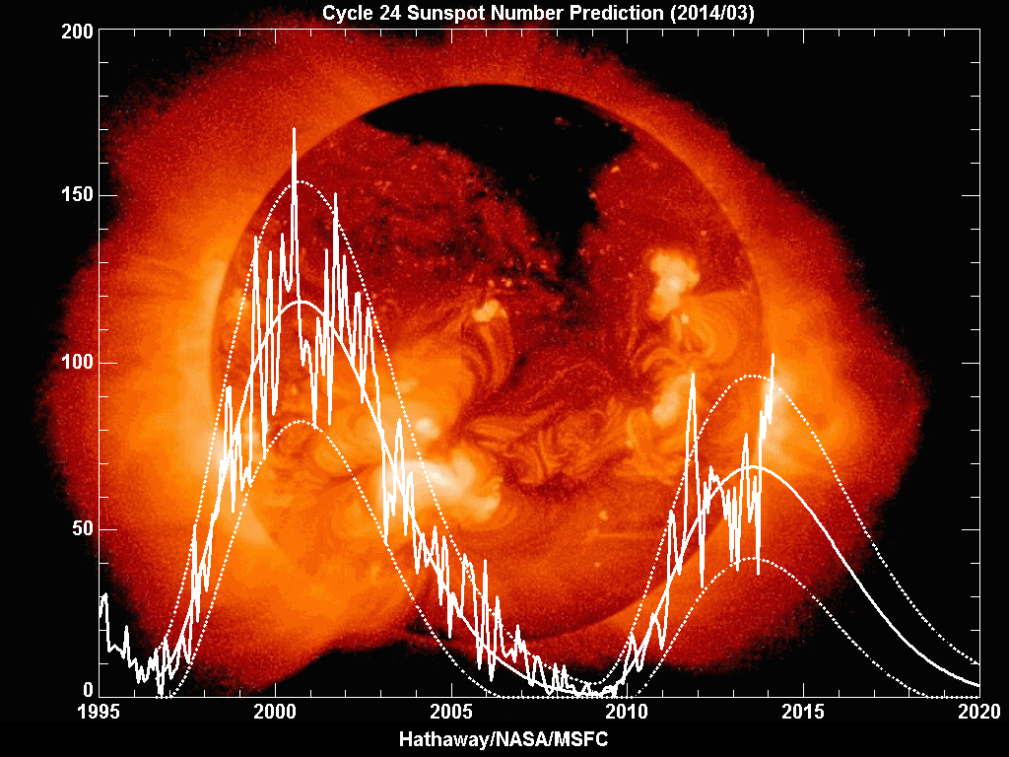
This is a Great Time to Improve and Maintain Your Antennas!
Feb 2014
peak
2015 prediction
Sunspot Number

Slide 3
Improving the Competitive Performance of a Single Tower Station
50-60 foot tower and a small rotator (e.g., HyGain Ham-IV)
  small tribander, Hex-beam or quad
  40 and 80 meter dipoles and a 160 meter inverted-L
70-80 foot tower and a medium rotator (e.g. HyGain T2X)
  Cushcraft XM-240 two element 40 meter Yagi
  large tribander such as the SteppIR 4 element Yagi
  80 meter dipole and a 160 meter inverted-L
100-140 foot tower and a large rotator (e.g., M2 Orion)
    Cushcraft XM-240 two element 40 meter Yagi
    monoband Yagis such as the HyGain LJ series on ring rotators
    80 meter dipole and a 160 meter inverted-L

Slide 4
Improving the Competitive Performance of 10 Meter Antennas
Horizontal polarization is always your best choice
  if you can install your antenna only 25 feet high or higher
  otherwise use a four-square vertical array with extensive radials
Moderate gain: a tribander, small Yagi, Hex-beam or quad
  a small Yagi 25-50 feet high will produce good results
  a small Yagi at 30-50 feet high for Sweepstakes and Field Day
High gain: a full size tribander, small monoband Yagi or quad, at 50-70 feet high for excellent DX results
Highest gain: two stacked monoband Yagis on a 60-70 foot tower (or 90-120 feet high for three stacked Yagis)
  stack switching ( a “stackmatch”) provides high payoff at low cost

Slide 5
Stacked 6 Element 10 Meter Yagis
36 Foot Booms
35 and 70 Feet High
70 ft
12º
elevation angle in degrees
BOTH
Europe
8º
35 ft
Asia/
VK/ZL
3º
2º
decibels

Slide 6
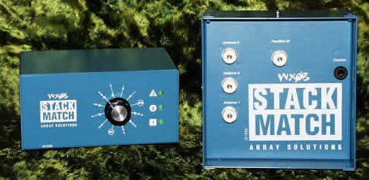
The Array Solutions
Stack Match
www.arraysolutions.com/Products/stackmatch.htm

Slide 7
Improving the Competitive Performance of 15 Meter Antennas
Horizontal polarization is always your best choice
  if you can install your antenna 35 feet high or higher
  otherwise use a four-square vertical array with extensive radials
Moderate gain: a tribander, small Yagi, Hex-beam or quad
  a small Yagi at 35-50 feet high will produce good DX results
  a small Yagi at 35-50 feet high for Sweepstakes and Field Day
High gain: a full size tribander, small monoband Yagi or quad at 70-90 feet high for excellent DX results
Highest gain: two stacked monoband Yagis on a 80-100 foot tower (or 120-140 feet high for three stacked Yagis)
  stack switching ( a “stackmatch”) provides high payoff at low cost

Slide 8
Stacked 6 Element 15 Meter Yagis
48 Foot Booms
47 and 94 Feet High
15º
94 ft
Europe
elevation angle in degrees
BOTH
10º
Asia/
VK/ZL
47 ft
4º
3º
decibels

Slide 9
Improving the Competitive Performance of 20 Meter Antennas
A horizontal Yagi or quad is always your best choice
  if you can install your antenna 50 feet high or higher
  otherwise use a four-square vertical array with extensive radials
Moderate gain: a small tribander, Yagi, Hex-beam or quad
  a small Yagi at 50-70 feet high will produce good DX results
  a small Yagi at 40-50 feet high for Sweepstakes and Field Day
High gain: full size triband Yagi, small monoband Yagi or a quad at 70-100 feet high for excellent DX results
Highest gain: two stacked monoband Yagis on a 100-140 foot tower (or 170-200 feet high for three stacked Yagis)
  stack switching ( a “stackmatch”) provides high payoff at low cost

Slide 10
Stacked 5 Element 20 Meter Yagis
48 Foot Booms
50 and 100 Feet High
18º
100 ft
Europe
BOTH
12º
elevation angle in degrees
Asia/
VK/ZL
50 ft
5º
4º
decibels

Slide 11
Improving the Competitive Performance of 40 Meter Antennas
High horizontal dipole at least 70 feet high for DX contests
  otherwise use a four-square vertical array with extensive radials
  a dipole at 35-50 feet high for Sweepstakes and Field Day
Higher gain: 2 element Yagi at 70-100 feet high
  significant improvement over a simple horizontal dipole for DX
  a Cushcraft XM-240 at 70-100 feet high is very cost effective
  www.cushcraftamateur.com/Product.php?productid=XM-240
Highest gain: full size 3 element Yagi at 100-140 feet high
  but don’t underestimate the high cost and complexity of the effort !
High performance receiving antennas
  Beverages and arrays of short verticals

Slide 12
Stacked 3 Element 40 Meter Yagis
48 Foot Booms
100 Feet and 200 Feet High
23º
Europe
200 ft
BOTH
15º
elevation angle in degrees
Asia/
VK/ZL
7º
100 ft
5º
decibels

Slide 13
Improving the Competitive Performance of 80 Meter Antennas
High horizontal dipole, at least 70 feet high for DX contests
  50-70 feet high for Sweepstakes and Field Day
A single full size vertical or a vertically polarized delta loop
  well separated from all nearby tall towers
    at least 70 feet from nearby towers over 40 feet tall
    much more than 70 feet of spacing optimizes performance
A short inverted-L or T-vertical is a very good alternative
  as little as 25 feet tall
  supported from a tower or trees
  Use at least 32-64 shallow buried radials
    at least 70 feet long, or
    at least two (but preferably four or more) elevated 65 foot radials
      but only if buried radials are impossible

Slide 14
Improving the Competitive Performance of 160 Meter Antennas
A single full size vertical or a vertically polarized delta loop
  well spaced from all nearby tall towers
    at least 140 feet from nearby towers over 80 feet tall
    spacing much more than 140 feet optimizes performance
A short inverted-L or T-vertical is a very good alternative
  as little as 50 feet tall
  supported from a tower or trees
  Use at least 32-64 shallow buried radials
    At least 130 feet long
    or at least two (but preferably four or more) elevated 125 foot radials
      but only if buried radials are impossible

Slide 15
4-Square Vertical Array for 80 and 40 Meters
A four square vertical array is very competitive with very high horizontal Yagis and quads on 80 meters and is also an excellent receiving antenna
  install at least 70 feet from all other towers
    more spacing will significantly improve its performance
  at least 30-60 slightly buried radials under each vertical
    at least 70 feet long on 80 meters
    at least 35 feet long on 40 meters

Slide 16
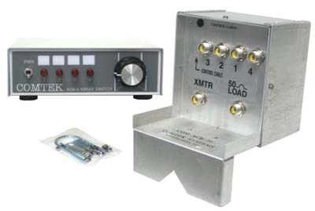
The Comtek
4-Square Controller
www.dxengineering.com/search/brand/comtek

Slide 17
Receiving Antennas for 160 and 80 Meters
What happened to the Beverages at K3LR and W3LPL?
  Large arrays of short verticals with performance similar to a five element Yagi
High performance 4-square receiving antennas in a small space
  Significantly better performance than Beverages
See the separate receiving antenna presentation by W3LPL at this years Contest University

Slide 18
Coaxial Cables Can Make or Break Competitive Performance
How well you select, install, waterproof and maintain your coaxial cables and connectors can make or break the competitive performance of your contest station
Cross-station interference in multi-operator and SO2R stations is often caused by
  inappropriate coaxial cable
  inappropriate or incorrectly installed connectors
  loose connectors
  improper installation practices such as bundling cables
  failure to perform annual inspections

Slide 19
Improving the Competitive Performance of Coaxial Feedlines
Coaxial cable loss, proper connector and cable installation and annual inspections are the most important concerns
  Andrew LDF4-50A 50 ohm Heliax and connectors are commonly available at hamfests and eBay for ~ $1.00/foot
    Less than 1 dB of loss on 10 meters for lengths up to 300 feet
  If flexible coaxial cable must be used on your tower, Davis RF Bury-Flex is an acceptable alternative for single operator stations only, at about the same price
    Never use any other type of foam dielectric flexible coaxial cable
  Non-flooded coax such as RG-213 and LMR-400 has a short service life in the harsh environment of a tower
    Never use for direct burial or laid on wet ground

Slide 20
Improving the Competitive Performance of Coaxial Cables for SO2R and Multi-Op Stations
Andrew LDF4-50A Heliax is an ideal choice for lengths up to
  300 ft on 10 meters, 400 ft on 20 meters, 600 ft on 40 meters
Eliminating common cross-station RFI sources:
  Use Heliax to avoid RFI caused by the dissimilar metals in the aluminum foil and tinned braid shields of Davis RF Bury-Flex cable
  Signal coupling between RG-213 single braid shielded coaxial cables when they are bundled or run together in conduits
  Never use nickel plated connectors and adapters
  Install connectors properly
  Minimize the use of connectors and adapters as much as possible
    use only brand name silver plated connectors and adapters

Slide 21
Improving the Competitive Performance of Coaxial Cables for Multi-tower Stations
Coaxial cables longer than 300 feet are often used in multi-tower stations
  Andrew LDF5-50A Heliax is an ideal choice for lengths up to
    600 feet on 10 meters
    700 feet on 15 meters
    900 feet on 20 meters
    1200 feet on 40 meters
Be cautious of the windload and weight (including ice load) of large Heliax cables mounted on towers

Slide 22
Coaxial Cable Inspections
Inspect all indoor and outdoor coaxial cables, connectors and waterproofing for evidence of damage, cuts, cracks, moisture intrusion or improper installation
    antenna feedpoint connection (wear and water intrusion)
    antenna rotation coaxial cable (chaffing and wear)
    tower top connectors and bonding to tower
    tower base connectors and bonding to tower
    all coaxial cable connectors in your station
    all SO-239 chassis connectors on equipment in your station
  if in doubt, remove the connector for detailed inspection
  verify that all indoor and outdoor connectors are wrench tight
    ¼ turn

Slide 23
Selecting and Maintaining
Low Loss Coaxial Cables
Select appropriate low loss coaxial cables for each antenna
Preserve your investment
  water and moisture entry is a persistent threat
Hard-line (e.g., Heliax or 75 ohm CATV) coaxial cables are the best choice for cable runs longer than 100 feet
  RG-213 and other flexible jacket coaxial cables are very susceptible to physical damage and water entry
    a pin hole can quickly cause a high loss cable
    carefully protect your coax cables from physical damage and water entry
Preserving long term performance
  test and inspect your cables and connectors annually

Slide 24
Maintaining the Competitive Performance of your Antennas
Annual inspections are the most effective step you can take to maintain the competitive performance of your tower, antennas and feedlines
  the environment continually attacks and degrades tower, antennas and coaxial cables
  degradations are often gradual and not noticed for years
  inspections can help avoid unplanned mid-contest and mid-winter emergency repairs

Slide 25
Antenna Performance Measurements Inside Your Shack
Immediately after installation, make a record of the following measurements at the hamshack end of every coaxial cable:
  VSWR across the entire band(s)
  Coaxial cable resistance
    typically either a fraction of one ohm or many megohms
  TDR and/or VNA plots
    you should own at least one of these excellent tools!
Well before your next competitive contest, repeat your measurements on every coax and verify that your measurements:
  have not changed relative to your records
  are not erratic
  any change (better or worse) requires detailed investigation

Slide 26
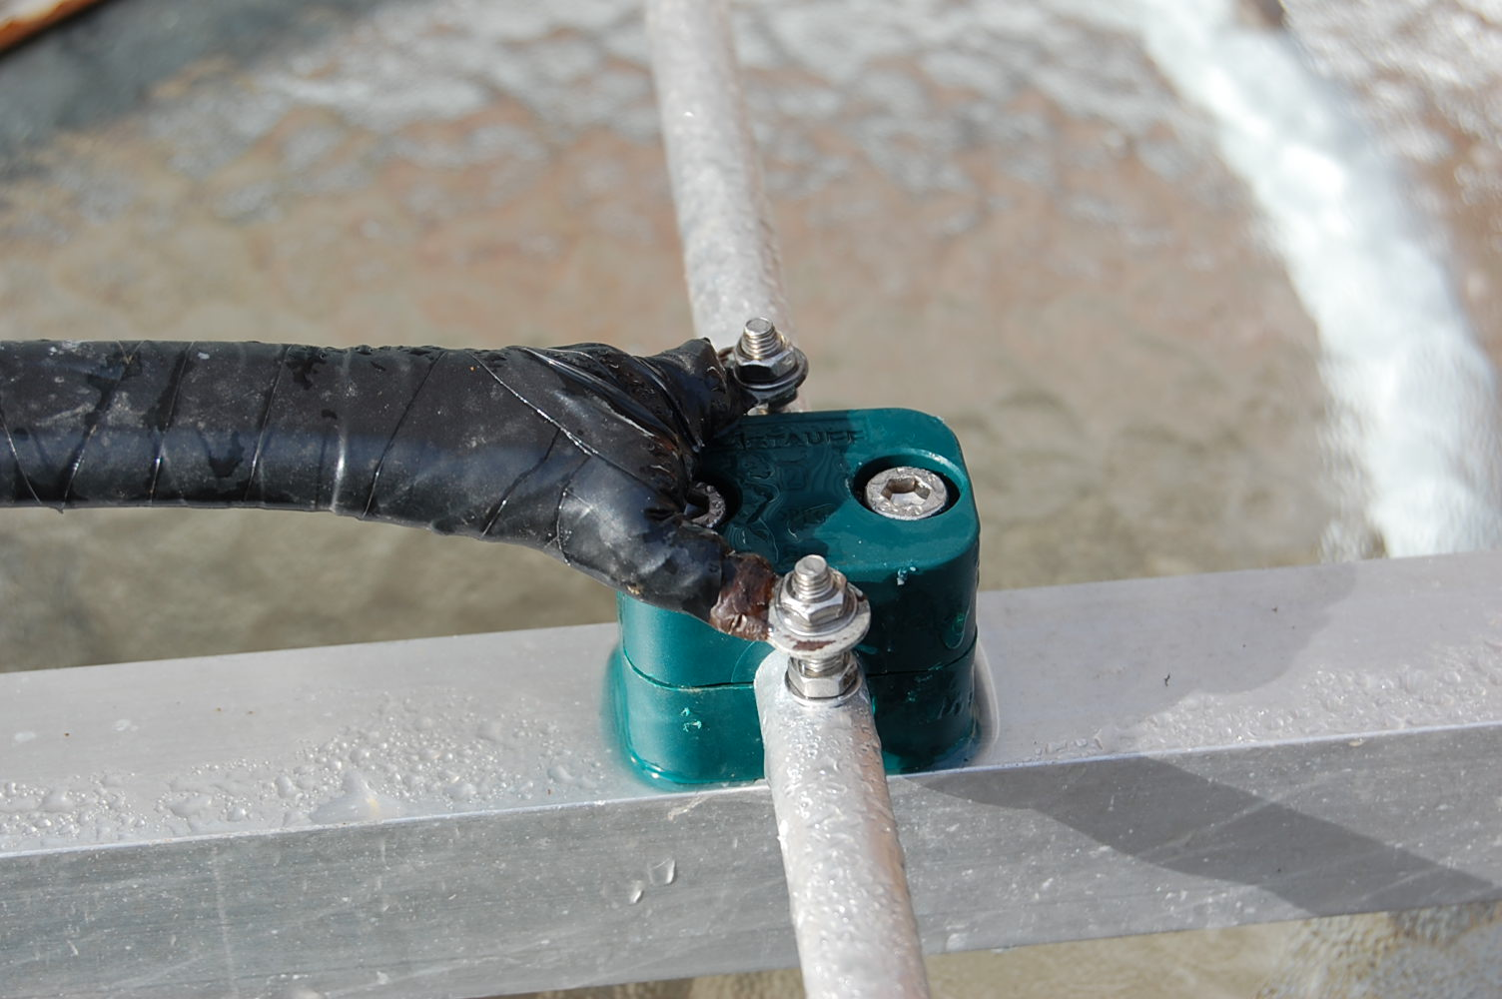
Antenna Feedpoint
Waterproof and Shakeproof Connections
Very firmly fasten the coax to the boom
Heavy solder lugs
Stainless steel screws
Nylon insert
stainless steel
locknuts
Scotch 130C and Scotch 33 waterproofing
External tooth
stainless steel
lockwashers

Slide 27
Antenna Rotation Coax Cable
Installation and Inspection
Your antenna rotation coaxial cable is exposed to the most extreme environmental conditions in your station
Carefully prevent the coax from rubbing or pulling against the tower or any other objects that could damage the coax jacket
  rotators with more than 360 degrees of rotation make this extremely difficult to achieve
Name brand, high quality RG-213 is a good choice
  95% shield, stranded center conductor, solid dielectric
  black UV-resistant jacket
  Replace the coax whenever you discover abrasion or damage during annual inspections
  Replace the antenna rotation coax at least once every ten years

Slide 28
Coaxial Cable Installation on your Tower
Wind, ice, water, condensation, heat, cold, ultra-violet radiation and lightning strikes are important concerns
  If any of these concerns are unusually severe in your environment, implement additional protective measures
Heliax and CATV hardline must be firmly fastened to the tower at least every to five feet to protect them from wind and ice damage
Flexible coaxial cables (e.g. RG-213) should be firmly attached to the tower at least every two or three feet to protect them from wind and ice damage
Use electrical tape to cover plastic tie-wraps to protect them from ultra-violet radiation

Slide 29
Improving the Reliability of Coaxial Cable Connectors
N and UHF connectors are the most common choices
Insignificant loss in both N and UHF connectors at HF
Insignificant difference in the VSWR of N and UHF connectors at HF
High quality silver plated UHF connectors provide much more center pin mating force than N connectors
  eliminates cross-station interference and connector failures from frequently unreliable N connector center pin mating force
  avoid saving a few dollars on cheap unbranded hamfest connectors
Avoid use of adapters, but if necessary be sure they are name-brand silver plated adapters, not nickel plated
Always use a wrench to tighten UHF connectors 1/4 turn

Slide 30
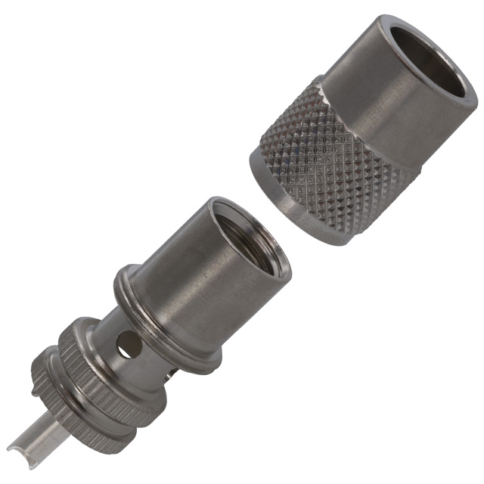
Coaxial Cable
Amphenol 83-1SP PL-259 Connector
Shell labeled exactly:
Amphenol 83-1SP
Silver Plated Body
Silver Plated Center Pin
Mouser Electronics part number 523-831SP
http://www.mouser.com/MobileCatalog.aspx?page=1369
This is not the place to save money

Slide 31
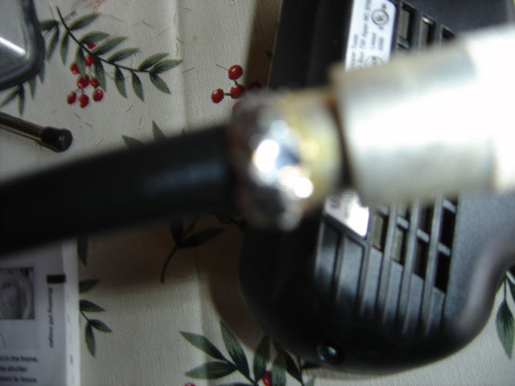
High Reliability Coaxial Cable
83-1SP Connector Installation
http://wwwww.k3lr.com/engineering/pl259/
An unconventional but superior method

Slide 32
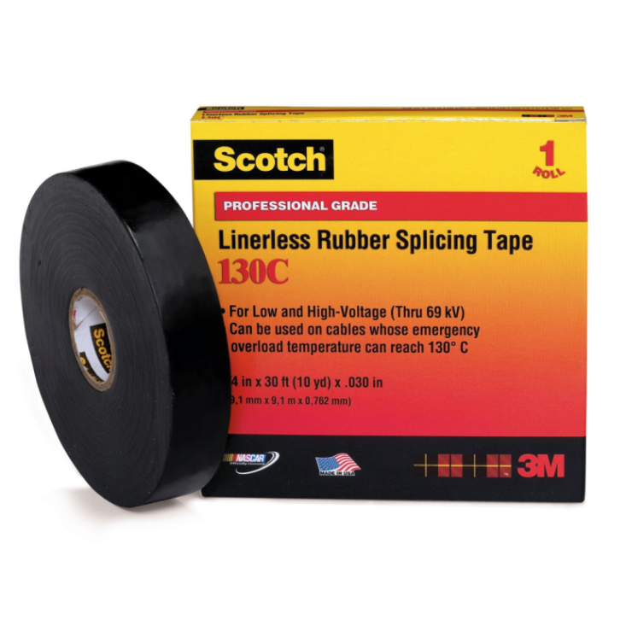
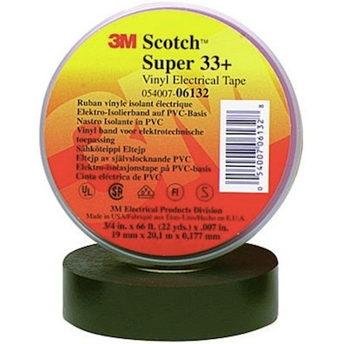
Coaxial Cable
Connector Waterproofing
Cover the connectors with two 50% overlapped layers of Scotch 130C stretched to 50% of its original width, sticky side facing out
Cover the Scotch 130C with two 50% overlapped layers of Scotch 33+ or Scotch 88

Slide 33
Tower
Maintenance and Inspections
Inspect all tower sections one year after installation
  then at least once every three years
  after every serious storm
  after any structural damage to the tower
Check plumb and twist of the tower
Pay special attention to damaged, loose, missing or corroded:
  diagonal and horizontal trusses, welds and hardware
  especially at and close to the guy attachments
  Beware of used or corroded tubular tower sections
  Regular inspections are key to safety and long term tower survival

Slide 34
Tower Base
Maintenance and Inspections
Inspect at least once every three years
Pay special attention to:
  corrosion at the tower-to-concrete interface
  standing water on the foundation
  dirt and debris accumulated on the foundation
  settling and cracks
  Dirt and debris accumulation on your tower foundation can lead to catastrophic tower failure

Slide 35
Guy Anchor
Maintenance and Inspections
Inspect at least once every three years
  dig down at least six inches to inspect for anchor rod corrosion
  missing hardware
  loose hardware
  corroded hardware
  Anchor rod corrosion
  is a very serious threat to tower safety survival

Slide 36
Guy Wire
Maintenance and Inspections
Inspect at least once every three years
Inspect after all serious storms
Check guy wire tension (7-15% of breaking strength)
Check for:
  damage from rubbing of chaffing of guy wire
  corrosion
  loose hardware
  Corroded guys and hardware
  risk catastrophic tower failure

Slide 37
Guy Attachment (tower and anchor)
Maintenance and Inspections
Inspect guys attachments at least once every three years
Check all guy attachment hardware
  missing or loose turnbuckle safety wires
  loose, missing or corroded hardware
  guy wire chaffing or rubbing
  integrity of the tower structure in the vicinity of each guy attachment
    damaged tower structural components
    broken welds
    loose or missing hardware
  Replace all degraded or missing guy attachment hardware

Slide 38
Lightning Protection
Maintenance and Inspections
Inspect all ground wire connections at least once every three years
  loose or missing hardware
  missing wires
  broken wires
  corrosion
  Repair all damaged or missing ground wires and connections

Slide 39
Rotator
Maintenance and Inspections
Inspect three months after installation
Inspect every three years
Check for:
  excessive mechanical play in the wind
  corroded hardware
  An under rated rotator will be a major maintenance problem

Slide 40
Antenna and Mast
Maintenance and Inspections
Inspect at least once every three years
  loose or missing antenna hardware
  loose or missing boom truss hardware
  corroded hardware
  ultra violet radiation damaged hardware
  coaxial cable electrical connection to the antenna
    water entry is a persistent threat
  coaxial cable physical connection to the antenna
  damaged structural components
  Coaxial cable connections to your antenna are easily damaged by wind, rain and UV

Slide 41
Tower, Antenna and Coaxial Cable Inspections Summary
Annual inspections are essential to long term tower, antenna and coaxial cable safety, reliability and station competitiveness
Conduct major inspections
  during the first year after construction or major modifications
  at least every three years
  after serious storms or damage
  Annual inspections are essential to tower, antenna and coaxial cable safety, long term reliability and competitiveness

