Slide 1
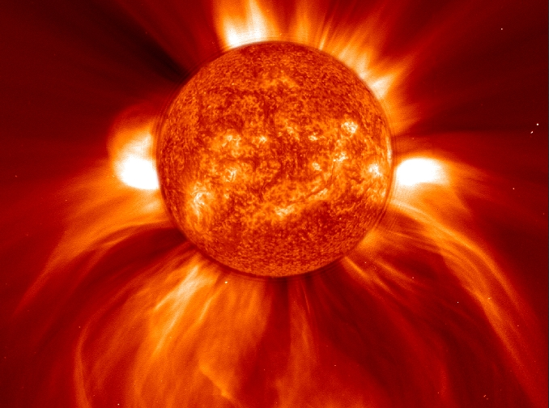
Propagation Trends 2014-2015
Solar Maximum!
But the slow decline to solar minimum in 2020 is likely to begin later this year

Slide 2
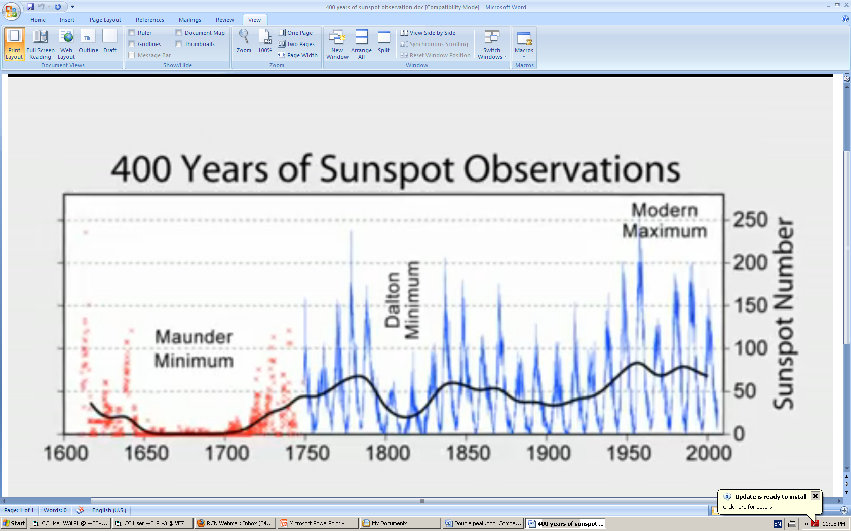
400 Years of Sunspot Observations
55 years of unusually high sunspot activity
(1947 - 2002) ended with the decline of Solar Cycle 23
Dalton Minimum
30 years
1790-1820
Early 20th century minimum
20 years
1896-1916
Modern Maximum
1947-2002
Maunder Minimum
70 years
1645-1715
The 80 year Gleissberg cycle is clearly visible in this data

Slide 3
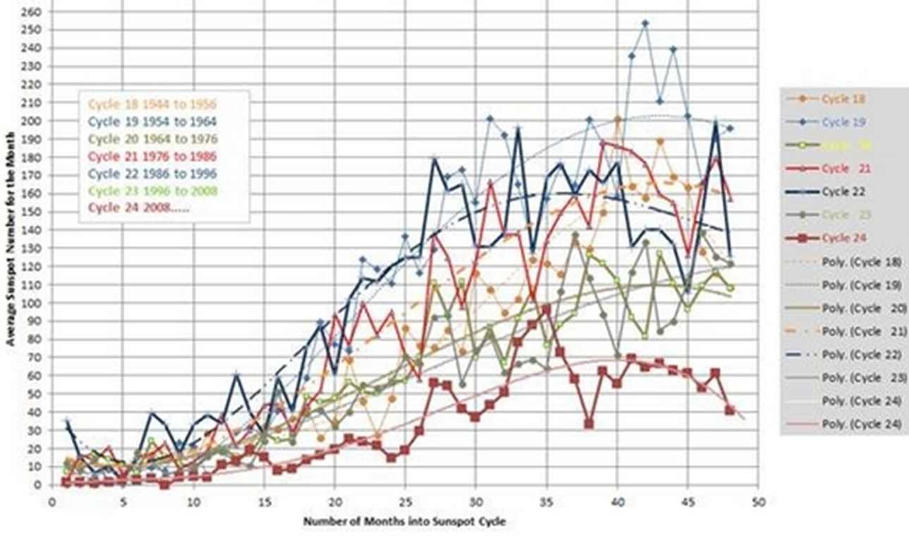
Solar Cycle 24 compared to all solar cycles since 1944
Cycle 24
The lowest solar minimum in 100 years
The weakest solar cycle maximum in 100 years

Slide 4
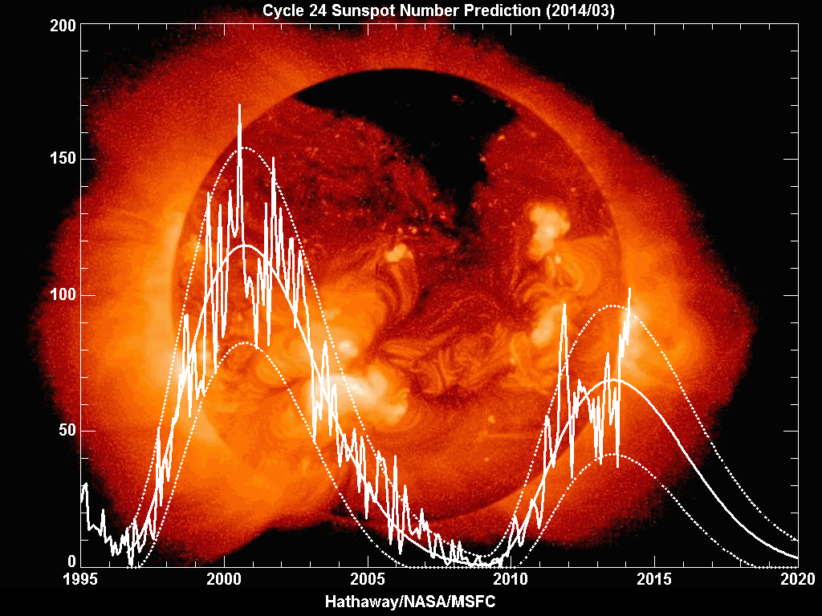
Solar Cycle 24 Progress the ongoing second peak is stronger than expected
2002
end of the Modern Maximum
Nov 2011
1st peak
Feb 2014
2nd peak
Sunspot Number
2020
solar
minimum
2008
266 spotless
days

Slide 5
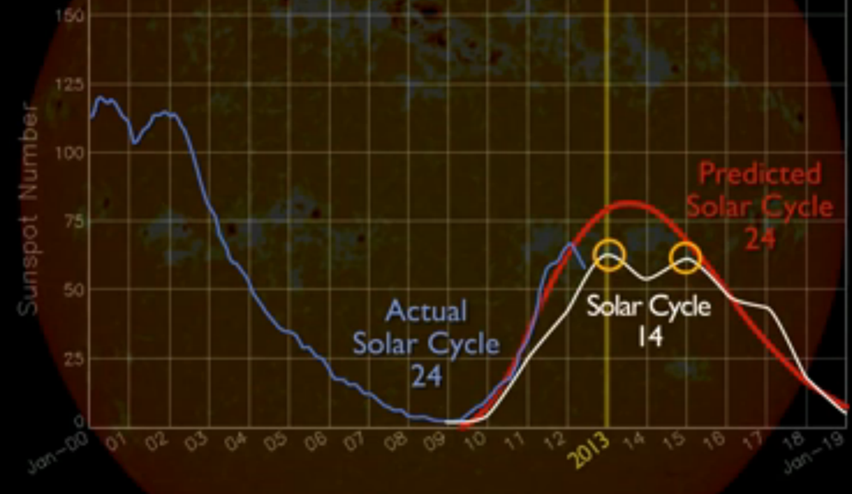
Solar Cycle 24 compared to similar Solar Cycle 14
two years between
Solar Cycle 14 peaks
Ongoing Solar Cycle 24 is also double peaked

Slide 6
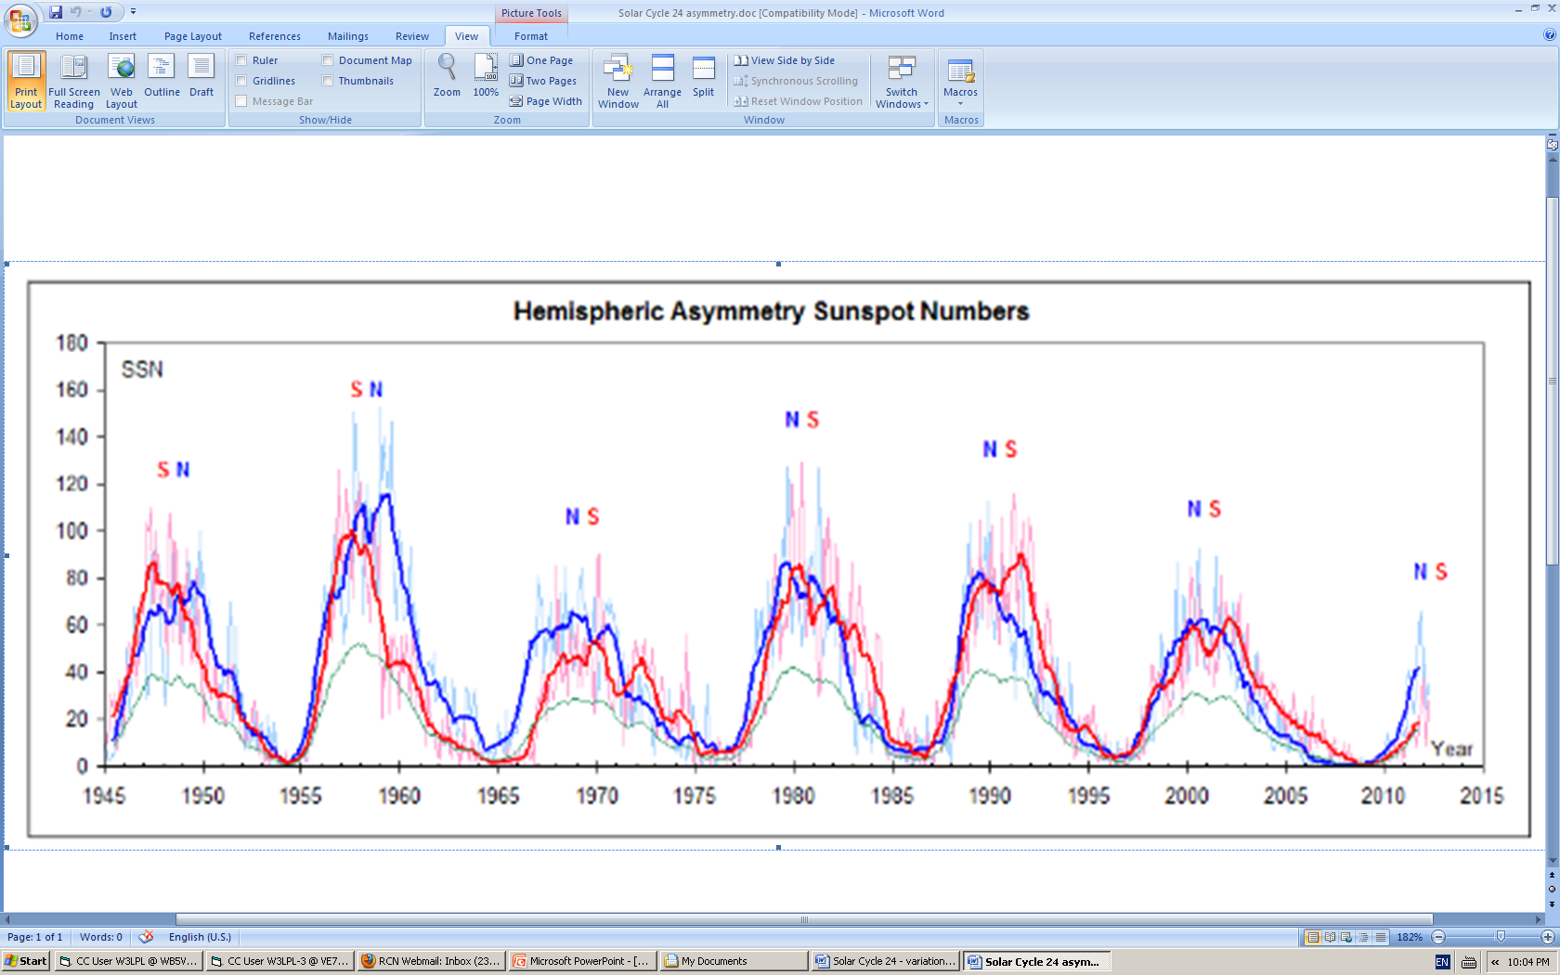
Why are there often two solar cycle peaks?
Sunspot Number
The northern and southern solar hemisphere
solar cycle peaks never occur at the same time

Slide 7
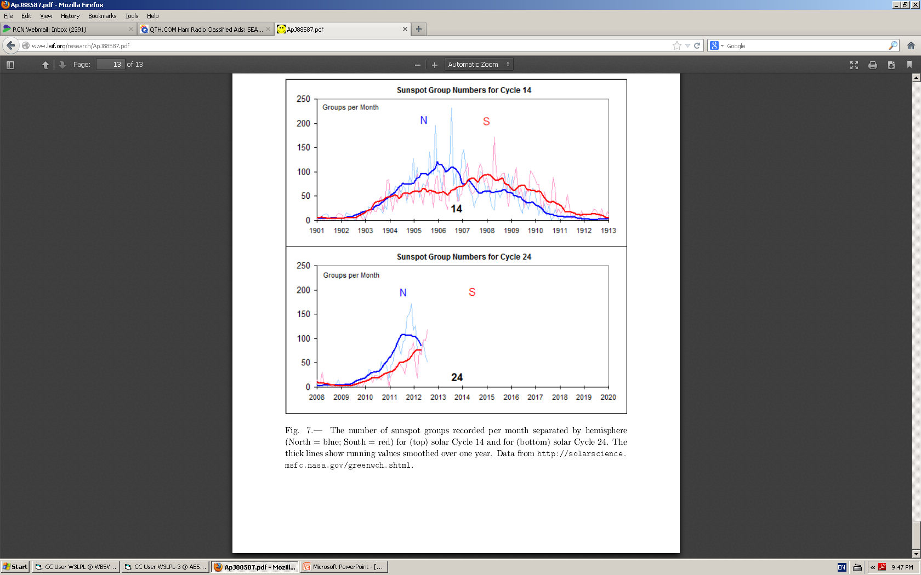
Solar Cycle 24 is similar to Cycle 14 the solar southern hemisphere sunspot peak occurred two years after the northern hemisphere sunspot peak
two years between Solar Cycle 14 peaks
Sunspot Groups per Month
N
S
Southern hemisphere sunspots started to increase
one year after the northern hemisphere sunspot peak

Slide 8
The Last Two Solar Cycles also had Double Peaks but much higher than Solar Cycle 24
two years between solar cycle peaks
two years between solar cycle peaks
N
S
N
S
southern hemisphere sunspots started to increase
one year after the northern hemisphere sunspot peak

Slide 9
Solar North-South Polar Field Reversal solar maximum usually occurs after both polar fields have reversed polarity
north polar field reversed polarity in June 2012
south polar field reversed polarity in June 2013
field reversal
N
smoothed polar field strength
micro-Tesla
S
north polar field strength remains very weak
Jun
2012
Dec
2013
Dec
Both poles had reversed polarity by June 2013

Slide 10
Sunspot Activity in each Solar Hemisphere Solar Cycle 24 achieved its second peak from Oct 2013 through Feb 2014
Northern hemisphere sunspot activity further
decreased after Jun 2013
Southern hemisphere sunspot activity peaked from Oct 2013 - Feb 2014
?
Southern
Sunspot Number
Northern
?
Jul
2012
Jan
2013
Jan
2014
Southern hemisphere sunspot activity is now
significantly greater than northern hemisphere activity

Slide 11
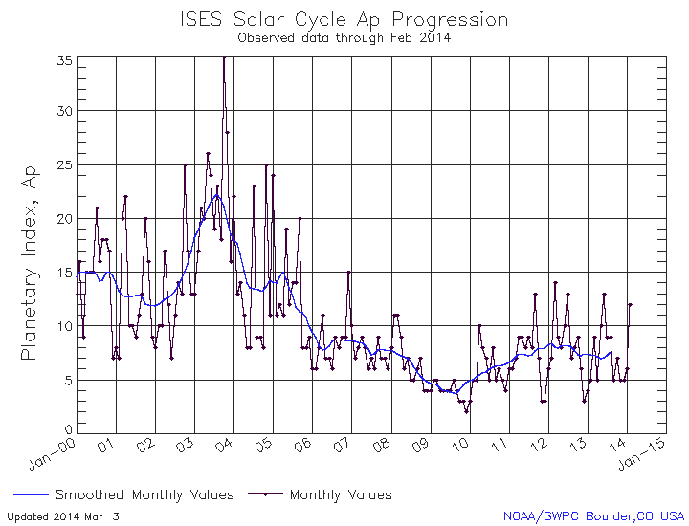
Weak Solar Cycle 24 has been unusually favorable for 160 and 80 Meters
The A-index has been much lower than prior sunspot cycles
Solar Cycle 23
double peaks
the A index usually increases
during the two years after solar maximum
unusually low A index
The A-Index may increase moderately
for the next two years

Slide 12
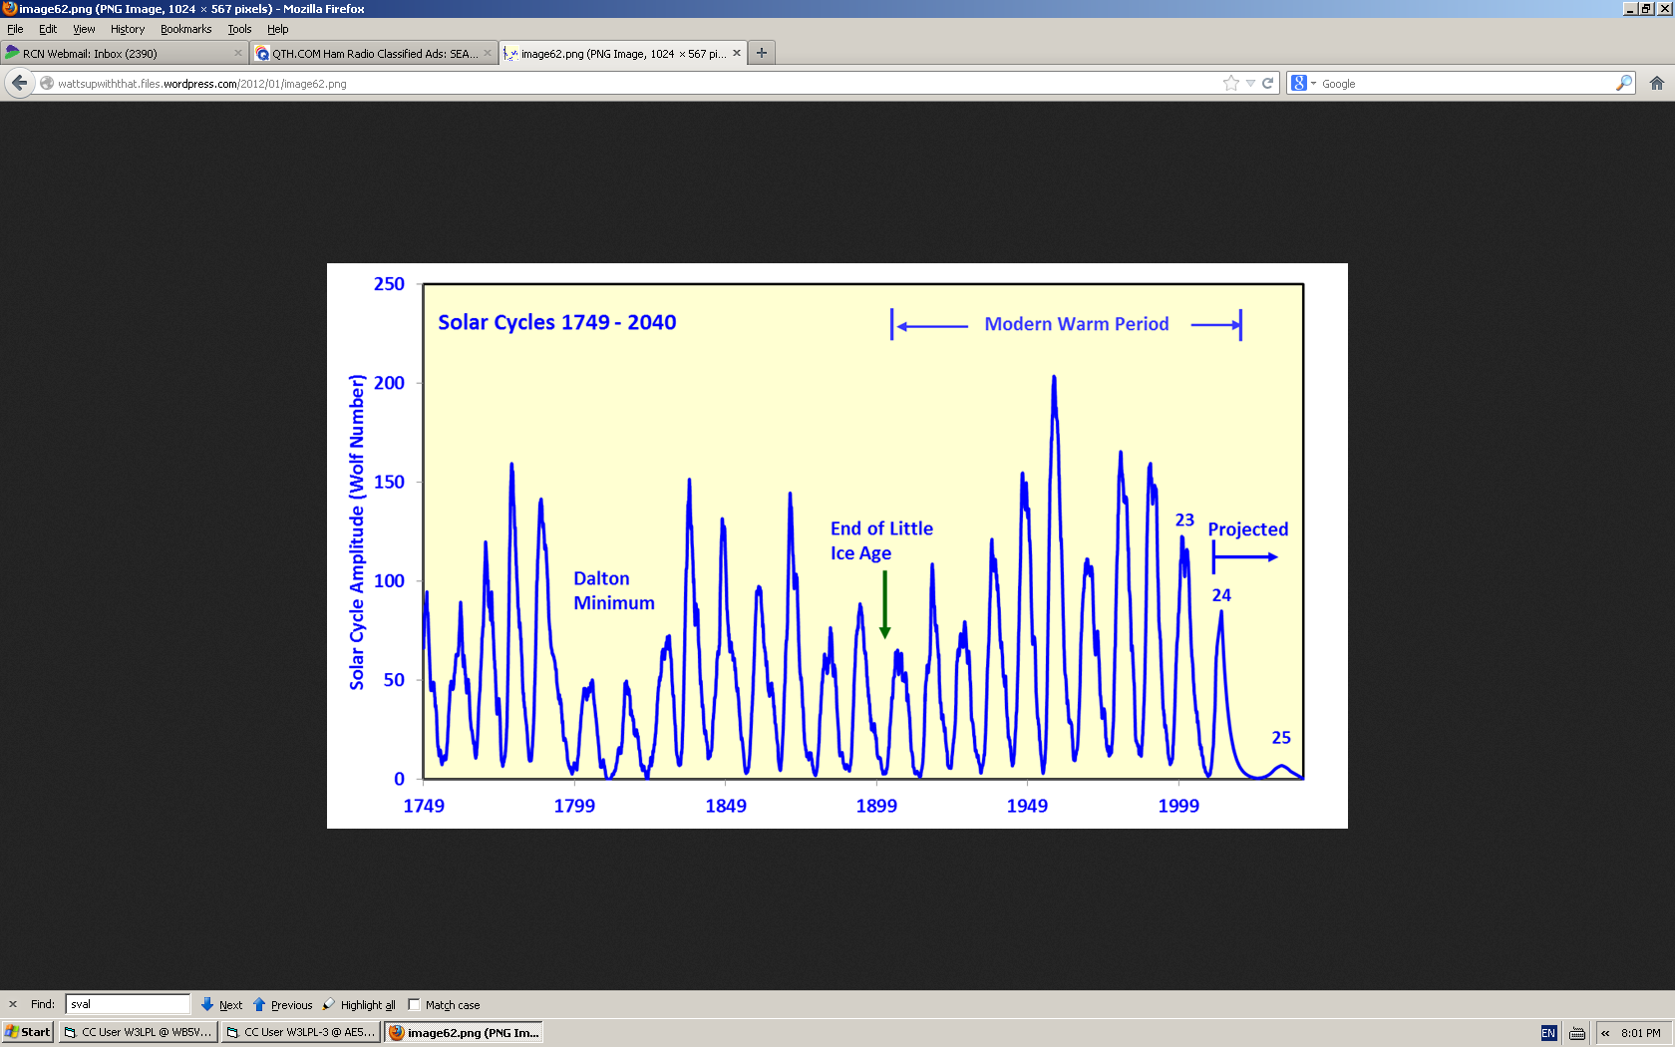
A Long Range Estimate of Solar Cycle 25 could sunspots nearly disappear by 2025?
Modern Maximum
1947 - 2002
19
http://myweb.wwu.edu/dbunny/pdfs/Solar-Cycle-25-Amplitude-estimate.pdf
3
n MM
18
21
22
8
11
4
n MM
9
2
1790 - 1835
17
20
15
1
10
13
7
12
16
14
5
6
?
some solar scientists expect Cycle 25 to be the
weakest solar cycle (SSN=7) in more than 300 years
http://www.landscheidt.info/?q=node/280

Slide 13
Solar Cycle 24 Prediction the slow decline to solar minimum in 2020 is likely to begin later this year
2015
Prediction
2020
Minimum
Sunspot Number

