Slide 1

2013 / 2014 Rig Contest Results + Test Data Means What?
Rob Sherwood
NCØB
How to optimize rig performance
Sherwood Engineering
Notes:
Changed font of Ø to 36pt Arial Black.

Slide 2
What is important in a contest or DX pile-up environment is still the same in 2014.
Good Dynamic Range to hear weak signals in the presence of near-by strong signals.
You need a better receiver for CW than for SSB.
2013 / 2014 Contest performance observations
How does published test data relate to on-air chance of overload?

Slide 3
What New Rigs have Shipped?
Announced rigs that actually shipped in 2013:
Hilberling PT-8000A @ $18,000
Kenwood TS-990S @ $8,000
Flex 6000 series @ $4,300 to $7,500
Ten-Tec Argonaut VI + 418 amp @ $1,780
Elecraft KX3 with KXPA100 amp* @ $1,750
(All of these used in contests in 2013 & 2014)
* The KXPA100 shipped in 2013

Slide 4
Comments about the new rigs?
Hilberling updated filter boards for better CW performance.
Kenwood TS-990 great bandscope with a very clean transmitter
Was my favorite contest rig in 2013.
Flex finally filled back orders and shipped V 1.00 & V 1.1 software
Excellent electrical performance. UI still being developed.
T-T Argonaut VI + 418 amp has excellent QSK (Any QRPers here?)
Elecraft KX3 + KXPA100 a flexible QRP / 100 watt option
(KX3 QSK not as good as K3 QSK or T-T QSK)

Slide 5
How did new rigs actually perform?
Hilberling’s new CW filter was a big improvement.
The TS-990S was a joy to use on SSB & CW.
Flex 6700 performed very well in CQ 160 CW contest, but required two computers.
Argonaut VI + 418 + Acom 1000 performed well, but lacks some features.
KX3 also worked well in W1BB CW contest but QSK was disappointing
Notes:
Typo: µV replaces uV.

Slide 6
Details - Hilberling PT-8000A
Covers 160 – 2 meters
16-Pole crystal filters, plus audio DSP
All factory hardware and software updates need to be installed.
New 250 Hz crystal CW filter selection was mandatory for better CW performance.
250-Hz 16-pole Xtal + 200 Hz audio DSP OK
100-Hz audio DSP in QRM not satisfactory
Used in ARRL 160-meter CW contest
Notes:
Typo: “an analog meter”

Slide 7
Details – Kenwood TS-990S
Main receiver down conversion all bands
Third-order transmit IMD excellent at -40 dB
Band scope very effective
Excellent low-fatigue receive audio
Price competitive with competing flagship products of other OEMs
RMDR is its weakest point, but should rarely be an issue in most environments.
Used in CQWW SSB, ARRL 10 M & ARRL 160 M CW contests. - Wonderful

Slide 8
Details – Flex 6700
Fantastic band scope with amazing resolution
Used 16 hours in CQ 160 meter CW contest
Clean audio, very low fatigue, minimal ringing
Tuned receiver with external Pod
UI is in an early stage of development.
Preamp gain selections are odd.
Required two separate computers, one for N1MM and SmartCAT for band data, plus second computer to actually run SmartSDR.
Will the need for two computers be a problem?
Notes:
“Are two computers…” is better grammatically.
Even better: “Will the need for two computers be a problem?”

Slide 9
Ten-Tec Argonaut VI + 418 Amp
QSK with 418 and Acom 1000 worked well
DSP noise blanker limited below 725 Hz BW
Used Timewave DSP-59+ for extra selectivity and to drive external speaker
Reasonable choice for QRP contesters who operate at home and in the field.
Does not cover 12 or 6 meters.
Are missing bands a big problem? Hands?
Ergonomics a bit sparse

Slide 10
Details – Elecraft KX3
Amazing tiny radio that performs well
Performed well in 2012 Stew Perry contest
QSK a disappointment with lots of clicks on receive audio
DSP provides good bandwidth control
Needs KXPA100 to drive any linear 1.5 kW
Opposite sideband rejection is its performance limit, being around 60 dB.
May require frequent SSB null calibration
Definitely a QRP contester consideration
Notes:
When I ran a few tests on the KX3, I found that calibration at fairly frequent intervals was required to maintain acceptable opposite-sideband rejection. - Adam

Slide 11
How does published test data relate?
In 1975 QST and Ham Radio Magazine changed the way receivers were tested. Before that all we had was data on Sensitivity, Selectivity and maybe Cross Modulation.
Now reviews and advertisements touted Dynamic Range, Noise Floor and possibly Noise Figure.
(Noise Figure relates to Noise Floor, but is filter bandwidth independent.)
What is often not understood is Noise Floor is usually significantly lower than Band Noise.
An ITU graph published in the ARRL Handbook gives us a starting point to relate band noise to noise floor.
This ITU data is in a 500-Hz bandwidth, just like typical noise floor data.

Slide 12
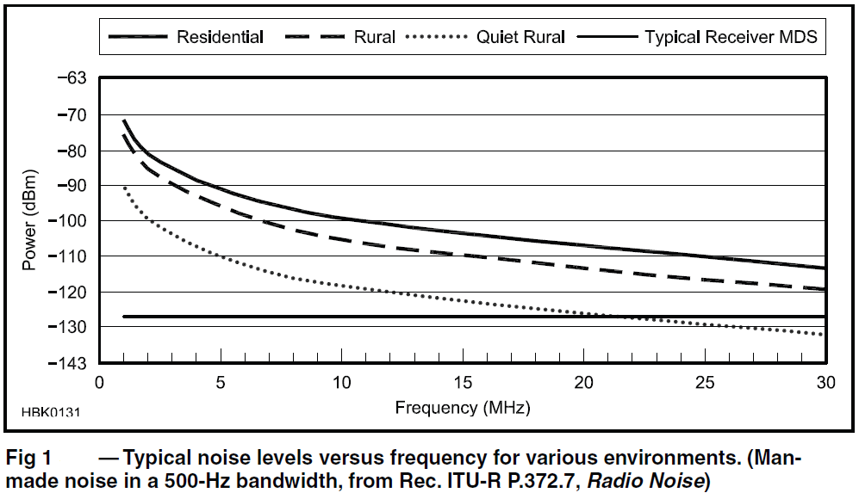
Band Noise vs. Frequency from ARRL Handbook

Slide 13
Most Radios are designed for 10 meters
It is easy to assume that a -140 dBm noise floor is better than a -130 dBm noise floor.
If band noise on 20 meters is typically -110 dBm, of what value is a receiver noise floor that is 20 to 30 dB lower than band noise?
The short answer is that it isn’t useful, unless we operate our receiver in an optimum way. (Use your attenuator on the lower bands.)
Two things to remember:
Band noise easily changes 10 dB depending on beam heading.
Optimally receiver noise should be 8 to 10 dB lower than band noise to have minimal effect on receiving weak signals.
Notes:
“The short answer is that it isn’t useful…” reads better.

Slide 14
How does band noise vary by band?
If we take the ITU rural data as a starting point, what is typical?
160 meters: -87 dBm
80 meters: -93 dBm
40 meters: -101 dBm
20 meters: -109 dBm
15 meters: -114 dBm
10 meters: -119 dBm
That’s a 30+ dB difference in band noise

Slide 15
Measured band noise at NC0B
160 meters 8:00 AM MST: -105 dBm January 2014
160 meters 4:00 PM MST: -101 dBm 160 meter CQ
160 meters 6:30 PM MST: -91 dBm CW Contest
ITU rural nominal value: -87 dBm
Beam Heading, October 2013 15 meters 10 meters
0 degrees beam heading: -124 dBm -129 dBm
30 degrees: -124 dBm -123 dBm
60 degrees: -118 dBm -120 dBm
90 degrees: -114 dBm -120 dBm
120 degrees: -113 dBm -122 dBm
150 degrees: -114 dBm -122 dBm
ITU rural nominal value: -114 dBm -119 dBm

Slide 16
Typical receiver noise floor values
Rig Preamp OFF Preamp ON
Pro III -132 dBm -140 dBm
TS-990 -127 dBm -138 dBm
K3 -130 dBm -138 dBm
ITU band noise on 40 meters is around -100 dBm, while typical receiver noise floor (no preamp) is -130 dBm, or 30 dB lower !
Notes:
“ITU band noise on 40m is around -100 dBm…” flows better.

Slide 17
What does all this imply?
For most radios: Up-conversion / down-conversion
On the lower bands, attenuation is often appropriate.
There is no point in band noise reading upscale on your S meter.
A preamp is rarely needed on 20 meters.
A preamp would never be needed on 40 meters and below, assuming the transmit antenna is used on receive.
Notes:
upscale: should be one word

Slide 18
Where do these examples not apply?
Direct sampling radios are very different
Their overload point is much higher, and the noise floor is also much higher without a preamp
Examples of direct sampling radios:
Perseus receiver (CW Skimmer)
Apache ANAN-100D
Flex 6500 or 6700
Notes:
Should be: ANAN-100D

Slide 19
Some comparison data
Rig Noise Floor Preamp Off / On Noise Figure Preamp Off / On
Icom Pro III -132 dBm / -140 dBm 12 dB / 4 dB
Elecraft K3 -130 dBm / -138 dBm 14 dB / 6 dB
Kenwood 990S -127 dBm / -138 dBm 17 dB / 6 dB
Flex 6700 -118 dBm / -134 dBm 26 dB / 10 dB
For classic radios with normal mixers (up-conversion or down-conversion) attenuation is often helpful in potential overload conditions (contests / DX pile-ups) on 40 meters and below. Possibly even on 20 meters.
For direct sampling radios, attenuation would rarely be needed, but a preamp would be useful on 15 meters and up.

Slide 20
How do we chose a new transceiver?
On most bands receivers are too sensitive.
Make the most of the radio’s dynamic range by properly using the attenuator and using the preamp only when necessary.
Published dynamic range can be misleading, depending on how it is measured. Read the fine print, as I discussed last year.
Look at RMDR, as this typically dominates.
(RMDR* = Reciprocal Mixing Dynamic Range)
[*QST April 2012 for sidebar – Bob Allison]
It is a numbers game today!
Evaluation in contest conditions is critical.
A lab setup can never approximate CQ WW !

Slide 21
Important factors to consider
Note: Use of the 6, 10 or 12 dB attenuator does affect the AGC threshold, so there may be a compromise between AGC and potential overload improvement.
Contest Fatigue is a subject I have been harping on for years.
What makes us tired in a contest beyond just the hours on the air?

Slide 22
Examples of Contest Fatigue Issues
Distortion in the audio from the product detector & audio amp or DSP artifacts.
A very fast AGC decay, though at time necessary, fills holes between words on SSB or letters on CW with noise.
Few radios have an adjustable AGC threshold, but can use RF gain control.
Flex 6000 series does remember AGC threshold by band (not by mode/bandwidth).

Slide 23
How to cope on noisy bands
Set the AGC threshold so punching in 6 dB attenuation definitely drops the band noise.
If the band noise is as loud as a weak but Q5 signal, this adds to fatigue.
If your receiver has hiss or hum in your phones, consider plugging your phones into a speaker that has high-pass and low-pass filters.
Examples: Icom SP-20, SP-23 or SP-34
Yaesu SP-2000 or Kenwood SP-990
Notes:
Should be SP-2000, SP-990.

Slide 24
Transmit IMD Needs to be improved
Receivers have improved dramatically over the past 10 years, but rarely so transmitters.
AI0L had complaints of being broad.
Comparing rig A & amp A to rig B and amp B
Desired sideband was S9 +15 dB
Opposite sideband with “A” combo = S8
Opposite sideband with “B” combo = S2
“A” combo is current rig & solid-state amp
“B” combo is 30 year old rig & 2x3CX800As

Slide 25
Transmit Intermodulation IC-7410
White noise fed into mic jack to approximate speech using IC-7410.
(This is a typical example, not just this rig.)
Look at the “shoulders” of IMD close-in to the transmit passband.
If this station is 3 kHz away and is strong, hearing a weak signal will be difficult.

Slide 26
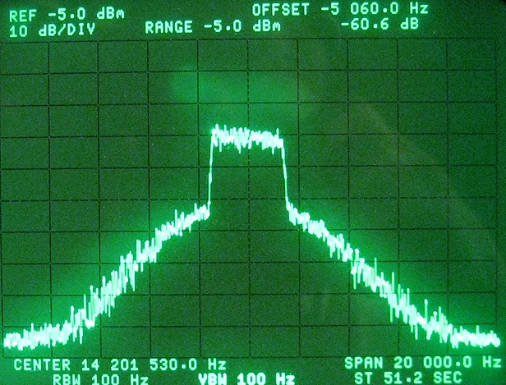
Icom IC-7410 Class AB, White Noise
Noise source = GR 1381, 5-kHz -3 dB BW
3 kHz from edge
40 dB down @ 3 kHz
Notes:
Actually, IC-7410 PA operates in Class AB (180° < conduction angle < 360°)
26

Slide 27
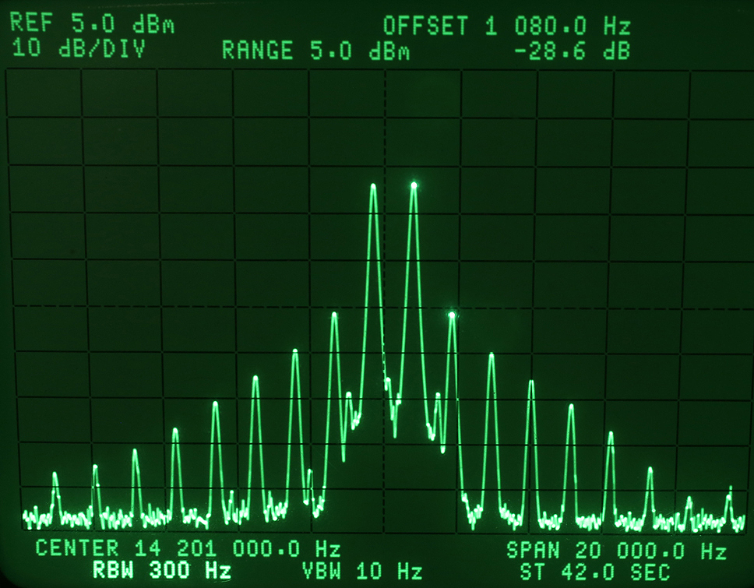
Tones are 700 Hz and 1800 Hz
Icom IC-781 Classic 2-Tone Test 3rd order -28 dB
-34 dB below PEP

Slide 28
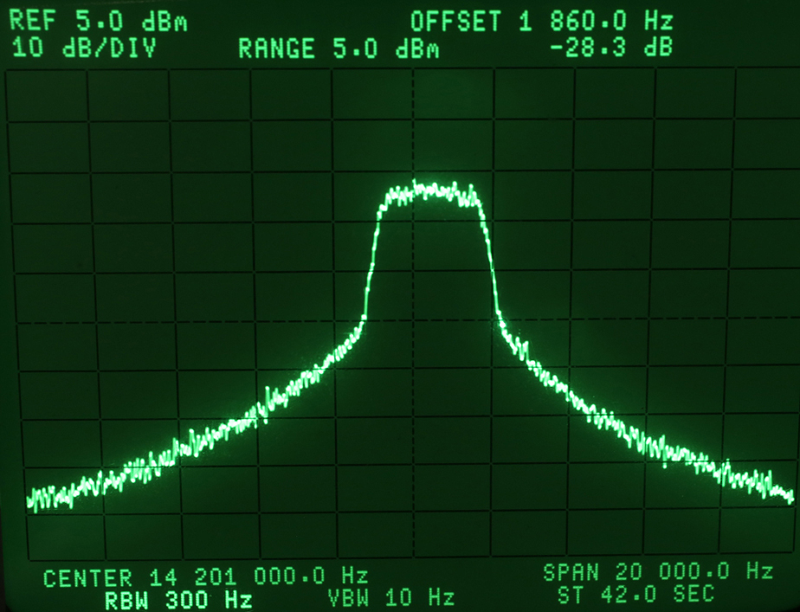
GR 1381 BW = 5 kHz @ -3 dB
IC-781 White Noise Intermodulation Occupied Bandwidth
28 dB

Slide 29
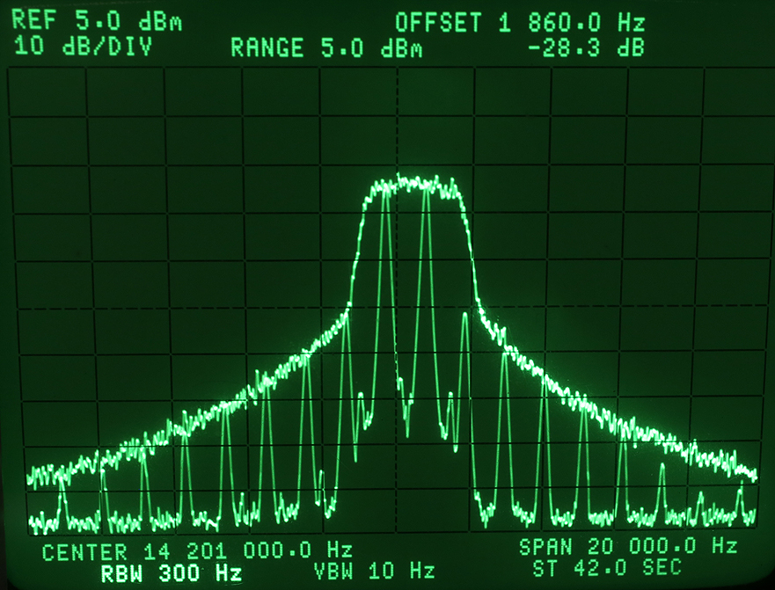
How Wide Is Your Signal ?
Comparison 2-Tone vs. Noise Intermodulation Bandwidth
3 kHz
-37 dB
Notes:
Remark: The overlay of the white noise IMD spectrum over the 2-tone IMD spectrum is pretty conclusive. They match very closely. I do not see how the “pink noise advocate” can rebut this. It may be interesting to add a similar image for the 7410.
In general, I always point out to my audience that as long as the ITU-R guideline remains at -25 dBc (ref. one of 2 equal tones) for single-channel J3E, we can expect nothing better from the ham equipment OEM’s. (Rec. SM.326-7, Sec. 1.2.3)

Slide 30
Broad signals Also Exist on CW
The following slide shows the difference between a rise time of 3 milliseconds vs. 10 milliseconds.
There is a 20 dB difference in the strength of the key click 700 Hz removed from the transmitting station.
(Transmitter was a Ten-Tec Omni-VII that has a menu to adjust the rise time.)

Slide 31
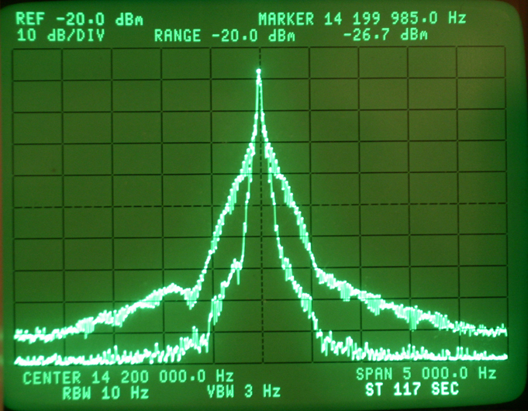
Spectrum of CW Signal on HP 3585A Analyzer
Comparison of 3 msec vs 10 msec rise time
20 dB difference

Slide 32
AGC Impulse Noise Anomaly
Most new radios since 2003 exaggerate impulse noise.
Elecraft K3, KX3 & updated Ten-Tec rigs incorporate DSP code that ignores clicks, ticks and pops.
Elecraft calls it the Sherwood Test.
Notes:
“Elecraft K3, KX3 & updated Ten-Tec incorporate DSP code to ignore a tick, click or pop.” reads better.

Slide 33
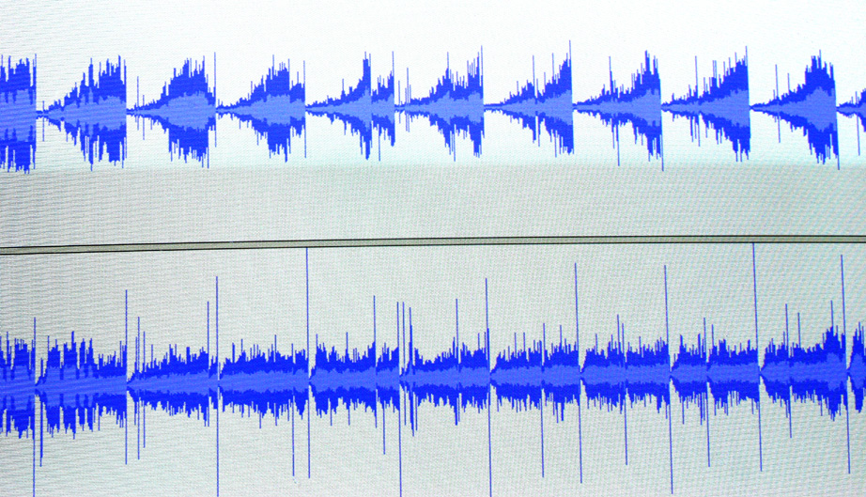
Omni-7 on Top - Pro III on Bottom
CW signal about 15 WPM
Electric Fence firing off every 2 seconds, 160 meters
2 sec

Slide 34

Listen to 30 second audio clip
Audio Icom 756 Pro III
160 meters, 4 PM, Dec 13, 2008
Electric fence & CW signals
KV4FZ calling DX station
Note volume level relatively constant

Slide 35
Audio clip with DSP AGC problem
Audio Ten-Tec Omni-VII
160 meters, 4 PM, Dec 13, 2008
Electric Fence & CW signals
Exact same signals as with Pro III
Note AGC being hammered by impulses
Other rigs with the same AGC problem:
IC-7800, IC-7700, IC-7600 & IC-7000
FTdx-9000, FTdx-5000, FTdx-3000
Orion II & T-T Eagle now fixed.
Notes:
The DSP-based noise blanker in the newer Icom radios (IC-7600/7700/7800/7410/9100/7200) and in the Perseus SDR effectively mitigates this AGC response to fast-rising RF events by modifying the AGC attack profile. If properly adjusted, the NB will not cause distortion or degrade recovered audio quality.

Slide 36
Contest Fatigue from audio artifacts
In the “good old days”, a pair of 6V6s in push pull were common. Audio was smooth and pleasant.
Often today receive audio is an afterthought.
The rig manufacturers need to be concerned about the noise and distortion beyond the 300 to 3000 Hz bandwidth. Our ears hear much more than 2700 Hz of bandwidth.
Notes:
afterthought – should be one word
Interestingly, the receive audio in commercial and military HF comms receivers cuts off aggressively at or just above 3000 Hz to minimise listening fatigue on voice circuits.

Slide 37
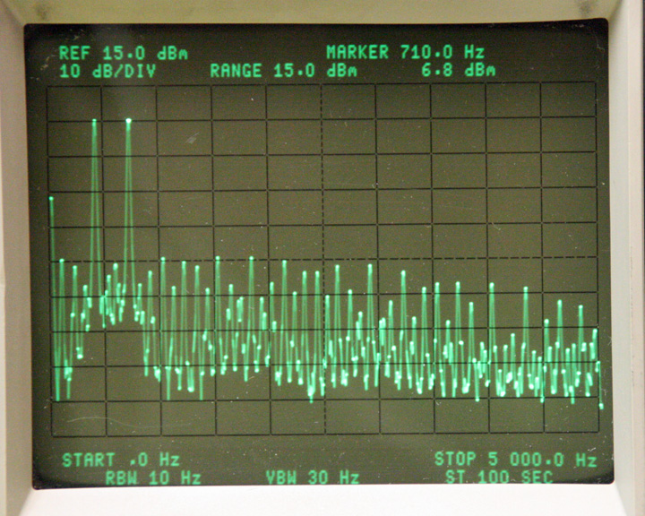
Screen shot from Elecraft Lab Fall 2008
Factory Confirms K3 Audio Problem

Slide 38
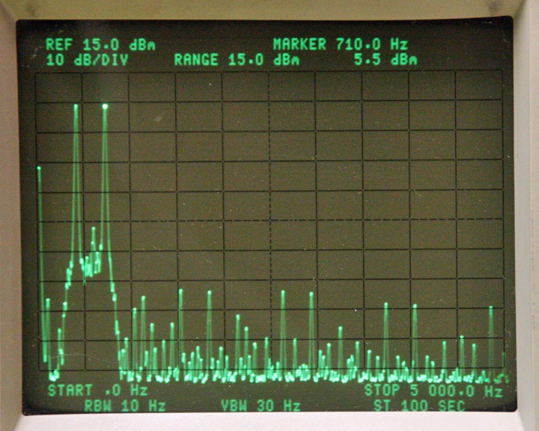
K3 After New Choke Installed
Factory Addresses K3 Audio Problem

Slide 39
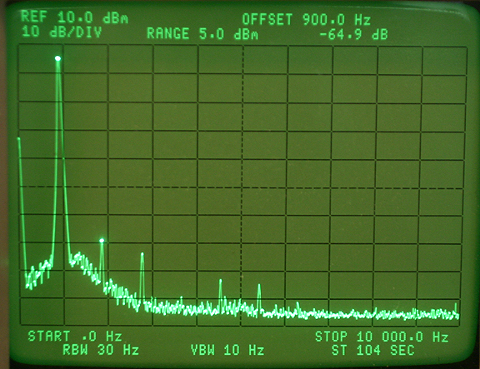
Icom 756 Pro III Harmonic Distortion
0.1 % distortion

Slide 40
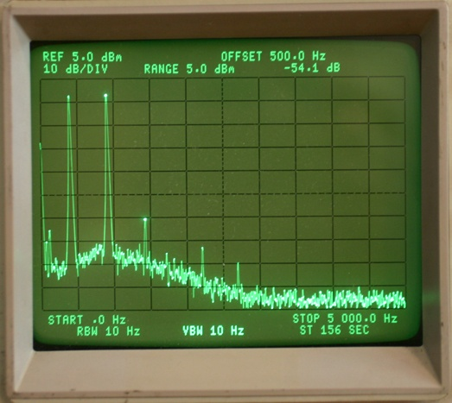
Icom 756 Pro III in-band IMD Distortion
< 0.3 % distortion
-54 dB 3rd Order IMD

Slide 41
Choices today on rig selection
We have rigs from $1000 to $18,000 for sale.
Many do well in contest conditions.
It is hard to evaluate on-air performance from some of the published data.
Many aspects of a radio affect contest scores
In the end, hopefully you enjoy using your rig on the air !
Notes:
It is hard to evaluate…

Slide 42

http://www.NC0B.com
Sherwood Engineering
http://www.sherwood-engineering.com
Videos from past CTU presentations
CTU 2013
http://www.contestuniversity.com/main/page_videos.html
CTU 2011
http://www.pvrc.org/webinar/radioperformance.wmv

