Slide 1
Contesting 201: Making and Keeping your Score
Randy Thompson, K5ZD
Notes:
50 Minutes
Original title - “Getting the most out of your station – Contest operating strategies”

Slide 2
Purpose of this Session
Discuss factors important to creating winning scores
Discuss how to avoid score reductions
Use CQWW Contest as real-world example

Slide 3
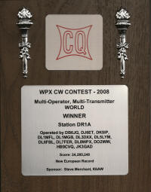

Choose the Game
Select category
All band or single band?
Power – High, low, QRP?
Assisted or unassisted?
Set a goal
Have fun?
Win a certificate?
Set a record?

Slide 4
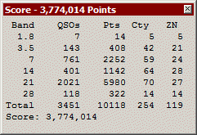
Understand Scoring
Points for each QSO?
Per mode?
Per continent?
By band?
What is a multiplier?
Section? Zone? Country? Prefix?
Constantly evaluate what you are doing against the final score

Slide 5
Example - ARRL Sweepstakes
You have 1000 QSOs x 80 sec
Which is more valuable?
1 more section or 10 contacts?
= 160,000 points
1001 x 81 sections = 162,162 points
1010 QSOs x 80 sec = 161,600 points
It takes 14 contacts to equal that new section!
@60 QSOs/hour – 14 minutes
@30 QSOs/hour – 28 minutes

Slide 6
Example – CQ WW
You have 1000 QSOs, 100 Zones, 250 countries
Which is more valuable?
Getting the 40th zone on 20 meters?
Working 10 more contacts?
~ 980,000 points
1001 x 352 = 986,586 points
1010 x 350 = 989,800 points
Each mult is only worth 2.8 QSOs!
@60 QSOs/hour – 4 minutes
@30 QSOs/hour – 7 minutes
All scores assume 2.8 points/QSO
Notes:
Assume 2.8 pts/QSO

Slide 7
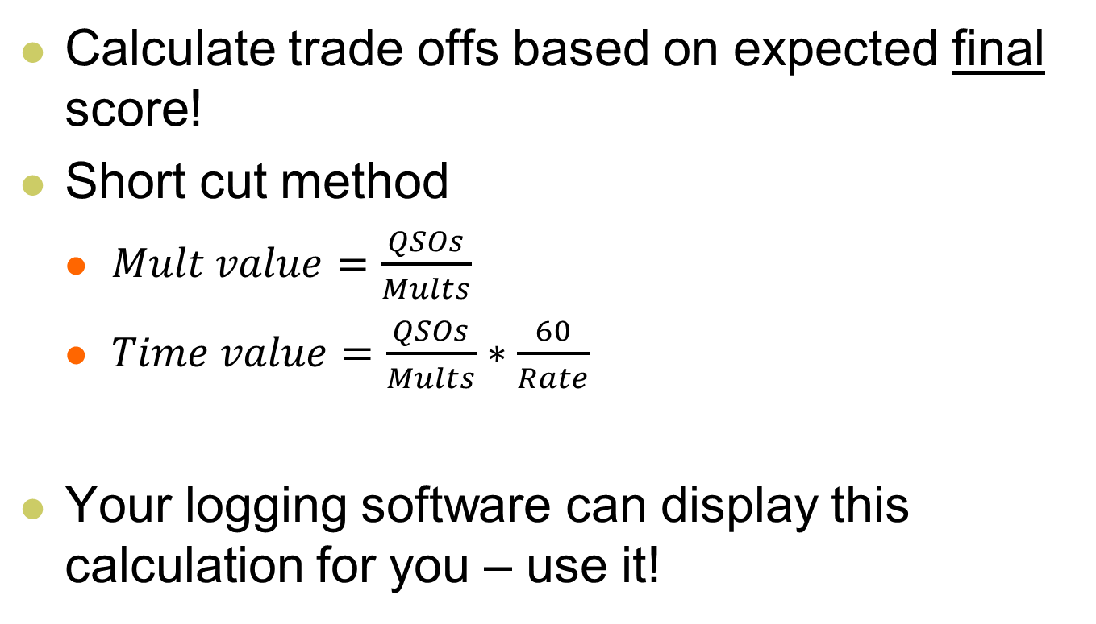
Tips
Calculate trade offs based on expected final score!
Short cut method
$Mult value=\frac{QSOs}{Mults}$
$Time value=\frac{QSOs}{Mults}∗\frac{60}{Rate}$
Your logging software can display this calculation for you – use it!
The higher the rate…
The less time you can spend!

Slide 8
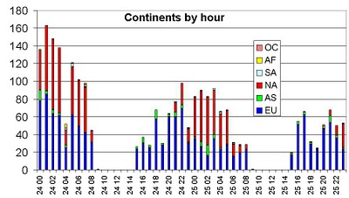
Log Analysis
Study past results and logs
Do the winners focus on QSOs or multipliers?
Where do the QSOs come from?
Do activity patterns repeat?

Slide 9
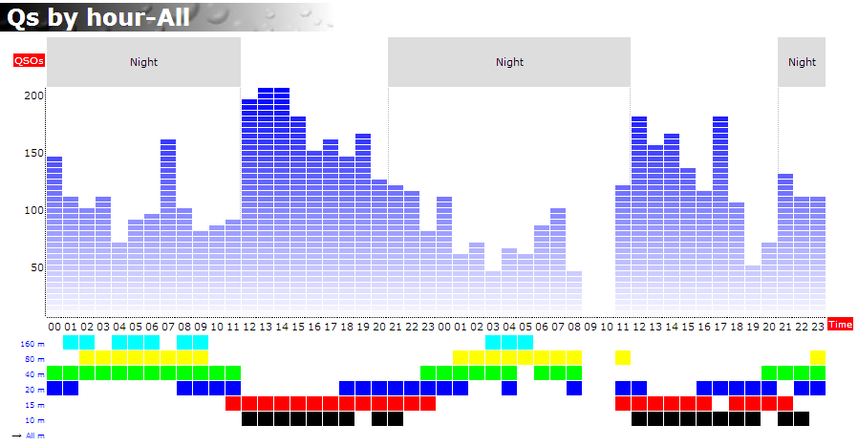
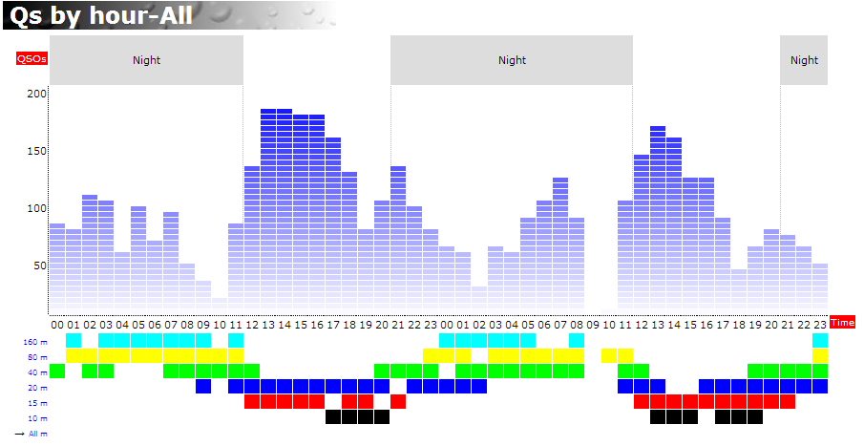
Activity Patterns Repeat
K5ZD/1
WW CW
2013
K5ZD/1
WW CW
2006
Rate charts by SH5 software

Slide 10
Make a Plan
CQWW and WPX logs are open…what did your closest peer do differently?
Where do the QSOs come from?
Do activity patterns repeat?
What hours to be on the air?
Expected opening times for each band
When to “run” and when to “search”

Slide 11
Make Good QSOs
Know who you are calling
NEVER NEVER TRUST CLUSTER SPOTS!
Know who is calling you!
Does the prefix make sense for the situation?
Ask for repeats if you are not sure
ERRORS REDUCE YOUR SCORE!!!!

Slide 12
Cost of Errors
Many contests have a penalty for errors
Loss of QSO
Loss of QSO + 1x, 2x, or 3x penalty
Errors happen
Focus on yours and how to prevent them
Post contest “log washing” is not an acceptable practice

Slide 13
Improve your Vocabulary
English has 180,000 words
Average person uses 10,000 – 12,000 words
College educated uses 15,000 – 20,000 words
CQ WW SSB 2013 logs had 108,210 calls
60,991 only appeared in only one log
Experience says >95% of these are errors
18,343 appeared in 20 or more logs
You should “know” 5,000 – 10,000 calls

Slide 14
Common Busts
SSB
CW
V and W
E and I
G and J
WW SSB Most Busted
HA3ØS
B9/BY9GA
DFØHQ
TC9ØA
ES9C
I, S, H, 5
V and 4
B and 6
WW CW Most Busted
JS3CTQ
ES9C
HF9Q
V47T
HA3ØS

Slide 15
Which of these calls are bad?
C73NL | FY5KE | LY7A | RG8U
CD6416 | GT8IOM | OB9DCM | TM6M
E2E | 1B1B | M5O | W0ASH
EY8MM | HI3TIJ | P3W | YU15OTC

Slide 16
Which of these calls are bad?
C73NL | FY5KE | LY7A | RG8U
CD6416 | GT8IOM | OB9DCM | TM6M
E2E | 1B1B | M5O | W0ASH
EY8MM | HI3TIJ | P3W | YU15OTC
Correct Calls
C37NL | FY5KE | LY7A | RG8U
CD6416 | GT8IOM | HB9DCM | TM6M
E2E | IB1B | M5O | W0AIH
EY8MM | HI3TEJ | P33W | YU15OTC

Slide 17
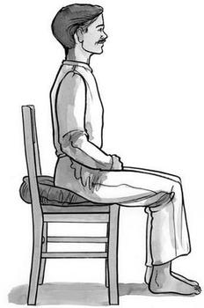
BIC – Butt in Chair
No other single thing will help you more to improve your scores
It only works if you spend your time working people

Slide 18
BIC Strategy
Plan your life to meet your contest goal
Work, family, food, rest, station repairs
Part time?
BIC for the best rate or at different times each day
Have a goal!

Slide 19
Sleep Facts
You can not train for lack of sleep
You can not store sleep
Under sleep deprivation, highly practiced skills will deteriorate more slowly than those which require new or creative thought

Slide 20

Contest Sleep Strategy
Preparation
Have good physical fitness
Stay on your normal sleep schedule
Get extra sleep 4-7 days before the contest
Take 3 hour nap before contest starts
During the contest
Sleep for 90 or 180 minutes
Avoid caffeine until needed

Slide 21
Remember your goal!
Fatigue will make you want to quit
A short nap is better than quitting
Sleep during low rates so you are fresh during the high rate periods

Slide 22
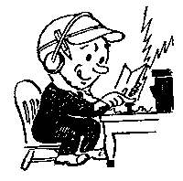
Keep Pushing
Use time wisely
The clock never stops
The next QSO could make the difference!
Pay attention to accuracy
Everyone is experiencing the same conditions!
Don’t get frustrated

Slide 23
CQ WW DX Contest

Slide 24
CQ WW is the Big One!
2013
SSB = 8,468
CW = 7,440
2012
SSB = 8,189
CW = 7,229

Slide 25
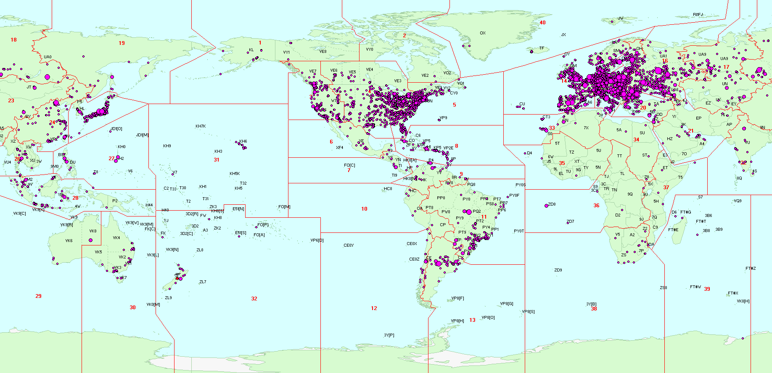
Entries - CQ WW Phone 2013
All entries from CQ WW Phone 2013
Locations from QRZ.com
Map by DXAtlas
Thanks to ZL2HAM

Slide 26
Entry Categories
 | 1500 W | 100 W | 5 W
Single Op All Bands | X | X | X
Single Op Single Band (160, 80, 40, 20, 15, 10) | X | X | X
Single Op Assisted All Bands | X | X | X
Single Op Assisted Single Band (160, 80, 40, 20, 15, 10) | X | X | X
Overlay – Rookie (All Bands) | X | X
Overlay – Classic (All Bands) | X | X
Multi-Op Single-Transmitter | X
Multi-Op Two-Transmitter | X
Multi-Op Multi-Transmitter | X
Checklog | X

Slide 27
New Overlay Categories!
Overlay Categories (Single Op Only)
Rookie – Licensed <3 years
Classic – One radio, no assistance, 24 hours
Enter by adding line to Cabrillo header
CATEGORY-OVERLAY: ROOKIE
CATEGORY-OVERLAY: CLASSIC
Entrants will have two scores in results
Traditional category score
Overlay category score calculated as All Bands regardless of log entry category

Slide 28
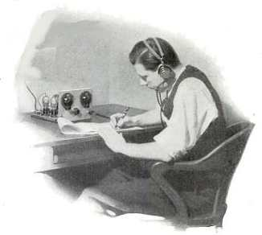
Classic Overlay
One Operator
One Radio
No DX Cluster (no Assisted)
24 hours of operating time
>60 minutes with no QSO is considered “off-time”
You may operate more time, but only first 24 hours of operating time will count for Overlay score
0000 – 0200z 2:00
0500 – 0900z 4:00
1200 – 2200z 10:00
0400 – 0900z 5:00
1300 – 1600z 3:00
24:00
1600 – 1800z n/a

Slide 29
Entry Categories – 2013 SSB
 | 1500 W | 100 W | 5 W | Total
Single Op All Bands | 960 | 2104 | 118 | 3182
Single Op Single Band (160, 80, 40, 20, 15, 10) | 489 | 1049 | 134 | 1672
Single Op Assisted All Bands | 974 | 765 | 24 | 1763
Single Op Assisted Single Band (160, 80, 40, 20, 15, 10) | 472 | 396 | 49 | 917
Overlay – Rookie (All Bands) | 29 | 227 |  | 256
Overlay – Classic (All Bands) | 295 | 500 |  | 795
Multi-Op Single-Transmitter | 375
Multi-Op Two-Transmitter | 115
Multi-Op Multi-Transmitter | 68
Checklog | 376

Slide 30
Submit your log!
Use Cabrillo format
One log per callsign
Put the correct callsign in the log!
Confirm entry category is correct
All dates/times are within contest period
Read the robot confirmation email
Visit logs received web page to confirm

Slide 31
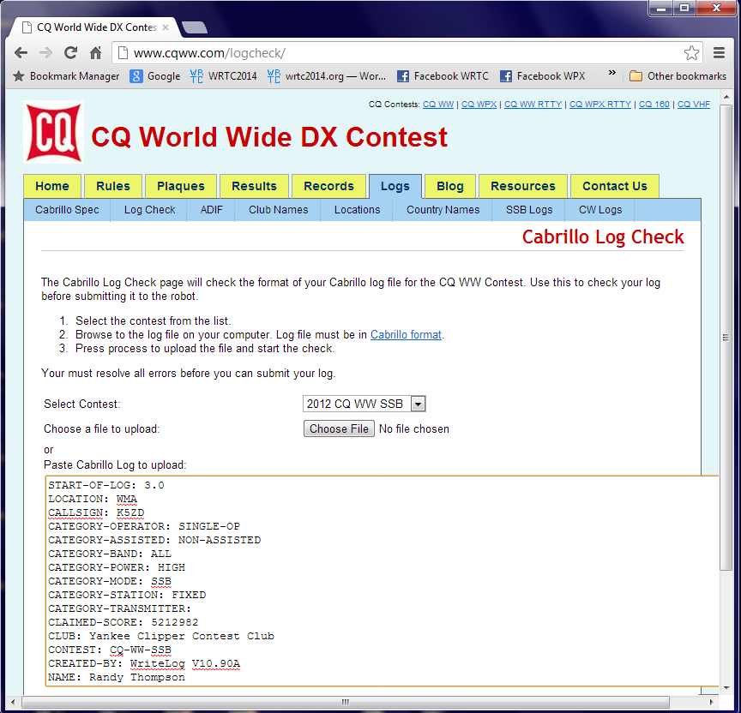
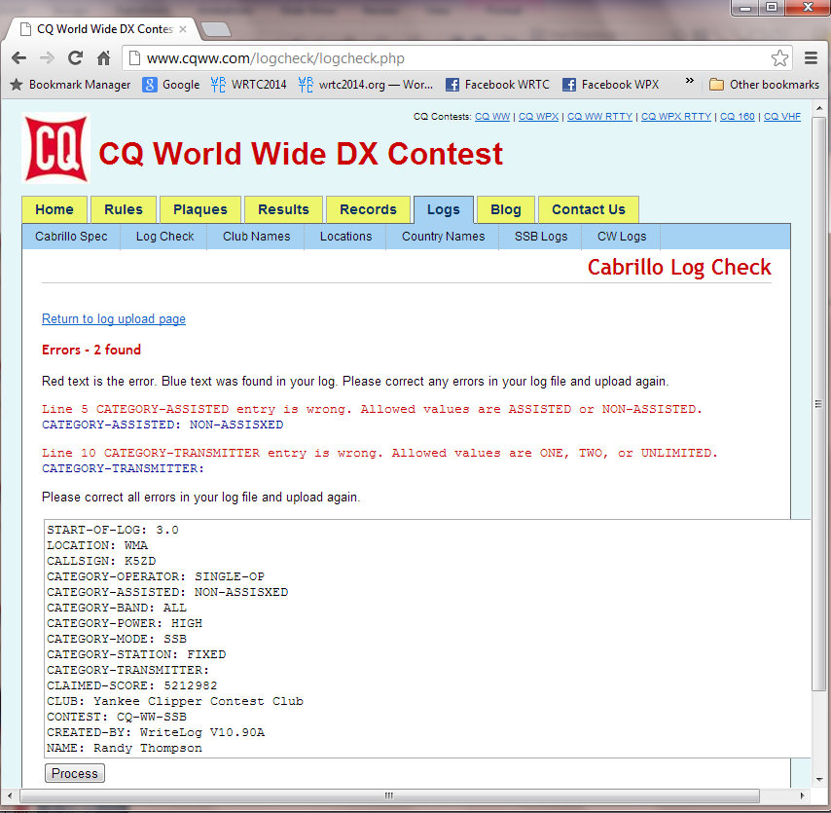
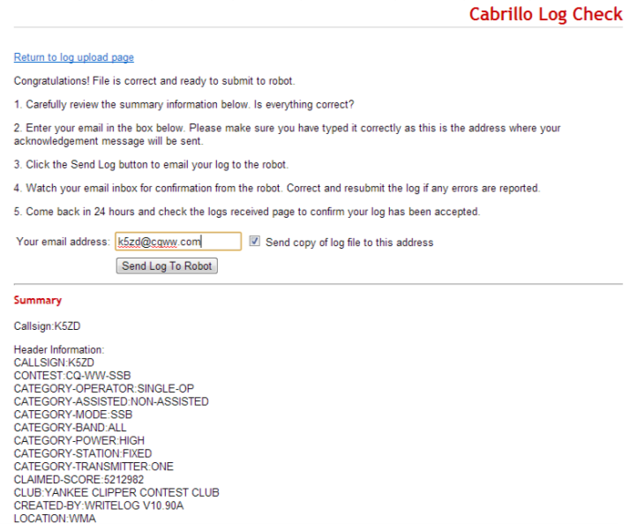
Log Check Tool
http://www.cqww.com/logcheck/

Slide 32
Penalties for Logging Errors
Duplicate contacts or Incorrect exchange
Removed, no penalty
Call sign errors or Not-In-Log (NIL)
Removed + 2x the QSO point value for that contact
Multi-operator band change errors
Removed, no penalty

Slide 33
Log Checking Notes
QSOs must match within a time window (+/-30 minutes)
No match = Not In Log
Please check the time on your logging computer!
Log every QSO you make including dupes!
Exchange information will be checked
Use extra attention when working USA stations

Slide 34
Log Checking Report
All entrants in CQ WW will be sent a log checking report
LCR shows
How score and penalties were calculated
Lists all errors detected
Shows all multipliers counted
List of how other stations made mistakes when working you

Slide 35
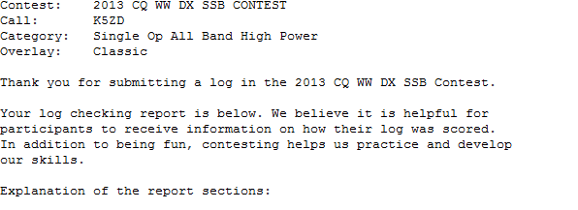
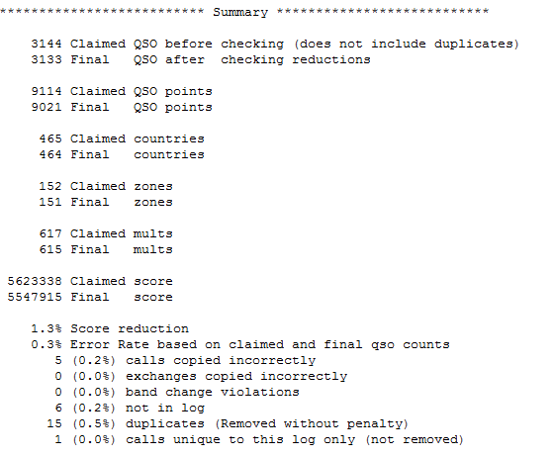

$$Error rate=\frac{Errors}{Claimed QSOs −Dupes}$$

Slide 36
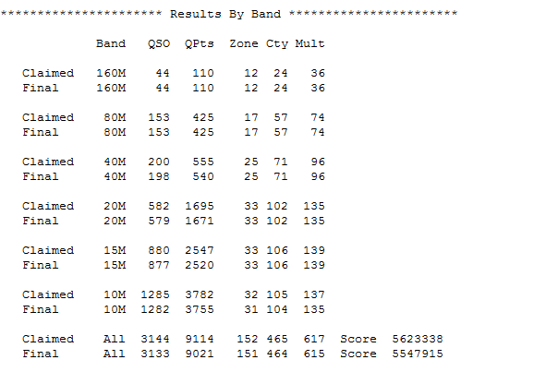
How We Calculated Your Score

Slide 37
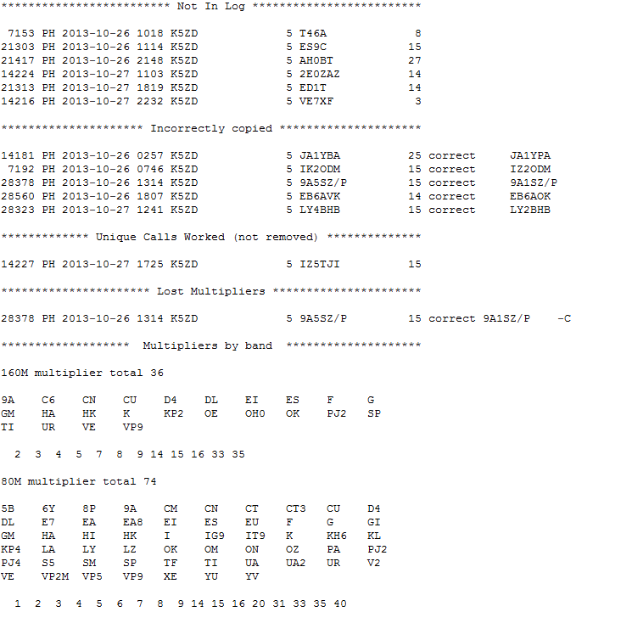
Your Errors
Uniques FYI
Multipliers

Slide 38
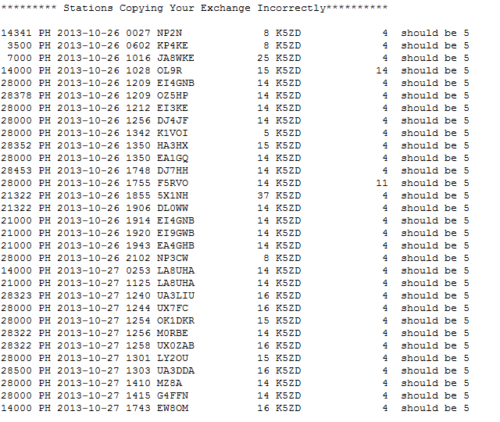
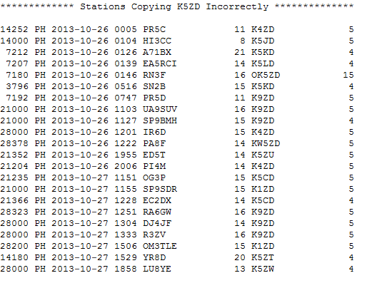
Mistakes Made By Others
Study the errors that others make when working you

Slide 39
Summary
Have a goal and a plan
Understand the scoring
Expand your callsign vocabulary
B.I.C.
Submit log
Study your LCR
Have fun!

Slide 40

World Wide Radio Operators Foundation
Non-profit corporation focused on support of radio contesting
Developed contester’s code of ethics
WWROF funds
CQWW infrastructure including the robot, web site, log checking software/hardware
Webinar series
Other projects that support contesting
Learn more and donate at www.WWROF.org

Slide 41
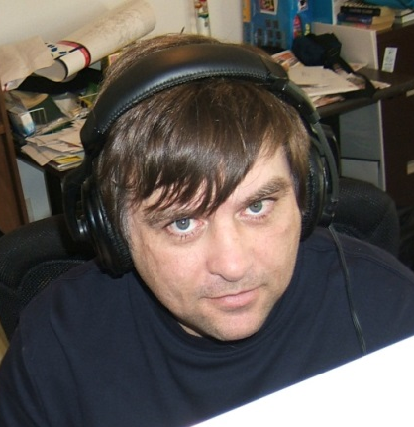
Questions?
Score
Preparation
Motivation
Accuracy
Planning
Efficiency
Hour 43 – The “look”

