Slide 1
Adapting Your Contest Strategies to the Rapidly Declining Solar Cycle 24
Two more years of declining solar activity
Then at least three years of solar minimum

Slide 2
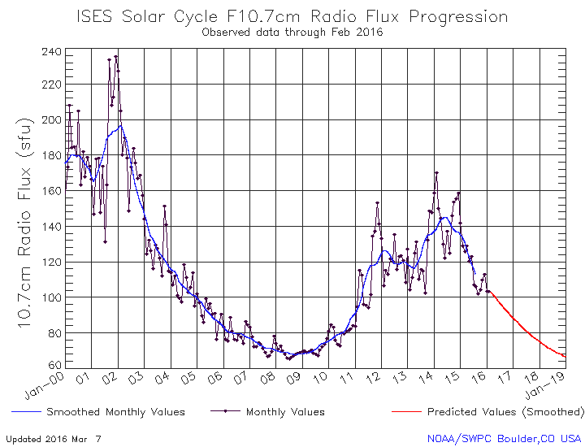
Two More Years of Declining Solar Activity Then Three+ Years of Solar Minimum

Slide 3
What About Solar Cycle 25 ?? Precursors of a possibly weak Solar Cycle 25
Unusually weak solar polar magnetic field strengths
field strengths should reach their peak between 2018 and 2020
www.solen.info/solar/polarfields/polarfields.jpg
Unusually large numbers of spotless days
possibly starting later this year or next year
Unusually quiet geomagnetic field from 2018 to 2020+
reported by the A-index
Unusually late appearance of new Solar Cycle 25 sunspots
new Solar Cycle 25 sun spots should appear by 2020
Unusually long solar minimum
solar flux in the low 70s persisting after 2020
Sunspot Number
Accurate Cycle 25 forecasting is not possible until about three years after solar minimum

Slide 4
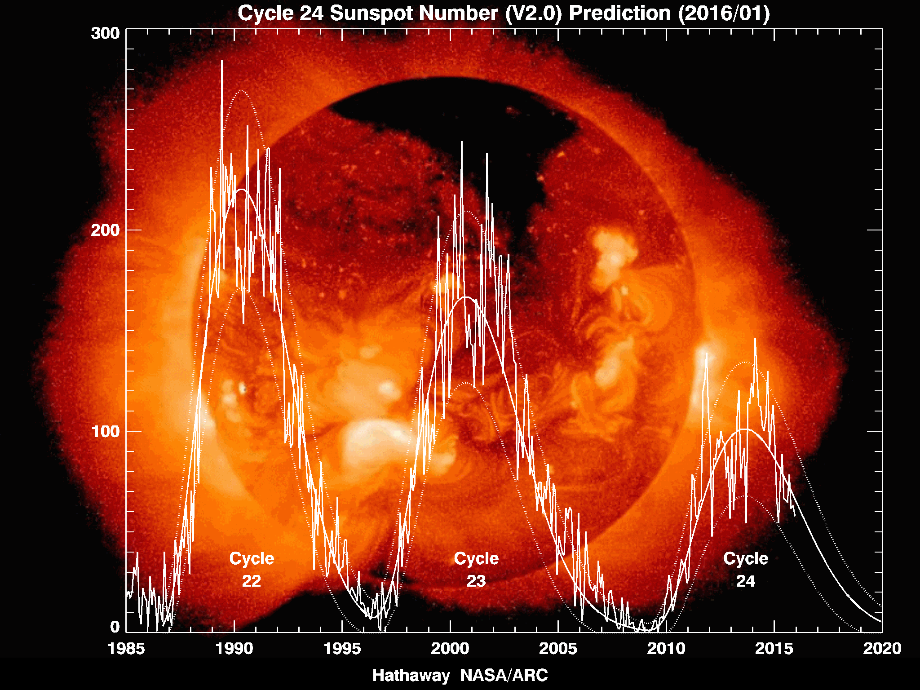
Declining Solar Activity Since Cycle 22 Suggests a Weak Solar Cycle 25
Cycle 25?

Slide 5
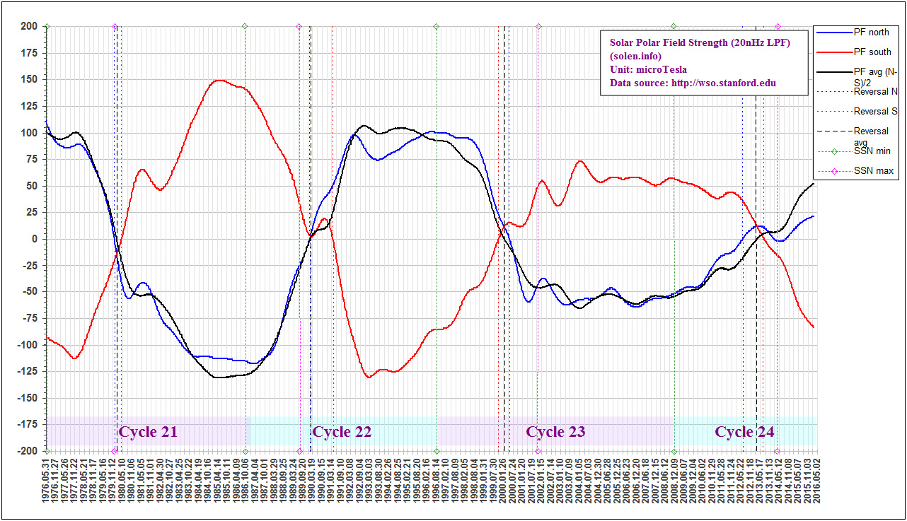
The Sun’s Polar Magnetic Field Strength A Reliable Precursor of Solar Cycle 25
Strong polar field strengths late in Solar Cycle 21
Weak polar field strengths late in Solar Cycle 23
-200 uT Polar Field Strength +200 uT
Polar magnetic field strengths late in Cycle 24?
Cycle 25
www.solen.info/solar/polarfields/polar.html

Slide 6
160 Meter Propagation During the Two Year Decline to Solar Minimum
Improving DX propagation
stronger signals
more reliable openings especially to Europe and Japan
lower geomagnetic activity
especially as we approach solar minimum in ~2020
declining daytime D layer absorption before sunset and after sunrise
declining nighttime E layer absorption
More crowded band conditions
especially when there is no strong 40 meter propagation to Europe
Longer and more regular worldwide openings
reliable openings to Europe, Mid-East & north Africa 2130-0830Z
more frequent openings to JA at our sunrise ~1200-1230Z

Slide 7
80 Meter Propagation During the Two Year Decline to Solar Minimum
Improving DX propagation
stronger signals
more reliable openings especially to Europe and Japan
lower geomagnetic activity
especially as we approach solar minimum in ~2020
declining daytime D layer absorption before sunset and after sunrise
declining nighttime E layer absorption
More crowded band conditions
especially when there is no strong 40 meter propagation to Europe
Longer and more regular worldwide openings
continuous openings to Europe, Mid-East & north Africa 2100-0830Z
regular openings to JA starting before sunrise ~1130-1300Z

Slide 8
40 Meter Propagation During the Two Year Decline to Solar Minimum
Nearly 24 hour DX propagation during CQWW CW
Europe, Mid-East, north Africa propagation
activity QSYs to 40 meters earlier in the afternoon ~1930Z
don’t miss the strong mid-afternoon European openings!
beginning at about 1930Z to 2030Z (earlier in New England)
propagation may fail several hours after our sunset at about 0100Z
strong openings often resume at European sunrise: ~0600-0900Z
Japan, Far East and Central Asia propagation
brief direct path opening starting before JA sunset: 0800-0900Z
weak skew path opening at ~ 240 degrees azimuth ~0900-1130Z
the strongest opening from the east coast: ~1130-1300Z
direct path strong signals for an hour or more
strong long path signals at 150 degrees azimuth: 2130-2215Z
VK/ZL and south Asia long path propagation 2100-2300Z
south and central Asia long path propagation ~1200-1300Z

Slide 9
20 Meter Propagation During the Two Year Decline to Solar Minimum
Usually closes well before midnight ~0300Z
usually stays closed all night
Europe, Mid-East, north Africa propagation
from before our sunrise until mid afternoon ~1000-1900Z
the opening may be delayed to until sunrise or later
shorter openings than we’ve enjoyed in recent years
Japan, Far East and central Asia propagation
afternoon short path opening from 2130Z to about 0000Z
morning short path opening from about 1300Z to about 1500Z
significantly shorter openings than we’ve enjoyed in recent years
Long path to VK/ZL and south Asia starting in mid-afternoon
starting about 1900Z until our sunset
Long path to south Asia begins about an hour after our sunrise
starting about 1300Z until about 1500Z

Slide 10
15 Meter Propagation During the Two Year Decline to Solar Minimum
Usually closes a few hours after our sunset ~0200Z
always stays closed all night
Europe, Mid-East, north Africa propagation
from about our sunrise until mid-afternoon 1200Z to about 1800Z
much shorter openings than we’ve enjoyed in recent years
Japan, Far East and central Asia propagation
afternoon short path opening from 2130 to about 0000Z
morning long path opening from about 1300Z to about 1400Z
polar opening to central Asia from about 1400 to about1600Z
much shorter openings than we’ve enjoyed in recent years

Slide 11
10 Meter Propagation During the Two Year Decline to Solar Minimum
Usually starts to open about an hour after our sunrise ~1300Z
Usually closes a few hours after our sunset ~0000Z
always stays closed all night
Europe, Mid-East, north Africa propagation
short path propagation becomes less frequent and much shorter
weak signal skew paths (110-150 degrees) typically ~1400-1700Z
Japan and Far East propagation
short path propagation is extremely unusual
morning long path starting at about 1300Z to about 1400Z
evening skew paths (200-270 degrees) from ~2130Z to 2230Z

Slide 12
DX Contest Strategies for the Two Year Decline to Solar Minimum
Improve your low band antennas this summer!
Start the contest on 40 meters
the strong European opening could end after just a few hours
Capitalize on improving 160 and 80M propagation 0200-0830Z
mainly when 40 meters is not strongly open to Europe
Look for a strong European opening on 40 meters 0600-0900Z
160, 80 and 40 meter openings to VK, ZL, JA 0900-1230Z
Look for the start of the 20M European opening 1000-1200Z
Look for the start of the 15M European opening 1200-1400Z
Check 10 meters frequently for propagation 1300-2200Z
Start of the strong 40M meter European opening at ~2000Z
Look for short 15 and 20 meter JA openings 2130-2300Z

