Slide 1

New transceiver options since CTU 2015
+
Performance – What’s Possible & What’s Needed?
Rob Sherwood
NCØB
How to optimize what you currently own
Sherwood Engineering

Slide 2
What is important in a Contest Environment?
We need Good Dynamic Range to hear weak signals in the presence of near-by strong signals.
In a Dxpedition the pile-up is typically:
CW signals “Up 2” or SSB signals “Up 5”
Contests – DX pile-up, it is the same problem
You need a better receiver for CW than for SSB.
How does published test data relate to reception of weak signals?

Slide 3
State-of-the-Art in Dynamic Range today
Close-in dynamic range (DR3) > 105 dB
Phase noise @ 10 kHz ≤ -145 dBc / Hz
Reciprocal Mixing (RMDR) > 115 dB
Rigs with this kind of performance:
Icom IC-7851, Flex 6700 & Elecraft K3S
Apache ANAN-200D not far behind

Slide 4
What is new since last year?
Icom 7851 Flagship up-conversion transceiver
Icom 7300 Direct-Sampling transceiver
Elecraft K3S update of the K3
New software for Apache ANAN-200D

Slide 5
Icom IC-7851 numbers
Greatly improved synthesizer (phase noise)
New 1.2 kHz VHF roofing filter
20 kHz dynamic range: 110 dB
2 kHz dynamic range: 105 dB
20 kHz RMDR: 125 dB
2 kHz RMDR: 115 dB
Noise floor as low at -141 dBm Preamp 2

Slide 6
Icom IC-7300 numbers
First direct-sampling SDR from the big three!
Tunes with knobs & touch LCD, no computer
20 kHz dynamic range: 103 dB (IP+)
2 kHz dynamic range: 94 dB (IP+)
20 kHz RMDR: 113 dB
2 kHz RMDR: 100 dB
Noise floor as low at -142 dBm Preamp 2

Slide 7
Elecraft K3S numbers
Greatly improved synthesizer
Improved receive audio
New 6-pole roofing filters, low passive IMD
20 kHz dynamic range: 107 dB
2 kHz dynamic range: 106 dB
20 kHz RMDR: 118 dB
2 kHz RMDR: 113 dB
New internal preamp 12 – 6 meters
Noise floor as low as -145 dBm

Slide 8
Apache ANAN new software features
Open Source code = new features fast
Better DSP filter defaults, particularly CW
Spectral NB works in contest conditions
New NR algorithms
Midi support for DJ Console for mechanical knobs or control via a tablet
For the “techie” new band noise measurement capabilities

Slide 9
Time for the numbers
What do these state-of-the-art numbers mean?
How do we cope with a more typical radio?
Optimize performance of what we own

Slide 10
What does dynamic range mean?
Two equal signals are fed into the receiver.
Third-order IMD is dominant.
Level increased until distortion = noise floor
This level vs. the noise floor = dynamic range
Defined in QST 1975
Noise floor = -128 dBm, test level = -28 dBm
-128 dBm minus -28 dBm = 100 dB
Dynamic Range (DR3) = 100 dB
Notes:
“dominant” is correct usage here.

Slide 11
Third Order IMD to Measure Dynamic Range
Signal
Signal
2 kHz spacing
IMD
IMD
2 kHz spacing
2 kHz spacing

Slide 12
A note on phase noise / RMDR
Reciprocal Mixing Dynamic Range (RMDR)
Only since late in 2013 has the ARRL consistently emphasized the importance of good phase noise performance (RMDR).
Read Bob Allison’s sidebar April 2012 QST & latest update May 2016 QST for details.
Peter Hart (G3SJX) for RSGB has long published RMDR data.
Notes:
Peter Hart G3SJX (RSGB) has always tested RMDR and stated it in his RadCom reviews.

Slide 13
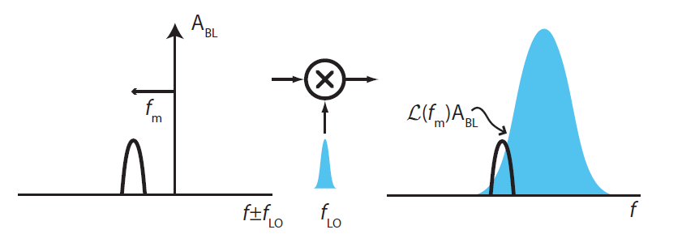
Reciprocal mixing puts LO noise on top of weak signal
Noisy LO
Strong signal
Weak signal
© Asad Abidi
Noisy local oscillator (LO) transfers its noise to the strong out-of-passband signal and on top of the weak signal we are trying to copy.

Slide 14
RMDR often dominates over DR3
Only a few “legacy” transceivers, plus direct-sampling SDR radios have RMDR > DR3.
Elecraft K3 w/ new synthesizer, K3S or KX3
Hilberling PT-8000A
Icom IC-7850, IC-7851 & IC-7300
Flex 6700, 6500 & 6300
Apache ANAN-200D

Slide 15
How do you relate to this data?
Typical receiver, preamp OFF
Noise floor = -128 dBm
“Holy grail” 100 dB DR3 radio (@ 2kHz)
Can handle signals -28 dBm = S9 +45 dB
Note: That is above the receiver’s noise floor
How does that relate to band noise?
Will get to that in a moment.

Slide 16
Luckily we can live with 85 dB radios
What performance is usually good enough?
From the advent of “up-conversion” radios around 1979 (TR-7) until 2003 with the Orion I, all we had were 70 dB DR3 radios at 2 kHz.
These were barely adequate on SSB and not acceptable on CW in DX pile-ups or contests.
If we operate our 85 to 90 dB radios properly, they perform well in most environments.
Most of the time our radios are not stressed to their limits.

Slide 17
Dynamic Range of Top 14 Transceivers
Close-in 2-kHz Test @ 500 Hz BW
Elecraft K3S 106 dB
Icom 7851 105 dB
Flex 6700 99 / 108 dB (preamp Off/On)
Hilberling 105 dB
Elecraft KX3 104 dB
FTdx-5000D 101 dB
Flex 5000 96 dB
Elecraft K3 95 dB (original synthesizer)
Orion II 95 dB
Icom 7300 94 dB (IP+)
Orion I 93 dB
TS-590SG 92 dB
TT Eagle 90 dB
Flex 3000 90 dB

Slide 18
Why is higher DR3 needed on CW?
Transmitted bandwidth of an adjacent strong signal may be the limit, not receiver overload.
A CW signal is about 1 kHz wide at -60 dB.
An SSB signal is about 10 kHz wide at -60 dB.
A CW pile-up may overload your receiver.
On SSB, splatter will likely dominate before the receiver dynamic range is exceeded.
Notes:
Add comma after “On SSB,:

Slide 19
What is the Bandwidth of a CW Signal?
On-channel signal = S9 + 40 dB (-33 dBm)
Receiver = K3, 400 Hz 8-pole roofing + 400 Hz DSP Filter
Transmitter = Omni-VII with adjustable rise time
Undesired signal 700 Hz away, continuous “dits” at 30 wpm
Rise time of Omni-VII Strength of CW sidebands
Signal S9 + 40 -33 dBm Ref
3 msec S7 -83 dBm -50 dB
4 msec S6 -88 dBm
5 msec S6 -88 dBm
6 msec S5 -93 dBm 22 dB !
7 msec S4 -99 dBm
8 msec S4 -99 dBm
9 msec S4 -99 dBm
10 msec S3 -105 dBm -72 dB
Notes:
On-channel

Slide 20
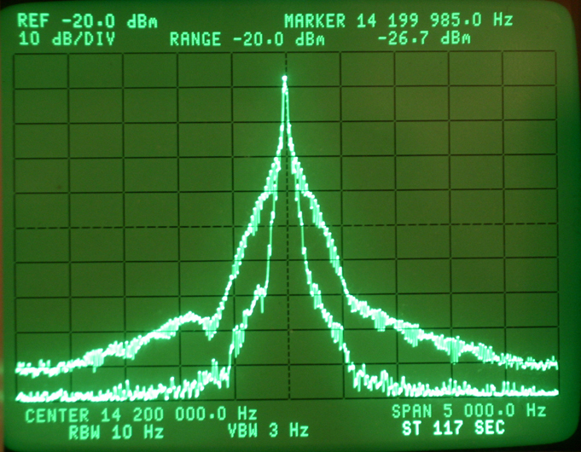
Spectrum of CW Signal on HP 3585A Analyzer
Many rigs are much faster than 3 msec
Comparison of 3 msec vs 10 msec rise time
20 dB difference

Slide 21
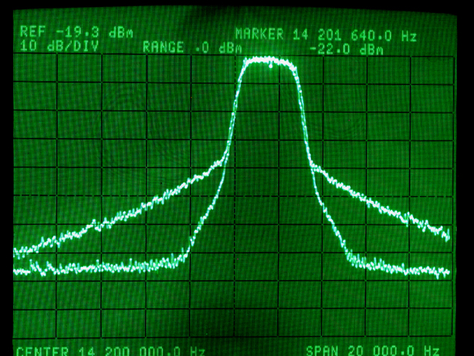
White Noise Mk V Class A vs. K3 Class B @ 75 Watts
Apache PureSignal much like class A
-60 dB
6 kHz
-60 dB
1.5 kHz
Courtesy W6XX

Slide 22
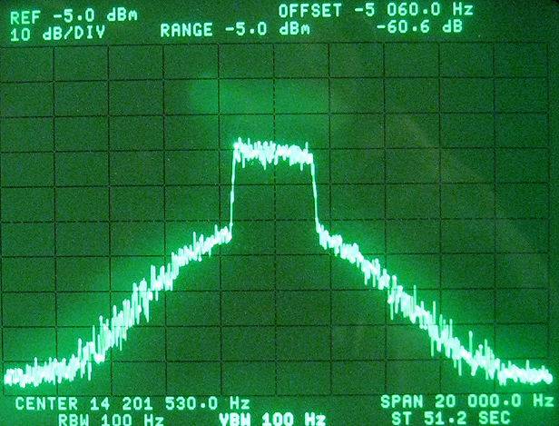
Icom IC-7410 Class AB, White Noise
Noise source = GR 1381, 5-kHz -3 dB BW
5 kHz from edge
60 dB down @ 5 kHz

Slide 23
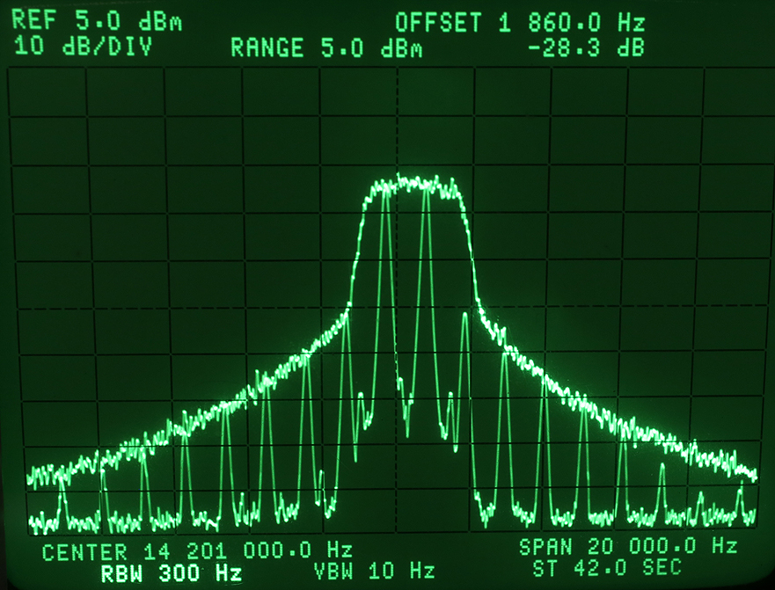
How Wide Is Your Signal ?
Comparison 2-Tone vs. Noise Intermodulation Bandwidth
3 kHz
-37 dB

Slide 24
How do we optimize what we have?
While we might own a 100+ dB DR3 radio, many of us have somewhat less performance.
My TS-990S is around a 90 dB radio @ 2 kHz.
Consider dynamic range a “window” of performance that can be moved around in absolute level by properly using your attenuator or preamp.

Slide 25
Receiver Noise Floor vs. Band Noise
When is the spec for noise floor significant?
Why does it rarely matter on most bands?
Noise Floor is usually significantly lower than Band Noise.
An ITU graph published in the ARRL Handbook gives us a starting point to relate band noise to noise floor.
This ITU data is in a 500-Hz bandwidth, just like typical noise floor data.

Slide 26
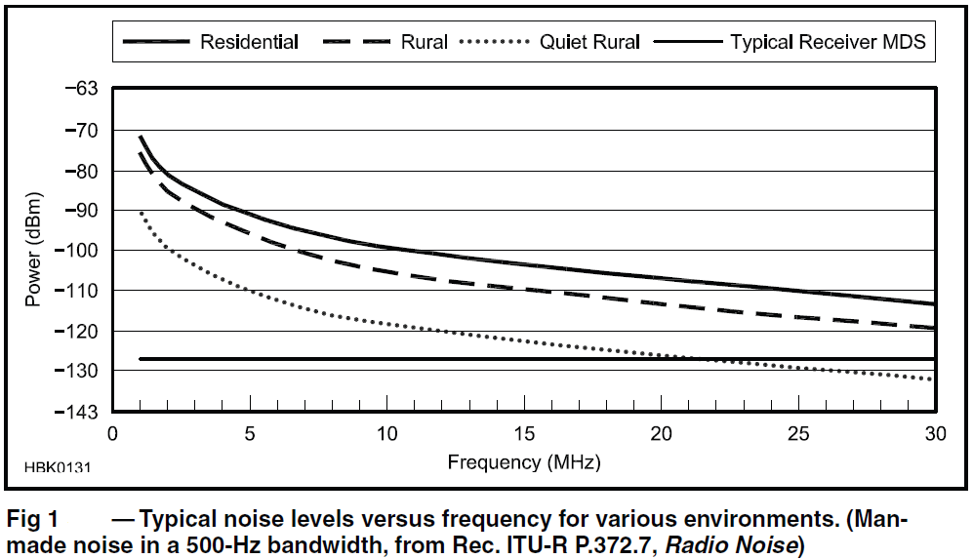
Band Noise vs. Frequency from ARRL Handbook

Slide 27
Most Radios are designed for 10 meters
Typical rural band noise on 10 meters is -120 dBm
Typical rural band noise on 20 meters is -110 dBm
On 20 meters, band noise is almost 20 dB higher than typical receiver noise with the preamp OFF !
Optimally receiver noise should be 8 to 10 dB lower than band noise to have minimal effect on receiving weak signals.
Even on 10 & 15 meters, a preamp isn’t needed all the time in a rural environment.

Slide 28
A simple test with only an analog meter
Most hams don’t own a calibrated signal generator.
How do you evaluate your receiver?
This also evaluates your antenna !
Measure the noise gain when you connect your antenna.
All you need is an analog meter with a dB scale, hooked up to your speaker.

Slide 29
Measure the noise gain
Disconnect your antenna and set the volume so your dB meter reads -10 dB.
(Put a dummy load on the rig, though open circuit usually works OK, too.)
Connect the antenna and see how many dB the noise goes up when tuned to a dead spot on the band.
Do this with Preamp OFF and ON.
Also rotate your Yagi 360 degrees.
Noise can easily change 10 dB with azimuth!

Slide 30
15 & 10 meters noise gain
Rig = Icom IC-756 Pro III
10 meter antenna = Hy-gain 105CA @ 65 feet
15 meter antenna = Hy-gain 155CA @ 70 feet
Preamp 15m 10m
None 4 dB 3 dB*
Preamp 1 11.5 dB 9.5 dB
Preamp 2 13.0 dB 11.0 dB
* @ 3 dB, receiver noise = band noise = not OK
Notes:
Changed to standard S.I. format

Slide 31
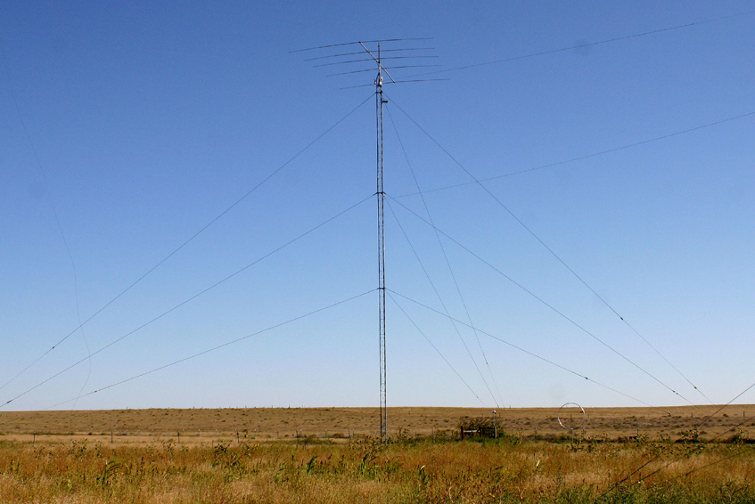
LJ-155CA Yagi in band noise example

Slide 32
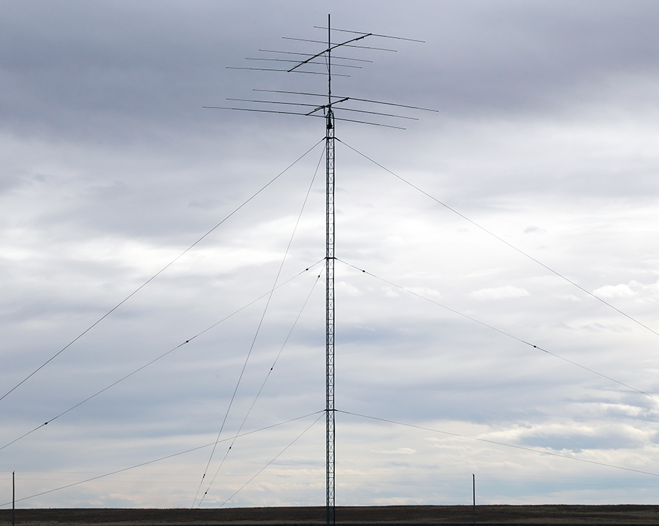
LJ-105CA in band noise example

Slide 33
How does band noise vary by band?
If we take the ITU rural data as a starting point, what is typical?
160 meters: -87 dBm *
80 meters: -93 dBm *
40 meters: -101 dBm *
20 meters: -109 dBm #
15 meters: -114 dBm #
10 meters: -119 dBm #
That’s a 30+ dB difference in band noise
* = nighttime # = daytime

Slide 34
Measured band noise at NC0B
160 meters 8:00 AM MST: -105 dBm January 2014
160 meters 4:00 PM MST: -101 dBm 160 meter CQ
160 meters 6:30 PM MST: -91 dBm CW Contest
ITU rural nominal value: -87 dBm
Beam Heading, October 2013 15 meters 10 meters
0 degrees beam heading: -124 dBm -129 dBm
30 degrees: -124 dBm -123 dBm
60 degrees: -118 dBm -120 dBm
90 degrees: -114 dBm -120 dBm
120 degrees: -113 dBm -122 dBm
150 degrees: -114 dBm -122 dBm
ITU rural nominal value: -114 dBm -119 dBm

Slide 35
ITU / ARRL Data is generally correct
Those numbers = starting point for a rural QTH
On a give day there can be ± 10 dB differences
In 2014 ARRL 10 Meter SSB my noise floor was 10 dB lower than the rural ITU value, pointed West between 3 and 5 PM local time while working ZL, VK & JAs.
(5 element monoband Yagi @ 65 feet)
Urban QTH with RFI noise, all bets are off
How’s your neighbor’s Plasma TV ?
Notes:
Standard symbol

Slide 36
A note about the ITU data
The ITU data assumes an omni-directional antenna.
Your Yagi or directional low-band antenna (4-square) can significantly improve on your band noise in some directions.

Slide 37
Noise Floor Quite Consistent in Top 12
Numbers with Preamp-1 ON
Flex 6700 -135 dBm
Icom 7851 -135 dBm
Elecraft K3s -138 dBm
Elecraft KX3 -138 dBm
FTdx-5000D -135 dBm
Flex 5000 -135 dBm
Orion II -133 dBm
Icom 7300 -141 dBm
Orion I -135 dBm
T-T Eagle -132 dBm
Flex 3000 -139 dBm
TS-590SG -135 dBm
Drake R-4C -138 dBm (For comparison)

Slide 38
What does all this imply?
For most radios: Up-conversion / down-conversion
On the lower bands at night, attenuation is often appropriate.
There is no point in band noise reading upscale on your S meter.
A preamp is usually NOT needed on 20 meters.
A preamp would never be needed at night on 40 meters and below, assuming the transmit antenna is used on receive.
Notes:
Emphasize “never”

Slide 39
Contests: 2015 / 2016
Reducing Contest Fatigue
February CQ SSB Contest 160m
Using a TS-990S during the day attenuator = 6 dB
During nighttime, attenuator = 12 dB, occasionally 18 dB !
Set the AGC threshold about 6 dB above band noise.
January CQ CW Contest 160m
Using Apache ANAN-200D, I set the AGC threshold about 6 dB above band noise. Time of day dependent
(December 2014 ARRL 160 m CW contest set AGC-T)
March 2016 ARRL SSB DX Contest using TS-990S
10m – Preamp & 6 dB pad or occasionally 12 dB pad !
Notes:
Inserted spacing line below “SSB Contest…”. SI abbreviations for band designators.

Slide 40
Times of day can break the general rules
In a rural environment, daytime band noise on 80 and 40 meters can be quite low.
Noon at my QTH 40 meters -115 dBm
8:30 AM my QTH 80 meters -120 dBm
Flex 6300 has no preamp below 30 meters*
There are times when you need a -128 dBm noise floor on 40 and 80 meters.
* Flex says this will be corrected, likely 2nd quarter 2016. Cost to retrofit unknown.

Slide 41
How do we evaluate & optimize a transceiver?
160 – 40m receivers are too sensitive at night.
Make the most of the radio’s dynamic range by properly using the attenuator and using the preamp only when necessary on the high bands.
Published dynamic range can be misleading, depending on how it is measured. This could be a complete presentation on its own.
Look at RMDR, as this typically dominates.
(RMDR* = Reciprocal Mixing Dynamic Range)
[*QST April 2012 for sidebar – Bob Allison]
It is a numbers game today!
Evaluation in pile-up conditions is critical.
A lab setup can never approximate CQ WW !
Notes:
SI band designator

Slide 42

http://www.NC0B.com
Sherwood Engineering
Videos from past CTU presentations
CTU 2015 (select from all presenters)
https://www.youtube.com/playlist?list=PLRSwUN4qr1Lq50amRtsZm-y2nKPHHRz0v
CTU 2013 & 2014 (Select desired year)
http://www.contestuniversity.com/main/page_videos.html
CTU 2011
http://www.pvrc.org/webinar/radioperformance.wmv

