Slide 1
CTU Presents
Fair Play – How to Earn and Keep Respect, K4RO

Slide 2
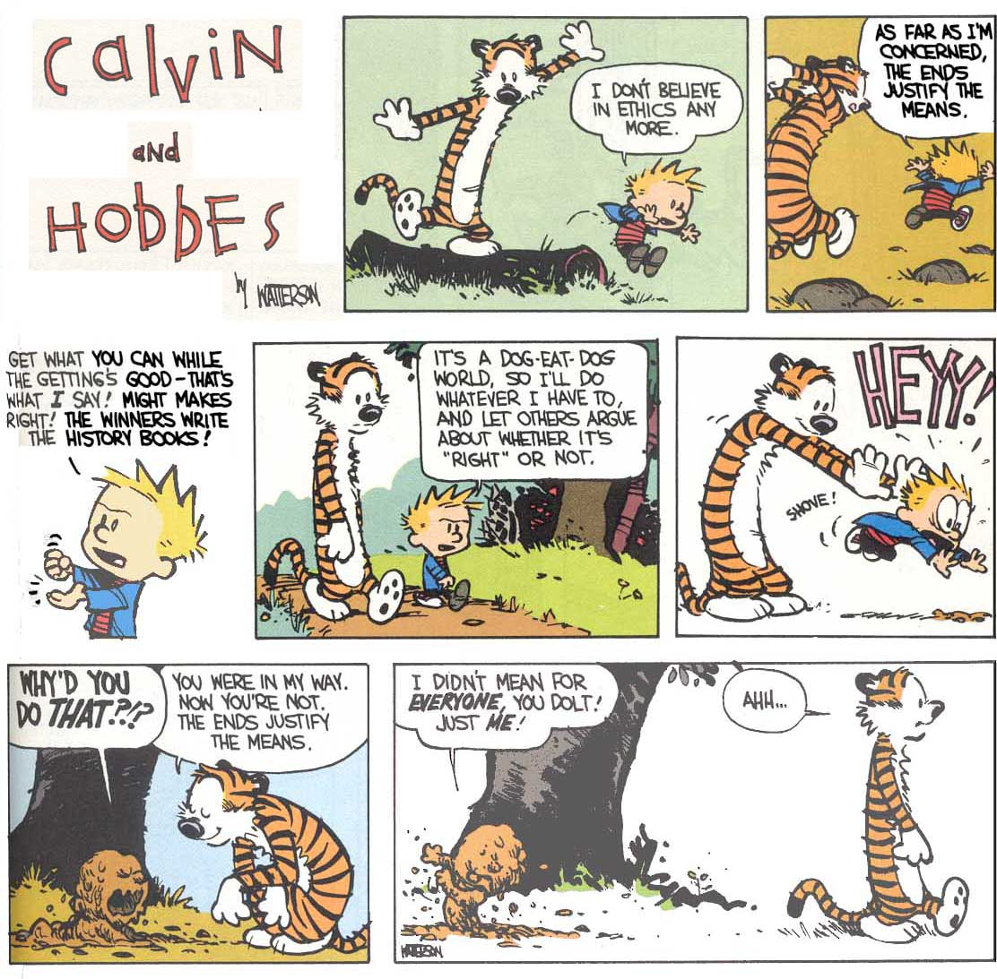

Slide 3
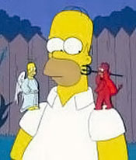
Purpose of this Session
Discussion of what ethical behavior is in radio contesting

Slide 4
Purpose of this Session
Discussion of what ethical behavior is in radio contesting
Understand the impact of unethical behavior, and some of the motivations behind it

Slide 5
Purpose of this Session
Discussion of what ethical behavior is in radio contesting
Understand the impact of unethical behavior, and some of the motivations behind it
Encourage us to take ownership of our own behavior and encourage others to do the same

Slide 6
Who are We?
K4RO check 76. Formerly WB3FAX.
Notes:
Grateful to be a PART OF a group whom I respect.
Less than 5 years? More than 30 years? In between?

Slide 7
Who are We?
K4RO check 76. Formerly WB3FAX
QSYed to W4 in 1980
Notes:
Grateful to be a PART OF a group whom I respect.
Less than 5 years? More than 30 years? In between?

Slide 8
Who are We?
K4RO check 76. Formerly WB3FAX
QSYed to W4 in 1980
First contest entry 1994 – Late to the game
Notes:
Grateful to be a PART OF a group whom I respect.
Less than 5 years? More than 30 years? In between?

Slide 9
Who are We?
K4RO check 76. Formerly WB3FAX
QSYed to W4 in 1980
First contest entry 1994 – Late to the game
Enthralled with the magic of radio
Notes:
Grateful to be a PART OF a group whom I respect.
Less than 5 years? More than 30 years? In between?

Slide 10
Who are We?
K4RO check 76. Formerly WB3FAX
QSYed to W4 in 1980
First contest entry 1994 – Late to the game
Enthralled with the magic of radio
Hopelessly hooked on contesting game
Notes:
Grateful to be a PART OF a group whom I respect.
Less than 5 years? More than 30 years? In between?

Slide 11
Who are We?
K4RO check 76. Formerly WB3FAX
QSYed to W4 in 1980
First contest entry 1994 – Late to the game
Enthralled with the magic of radio
Hopelessly hooked on contesting game
Grateful to the contesting community
Notes:
Grateful to be a PART OF a group whom I respect.
Less than 5 years? More than 30 years? In between?

Slide 12
Who are We?
K4RO check 76. Formerly WB3FAX
QSYed to W4 in 1980
First contest entry 1994 – Late to the game
Enthralled with the magic of radio
Hopelessly hooked on contesting game
Grateful to the contesting community
Audience contesting experience?
Notes:
Grateful to be a PART OF a group whom I respect.
Less than 5 years? More than 30 years? In between?

Slide 13
Acknowledgments
This presentation draws on material developed by Ken Adams, K5KA (SK), Randy Thompson, K5ZD, Doug Grant K1DG, Larry Tyree N6TR, Dave McCarty K5GN and Ward Silver N0AX.

Slide 14
Acknowledgments
This presentation draws on material developed by Ken Adams, K5KA (SK), Randy Thompson, K5ZD, Doug Grant K1DG, Larry Tyree N6TR, Dave McCarty K5GN and Ward Silver N0AX.
Grateful to be standing on the shoulders of giants

Slide 15
Why do we play games?
What is a game?
A contest with rules to determine a winner
An amusement, pastime, entertainment

Slide 16
Why do we play games?
What is a game?
A contest with rules to determine a winner
An amusement, pastime, entertainment
Games provide players with
A means of exploring one's own capabilities
An opportunity to look at, understand, and experience things
Lessons about themselves and possibly the world.

Slide 17
An unusual game
Entrants keep their own score

Slide 18
An unusual game
Entrants keep their own score
Complex rules govern scoring

Slide 19
An unusual game
Entrants keep their own score
Complex rules govern scoring
Individuals and “team” entries permitted

Slide 20
An unusual game
Entrants keep their own score
Complex rules govern scoring
Individuals and “team” entries permitted
Some events include off-times

Slide 21
An unusual game
Entrants keep their own score
Complex rules govern scoring
Individuals and “team” entries permitted
Some events include off-times
Winners of the top-level event often invest $50k or more and travel to favorable locations

Slide 22
An unusual game
Entrants keep their own score
Complex rules govern scoring
Individuals and “team” entries permitted
Some events include off-times
Winners of the top-level event often invest $50k or more and travel to favorable locations
An on-line network helps participants increase their scores

Slide 23
An unusual game
Entrants keep their own score
Complex rules govern scoring
Individuals and “team” entries permitted
Some events include off-times
Winners of the top-level event often invest $50k or more and travel to favorable locations
An on-line network helps participants increase their scores
Spectators don’t find it particularly interesting

Slide 24
Is this Radio Contesting?

Slide 25
Is this Radio Contesting?
YES! It’s a Strange Game!
Like many games, contesting is a game clearly intended for the participants, and not really meant to entertain others.
The rules (written and unwritten) have evolved over time, but the basic nature of the game itself remains the same.

Slide 26
Why do we operate contests?
FUN and EXCITEMENT!!!

Slide 27
Why do we operate contests?
FUN and EXCITEMENT!!!
Self Improvement

Slide 28
Why do we operate contests?
FUN and EXCITEMENT!!!
Self Improvement
Personal Satisfaction

Slide 29
Why do we operate contests?
FUN and EXCITEMENT!!!
Self Improvement
Personal Satisfaction
Financial Rewards

Slide 30
Why do we operate contests?
FUN and EXCITEMENT!!
Self Improvement
Personal Satisfaction
Financial Rewards
Notes:
Respect is the currency of our community.

Slide 31
Why do we operate contests?
FUN and EXCITEMENT!!
Self Improvement
Personal Satisfaction
Financial Rewards
Peer Recognition
Notes:
Respect is the currency of our community.

Slide 32
Why do we operate contests?
FUN and EXCITEMENT!!
Self Improvement
Personal Satisfaction
Financial Rewards
Peer Recognition
Internal
Notes:
Respect is the currency of our community.

Slide 33
Why do we operate contests?
FUN and EXCITEMENT!!
Self Improvement
Personal Satisfaction
Financial Rewards
Peer Recognition
Internal
External
Notes:
Respect is the currency of our community.

Slide 34
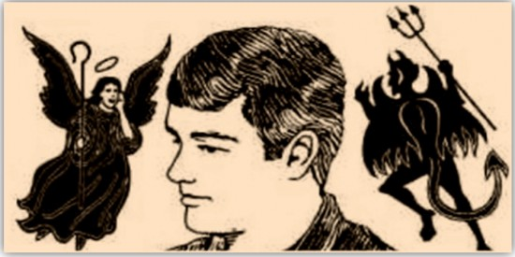
Ethics in Contesting
Unobservable rules require participants to choose right or wrong on their own.

Slide 35
Ethics in Contesting
Unobservable rules require participants to choose right or wrong on their own.
Ethics are in play particularly when no one is looking. We are free to choose.

Slide 36
Ethics in Contesting
Unobservable rules require participants to choose right or wrong on their own.
Ethics are in play particularly when no one is looking. We are free to choose.
The freedom to choose right or wrong carries both responsibility and scrutiny.

Slide 37
What do we mean … Ethics?
Ethics denote the theory of right and wrong actions
Notes:
K0EJ and AA4NU anothers

Slide 38
What do we mean … Ethics?
Ethics denote the theory of right and wrong actions
Ethics in practice is knowing the difference between right and wrong and choosing to do what is right.
Notes:
K0EJ and AA4NU anothers

Slide 39
What do we mean … Ethics?
Ethics denote the theory of right and wrong actions
Ethics in practice is knowing the difference between right and wrong and choosing to do what is right.
N0AX refers to our “Good Arrow.” We know which way it points. Our ethics begin here.
Notes:
K0EJ and AA4NU anothers

Slide 40
What do we mean … Ethics?
Ethics denote the theory of right and wrong actions
Ethics in practice is knowing the difference between right and wrong and choosing to do what is right.
N0AX refers to our “Good Arrow.” We know which way it points. Our ethics begin here.
We also know where it doesn’t point (narcissism, psychopathic behavior, Machiavellianism.)
Notes:
K0EJ and AA4NU and others

Slide 41
Ethics and Respect
Ethical behavior requires respect…

Slide 42
Ethics and Respect
Ethical behavior requires respect…
Respect for others

Slide 43
Ethics and Respect
Ethical behavior requires respect…
Respect for others
Respect for the game

Slide 44
Ethics and Respect
Ethical behavior requires respect…
Respect for others
Respect for the game
Respect for yourself

Slide 45
Ethics and Respect
Ethical behavior requires respect…
Respect for others
Respect for the game
Respect for yourself
To get respect, you have to give respect

Slide 46
Ethics and Respect
Ethical behavior requires respect…
Respect for others
Respect for the game
Respect for yourself
To get respect, you have to give respect
Our fellow competitors want the same respect that we want for ourselves (Golden Rule principle)

Slide 47
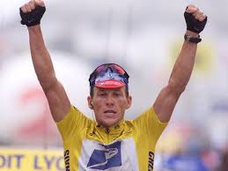
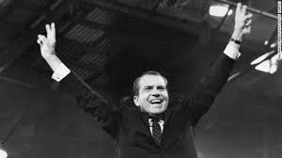
Why do ethics matter?
Without ethics and respect – we have NOTHING
( N0AX 2015 )
Notes:
NIXON AND ARMSTRONG:
It’s not just their personal disgrace that we shame. Heck some might even still like them personally.
It’s the DAMAGE THEY CAUSED respectively to CYCLING and POLITICS.
THIS IS WHAT CHEATERS AND CON ARTISTS DO TO OUR GAME. They RUIN it for EVERYONE.
And this is **OUR GAME**

Slide 48
Motivations for Cheating
Desire to be a “hero” on the field of competition (ancient archetype, unconscious)
Notes:
Hero Archetype of humanity
We remember and hold in high esteem W3GRF, W4KFC, W9IOP etc.
Matter of scale.
Pushed around on the playground.

Slide 49
Motivations for Cheating
Desire to be a “hero” on the field of competition (ancient archetype, unconscious)
Achieve immortality via community legend, fame, and lasting peer recognition
Notes:
Hero Archetype of humanity
We remember and hold in high esteem W3GRF, W4KFC, W9IOP etc.
Matter of scale.
Pushed around on the playground.

Slide 50
Motivations for Cheating
Desire to be a “hero” on the field of competition (ancient archetype, unconscious)
Achieve immortality via community legend, fame, and lasting peer recognition
Seeking current community “stardom”
Notes:
Hero Archetype of humanity
We remember and hold in high esteem W3GRF, W4KFC, W9IOP etc.
Matter of scale.
Pushed around on the playground.

Slide 51
Motivations for Cheating
Desire to be a “hero” on the field of competition (ancient archetype, unconscious)
Achieve immortality via community legend, fame, and lasting peer recognition
Seeking current community “stardom”
Prove superiority over others (sibling rivalry)
Notes:
Hero Archetype of humanity
We remember and hold in high esteem W3GRF, W4KFC, W9IOP etc.
Matter of scale.
Pushed around on the playground.

Slide 52
Motivations for Cheating
Desire to be a “hero” on the field of competition (ancient archetype, unconscious)
Achieve immortality via community legend, fame, and lasting peer recognition
Seeking current community “stardom”
Prove superiority over others (sibling rivalry)
A means to prove self-worth
Notes:
Hero Archetype of humanity
We remember and hold in high esteem W3GRF, W4KFC, W9IOP etc.
Matter of scale.
Pushed around on the playground.

Slide 53
Motivations for Cheating
Desire to be a “hero” on the field of competition (ancient archetype, unconscious)
Achieve immortality via community legend, fame, and lasting peer recognition
Seeking current community “stardom”
Prove superiority over others (sibling rivalry)
A means to prove self-worth
Powerful forces, worthy of study and caution
Notes:
Hero Archetype of humanity
We remember and hold in high esteem W3GRF, W4KFC, W9IOP etc.
Matter of scale.
Pushed around on the playground.

Slide 54
Rationalizations for Cheating
Everybody is doing it (#1 Reason)
Notes:
There’s no hiding place down here…

Slide 55
Rationalizations for Cheating
Everybody is doing it (#1 Reason)
Nobody was hurt (Except those cheated)
Notes:
There’s no hiding place down here…

Slide 56
Rationalizations for Cheating
Everybody is doing it (#1 Reason)
Nobody was hurt (Except those cheated)
Nobody was watching (Not any longer)
Notes:
There’s no hiding place down here…

Slide 57
Rationalizations for Cheating
Everybody is doing it (#1 Reason)
Nobody was hurt (Except those cheated)
Nobody was watching (Not any longer)
Large investments in QTH & station
Notes:
There’s no hiding place down here…

Slide 58
Rationalizations for Cheating
Everybody is doing it (#1 Reason)
Nobody was hurt (Except those cheated)
Nobody was watching (Not any longer)
Large investments in QTH & station
Overcome unfair disadvantages
Notes:
There’s no hiding place down here…

Slide 59
Rationalizations for Cheating
Everybody is doing it (#1 Reason)
Nobody was hurt (Except those cheated)
Nobody was watching (Not any longer)
Large investments in QTH & station
Overcome unfair disadvantages
Rules don’t specifically disallow a practice
Notes:
There’s no hiding place down here…

Slide 60
Rationalizations for Cheating
Everybody is doing it (#1 Reason)
Nobody was hurt (Except those cheated)
Nobody was watching (Not any longer)
Large investments in QTH & station
Overcome unfair disadvantages
Rules don’t specifically disallow a practice
Rules apply to others, not us
Notes:
There’s no hiding place down here…

Slide 61
“All the guys at the top are cheating”
No, they are not
There are a few bad apples – this is true in any sport
They usually don’t last long
Notes:
Flip side of the respect coin. Act of faith.
I used to think others were cheating. They weren’t.
Just because you think you deserve to win, doesn’t mean that you do.

Slide 62
“All the guys at the top are cheating”
No, they are not
There are a few bad apples – this is true in any sport
They usually don’t last long
This belief is the primary reason for cheating - in virtually every sport studied! It’s mostly an illusion!
Notes:
Flip side of the respect coin. Act of faith.
I used to think others were cheating. They weren’t.
Just because you think you deserve to win, doesn’t mean that you do.

Slide 63
“All the guys at the top are cheating”
No, they are not
There are a few bad apples – this is true in any sport
They usually don’t last long
This belief is the primary reason for cheating - in virtually every sport studied! It’s mostly an illusion!
This mindset is a contagious malady – don’t let it get a foothold
Notes:
Flip side of the respect coin. Act of faith.
I used to think others were cheating. They weren’t.
Just because you think you deserve to win, doesn’t mean that you do.

Slide 64
“I’m not a big gun…it doesn’t matter if I cut corners a bit”
Yes it does!
Notes:
Conscience wheel

Slide 65
“I’m not a big gun…it doesn’t matter if I cut corners a bit”
Yes it does!
Bad habits early on become seriously bad habits later
Notes:
Conscience wheel

Slide 66
“I’m not a big gun…it doesn’t matter if I cut corners a bit”
Yes it does!
Bad habits early on become seriously bad habits later
Your reputation is established early
Notes:
Conscience wheel

Slide 67
“I’m not a big gun…it doesn’t matter if I cut corners a bit”
Yes it does!
Bad habits early on become seriously bad habits later
Your reputation is established early
Dealing with temptation is hard…“It’s easy to just give in! And it keeps getting easier.”
Notes:
Conscience wheel

Slide 68
“I’m not a big gun…it doesn’t matter if I cut corners a bit”
Yes it does!
Bad habits early on become seriously bad habits later
Your reputation is established early
Dealing with temptation is hard…“It’s easy to just give in! And it keeps getting easier.”
Start off right, and it will pay big rewards later
Notes:
Conscience wheel

Slide 69
What is this peer recognition?
We are recognized by our achievements and how we went about achieving those results

Slide 70
What is this peer recognition?
We are recognized by our achievements and how we went about achieving those results
Our recognition is influenced by what other people say about us

Slide 71
What is this peer recognition?
We are recognized by our achievements and how we went about achieving those results
Our recognition is influenced by what other people say about us
We all need peer recognition (external) more than we may realize

Slide 72
What is this peer recognition?
We are recognized by our achievements and how we went about achieving those results
Our recognition is influenced by what other people say about us
We all need peer recognition (external) more than we may realize
The classical “hero” myth lives in our psyche. We rightfully cheer those who win fairly.

Slide 73
Negative Peer Recognition Examples
That station was too loud in the NAQP
While most of these examples can not be proven – they are often based upon something not being quite right about a log entry.

Slide 74
Negative Peer Recognition Examples
That station was too loud in the NAQP
That team uses a pair of 3CX-3000’s per band
While most of these examples can not be proven – they are often based upon something not being quite right about a log entry.

Slide 75
Negative Peer Recognition Examples
That station was too loud in the NAQP
That team uses a pair of 3CX-3000’s per band
Dude uses spots but enters as unassisted
While most of these examples can not be proven – they are often based upon something not being quite right about a log entry.

Slide 76
Negative Peer Recognition Examples
That station was too loud in the NAQP
That team uses a pair of 3CX-3000’s per band
Dude uses spots but enters as unassisted
Dim padded his log with bogus QSOs
While most of these examples can not be proven – they are often based upon something not being quite right about a log entry.

Slide 77
Negative Peer Recognition Examples
That station was too loud in the NAQP
That team uses a pair of 3CX-3000’s per band
Dude uses spots but enters as unassisted
Dim padded his log with bogus QSOs
Jerk operates with a broad signal to push away nearby stations and keep his channel clear.
While most of these examples can not be proven – they are often based upon something not being quite right about a log entry.

Slide 78
How do we know what to do?
We need Rules for any game.

Slide 79
How do we know what to do?
Written Rules
Specified by the contest sponsor in writing
Black and white
May, can, should, must…

Slide 80
How do we know what to do?
Written Rules
Specified by the contest sponsor in writing
Black and white
May, can, should, must…
Unwritten Rules
Expectations about behavior
Interpreted norms
Gray areas – Ethical behavior required

Slide 81
Some written rules are very clear (some people break these anyway)
“A. Single Operator categories: For all single operator categories, only one person (the operator) can contribute to the final score during the official contest period.”
“Total output power per band must not exceed 1500 watts or the output power regulations of the country in which the entrant is operating, whichever is less.”

Slide 82
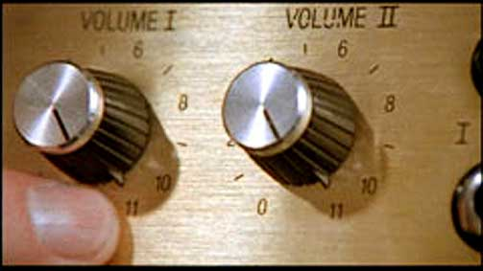
Excessive Power
Do not exceed power limits for your category
Just because the knobs go to 11…
Applies to ALL power categories

Slide 83
Essence of Unwritten Rules
Just because it’s not specifically prohibited by written rules doesn’t mean you should do it!

Slide 84
Essence of Unwritten Rules
Just because it’s not specifically prohibited by written rules doesn’t mean you should do it!
Keep the contest on the radio and within the contest period – no log washing or padding!

Slide 85
Essence of Unwritten Rules
Just because it’s not specifically prohibited by written rules doesn’t mean you should do it!
Keep the contest on the radio and within the contest period – no log washing or padding!
Don’t give or take unfair advantage of others

Slide 86
Essence of Unwritten Rules
Just because it’s not specifically prohibited by written rules doesn’t mean you should do it!
Keep the contest on the radio and within the contest period – no log washing or padding!
Don’t give or take unfair advantage of others
Learn and follow the spirit of the rules

Slide 87
Examples of Unwritten “Rules”
Do not make pre-arranged schedules

Slide 88
Examples of Unwritten “Rules”
Do not make pre-arranged schedules
Do identify frequently

Slide 89
Examples of Unwritten “Rules”
Do not make pre-arranged schedules
Do identify frequently
Do not ask friends to work you … only

Slide 90
Examples of Unwritten “Rules”
Do not make pre-arranged schedules
Do identify frequently
Do not ask friends to work you … only
Do encourage club members to work everyone

Slide 91
Examples of Unwritten “Rules”
Do not make pre-arranged schedules
Do identify frequently
Do not ask friends to work you … only
Do encourage club members to work everyone
Do not work friends with multiple calls

Slide 92
Examples of Unwritten “Rules”
Do not make pre-arranged schedules
Do identify frequently
Do not ask friends to work you … only
Do encourage club members to work everyone
Do not work friends with multiple calls
Do work and spot stations equally

Slide 93
Examples of Unwritten “Rules”
Do not telephone or text message multipliers

Slide 94
Examples of Unwritten “Rules”
Do not telephone or text message multipliers
Do make an effort to help casual callers enjoy the contest and make a contact

Slide 95
Examples of Unwritten “Rules”
Do not telephone or text message multipliers
Do make an effort to help casual callers enjoy the contest and make a contact
Do not let others “help” your single-op effort

Slide 96
Examples of Unwritten “Rules”
Do not telephone or text message multipliers
Do make an effort to help casual callers enjoy the contest and make a contact
Do not let others “help” your single-op effort
Do not plop down 100 Hertz away from your competitor to intentionally disrupt their run

Slide 97
Examples of Unwritten “Rules”
Do not telephone or text message multipliers
Do make an effort to help casual callers enjoy the contest and make a contact
Do not let others “help” your single-op effort
Do not plop down 100 Hertz away from your competitor to intentionally disrupt their run
See the ARRL’s “HF Contesting - Good Practices, Interpretations & Suggestions”

Slide 98
No “Log Washing”
Using QRZ.com, spot history, 3830 reports, LoTW, club databases

Slide 99
No “Log Washing”
Using QRZ.com, spot history, 3830 reports, LoTW, club databases
Using utilities to analyze and correct the log

Slide 100
No “Log Washing”
Using QRZ.com, spot history, 3830 reports, LoTW, club databases
Using utilities to analyze and correct the log
Replaying the contest to change the log

Slide 101
No “Log Washing”
Using QRZ.com, spot history, 3830 reports, LoTW, club databases
Using utilities to analyze and correct the log
Replaying the contest to change the log
Asking others who they worked or if a call sign is correct

Slide 102
No “Log Washing”
Using QRZ.com, spot history, 3830 reports, LoTW, club databases
Using utilities to analyze and correct the log
Replaying the contest to change the log
Asking others who they worked or if a call sign is correct
“Fixing” off times or band changes

Slide 103
No “Log Washing”
Using QRZ.com, spot history, 3830 reports, LoTW, club databases
Using utilities to analyze and correct the log
Replaying the contest to change the log
Asking others who they worked or if a call sign is correct
“Fixing” off times or band changes
It’s over when the 2359 rolls over to 0000

Slide 104
Technology - A Game Changer
With more technology comes more ways to cheat… and more ways to detect cheating..

Slide 105
Technology - A Game Changer
With more technology comes more ways to cheat… and more ways to detect cheating..
Remote operations - Specify transmitter QTH unambiguously. Adhere to RX distance rules.

Slide 106
Technology - A Game Changer
With more technology comes more ways to cheat… and more ways to detect cheating..
Remote operations - Specify transmitter QTH unambiguously. Adhere to RX distance rules.
Crowd sourcing – CQWW 2014 CW – egregious cheating found through community effort. World high TO7A DQed – previous years also DQed!

Slide 107
Technology - A Game Changer
With more technology comes more ways to cheat… and more ways to detect cheating..
Remote operations - Specify transmitter QTH unambiguously. Adhere to RX distance rules.
Crowd sourcing – CQWW 2014 CW – egregious cheating found through community effort. World high TO7A DQed – previous years also DQed!
Few places left to hide with SDR, RBN, etc.

Slide 108
Technology - A Game Changer
With more technology comes more ways to cheat… and more ways to detect cheating..
Remote operations - Specify transmitter QTH unambiguously. Adhere to RX distance rules.
Crowd sourcing – CQWW 2014 CW – egregious cheating found through community effort. World high TO7A DQed – previous years also DQed!
Few places left to hide with SDR, RBN, etc.
Ethics becomes more important than ever as technology marches onward

Slide 109
Honor Code
You are responsible for your own reputation
Follow the rules!
Don’t participate with people who cheat – you will be known by the company you keep

Slide 110
Honor Code
You are responsible for your own reputation
Follow the rules!
Don’t participate with people who cheat – you will be known by the company you keep
Lead by example
You never know who is listening or watching
Don’t do anything you would not want to be made public

Slide 111
Honor Code
You are responsible for your own reputation
Follow the rules!
Don’t participate with people who cheat – you will be known by the company you keep
Lead by example
You never know who is listening or watching
Don’t do anything you would not want to be made public
Be vocal
Confront cheating when you see it
Every incident is an opportunity to teach proper behavior

Slide 112
Peer Pressure
Social pressure by members of one's peer group to take a certain action, adopt certain values, or otherwise conform in order to be accepted.

Slide 113
Peer Pressure
Social pressure by members of one's peer group to take a certain action, adopt certain values, or otherwise conform in order to be accepted.
Good
Encourage others to follow the rules
People respect those who are true to their beliefs

Slide 114
Peer Pressure
Social pressure by members of one's peer group to take a certain action, adopt certain values, or otherwise conform in order to be accepted.
Good
Encourage others to follow the rules
People respect those who are true to their beliefs
Bad
Letting others influence you into not doing the right thing
“everyone else is doing it."

Slide 115
Applying Positive Peer Pressure
Be aware of your motives
Is it personal?
If necessary, enlist others to help deliver the message

Slide 116
Applying Positive Peer Pressure
Be aware of your motives
Is it personal?
If necessary, enlist others to help deliver the message
Give the benefit of the doubt
They may not realize what they are doing is against the rules
Take the opportunity to encourage taking the right path

Slide 117
Applying Positive Peer Pressure
Be aware of your motives
Is it personal?
If necessary, enlist others to help deliver the message
Give the benefit of the doubt
They may not realize what they are doing is against the rules
Take the opportunity to encourage taking the right path
Choose the right time and place
Can they listen without feeling attacked?

Slide 118
Applying Positive Peer Pressure
Be aware of your motives
Is it personal?
If necessary, enlist others to help deliver the message
Give the benefit of the doubt
They may not realize what they are doing is against the rules
Take the opportunity to encourage taking the right path
Choose the right time and place
Can they listen without feeling attacked?
Don’t be angry, accusatory, or judgmental
Treat the issue as a mistake, not a crime
Focus on actions, not character

Slide 119
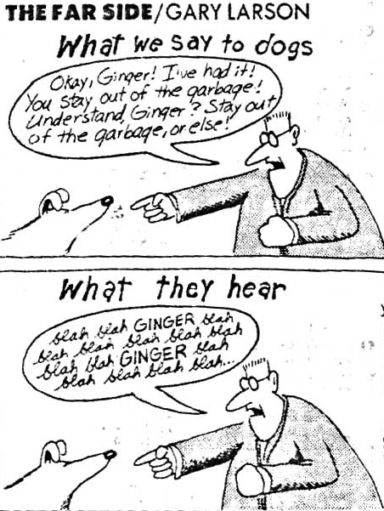
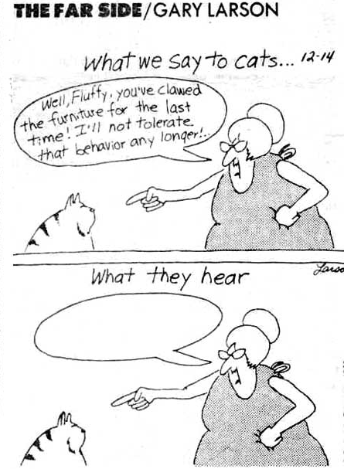
Communication Success is Defined by the Receiver

Slide 120
Scenario 1
We discover a local contester uses cluster spotting and enters an unassisted category. What do we do?
They never win anything so assume it doesn’t matter

Slide 121
Scenario 1
We discover a local contester uses cluster spotting and enters an unassisted category. What do we do?
They never win anything so assume it doesn’t matter
Avoid speaking to them ever again

Slide 122
Scenario 1
We discover a local contester uses cluster spotting and enters an unassisted category. What do we do?
They never win anything so assume it doesn’t matter
Avoid speaking to them ever again
Publicly call them a cheater at the next club meeting

Slide 123
Scenario 1
We discover a local contester uses cluster spotting and enters an unassisted category. What do we do?
They never win anything so assume it doesn’t matter
Avoid speaking to them ever again
Publicly call them a cheater at the next club meeting
Send a letter to the contest sponsor

Slide 124
Scenario 1
We discover a local contester uses cluster spotting and enters an unassisted category. What do we do?
They never win anything so assume it doesn’t matter
Avoid speaking to them ever again
Publicly call them a cheater at the next club meeting
Send a letter to the contest sponsor
Call them up and ask if they are aware of the rules about using spotting information

Slide 125
Scenario 2
We are invited to a multi-op and upon arrival, we discover they are running 2.5 kW. What do we do?
We are there, loud is good, operate anyway

Slide 126
Scenario 2
We are invited to a multi-op and upon arrival, we discover they are running 2.5 kW. What do we do?
We are there, loud is good, operate anyway
Turn the power down to 1500 W when we’re operating

Slide 127
Scenario 2
We are invited to a multi-op and upon arrival, we discover they are running 2.5 kW. What do we do?
We are there, loud is good, operate anyway
Turn the power down to 1500 W when we’re operating
Loudly encourage the other ops to follow our example

Slide 128
Scenario 2
We are invited to a multi-op and upon arrival, we discover they are running 2.5 kW. What do we do?
We are there, loud is good, operate anyway
Turn the power down to 1500 W when we’re operating
Loudly encourage the other ops to follow our example
Quietly ask the owner if he always runs excess power

Slide 129
Scenario 2
We are invited to a multi-op and upon arrival, we discover they are running 2.5 kW. What do we do?
We are there, loud is good, operate anyway
Turn the power down to 1500 W when we’re operating
Loudly encourage the other ops to follow our example
Quietly ask the owner if he always runs excess power
Leave (hard to do if thousands of miles from home)

Slide 130
Scenario 2
We are invited to a multi-op and upon arrival, we discover they are running 2.5 kW. What do we do?
We are there, loud is good, operate anyway
Turn the power down to 1500 W when we’re operating
Loudly encourage the other ops to follow our example
Quietly ask the owner if he always runs excess power
Leave (hard to do if thousands of miles from home)
Send a note to the contest sponsor and FCC

Slide 131
Scenario 3
A local contester has key clicks that wipe out large chunks of the band. What do you do?
Sharpen up YOUR keying and give him a dose of his own medicine!

Slide 132
Scenario 3
A local contester has key clicks that wipe out large chunks of the band. What do you do?
Sharpen up YOUR keying and give him a dose of his own medicine!
Send “KLIX” on his frequency anonymously

Slide 133
Scenario 3
A local contester has key clicks that wipe out large chunks of the band. What do you do?
Sharpen up YOUR keying and give him a dose of his own medicine!
Send “KLIX” on his frequency anonymously
Call him, tell him he has key clicks, and sign your call

Slide 134
Scenario 3
A local contester has key clicks that wipe out large chunks of the band. What do you do?
Sharpen up YOUR keying and give him a dose of his own medicine!
Send “KLIX” on his frequency anonymously
Call him, tell him he has key clicks, and sign your call
Contact him after the contest, explain the problem, and ask to help fix the problem

Slide 135
Scenario 3
A local contester has key clicks that wipe out large chunks of the band. What do you do?
Sharpen up YOUR keying and give him a dose of his own medicine!
Send “KLIX” on his frequency anonymously
Call him, tell him he has key clicks, and sign your call
Contact him after the contest, explain the problem, and ask to help fix the problem
Notify the contest sponsor and his rig’s manufacturer

Slide 136
The Contest Code of Ethics www.wwrof.org
I will learn and obey the rules of any contest I enter, including the rules of my entry category.
I will obey the rules for amateur radio in my country.
I will not modify my log after the contest by using additional data sources to correct call sign/exchange errors.
I will accept the judging and scoring decisions of the contest sponsor as final.
I will adhere to the DX Code of Conduct in my operating style (see dx-code.org).
I will yield my frequency to any emergency communications activity.
I will operate my transmitter with sufficient signal quality to minimize interference to others.

Slide 137
Contest Code of Ethics, expanded
1. I will learn and obey the rules of any contest I enter, including the rules of my entry category.
No spotting if not permitted, no second op or skimmer for single ops, off-times per rules, correct output power

Slide 138
Contest Code of Ethics, expanded
1. I will learn and obey the rules of any contest I enter, including the rules of my entry category.
No spotting if not permitted, no second op or skimmer for single ops, off-times per rules, correct output power
2. I will obey the rules for amateur radio in my country.
Power, frequencies, licensing – wherever you transmit. Remote operations must be especially vigilant!

Slide 139
Contest Code of Ethics, expanded
1. I will learn and obey the rules of any contest I enter, including the rules of my entry category.
No spotting if not permitted, no second op or skimmer for single ops, off-times per rules, correct output power
2. I will obey the rules for amateur radio in my country.
Power, frequencies, licensing – wherever you transmit. Remote operations must be especially vigilant!
3. I will not modify my log after the contest by using additional data sources to correct call sign/exchange errors.
When it’s over, it’s over

Slide 140
Contest Code of Ethics, expanded
4. I will accept the judging and scoring decisions of the contest sponsor as final.
No whining, no lawsuits, no threats or defamation of any sort. No operation is that important.

Slide 141
Contest Code of Ethics, expanded
4. I will accept the judging and scoring decisions of the contest sponsor as final.
No whining, no lawsuits, no threats or defamation of any sort. No operation is that important.
5. I will adhere to the DX Code of Conduct in my operating style (see dx-code.org).
Listen, listen, listen; only call when you can hear the station; never trust the cluster (copy the call!)…

Slide 142
Contest Code of Ethics, expanded
6. I will yield my frequency to any emergency communications activity.
Contesting is a game. Emergencies are real life.
www.wwrof.org

Slide 143
Contest Code of Ethics, expanded
6. I will yield my frequency to any emergency communications activity.
Contesting is a game. Emergencies are real life.
7. I will operate my transmitter with sufficient signal quality to minimize interference to others.
Mic gain set properly; amp not overdriven; no splatter!
Note that CQWW rules have added language specifically emphasizing this rule of conduct. Expect increased scrutiny as SDR archives reveal the worst offenders!
www.wwrof.org

Slide 144
The RIGHT Way – It’s Not Hard
Play Fair!
Obey the rules, respect your fellow competitors

Slide 145
The RIGHT Way – It’s Not Hard
Play Fair!
Obey the rules, respect your fellow competitors
Try to do better next time
Improve your skills, station, and strategies

Slide 146
The RIGHT Way – It’s Not Hard
Play Fair!
Obey the rules, respect your fellow competitors
Try to do better next time
Improve your skills, station, and strategies
Make your enjoyment of contesting be about the journey, not the destination. Set goals, and enjoy achieving them ethically.

Slide 147

Who is the final judge ?
The person in the mirror
Notes:
Thanks for listening. Have fun, and see you on the air!

Slide 148
Who is the final judge ?
The person in the mirror
Your peers
“Yeah, I know that guy. He cheats.”
- Anonymous Contester
Notes:
Thanks for listening. Have fun, and see you on the air!

Slide 149
Who is the final judge ?
The person in the mirror
Your peers
We learned it in grade school – just follow the Golden Rule.
“Yeah, I know that guy. He cheats.”
- Anonymous Contester
Notes:
Thanks for listening. Have fun, and see you on the air!

